Slide 1
DeepDive: A Data Management System for Automatic Knowledge Base Construction
Ce Zhang
Department of Computer Sciences
czhang@cs.wisc.edu

Slide 2

DeepDive for Knowledge Base Construction (KBC)
http://deepdive.stanford.edu

Slide 3
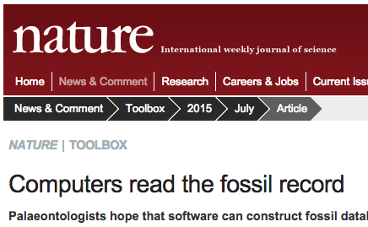


Validation on Real Applications
Paleontology
“It's a little scary,
the machines are
getting that
good.”
Wikipedia-like Relations
Geology
Recall: 2-10x more extractions than human
Precision: 92%-97% (Human ~84%-92%)
Pharmacogenomics
1 PhD
Genomics
1 PhD
Highest score out of 18 teams and 65
submissions (2nd highest is also DeepDive).
Dark Web
Enables easy engineering to build high-quality KBC Systems.
Applied Physics

Slide 4
Overview
Application
Abstraction
Techniques
Why KBC? How does DeepDive help KBC?
How to build a KBC Application with DeepDive?
How to make DeepDive Efficient and Scalable?
It is feasible to build a data management system to support the end-to-end workflow of building KBC applications.

Slide 5
Overview
Application
Abstraction
Techniques
Brief for
today
Why KBC? How does DeepDive help KBC?
How to build a KBC Application with DeepDive?
How to make DeepDive Efficient and Scalable?
It is feasible to build a data management system to support the end-to-end workflow of building KBC applications.

Slide 6
Application: Overview
Application
1. What is KBC? Why it is useful?
Key Scientific questions could be enabled by KBC Systems. Manual KBC could be expensive and cumbersome.
Why KBC? How does DeepDive help KBC?
2. DeepDive makes KBC easier
DeepDive helps developer to deal with diverse data sources jointly to build high-quality KBC applications.
Abstraction

Slide 7
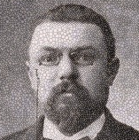



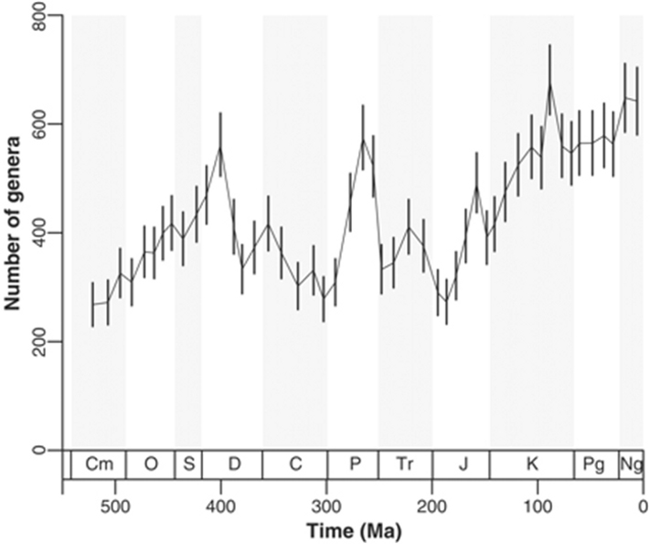


KBC Applications
Science is built up with facts, as a house is with stones.
- Jules Henri Poincaré
Example: Paleontology
Scientific Facts
Macroscopic View
Insights & Knowledge
Taxon
Rock
Biodiversity
Impact of climate
change to bio-
diversity?
Age
Location

Slide 8
KBC Applications
Example: Paleontology
Scientific Facts
Macroscopic View
Insights & Knowledge
Taxon
Rock
Biodiversity
Impact of climate
change to bio-
diversity?
Age
Location

Slide 9
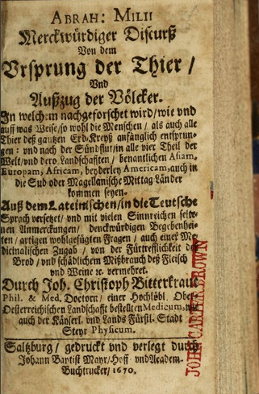
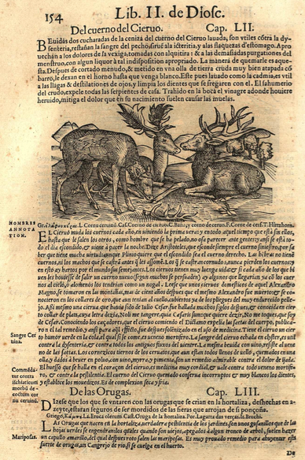
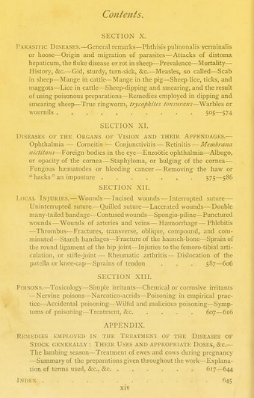
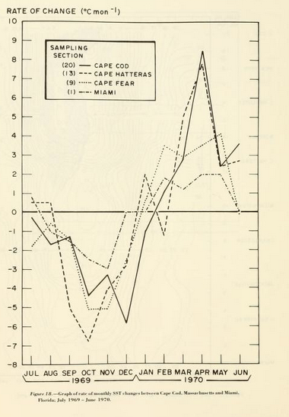
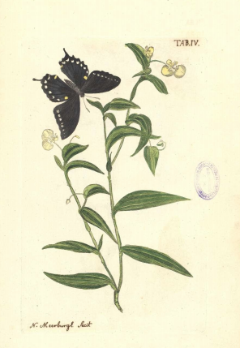
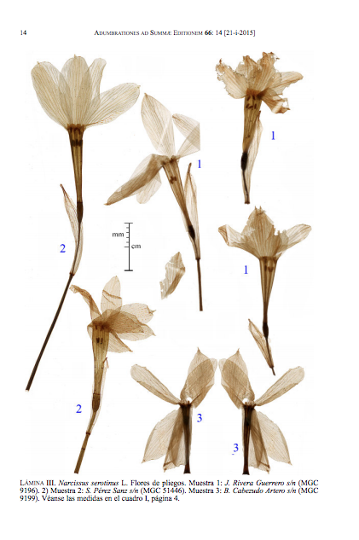
KBC Applications
Example: Paleontology
Knowledge Base (KB)
Scientific Facts
Macroscopic View
Insights & Knowledge
Taxon
Rock
Biodiversity
Impact of climate
change to bio-
diversity?
Age
Location
KB Construction
Input Sources
1570
1670
1770
1870
1970
2015

Slide 10









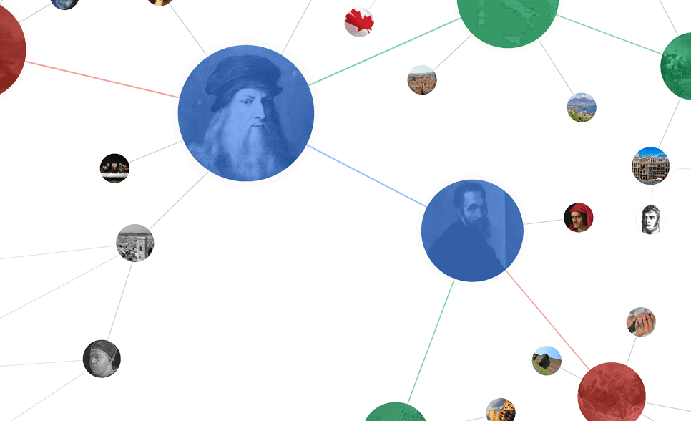


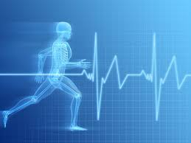


KBC Applications
Paleontology
Genomics
Dark Web
Knowledge Base
Knowledge Base
Knowledge Base
Taxon
Rock
Gene
Drug
Server
Service
Age
Location
Disease
Price
Location
Climate & Biodiversity
Health & Medicine
Social Good

Slide 11
Can we just do KBC manually?

Slide 12
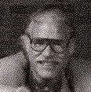

Challenge of Manual KBC
Paleontology
Effort on Manual KBC
Knowledge Base
Sepkoski (1982) manually compiled a compendium of 3300 animal families with 396 references in his monograph.
Taxon
Rock
300 professional volunteers (1998-present) spent 8 continuo-us human years to compile PaleoDB with 55,479 references.
Age
Location
100K new references
per year!
16 continuous human years every year just to keep up-to-date!

Slide 13
Could we build a machine
to read for us?

Slide 14

Automatic KBC
Input Sources
Knowledge Base
Machine

Slide 15
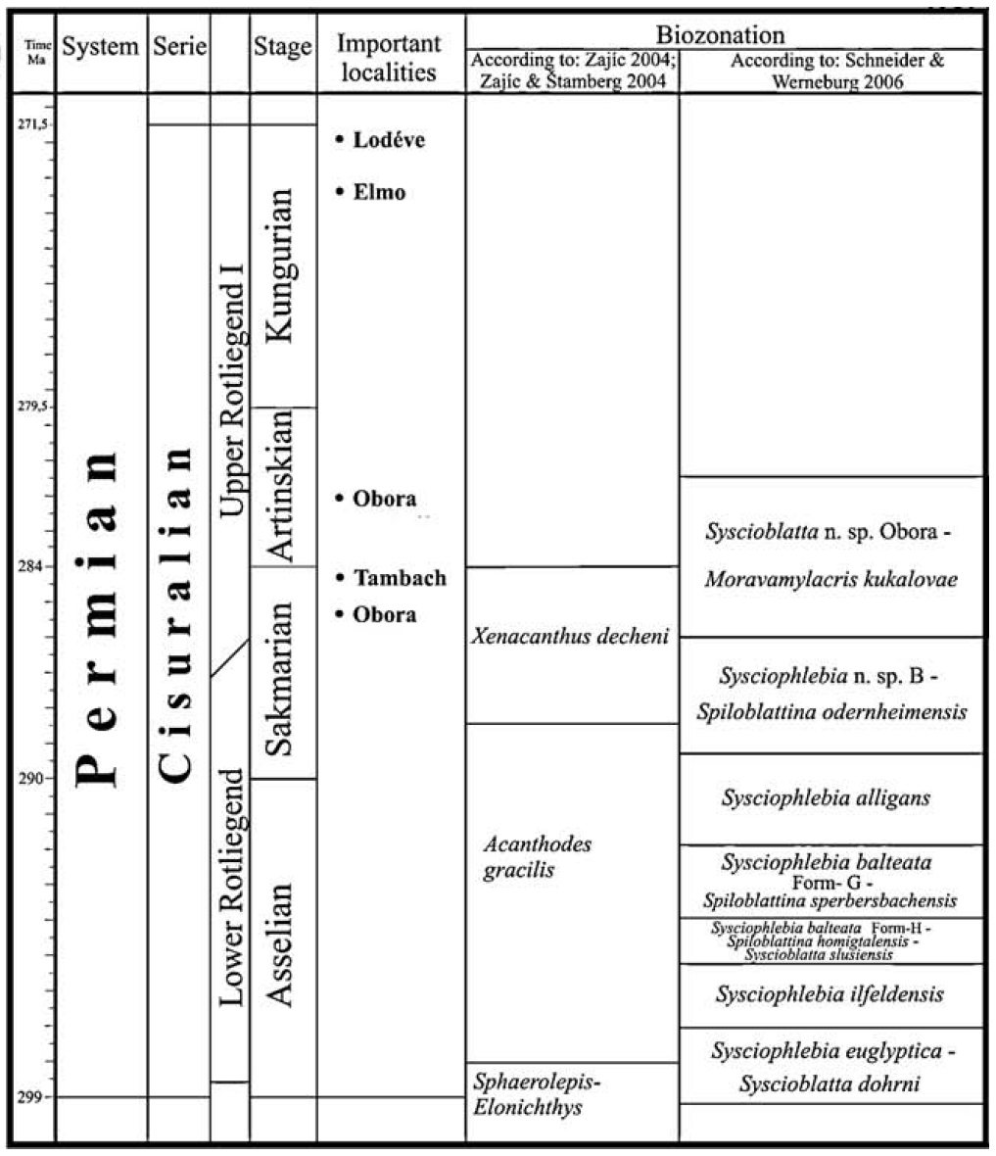
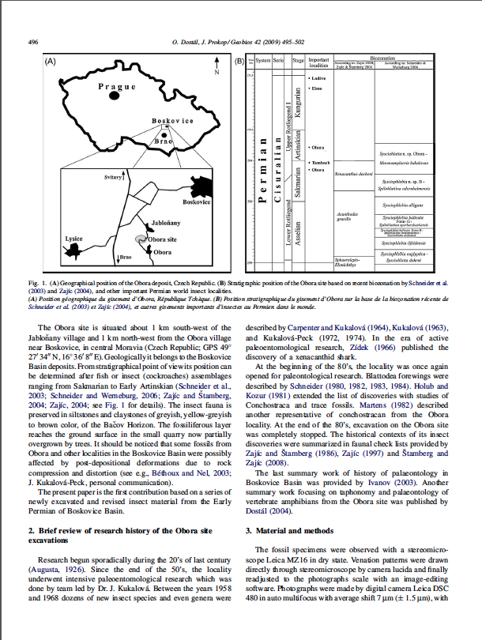
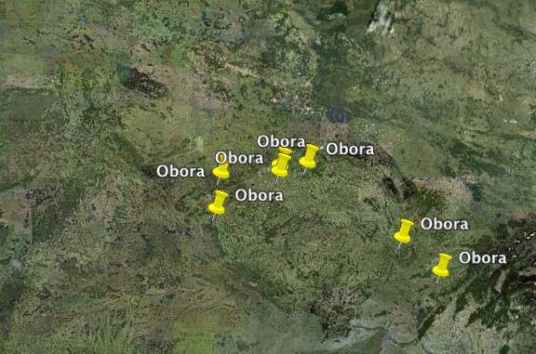
Challenge of Automatic KBC
High-quality Automatic KBC systems often require the developer deal with a diverse set of data jointly.
Appear
(Location,Genus)
Obora
Moravamylacris
?
[ACL 2013]

Slide 16
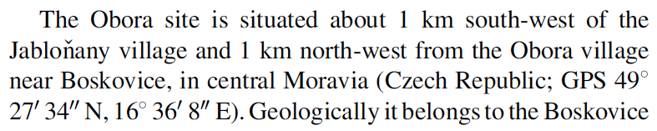
Challenge of Automatic KBC
High-quality Automatic KBC systems often require the developer deal with a diverse set of data jointly.
Appear
(Location,Genus)
Table
Joint Inference
Obora
Moravamylacris
Text
?
Features
External Sources

Slide 17
Challenge of Automatic KBC
High-quality Automatic KBC systems often require the developer deal with a diverse set of data jointly.
Appear
(Location,Genus)
Table
Joint Inference
Obora
Moravamylacris
Text
A Data Management System for KBC
?
Features
External Sources

Slide 18
Overview
Application
Abstraction
Techniques
Why KBC? How does DeepDive help KBC?
How to build a KBC Application with DeepDive?
How to make DeepDive Efficient and Scalable?

Slide 19
Abstraction: Overview
Abstraction
1. How to write a DD Program
DeepDive provides a declarative way for use to specify a KBC application.
How to build a KBC Application with DeepDive?
2. Example: PaleoDeepDive
A high-quality KBC system built with DeepDive for Paleontology
Technique

Slide 20
The Goal of Abstraction
General enough to model all 10 KBC systems we built.
General enough to model state-of-the-art techniques on KBC.

Slide 21

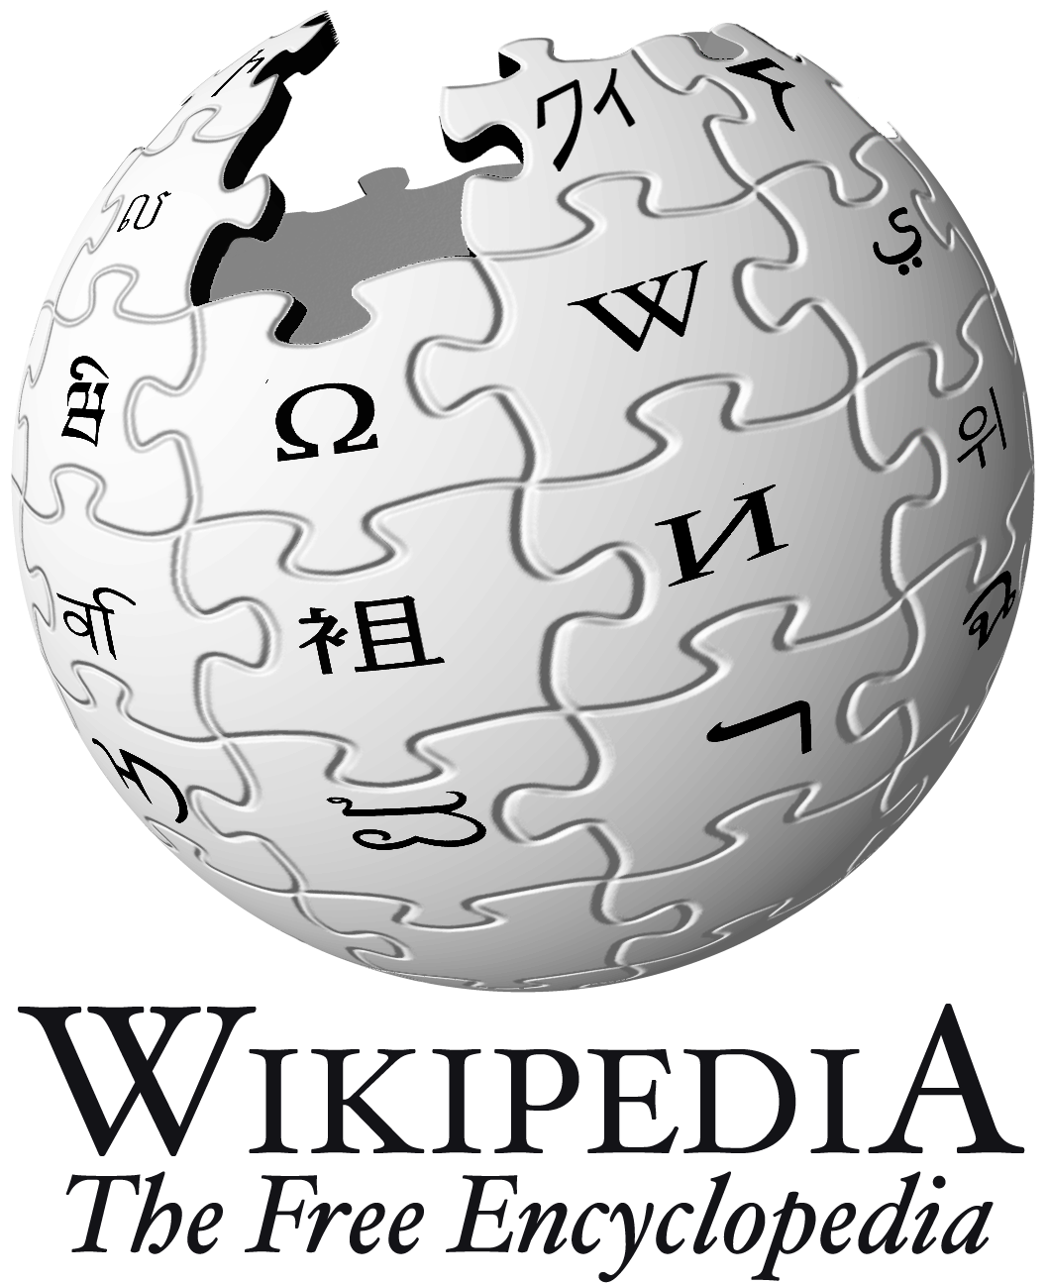


DeepDive Workflow
Feature
Extraction
Feature
Extraction
Statistical Learning
Probabilistic Knowledge Engineering
Statistical Learning & Inference
Input Sources
R.V.
Factor Graph
Supervision Rule
Domain Knowledge Rule
Inference Result
p
External KB
Features
0.9
Feature Extractor
0.6
[IEEE Data Eng. Bull. 2014]

Slide 22




DeepDive: KBC Model
Mr. Gates was the CEO of Microsoft.
Google acquired YouTube in 2006.
Entity Linking
Corpus
Person
Bill Clinton
Bill Gates
Steve Jobs
Org
Microsoft Co.
Google Inc.
YouTube
Entity
Relationship
FoundedBy
Company | Founder
[IJWIS 2012]

Slide 23
DeepDive: KBC Model
Mr. Gates was the CEO of Microsoft.
Google acquired YouTube in 2006.
Mention Relation Extraction
Microsoft | Mr. Gates
Corpus
Person
Bill Clinton
Bill Gates
Steve Jobs
Org
Microsoft Co.
Google Inc.
YouTube
Entity
Relationship
FoundedBy
Company | Founder

Slide 24
DeepDive: KBC Model
Mr. Gates was the CEO of Microsoft.
Google acquired YouTube in 2006.
Corpus
Person
Bill Clinton
Bill Gates
Steve Jobs
Org
Microsoft Co.
Google Inc.
YouTube
Entity
Entity Relation Extraction
Relationship
FoundedBy
Company | Founder
Microsoft Co. | Bill Gates

Slide 25
DeepDive: KBC Model
Mr. Gates was the CEO of Microsoft.
Google acquired YouTube in 2006.
Entity Linking
Mention Relation Extraction
Microsoft | Mr. Gates
Corpus
Person
Bill Clinton
Bill Gates
Steve Jobs
Org
Microsoft Co.
Google Inc.
YouTube
Entity
Entity Relation Extraction
Relationship
FoundedBy
Company | Founder
Microsoft Co. | Bill Gates

Slide 26
DeepDive: KBC Model
Mr. Gates was the CEO of Microsoft.
Google acquired YouTube in 2006.
Entity Linking
Mention Relation Extraction
Microsoft | Mr. Gates
Corpus
Feature
Extraction
Feature
Extraction
Statistical Learning
Probabilistic Engineering
Statistical Learning & Inference
Person
Bill Clinton
Bill Gates
Steve Jobs
Org
Microsoft Co.
Google Inc.
YouTube
Entity
Entity Relation Extraction
Relationship
FoundedBy
Company | Founder
Microsoft Co. | Bill Gates

Slide 27

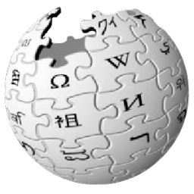


Feature Extraction
Michelle Obama married to President Barack Obama.
StanfordCoreNLP
User Defined Function
Mention | Type
Michelle Obama | PERSON
Barack Obama | PERSON
President | TITLE
Mention1 | Mention2 | Feature
Michelle Obama | Barack Obama
PERSON
marry
PERSON
Sentences
sql: SELECT text FROM Sentences;
python:
for text in sys.stdin():
rs = invoke_CoreNLP(text)
print rs
id
text
Michelle Obama
married to President Barack Obama.

Slide 28
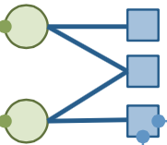
Probabilistic Engineering
Feature
HasSpouse
m1 | m2 | feature
M. Obama | B. Obama | …marry to…
B. Obama | M. Robinson | …meet…
m1 | m2
M. Obama | B. Obama
B. Obama | M. Robinson
R.V.
+
-
sql:
SELECT t1.*, t0.feature
FROM Feature t0, HasSpouse t1
WHERE t0.m1=t1.m2 AND
t0.m2=t1.m2
function: IsTrue(t1)
weight: t0.feature
R.V.
Factor
“marry to”
“meet”

Slide 29
Probabilistic Engineering
Feature
HasSpouse
m1 | m2 | feature
M. Obama | B. Obama | …marry to…
B. Obama | M. Robinson | …meet…
m1 | m2
M. Obama | B. Obama
B. Obama | M. Robinson
R.V.
+
-
sql:
SELECT t1.*, t0.feature
FROM Feature t0, HasSpouse t1
WHERE t0.m1=t1.m2 AND
t0.m2=t1.m2
function: IsTrue(t1)
weight: t0.feature
sql:
SELECT t0.*, t1.*
FROM HasSpouse t0,
HasSpouse t1
WHERE t0.m2=t1.m1 AND
t0.m1=t1.m2
function: Imply(t0, t1)
weight: 1
R.V.
Factor
“marry to”
“meet”

Slide 30
Probabilistic Engineering
How to get training examples to learn the weight?
Mention1 | Mention2 | Feature
Michelle Obama | Barack Obama | …marry to…
Barack Obama | Michelle Robinson | …meet…
Barack Obama | Joe Biden | …meet…
Label
✓
✗
✗
Labor-Intensive
Millions of examples to label!
Whether the feature indicates relations
Feature | Weight
…marry to… | 2.0
…meet… | 0.0

Slide 31
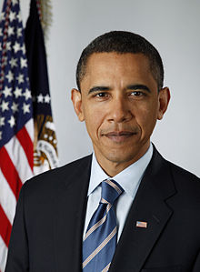
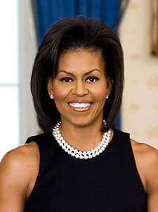
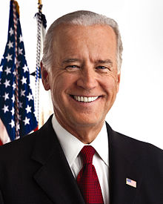
Probabilistic Engineering
How to get training examples to learn the weight?
Mention1 | Mention2 | Feature
Michelle Obama | Barack Obama | …marry to…
Barack Obama | Michelle Robinson | …meet…
Barack Obama | Joe Biden | …meet…
Label
✓
✗
✗
Distant Labels
✓
✓
Spouse
Person 1 | Person 2
NotSpouse
Person 1 | Person 2

Slide 32

Probabilistic Engineering
How to get training examples to learn the weight?
Mention1 | Mention2 | Feature
Michelle Obama | Barack Obama | …marry to…
Barack Obama | Michelle Robinson | …meet…
Barack Obama | Joe Biden | …meet…
Label
✓
✗
✗
Distant Labels
✓
✓
✗
Spouse
Person 1 | Person 2
NotSpouse
Person 1 | Person 2
SQL

Slide 33
Probabilistic Engineering
How to get training examples to learn the weight?
Mention1 | Mention2 | Feature
Michelle Obama | Barack Obama | …marry to…
Barack Obama | Michelle Robinson | …meet…
Barack Obama | Joe Biden | …meet…
Label
✓
✗
✗
Distant Labels
✓
✓
✗
Challenge
How to increase training quality by amortizing labeling errors caused by distant supervision?

Slide 34
Probabilistic Engineering
How to get training examples to learn the weight?
Mention1 | Mention2 | Feature
Michelle Obama | Barack Obama | …marry to…
Barack Obama | Michelle Robinson | …meet…
Barack Obama | Joe Biden | …meet…
Label
✓
✗
✗
Distant Labels
✓
✓
✗
Mention1 | Mention2 | Feature
Michelle Obama | Barack Obama | …marry to…
Barack Obama | Michelle Robinson | …meet…
Barack Obama | Joe Biden | …meet…
Technique
How to make DeepDive Efficient and Scalable?
Add more mention pairs!
Add more distant supervision rules!

Slide 35
DeepDive Workflow
Feature
Extraction
Feature
Extraction
Statistical Learning
Probabilistic Engineering
Statistical Learning & Inference
sql: SELECT text FROM Sentences;
python:
for text in sys.stdin():
rs = invoke_CoreNLP(text)
print rs
Inference Result
sql:
SELECT t1.*, t0.feature
FROM Feature t0, HasSpouse t1
WHERE t0.m1=t1.m2 AND
t0.m2=t1.m2
function: IsTrue(t1)
weight: t0.feature
p
0.9
0.6

Slide 36
Case Study: PaleoDeepDive

Slide 37
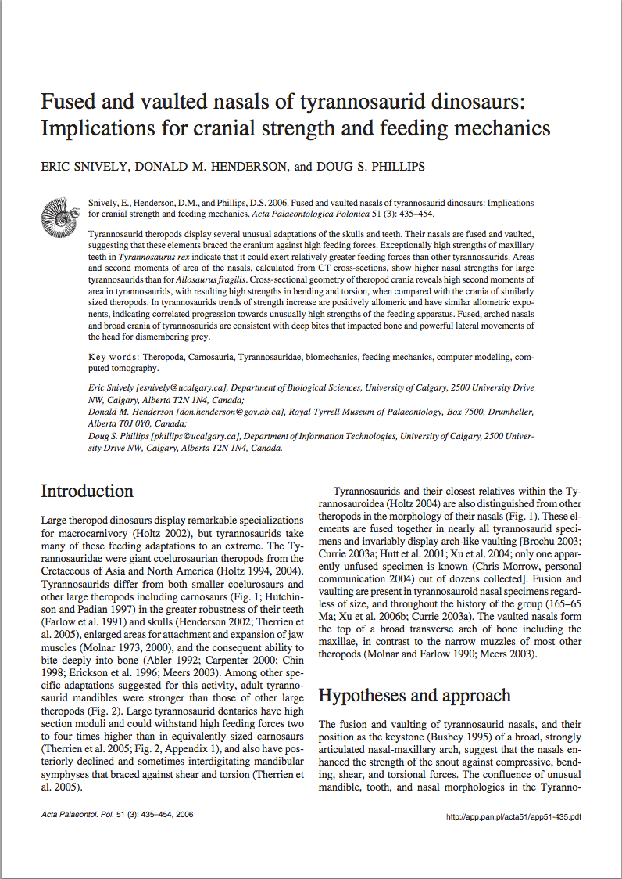
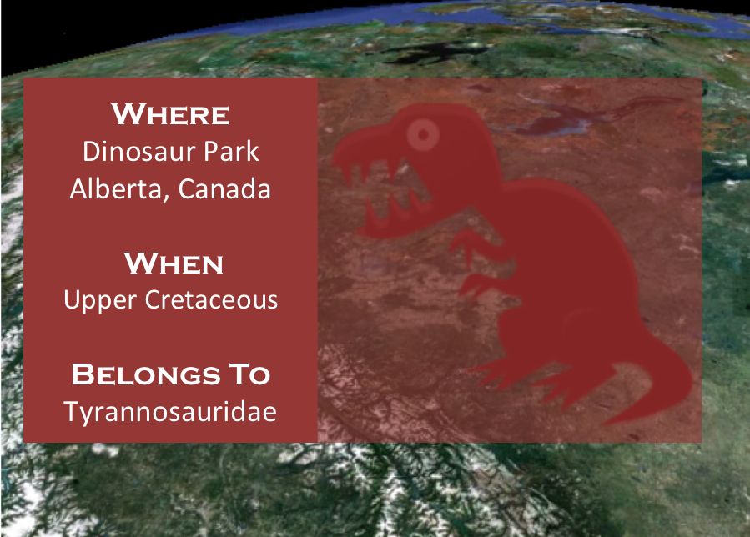
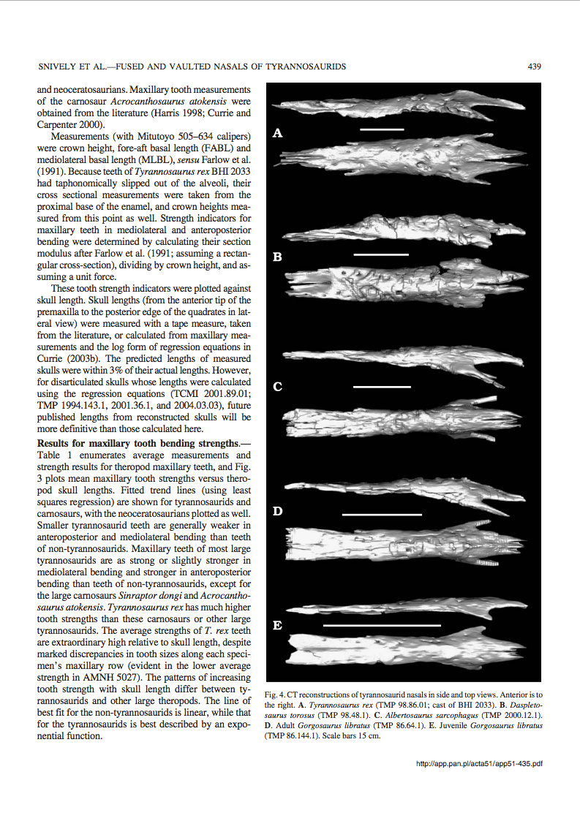
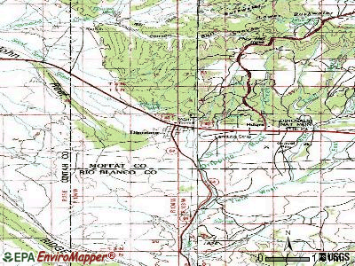
Case Study - PaleoDeepDive
The Goal
Extract paleobiological facts to build higher coverage fossil record.
T. Rex are found dating to
the upper Cretaceous.
DeepDive
Appears(“T. Rex”, “Cretaceous”)
[PLoS ONE 2014]

Slide 38
Case Study - PaleoDeepDive

Slide 39

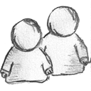






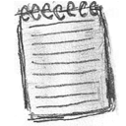

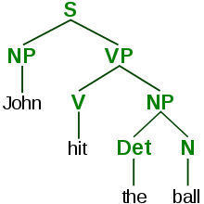
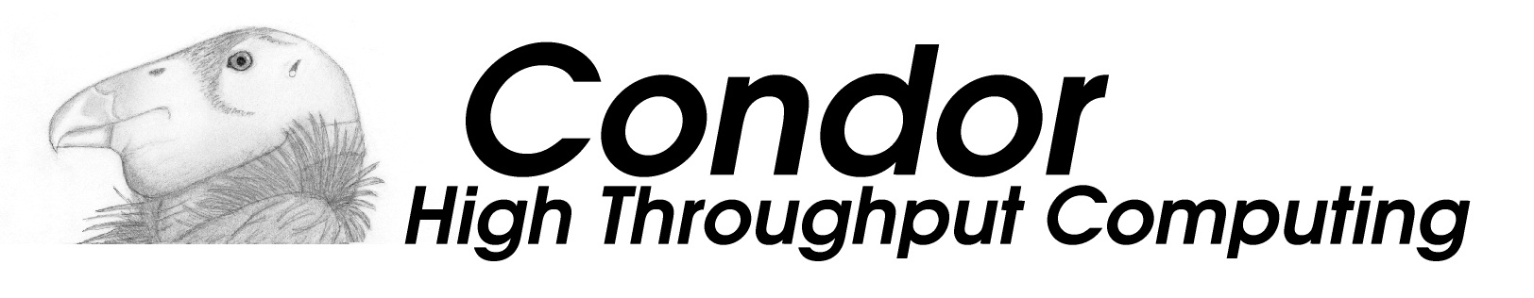




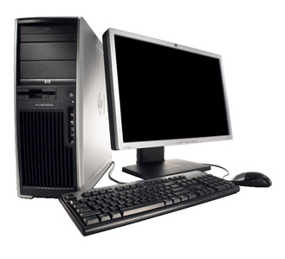
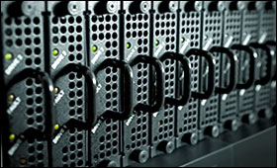
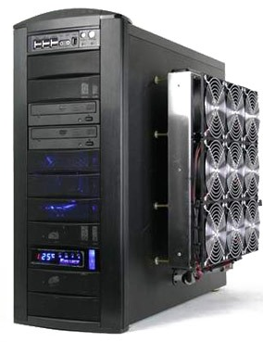
Case Study - PaleoDeepDive
Data
Acquisition
SotA
NLP
Statistical
Inference
Standard Tools
Stanford CoreNLP
400K CPU Hours(~46 years)
~300K Articles (2TB)
~100M
sentences
3M Mention.
2.1M Relations.
X 1000 @ UW-Madison
200 Nodes
250 TB
X 2 High-end
Servers
X 100K @ US Open
Science Grid
Storage Infrastructure
Inference Infrastructure

Slide 40






Case Study - PaleoDeepDive
PaleoDB
PaleoDeepDive
Biodiversity Curve
Human-created
Paleobiology database!
Machine-created
Paleobiology database!
(>90% Precision)
329 geoscientists
2000 machine cores
8 years
46 machine years
55K documents
300K documents
126K fossil mentions
3M fossil mentions
1M relations
2.1M relations
On the same relation, PaleoDeepDive achieves equal (or sometimes better) precision as professional human volunteers.

Slide 41
Overview
Application
Abstraction
Technique
Why KBC? How does DeepDive help KBC?
How to build a KBC Application with DeepDive?
How to make DeepDive Efficient and Scalable?

Slide 42
Technique: Teasers
1. One-shot Execution
Performant and Scalable Statistical Inference and Learning on Modern Hardware.
Technique
How to make DeepDive Efficient and Scalable?
2.Iterative Execution
Materialization Optimizations to support exploratory iterative development for statistical workload.

Slide 43
Technique: Teasers - Overview
Scalable Statistical Inference (via Gibbs sampling) over factor graphs.
[SIGMOD 2013]
Performant Statistical Learning on modern hardware.
[VLDB 2014]
Performant Iterative Feature Selection.
[SIGMOD 2014]
Performant Iterative Feature Engineering.
[VLDB 2015]

Slide 44
What is the benefit of doing all three phases
inside a single system?

Slide 45
Incremental Maintenance of KBC
Feature
Extraction
Feature
Extraction
Statistical Learning
Probabilistic Knowledge Engineering
Statistical Learning & Inference
Can we avoid rerun
the whole program
from scratch?
Factor Graph
Statistical (?)
6 hours to rerun!
20 minutes!
Supervision
Domain Knowledge
Inference Result
Add a new
feature!
SQL (✓)
< 0.1% old features change weights given a new features
p
Input
Features
0.9
Feature Extraction
SQL (✓)
0.6
[VLDB 2015]

Slide 46
Recap (Before Future Work)
Application
Abstraction
Technique
Why KBC? How does DeepDive help KBC?
How to build a KBC Application with DeepDive?
How to make DeepDive Efficient, and Scalable?

Slide 47
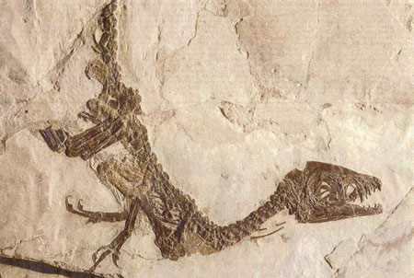
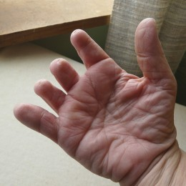
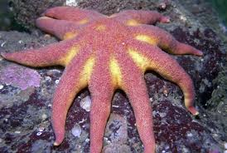
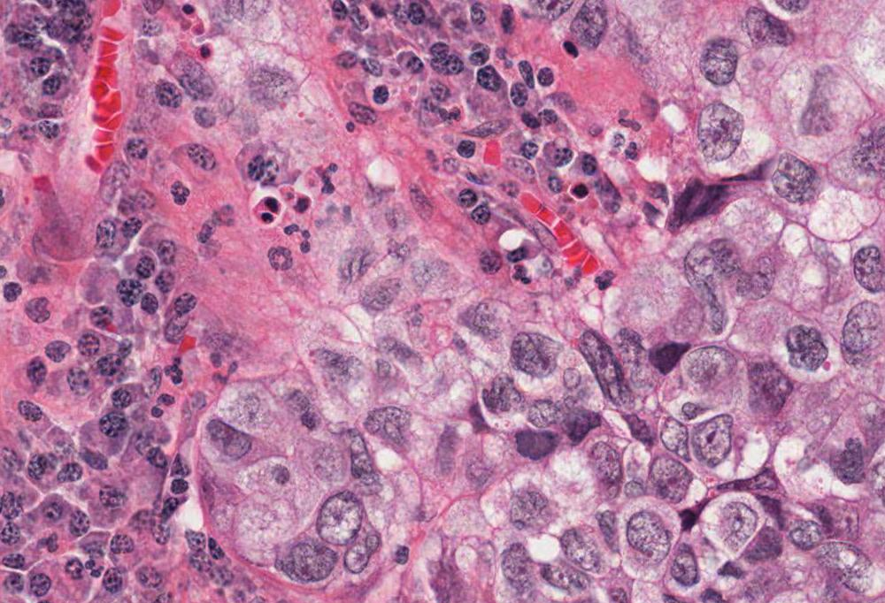
Ongoing & Future Work: Go Beyond Text-Processing
DeepDive’s current support of non-textual extraction is
weak, but sources like images are important to many
scientific questions.
What kind
of dinosaur
is this?
Does this
patient have
short finger?
Is this sea
star found in
2014 sick?
What’s the
Clinical out-
come of this
patient?

Slide 48

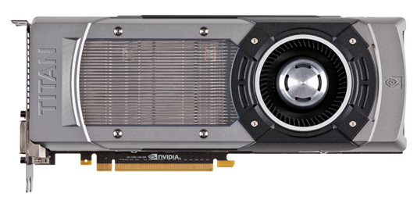
Ongoing & Future Work: Speed up Deep Learning
Existing software, e.g., Caffe, usually runs 10x slower on CPU than GPU. But can we still use our existing CPU clusters and still be reasonably fast?
EC2: c4.4xlarge
8 cores@2.90GHz
EC2: g2.2xlarge
1.5K cores@800MHz
0.7TFlops
1.2TFlops
Not a terrible gap? Can we achieve this?
Caffe
GPU
2x 8-core Haswell CPUs
= 1 M520 GPU
Our
CPU
2 CPUs
End-to-end
TFlops
Caffe
CPU
Can we distribute the
workload to a CPU-GPU
hybrid cluster?

Slide 49
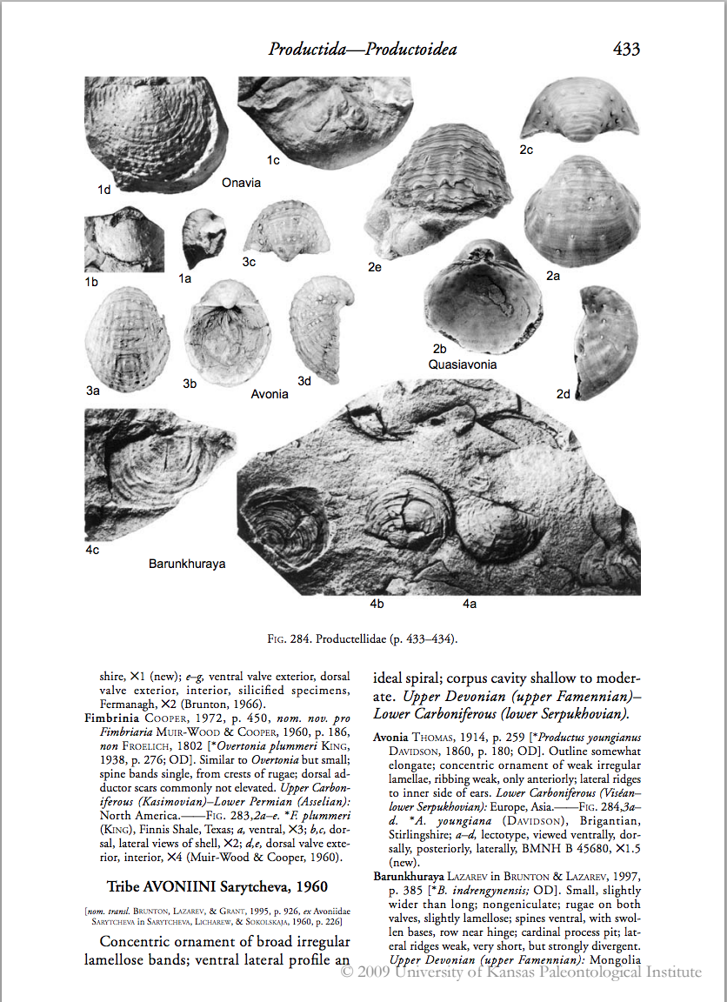
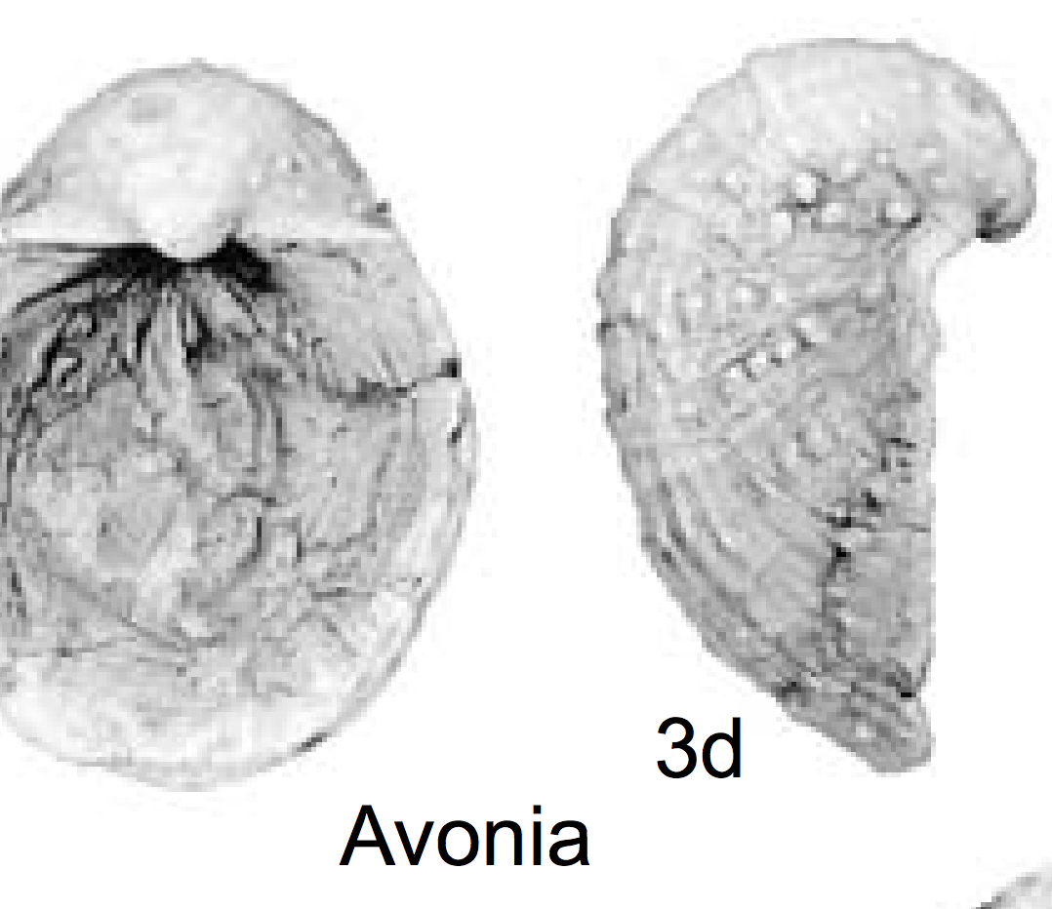
Ongoing & Future Work: Visual Distant Supervision
Images without high-quality human labels also contain valuable information.
Fossil Image
Name of Fossil
What can we learn from these
images without human labels?

Slide 50
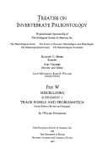
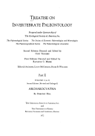
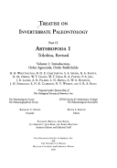
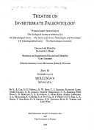
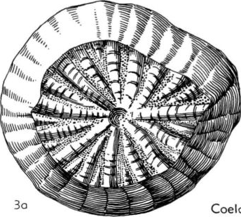
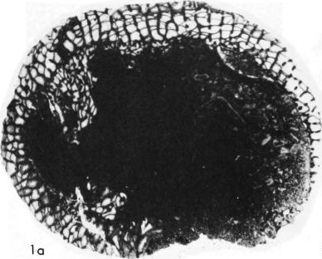
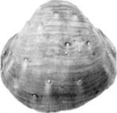
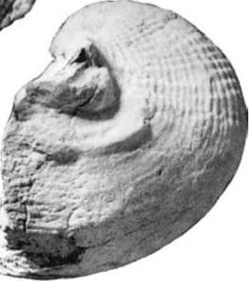

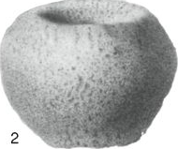
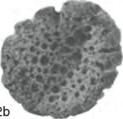


Ongoing & Future Work: Visual Distant Supervision
Can we build a system that automatically “reads” a Paleontology textbook and learn the difference between sponges and shells?
Document
Classifier
Porifera
Brachiopoda
We apply Distant Supervision!

Slide 51

Ongoing & Future Work: Visual Distant Supervision
DeepDive Extractions
Figure Name Mention
Taxon Mention
Fig. 387,1a-c. *B. rara, Serpukhovian, Kazakhstan, Dzhezgazgan district; a,b, holotype, viewed ventrally, laterally, MGU 31/342, XI (Litvinovich, 1967);
Figures
Fig. 387
Provide Labels
Test with Human Labels
3K Brachiopoda Images
2K Porifera Images
Accuracy = 94%
Train CNN

Slide 52
Conclusion
It is feasible to build a data management system to support the end-to-end workflow of building KBC applications.

