Slide 1
Integrating Knowledge Capture and Supervised Learning through a
Human-Computer Interface
Trevor Walker, Gautam Kunapuli, Noah Larsen,
David Page, Jude Shavlik
KCAP 2011
University of Wisconsin – Madison, WI USA

Slide 2

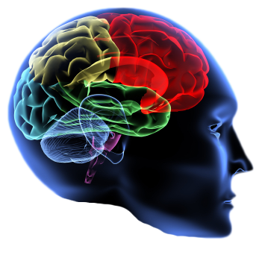
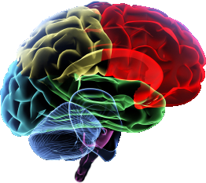
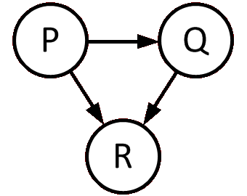
Learning with Domain Knowledge
+
=
Domain-expert knowledge
Learner
Model
Approach: Advice-taking
Some learning algorithms can take advice
Notes:
Looking at acquisition of knowledge for learning purposes
Learning with Domain knowledge is good

Slide 3

Providing Domain Knowledge is Hard
+
=
Knowledge
Learner
Model
AI/ML expert required
Limits applicability of such algorithms
Notes:
Articulating expertise requires in-depth understanding of underlying learning mechanism
Grounded descriptions of “why” easy to provide and understandable
Generalizing advice left to learning algorithms
Still requires understanding of underlying syntax
HCI provides method to alleviate these problems
Learning is an iterative approach – Obtain knowledge, learn, fix mistakes through more knowledge

Slide 4
Domain Knowledge Difficulties
+
=
Domain-expert knowledge
Learner
Model
Notes:
Articulating expertise requires in-depth understanding of underlying learning mechanism
Grounded descriptions of “why” easy to provide and understandable
Generalizing advice left to learning algorithms
Still requires understanding of underlying syntax
HCI provides method to alleviate these problems
Learning is an iterative approach – Obtain knowledge, learn, fix mistakes through more knowledge

Slide 5
Providing Domain Knowledge is Hard
Knowledge
Learner
Want to provide method for non-expert to provide advice
Use concrete advice provided via an HCI
Notes:
Articulating expertise requires in-depth understanding of underlying learning mechanism
Grounded descriptions of “why” easy to provide and understandable
Generalizing advice left to learning algorithms
Still requires understanding of underlying syntax
HCI provides method to alleviate these problems
Learning is an iterative approach – Obtain knowledge, learn, fix mistakes through more knowledge

Slide 6
Notes
Want to provide method for non-expert to provide knowledge -> use concrete advice + HCI

Slide 7
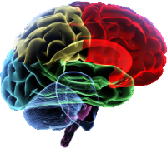
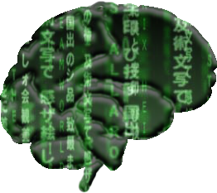
Domain Knowledge Difficulties
?
Domain-expert knowledge
Learner
Identifying important knowledge
is difficult
Articulating knowledge requires understanding of underlying algorithm – requires AI expert
Notes:
Articulating expertise requires in-depth understanding of underlying learning mechanism
Grounded descriptions of “why” easy to provide and understandable
Generalizing advice left to learning algorithms
Still requires understanding of underlying syntax
HCI provides method to alleviate these problems
Learning is an iterative approach – Obtain knowledge, learn, fix mistakes through more knowledge

Slide 8
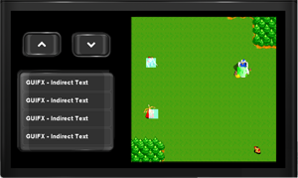
Domain Knowledge Solutions
Domain-expert knowledge
Learner
Iteratively acquire knowledge
Use advice-taking Human-Computer Interface (HCI)
Notes:
Articulating expertise requires in-depth understanding of underlying learning mechanism
Grounded descriptions of “why” easy to provide and understandable
Generalizing advice left to learning algorithms
Still requires understanding of underlying syntax
HCI provides method to alleviate these problems
Learning is an iterative approach – Obtain knowledge, learn, fix mistakes through more knowledge

Slide 9
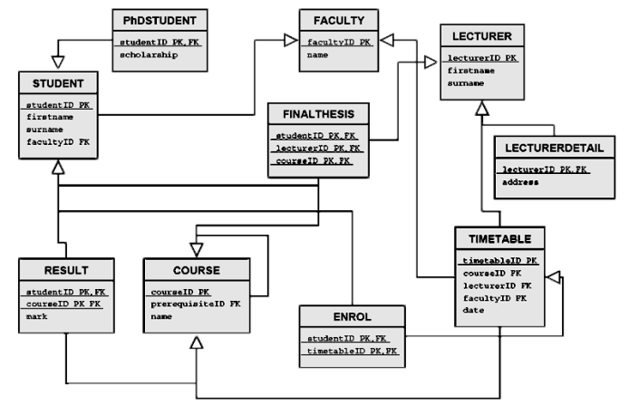
Learning Scenario Specifics
Supervised Learning
  Training examples & labels are given
  Relational domains
Knowledge in the form of advice
  Hints to learner, possibly incorrect
  Written in first-order logic
  Grounded in a specific example

Slide 10


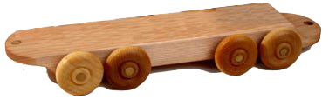
Advice Processing [Walker et. al., 2010]
giraffe
Positive Example:
eastbound (train1)
car1
train1
Advice:
train(train1), has_car(train1, car1),
cargo(car1, giraffe)
Generated knowledge:
bk1(Train) ← train(Train), has_car(Train, Car),
cargo(Car, giraffe)
Advice:
train(train1), has_car(train1, car1),
cargo(car1, giraffe)
Generated knowledge:
bk1(Train) ← train(Train), has_car(Train, Car),
cargo(Car, giraffe)
Bad: First-Order Logic
Good: Grounded Advice

Slide 11
Grounded Advice
Easier for domain-expert to specify
Easier to design HCI for grounded advice

Slide 12
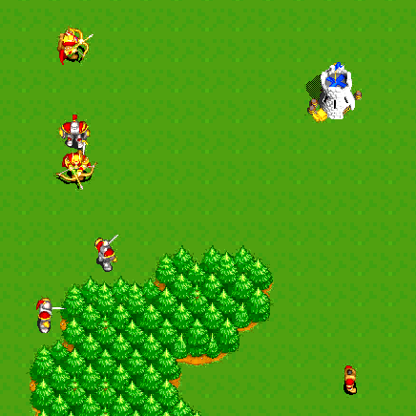
Case Study: WillTowerFall?
Our HCI advice-taking case study
WillTowerFall?
  Subset of Wargus

Slide 13
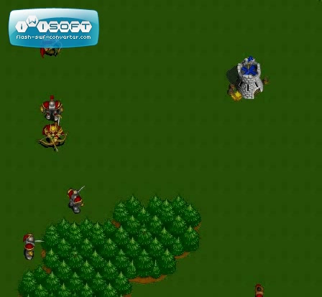
WillTowerFall? Sample Scenario

Slide 14
Domain Knowledge Solutions
Knowledge
Learner
Iteratively acquire knowledge
Use advice-taking Human-Computer Interface (HCI)
Notes:
Articulating expertise requires in-depth understanding of underlying learning mechanism
Grounded descriptions of “why” easy to provide and understandable
Generalizing advice left to learning algorithms
Still requires understanding of underlying syntax
HCI provides method to alleviate these problems
Learning is an iterative approach – Obtain knowledge, learn, fix mistakes through more knowledge

Slide 15
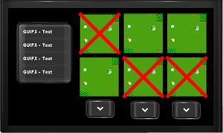
Our Knowledge Acquisition Loop
Domain-expert knowledge
Review HCI
Advice HCI
Model
Learner

Slide 16
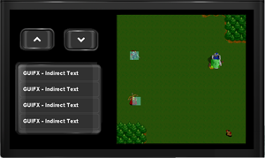
Giving Advice via the HCI
User selects example to provide advice for
HCI presents example information
User specifies advice by
1. Selecting objects
2. Specifying relations

Slide 17
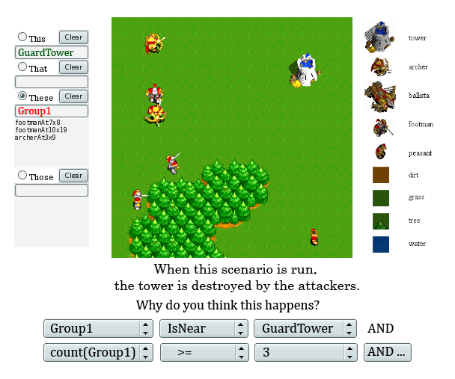
Giving Advice via the HCI
Wargus GUI

Slide 18
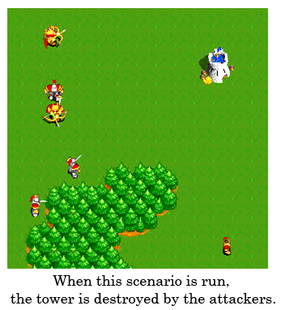
Giving Advice via the HCI
Wargus GUI

Slide 19
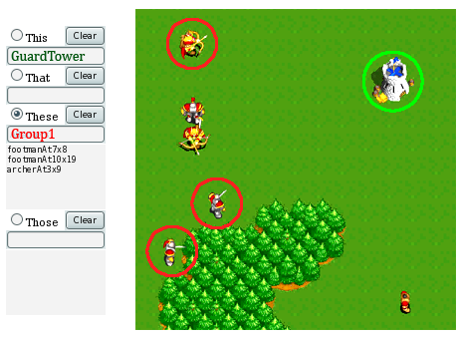
Giving Advice via the HCI
Wargus GUI

Slide 20
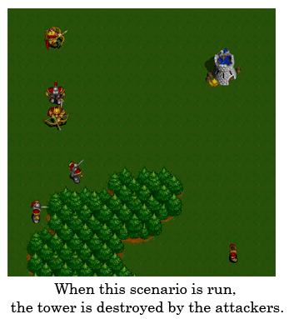
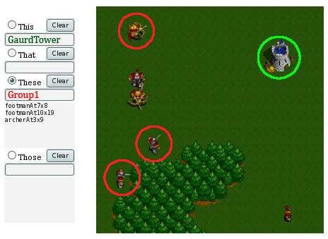
Giving Advice via the HCI
Wargus GUI

Slide 21

Giving Advice via the HCI
Wargus GUI

Slide 22
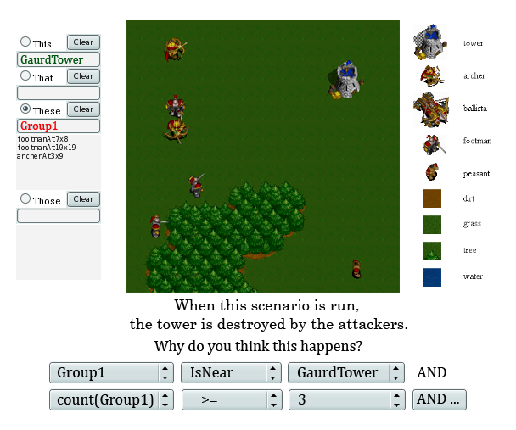

Giving Advice via the HCI
Make Big
Wargus Prototype GUI

Slide 23

Iterative Knowledge Acquisition
Domain-expert knowledge
Review HCI
Advice HCI
Model
Learner

Slide 24
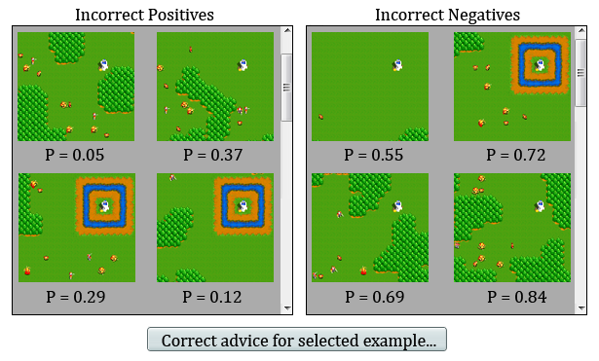
Reviewing / Correcting Results

Slide 25

What Would Users Like to Say?
First pass – collect advice in
natural language
Second pass – provide GUI that supports most of natural language sentences

Slide 26
Wargus Natural Language Advice
Tower falls | Three or more footmen can take down a tower if there is no moat. Five or more archers can take down a tower.
Tower stands (does not fall?) | If there are only peasants, the tower stands. Four archers or less cannot take down a tower. ANIMATE
MENTION:
Percentage Representable | 87% | 86%

Slide 27
Wargus Natural Language Advice
Tower will fall
  Three or more footmen can take down a tower if there is no moat
  Five or more archers can take down a tower
Tower will not fall
  If there are only peasants, the tower stands
  Four archers or less cannot take down
  a tower
90% representable by GUI

Slide 28
Experiments
Wargus WillTowerFall?
Use boosted relational dependency network (bRDN) – Probabilistic relational supervised learner [Natarajan et. al., 2010]
Advice generalization algorithm
[Walker et. al., 2010]

Slide 29
Experimental Comparisons
No Advice
User-provide advice via HCI
Hand-written AI expert advice

Slide 30
Representable Natural Language
Language Representable through GUI
Feature Mentioned In Advice | Context
 | Tower stands | Tower falls
Total number of attackers | 50 | 36
Number of Archers | 43 | 62
Number of Footmen | 50 | 46
Number of Ballistae | 18 | 1
Number of Peasants | 0 | 24
Presence of Moat | 6 | 28
Sum | 67 | 97
Language NOT Representable through GUI
Other (terrain/distance/angle) | 10 | 16
Percentage Representable | 87% | 86%

Slide 31
Testset Results
GUI-provided advice is equally effective as AI-expert advice

Slide 32






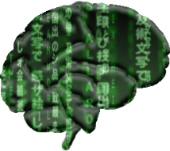
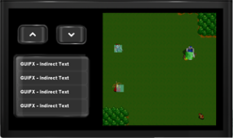
Conclusion
?
Determining important knowledge
is difficult
Iteratively acquire knowledge
Articulating knowledge requires
understanding of underlying algorithm
Use advice-taking
Human-Computer Interface

Slide 33
Conclusion
Algorithms exist that take advice
  However, advice must be written in
  formal languages
  High barrier to entry for non-AI users
Designed a GUI
  Motivated by natural language statements
  Allowed input of grounded advice about
  specific examples
Successful pilot study

Slide 34



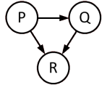

Future Work
Apply framework to additional, more complex domains
Develop domain-independent GUI for relational advice taking

Slide 35
ACKNOWLEDGEMENTS
Thank You
DARPA Bootstrap Learning program, grant HR0011-07-C-006

