Slide 1
Learning Parameters for
Relational Probabilistic Models
with Noisy-Or Combining Rule
Sriraam Natarajan
Prasad Tadepalli*
Gautam Kunapuli
Jude Shavlik
Dept of CS, University of Wisconsin-Madison
* School of EECS,Oregon State University

Slide 2
Logic + Probability = Probabilistic Logic aka Statistical Relational Learning
Logic
Add Probabilities
Statistical Relational Learning (SRL)
Probabilities
Add Relations
Uncertainty in SRL Models is captured by probabilities, weights or potential functions

Slide 3
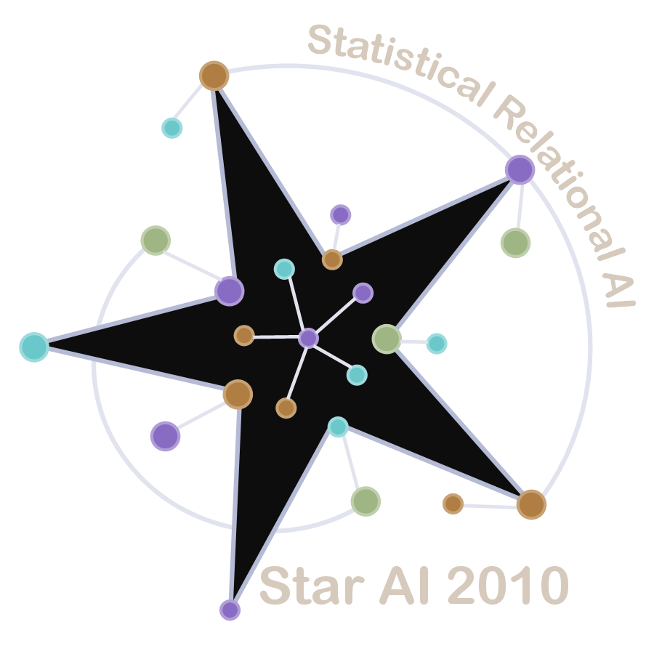
Statistical Relational Learning
Combines the expressiveness of relational logic with
the uncertainty modeling of graphical models
Several formalisms already exist
Probabilistic Relational Models (PRMs)
Bayesian Logic Programs (BLPs)
Stochastic Logic Programs (SLPs)
Relational Bayesian Networks (RBNs)
Probabilistic Logic Programs (PLPs),
Markov Logic Networks (MLNs) …
Parameter sharing and quantification allow
compact representation
Notes:
What is SRL
Why SRL – universal quantification
Multiple-parent – use the mosquito

Slide 4
Multiple Parents Problem
Often multiple objects are related to an object by the same relationship
One’s friend’s drinking habits influence one’s own
A student’s GPA depends on the grades in the courses he/she takes
The size of a mosquito population depends on the temperature and the rainfall each day since the last freeze
The resultant variable in each of these statements
has multiple influents (“parents” in Bayes net jargon)

Slide 5
Multiple Parents for Population since Last Freeze
Temp_1
Rain_1
…
Temp_n
Rain_n
Population
Variable number of parents
Large number of parents
Need for compact parameterization
Notes:
Make it explicit to specify – last freeze (use 2 sets and …)

Slide 6
Solution 1: Aggregators
Temp1
Rain1
Temp2
Rain2
Temp3
Rain3
Deterministic
AverageTemp
AverageRain
Stochastic
Population
Problem: Does not take into account the interaction between
Rain and Temp
Notes:
Add animation to present the “Problem”. The number of parents (variable)

Slide 7
Solution 2: Combining Rules
Temp1
Rain1
Temp2
Rain2
Temp3
Rain3
Population1
Population2
Population3
Population
Top 3 distributions share parameters
The 3 distributions are combined into one final distribution

Slide 8
Outline
Multi-Level Combining Rules
Learning the Parameters
Experiments and Results
Conclusion and Future Work

Slide 9
Outline
Multi-Level Combining Rules
Learning the Parameters
Experiments and Results
Conclusion and Future Work

Slide 10
First-order Conditional Influence Language – Abstract Syntax
The difficulty of the course and the intelligence of the student influence his/her grade
if (student(s), course(c), takes(r,s,c))}
then s.IQ, c.difficulty Qinf r.grade
P(grade |diff, IQ)
 | L |  |  | M |  |  | H
 | L | M | H | L | M | H | L | M | H
A | 0.2 | 0.5 | 0.8 | 0.1 | 0.4 | 0.7 | 0 | 0.2 | 0.6
B | 0.5 | 0.3 | 0.2 | 0.6 | 0.4 | 0.2 | 0.2 | 0.6 | 0.3
C | 0.3 | 0.1 | 0 | 0.3 | 0.2 | 0.1 | 0.8 | 0.2 | 0.1
Notes:
Remove the top 2 examples and include a CPT

Slide 11
A Rule to Predict Student Satisfaction
if { student(s), course(c), takes(s,c,t) }
then t.grade, c.diff Qinf (Mean)s.satisfaction
t₁.grade
c₁.diff
…
t_{n}.grade
c_{n}.diff
s.satisfaction
s.satisfaction
Mean
s.satisfaction

Slide 12
A 2nd Rule to Predict Student Satisfaction
if {student(s), paper(p,s) }
then p.quality Qinf (Mean) s.satisfaction
p₁.quality
…
p_{m}.quality
s.satisfaction
s.satisfaction
Mean
s.satisfaction

Slide 13
Multi-Level Combining Rules
Noisy-Or{
if { student(s), course(c), takes(s,c,t) }
then t.grade, c.diff Qinf (Mean) s.satisfaction
if { student(s), paper(p,s) }
then p.quality Qinf (Mean) s.satisfaction
}
Prior work: Used Weighted Mean instead of Noisy-Or

Slide 14
“Unrolled” Network
t₁.grade
c₁.diff
t_{n}.grade
c_{n}.diff
p₁.quality
p_{m}.quality
…
…
s.sat
s.sat
s.sat
s.sat
Mean
Mean
s.sat
s.sat
Noisy-Or
s.sat

Slide 15
Goals
Given: FOCI statements by the domain expert
Goal1: Learn the parameters of the CPTs
Goal2: Learn the parameters of the Combining Rules (Weights / Noise)

Slide 16
Outline
Multi-Level Combining Rules
Learning the Parameters
Experiments and Results
Conclusion and Future Work
Notes:
Add a slide to show the final probability distribution using combining rules

Slide 17
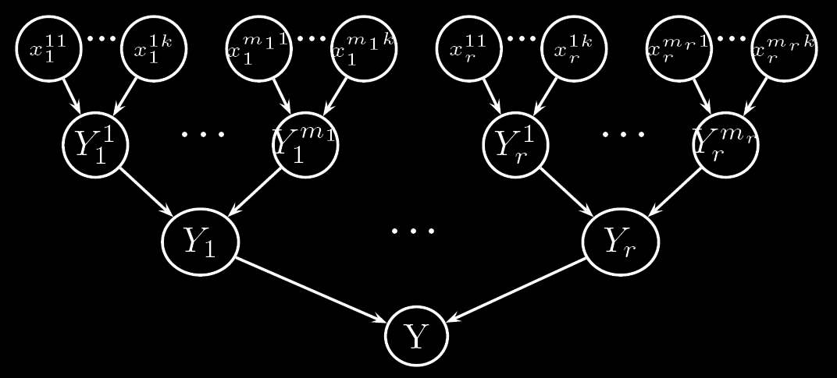
Value-based Bayes Net

Slide 18
Gradient Descent for Mean-Squared Error
Squared error
Gradient Step:
where,
Notes:
Split the slide into 2. Use dasthul talk.

Slide 19
Gradient Descent for Loglikelihood
Loglikelihood
Loglikelihood is well explored for many graphical models
Random restarts used to avoid local optima
Direction of gradient changes if true label is different from observed label
where,

Slide 20
EM Learning
Key Idea: Use the Noisy-Or value based network, where a multiplexer (hidden node) chooses one of the y-values according to the noisy-or function
E-step: Separate equations for different cases
M-Step: Treat the probabilities from E-step as fractional counts and estimate the expected number of groundings
Refer to the paper for equations

Slide 21
Outline
Multi-Level Combining Rules
Learning the Parameters
Experiments and Results
Conclusion and Future Work

Slide 22
Synthetic Data Set
2 rules with 2 inputs each having 10 and 2 values respectively
CPT entries kept between ‹0,0.1› and ‹0.9,1›
Performance metric: average absolute error in predicted probability
15 sets – 2000 training ex, 1000 test ex
Notes:
Trianing data: 30 sets of 2000 examples. Test data 1000 examples.

Slide 23
Results
Propositional Models
Weka (J48 and Naïve Bayes) Error Rate 0.45

Slide 24
Real-World Datasets*
UW Dataset : Goal is to predict advisedBy relationship between Professors and Students
2 Rules
Combining Rule{
if { student(S), professor(P), course(C) }
then taughtBy(P,C,Q),ta(S,C,Q)Qinf(Mean)advisedBy(S,P).
if { student(S), professor(P) }
then publication(P,W), publication(S,W)
Qinf (Mean) advisedBy(S,P).
}
Combining Rule - One of Weighted Mean, Noisy-Or
Same 2 Rules given to Alchemy
* http://alchemy.cs.washington.edu/

Slide 25
Real-World Datasets
Citeseer Dataset : Goal is to predict if two cites refer to the same publication
2 Rules
Combining Rule {
if { pub(P1), pub(P2) }
then similarTitle(P1,P2,T1,T2), sameVenue(P1,P2)
Qinf (Mean) sameBib(P1,P2).
if { pub(P1), pub(P2), pub(P3) }
then sameBib(P1,P3), sameBib(P3,P2)
Qinf (Mean) sameBib(P3,P2).
}
CR – Weighted Mean / Noisy-Or
2 Rules for Alchemy

Slide 26
Results
 | Algorithm | UW-CSE | Citeseer
Weighted Mean | EM | 0.730 | 0.701
 | GDMS | 0.756 | 0.705
 | GDLL | 0.740 | 0.664
Noisy-Or | EM | 0.790 | 0.686
 | GDMS | 0.796 | 0.678
 | GDLL | 0.767 | 0.654
Alchemy | MLN-2 | 0.5 | 0.34
 | MLN-N | 0.52 | 0.40
Performance metric - Average Likelihood over test examples

Slide 27
Outline
Multi-Level Combining Rules
Learning the parameters of Combining Rules
Experiments and Results
Conclusion and Future Work

Slide 28
Conclusion
Developed EM and Gradient-Descent algorithms for learning in presence of multi-level combining rules
EM algorithm uses a value-based network to learn the parameters
Propositional classifiers are unable to learn the true distribution
MLNs do not perform well with a small number of rules
Performance increases with more weakly predictive rules
Decomposable combining rules add special structure to the problem that can be exploited while learning
Notes:
SPLIT into 2 slides

Slide 29
Future Work
We plan to extend these to more general classes of combining rules
Search through the space of combining rules?
Use efficient inference algorithms in inner loop
Understand the relationship between combining rules and aggregators
Both extend the idea of causal independence to the first-order setting
Are combining rules a generalization of aggregators?
Representing arbitrary distributions in MLNs

Slide 30
EM Learning
Earlier work used the notion of responsibilties
Responsibility is the contribution of each input towards the final value
Noisy-OR is asymmetric with respect to its values
Hence, we cannot use auxillary random variables
Prior work on EM for Noisy-Or – for propositional models
We derive the EM from first principles
Notes:
EM is shown for two rules. Both the rules have 2 influents t,r. The parameters and the gammas are shown for the first rule and can be extended for the second rule as well.

Slide 31
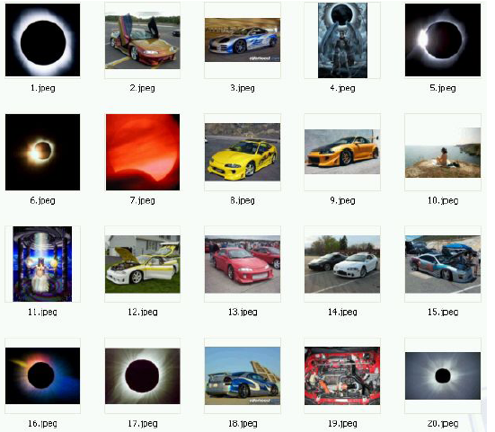
Motivation
Most learners assume i.i.d. data (independent and identically distributed)
One type of object
Objects have no relation to each other
To predict if the image is “eclipse”

Slide 32
Real-World Data (Dramatically Simplified)
Non- i.i.d
PatientID Gender Birthdate
P1 M 3/22/63
PatientID Date Physician Symptoms Diagnosis
P1 1/1/01 Smith palpitations hypoglycemic
P1 2/1/03 Jones fever, aches influenza
Shared Parameters
Solution: First-Order Logic / Relational Databases
PatientID Date Lab Test Result
PatientID SNP1 SNP2 … SNP500K
P1 AA AB BB
P2 AB BB AA
P1 1/1/01 blood glucose 42
P1 1/9/01 blood glucose 45
Multi-Relational
PatientID Date Prescribed Date Filled Physician Medication Dose Duration
P1 5/17/98 5/18/98 Jones prilosec 10mg 3 months

Slide 33
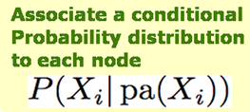
The World is Inherently Uncertain
Graphical Models (here e.g. a Bayesian network) - Model uncertainty explicitly by representing the joint distribution
Fever
Ache
Random Variables
Influenza
Direct Influences
Propositional Model!

