Slide 1
Questions to Start With
Why are you here?
What is Computer Graphics?
What do you want to get out of it?
What do you expect?
What have you heard?
Do not want to blow a lecture on mechanics

Slide 2
Topics du Jour
What is Computer Graphics – the topic
What is Computer Graphics – the class
Some basic things to get started

Slide 3
What is Computer Graphics?
How computers create things we see
alternative
Geometry
Geometry for non-visual stuff, often another field

Slide 4
What kinds of “things we see”
What?
Computer Displays
Movies / Video
Print
Interactive Media
Games
Virtual Reality
Other devices (mobile)
…
Why?
Computer Displays
Entertainment
Design
Communication
Simulation
Medicine / Science

Slide 5
What is computer graphics?
(almost) Any picture we see!
and a lot more than “computer pictures.”
Computers touch everything …
All movies
Photography (even film is printed digitally)
Print
…
More than Pictures? (3D Displays, …)

Slide 6
What do we see? What is an Image?
Basics of Light
Electromagnetic radiation
Waves, frequencies (later)
Particle model
Travels from source to receiver
Source to Viewer?
Not known until around 1000
Euclid and Ptolemy PROVED otherwise
Ibn Al-Haythan (Al-hazen) around 985
Triumph of the scientific method
Proof by observation – not authority
Experiment – stare at sun, burns eyes, …
Also figured out light travels in straight lines

Slide 7
Depth and Distance
Light travels in straight lines
Except in weird cases that only occur in theoretical physics
Doesn’t matter how far away
Can’t tell where photon comes from
Photons leaving source might not all make it to eye
Photons might bounce around on stuff
Longer distance, more chance of hitting something

Slide 8
Looking at things
Light leaves source
Light bounces off object
Light goes to receiver
Eye, Camera
Receiver is 2D, process is 3D
Mathematics later
Could be a picture (per eye)

Slide 9
What is Computer Graphics?
Images - Visual Computing
Geometry - Geometric Computing
Probably turned into an image at some point
Except if it’s a 3D printer, hologram, …
Not just pictures of world (text, painting, …)

Slide 10
Images
Dictionary: a reproduction of the form of a person or object, especially a sculptured likeness
Math: the range of a function
A picture (2D)
A sampled representation of a spatial thing

Slide 11
How to make images?
Represent 3D World & Make a picture
Rendering (act of making a picture from a model)
Either simulate physics or other ways
Capture measurements of the real world
Make up 2D stuff (like painting text, …)

Slide 12
Kinds of Image Representations
Old: Raster vs. Vector
New: Sampled vs. Geometric
Raster: regular measurements (independent of content)
Geometric: mathematical description of content
Display: vector vs. raster

Slide 13
Color
Quality of light
Energy spectrum / reflectance function
Perception
Can we represent color with 3 numbers?
No!
Sortof (R,G,B or X,Y,Z, or its variants)
Details later in the class
For now, pixels have 3 brightnesses

Slide 14
Pixels
A little square?
Bad model – but right idea
A measurement (at a point)
In theory a point – in practice could be average over a region, …
Limited precision…
Grid? (or any pattern)
Key point: independent of content

Slide 15
What is the field of Graphics?
(as far as we’re concerned as a part of CS)
Not content
Not how to use graphics tools (***)

Slide 16
Related Fields / Courses
Art
Image Processing
Computational Geometry
Geometric Modeling
Computer Vision
Human Perception
Human-Computer Interaction
Advanced Graphics

Slide 17
What do you need to know?
About images
About geometry
About 3D
Importance of images in graphics classes
A new thing
Not well reflected in texts

Slide 18
What will we try to teach you?
Eyes and Cameras – where images go
Images (sampling, color, image processing)
Digital Photography
Drawing and representing things in 2D
Raster algorithms, transformations, curves, …
Drawing and representing things in 3D
Viewing 3D in 2D, surfaces, lighting
Making realistic looking pictures
Miscellaneous topics

Slide 19
How will we teach this to you?
CS559 – Computer Graphics
Basic course info – its all on the web www.cs.wisc.edu/~cs559-1
Web for announcements – issues with mailing lists

Slide 20
What’s new this year?
Less digital photography (new course)
Some new topics
Programming graphics hardware (shaders, GPU)
Rendering
Experiment with project structure
Cut out “non-graphics” aspects to make smaller
More emphasis on using sample code
Not all projects the same size/weight
Mini project

Slide 21
Who
Prof: Mike Gleicher
6385 CS
Office Hours:
Wednesday 11-11:45, Thursday 9:30-10:15
Or by appointment
gleicher@cs.wisc.edu
TA: Blayne Field
1308 CS
Office Hours
Mondays 3:30-4:30pm, Tuesdays 1:00-2:00pm
See the website

Slide 22
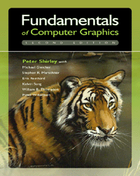
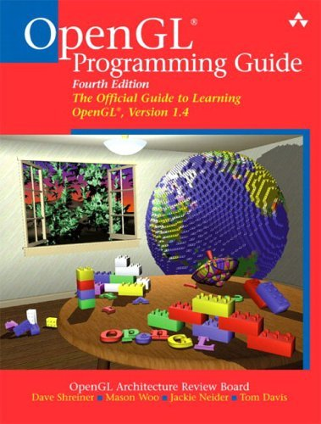
Books
Fundamentals of Computer Graphics, 2nd ed
By Peter Shirley (and others)
NOT the 1st edition
Referred to as Shirley
or Tiger Book
OpenGL Programming Guide
By Woo et al.
“red book” – common reference
Any version is OK for class
Old version is on the web

Slide 23
Other Books
RTR
2e – old, but good – have readings from it
3e – just came out. encyclopedic
C++
Evolution of book thickness
Books on fancy C++

Slide 24
Collaboration
Collaboration vs. Academic Misconduct
We encourage collaboration (to a point)
Not on exams
You must do your own project work

Slide 25
Parts of the Course
Exams
Midterm (Tues, Oct 28th evening), FINAL
Assignments
Written – double check the theory (exam prep)
Programming – try things out (before projects)
Projects
Smaler
Something due every Tuesday
Survey next week

Slide 26
Software Infrastructure
Visual Studio (C++ on Windows)
Your program must compile and run on machines in B240!
FlTk
OpenGL
LibTarga
Class is not about tools, but we will help you with them

Slide 27
Other Administrative Questions?
C++ (vs. GLUT)
Workload
Extra Credit
Grading and Late Policies

