Slide 1


Tuffy
Scaling up Statistical Inference in Markov Logic using an RDBMS
Feng Niu, Chris Ré, AnHai Doan, and Jude Shavlik
University of Wisconsin-Madison

Slide 2
One Slide Summary
Machine Reading is a DARPA program to capture knowledge expressed in free-form text
Similar challenges in enterprise applications
We use Markov Logic, a language that allows rules that are likely – but not certain – to be correct
Markov Logic yields high quality, but current implementations are confined to small scales
Tuffy scales up Markov Logic by orders of magnitude using an RDBMS

Slide 3
Outline
Markov Logic
  Data model
  Query language
  Inference = grounding then search
Tuffy the System
  Scaling up grounding with RDBMS
  Scaling up search with partitioning

Slide 4






A Familiar Data Model
Markov Logic program
Datalog?
Datalog + Weights
≈ Markov Logic
Relations with
known facts
Relations to
be predicted
EDB
IDB

Slide 5
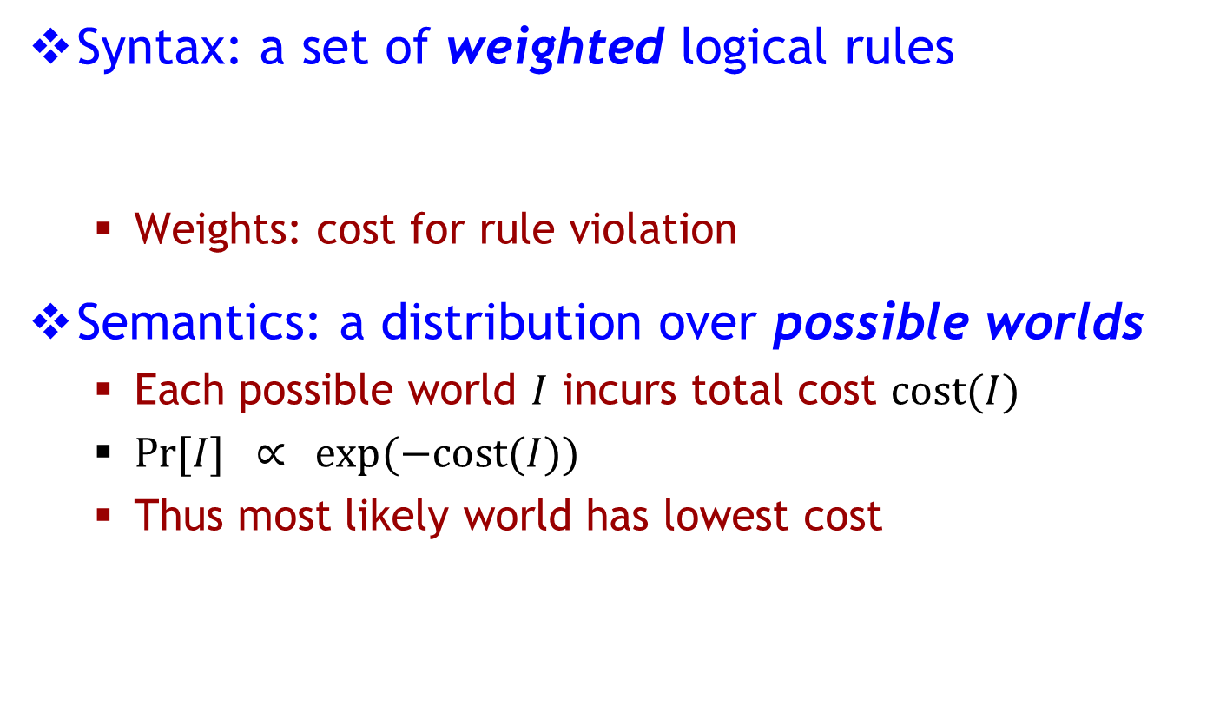
Markov Logic*
Syntax: a set of weighted logical rules
  Weights: cost for rule violation
Semantics: a distribution over possible worlds
  Each possible world $I$ incurs total cost $\text{cos}\text{t}(I)$
  $Pr[I] ∝⁡ exp⁡(−\text{cos}\text{t}(I))$
  Thus most likely world has lowest cost
3 wrote(s,t) ∧ advisedBy(s,p) → wrote(p,t)
// students’ papers tend to be co-authored by advisors
exponential models
* [Richardson & Domingos 2006]

Slide 6
Markov Logic by Example
Rules
3 wrote(s,t) ∧ advisedBy(s,p) → wrote(p,t)
// students’ papers tend to be co-authored by advisors
5 advisedBy(s,p) ∧ advisedBy(s,q) → p = q
// students tend to have at most one advisor
∞ advisedBy(s,p) → professor(p)
// advisors must be professors
EDB
IDB
Evidence
wrote(Tom, Paper1)
wrote(Tom, Paper2)
wrote(Jerry, Paper1) professor(John)
…
Query
advisedBy(?, ?)
// who advises whom

Slide 7
Inference
Rules
Query
Relations
Inference
Evidence
Relations
MAP
regular tuples
Marginal
tuple probabilities

Slide 8
Inference
Rules
Query
Relations
Grounding
Search
Evidence
Relations
Find tuples that are true
(in most likely world)
Find tuples that are relevant
(to the query)

Slide 9
How to Perform Inference
Step 1: Grounding
  Instantiate the rules
wrote(s, t) ∧ advisedBy(s, p) → wrote(p, t)
Grounding
3 wrote(Tom, P1) ∧ advisedBy(Tom, Jerry) → wrote (Jerry, P1)
3 wrote(Tom, P1) ∧ advisedBy(Tom, Chuck) → wrote (Chuck, P1)
3 wrote(Chuck, P1) ∧ advisedBy(Chuck, Jerry) → wrote (Jerry, P1)
3 wrote(Chuck, P2) ∧ advisedBy(Chuck, Jerry) → wrote (Jerry, P2)
…

Slide 10
How to Perform Inference
Step 1: Grounding
  Instantiated rules → Markov Random Field (MRF)
    A graphical structure of correlations
3 wrote(Tom, P1) ∧ advisedBy(Tom, Jerry) → wrote (Jerry, P1)
3 wrote(Tom, P1) ∧ advisedBy(Tom, Chuck) → wrote (Chuck, P1)
3 wrote(Chuck, P1) ∧ advisedBy(Chuck, Jerry) → wrote (Jerry, P1)
3 wrote(Chuck, P2) ∧ advisedBy(Chuck, Jerry) → wrote (Jerry, P2)
…
Nodes: Truth values of tuples
Edges: Instantiated rules

Slide 11
How to Perform Inference
Step 2: Search
  Problem: Find most likely state of the MRF (NP-hard)
  Algorithm: WalkSAT*, random walk with heuristics
  Remember lowest-cost world ever seen
advisee | advisor
Tom | Jerry
Tom | Chuck
Search
False
True
* [Kautz et al. 2006]

Slide 12
Outline
Markov Logic
  Data model
  Query language
  Inference = grounding then search
Tuffy the System
  Scaling up grounding with RDBMS
  Scaling up search with partitioning

Slide 13
Challenge 1: Scaling Grounding
Previous approaches
  Store all data in RAM
  Top-down evaluation
[Singla and Domingos 2006]
[Shavlik and Natarajan 2009]
RAM size quickly becomes bottleneck
Even when runnable,
grounding takes long time

Slide 14
Grounding in Alchemy*
Prolog-style top-down grounding with C++ loops
  Hand-coded pruning, reordering strategies
3 wrote(s, t) ∧ advisedBy(s, p) → wrote(p, t)
For each person s:
For each paper t:
If !wrote(s, t) then continue
For each person p:
If wrote(p, t) then continue
Emit grounding using <s, t, p>
Grounding sometimes accounts for over 90% of Alchemy’s run time
[*] reference system from UWash

Slide 15
Grounding in Tuffy
Encode grounding as SQL queries
Executed and optimized by RDBMS

Slide 16
Grounding Performance
Tuffy achieves orders of magnitude speed-up
 | Relational Classification | Entity Resolution
Alchemy [C++] | 68 min | 420 min
Tuffy [Java + PostgreSQL] | 1 min | 3 min
Evidence tuples | 430K | 676
Query tuples | 10K | 16K
Rules | 15 | 3.8K
Yes, join algorithms & optimizer are the key!

Slide 17

Challenge 2: Scaling Search
Grounding
Search

Slide 18
Challenge 2: Scaling Search
First attempt: pure RDBMS, search also in SQL
  No-go: millions of random accesses
Obvious fix: hybrid architecture
Alchemy
Tuffy-DB
Tuffy
Grounding
RAM
RDBMS
RDBMS
Search
RAM
RDBMS
RAM
Problem: stuck if |MRF | > |RAM|!

Slide 19
Partition to Scale up Search
Observation
  MRF sometimes have multiple components
Solution
  Partition graph into components
  Process in turn

Slide 20


Effect of Partitioning
Pro
Con (?)
  Motivated by scalability
  Willing to sacrifice quality
Scalability
Parallelism
What’s the effect on quality?

Slide 21
Partitioning Hurts Quality?
Alchemy took over 1 hr.
Quality similar to
Tuffy-no-part
Relational Classification
Goal: lower the cost quickly
Partitioning can actually improve quality!

Slide 22
Partitioning (Actually) Improves Quality
Reason:
Tuffy
Tuffy-no-part
WalkSATiteration | cost1 | cost2 | cost1 + cost2
1 | 5 | 20 | 25
min | 5 | 20 | 25

Slide 23
Partitioning (Actually) Improves Quality
Reason:
Tuffy
Tuffy-no-part
WalkSATiteration | cost1 | cost2 | cost1 + cost2
1 | 5 | 20 | 25
2 | 20 | 10 | 30
min | 5 | 10 | 25

Slide 24
Partitioning (Actually) Improves Quality
Reason:
Tuffy
Tuffy-no-part
WalkSATiteration | cost1 | cost2 | cost1 + cost2
1 | 5 | 20 | 25
2 | 20 | 10 | 30
3 | 20 | 5 | 25
min | 5 | 5 | 25
cost[Tuffy] = 10
cost[Tuffy-no-part] = 25

Slide 25
Partitioning (Actually) Improves Quality
Theorem (roughly):
Under certain technical conditions, component-wise
partitioning reduces expected time to hit an optimal
state by (2 ^ #components) steps.
100 components → 100 years of gap!

Slide 26
Further Partitioning
Partition one component further into pieces
Graph | Scalability | Quality
 | ☺
☺
Sparse
☺/☹
Dense
In the paper: cost-based trade-off model

Slide 27
Conclusion
Markov Logic is a powerful framework for statistical inference
  But existing implementations do not scale
Tuffy scales up Markov Logic inference
  RDBMS query processing is perfect fit for grounding
  Partitioning improves search scalability and quality
Try it out!
http://www.cs.wisc.edu/hazy/tuffy

