Slide 1

Machine Learning for Medical Decision Support and Individualized Treatment Assignment
Finn Kuusisto
Department of Computer Sciences
Doctoral Defense
August 14, 2015

Slide 2
Health Care Expenditure
*World Health Statistics 2015, World Health Organization (WHO)

Slide 3

Precision Medicine Initiative
“Tonight, I'm launching a new Precision Medicine Initiative to bring us closer to curing diseases like cancer and diabetes — and to give all of us access to the personalized information we need to keep ourselves and our families healthier.”
-President Barack Obama, State of the Union Address, January 20, 2015

Slide 4
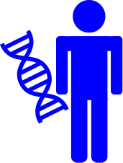
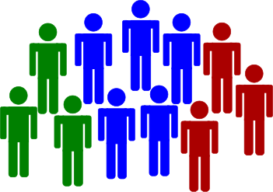
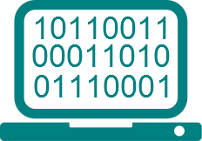
Precision Medicine
Tailoring medical treatment to individual characteristics of each patient
Classify individuals into subpopulations that differ in:
  Susceptibility to particular diseases
  Biology and/or prognosis of diseases they develop
  Response to specific treatments
Notes:
The Opportunity
EHR use growing
Genome sequencing getting cheaper
Greater access to compute resources
Call for new tools and technology

Slide 5
Supervised Learning
Given: Values of the input features and the output feature (response, class) for many patients
Do: Build a model that can accurately predict the unknown value of the output class for new (previously unseen) patients whose values of the input features are known
Classical methods: linear and logistic regression
Other methods: decision trees, random forests, support vector machines, Bayesian networks, artificial neural networks, etc.
yes
A?
no
yes
B?
no

Slide 6
Thesis Statement
Machine learning results can be made more clinically-relevant by tailoring current approaches to meet clinical objectives through the development of new algorithms to model individual response to treatment, and by incorporating clinical expertise into model development and refinement.

Slide 7
Publications
Clinical Collaboration
F. Kuusisto, I. Dutra, M. Elezaby, E. Mendonca, J. Shavlik, and E. S. Burnside. “Leveraging Expert Knowledge to Improve Machine-Learned Decision Support Systems”. AMIA Joint Summits on Translational Science, 2015.
M. Elezaby, F. Kuusisto, J. Shavlik, Y. Wu, A. Gegios, H. Neuman, W. B. DeMartini, E. S. Burnside. Core Needle Biopsies: A Predictive Model that Identifies Low Probability (≤2%) Lesions to Safely Avoid Surgical Excision. Radiological Society of North America (RSNA) 101st Scientific Assembly and Annual Meeting, 2015.
A. Gegios, M. Elezaby, W. B. DeMartini, J. Cox, C. Montemayor-Garcia, H. Neuman, F. Kuusisto, J. M. Hampton, E. S. Burnside. Differential Upgrade Rates for Non-Definitive Image-Guided Core Needle Breast Biopsies Based on BI-RADS Features. Radiological Society of North America (RSNA) 101st Scientific Assembly and Annual Meeting, 2015.
F. Kuusisto, I. Dutra, H. Nassif, Y. Wu, M. E. Klein, H. Neuman, J. Shavlik, and E. S. Burnside. “Using Machine Learning to Identify Benign Cases with Non-Definitive Biopsy”. IEEE International Conference on e-Health Networking, Applications & Services, 2013.
Individualized Treatment Effects
J. Weiss, F. Kuusisto, K. Boyd, J. Liu, D. Page. “Machine Learning for Treatment Assignment: Improving Individualized Risk Attribution”. AMIA Annual Symposium, 2015.
F. Kuusisto, V. Santos Costa, H. Nassif, E. S. Burnside, D. Page, and J. Shavlik. “Support Vector Machines for Differential Prediction”. European Conference on Machine Learning, 2014.
H. Nassif, F. Kuusisto, E. S. Burnside, D. Page, J. Shavlik, and V. Santos Costa. “Score As You Lift (SAYL): A Statistical Relational Learning Approach to Uplift Modeling”. European Conference on Machine Learning, 2013.
H. Nassif, F. Kuusisto, E. S. Burnside, and J. Shavlik. “Uplift Modeling with ROC: An SRL Case Study”. International Conference on Inductive Logic Programming, 2013.

Slide 8
Publications
Clinical Collaboration
F. Kuusisto, I. Dutra, M. Elezaby, E. Mendonca, J. Shavlik, and E. S. Burnside. “Leveraging Expert Knowledge to Improve Machine-Learned Decision Support Systems”. AMIA Joint Summits on Translational Science, 2015.
M. Elezaby, F. Kuusisto, J. Shavlik, Y. Wu, A. Gegios, H. Neuman, W. B. DeMartini, E. S. Burnside. Core Needle Biopsies: A Predictive Model that Identifies Low Probability (≤2%) Lesions to Safely Avoid Surgical Excision. Radiological Society of North America (RSNA) 101st Scientific Assembly and Annual Meeting, 2015.
A. Gegios, M. Elezaby, W. B. DeMartini, J. Cox, C. Montemayor-Garcia, H. Neuman, F. Kuusisto, J. M. Hampton, E. S. Burnside. Differential Upgrade Rates for Non-Definitive Image-Guided Core Needle Breast Biopsies Based on BI-RADS Features. Radiological Society of North America (RSNA) 101st Scientific Assembly and Annual Meeting, 2015.
F. Kuusisto, I. Dutra, H. Nassif, Y. Wu, M. E. Klein, H. Neuman, J. Shavlik, and E. S. Burnside. “Using Machine Learning to Identify Benign Cases with Non-Definitive Biopsy”. IEEE International Conference on e-Health Networking, Applications & Services, 2013.
Individualized Treatment Effects
J. Weiss, F. Kuusisto, K. Boyd, J. Liu, D. Page. “Machine Learning for Treatment Assignment: Improving Individualized Risk Attribution”. AMIA Annual Symposium, 2015.
F. Kuusisto, V. Santos Costa, H. Nassif, E. S. Burnside, D. Page, and J. Shavlik. “Support Vector Machines for Differential Prediction”. European Conference on Machine Learning, 2014.
H. Nassif, F. Kuusisto, E. S. Burnside, D. Page, J. Shavlik, and V. Santos Costa. “Score As You Lift (SAYL): A Statistical Relational Learning Approach to Uplift Modeling”. European Conference on Machine Learning, 2013.
H. Nassif, F. Kuusisto, E. S. Burnside, and J. Shavlik. “Uplift Modeling with ROC: An SRL Case Study”. International Conference on Inductive Logic Programming, 2013.

Slide 9
Outline
Introduction
Advice-Based Learning Framework
Support Vector Machines for Uplift Modeling
Conclusions

Slide 10
Outline
Introduction
Advice-Based Learning Framework
Support Vector Machines for Uplift Modeling
Conclusions

Slide 11
Decision Support
Great opportunities for machine-learned
decision support systems
But…
Standardized, complete, and sufficient training data
is rarely available
Notes:
Data may be challenging due to:
Variability of practice between physicians
Variability of practice between institutions
Low disease prevalence
Confidentiality

Slide 12
ABLe
Comprises two parts
Categories of advice sources
Iterative process for model refinement

Slide 13
ABLe - Advice Categories
Task
What is the problem and scope?
What predictor variables are important?
How should the problem be modeled?
Relationships Among Variables
What combinations of variables are important to the task?
Parameter Values
What is the clinical objective?
What model parameters best represent that objective?
Notes:
Variable relationships:
Not only do clinicians have background knowledge about variable dependencies,
but also have background knowledge of how data produced

Slide 14




ABLe - Iterative Process
Repeated iterations to optimize performance
Start
MDE and CSE
define/refine advice
Accept model
Build model
Evaluate model
Notes:
Need to address overfitting
Use x-validation while training, validate on future data

Slide 15
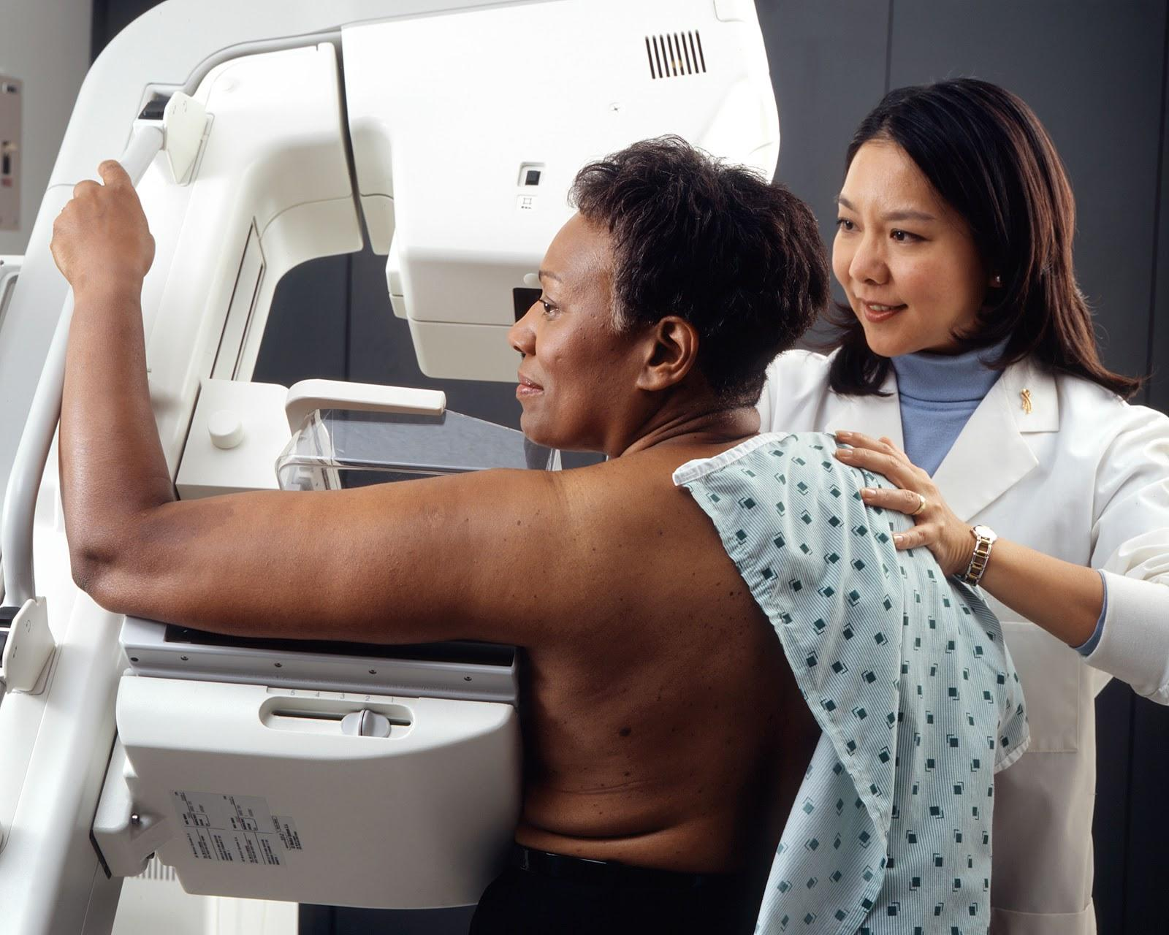
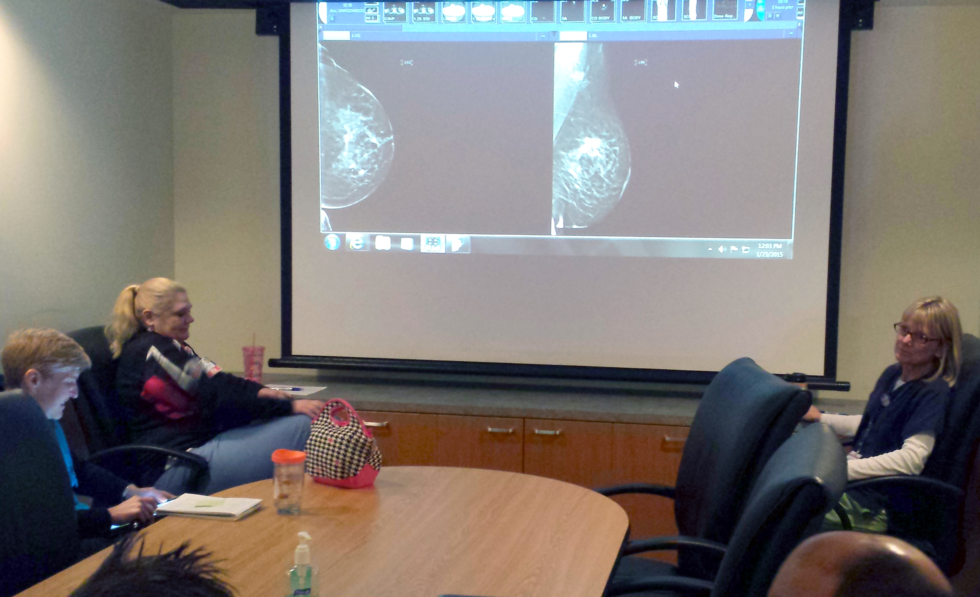
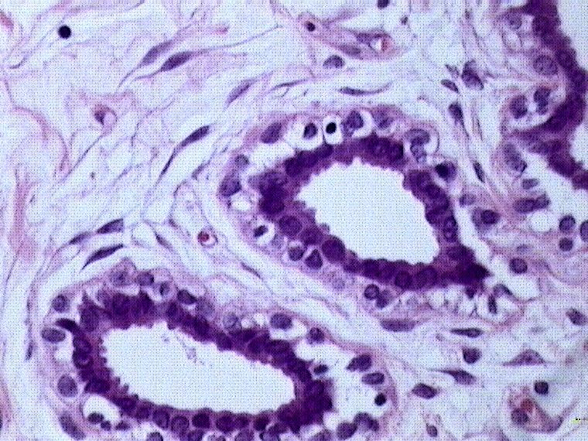
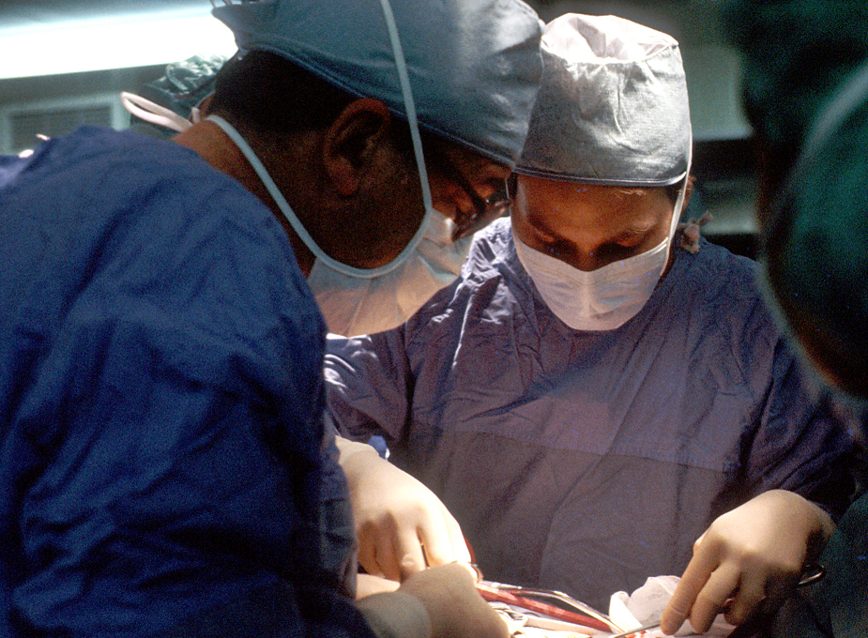
Upgrade Prediction
1
Mammogram
2
Needle Biopsy
3
Radiologic-Histologic
Correlation
4
Excision
Abnormality
Benign Tissue
Non-definitive Diagnosis
Final Diagnosis
Malignant
=
“Upgrade”
Image Sources:
NIH - wikimedia.org/wiki/File:Woman_receives_mammogram.jpg
Itayba - wikimedia.org/wiki/File:Normal.jpg
UW Hospital and Clinics
NIH - wikimedia.org/wiki/File:Surgical_breast_biopsy.jpg

Slide 16
Upgrade Prediction
5-15% of core needle biopsies non-definitive
Approximately 35,000-105,000* per year
80-90% of non-definitive biopsies are benign
* Based on 2010 annual breast biopsy utilization rate in the United States
Notes:
-Want to be more thoughtful and realistic about actual risk
-Still want to be conservative for the sake of malignant cases

Slide 17
Upgrade Prediction
?
1
Mammogram
2
Needle Biopsy
3
Radiologic-Histologic
Correlation
4
Excision
Abnormality
Benign Tissue
Non-definitive Diagnosis
Final Diagnosis
Malignant
=
“Upgrade”
Image Sources:
NIH - wikimedia.org/wiki/File:Woman_receives_mammogram.jpg
Itayba - wikimedia.org/wiki/File:Normal.jpg
UW Hospital and Clinics
NIH - wikimedia.org/wiki/File:Surgical_breast_biopsy.jpg
Notes:
Challenge:
Relatively rare event
Solution:
Incorporate clinical experience and intuition

Slide 18
Phase 1
Task
Simple probabilistic model (Naïve Bayes)
Standardized BI-RADS descriptor features
Some non-standard pathology features and demographics
Predict probability of malignancy
Assume excision at ≥ 0.02 model score (to balance risk)
Relationships Among Variables
Rules predicting increase/decrease risk of malignancy
Parameter Values
None

Slide 19
Relationships Among Variables
If-Then rules from domain expert (Beth) that suggest increase/decrease risk of upgrade.
High-risk mass rule:
IF
Irregular mass shape is present OR
Spiculated mass margin is present OR
High density mass is present OR
Increasing mass size
THEN
Risk of upgrade increases
Notes:
Included as binary features.

Slide 20
Biopsies in Practice (2006-11)
Core Needle Biopsies
2,808
Core Needle Biopsies + Dx Mammogram
1,910
Malignant Biopsy
601
Benign Biopsy
1,309
Non-definitive
157
Malignant (upgrade)
29
Benign (non-upgrade)
128

Slide 21
Phase 1 Results
Naïve Bayes to predict malignancy
Assume excision at ≥ 0.02 model score
Experiments with and without expert rule features
 | Data | Rules | Data + Rules
Malignant Excisions Missed (%) | 8 (27.6%) | 1 (3.4%) | 9 (31.0%)
Benign Excisions Avoided (%) | 46 (35.9%) | 5 (3.9%) | 63 (49.2%)

Slide 22
Observations & Refinements
Observations
No output threshold with acceptable performance
Non-definitive biopsies broken into 3 categories at diagnosis
  Atypical/Radial Scar (ARS)
  Insufficient (I)
  Discordant (D)
ARS and I cases consistently mislabeled
Refinements
Focus exclusively on discordant cases

Slide 23
Discordant Biopsies (2006-11)
Discordant Biopsy
60
Malignant (upgrade)
10
Benign (non-upgrade)
50

Slide 24
Phase 2 Results
Naïve Bayes to predict malignancy of discordants
Assume excision at ≥ 0.02 model score
Experiments with and without expert rule features
 | Data | Rules | Data + Rules
Malignant Excisions Missed (%) | 3 (30.0%) | 1 (10.0%) | 3 (30.0%)
Benign Excisions Avoided (%) | 29 (58.0%) | 17 (34.0%) | 27 (54.0%)

Slide 25
Observations & Refinements
Observations
Good ranking of cases by output model scores
Most cases assigned less than 0.02 risk
Refinements
Make model conservative
  Different costs for false negatives (FN) versus false positives (FP)
  Take from utility analysis literature in mammography

Slide 26
Phase 3 Results
Naïve Bayes to predict malignancy of discordants
Cost ratio of 150:1 for FN:FP
Assume excision at ≥ 0.02 model score
Experiments with and without expert rule features
 | Data | Rules | Data + Rules
Malignant Excisions Missed (%) | 0 (0.0%) | 0 (0.0%) | 0 (0.0%)
Benign Excisions Avoided (%) | 5 (10.0%) | 5 (10.0%) | 12 (24.0%)

Slide 27
Outline
Introduction
Advice-Based Learning Framework
Support Vector Machines for Uplift Modeling
Conclusions

Slide 28
Clinical Trial
Clinical experiment to determine the average effect of some treatment for:
Safety
Efficacy

Slide 29
Clinical Trial
Treatment Group
Control Group
Pretrial
Outcome
28.6%
57.1%
Notes:
Example: Warfarin->stroke

Slide 30
Clinical Trial
Treatment Group
Control Group
Pretrial
ATE = 28.6% - 57.1% = -28.5 percentage points
Outcome
28.6%
57.1%

Slide 31
Clinical Trial
Treatment Group
Control Group
Pretrial
Outcome
28.6%
57.1%
Notes:
We would really like to assess treatment effects based on individual differences

Slide 32
Clinical Trial
Treatment Group
Control Group
Pretrial
=
ITE =
=
=
Outcome
28.6%
57.1%

Slide 33
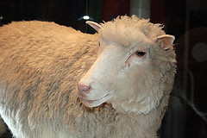
ITE Challenge
Cannot observe both treatment and control outcomes for any one individual
Need a lot of data to model ITE for even a moderate number of individual features
Image by Toni Barros - https://www.flickr.com/photos/12793495@N05/3233344867/

Slide 34
Uplift Modeling
(RADCLIFFE & SIMPSON, 2008)
How do we choose which customers to target with some marketing activity?
Persuadables | Customers who respond positively to marketing activity.
Sure Things | Customers who respond positively regardless.
Lost Causes | Customers who respond negatively regardless.
Sleeping Dogs | Customers who respond negatively to marketing activity.

Slide 35
Uplift Modeling
(RADCLIFFE & SIMPSON, 2008)
True customer groups are unknown
Treatment |  | Control
Response | No Response | Response | No Response
Persuadables, Sure Things | Sleeping Dogs, Lost Causes | Sleeping Dogs, Sure Things | Persuadables, Lost Causes

Slide 36
Standard Model
Treatment |  | Control
Response | No Response | Response | No Response
Persuadables, Sure Things | Sleeping Dogs, Lost Causes | Sleeping Dogs, Sure Things | Persuadables, Lost Causes
POSITIVE
NEGATIVE
Persuadables
Sleeping Dogs
Persuadables
Sleeping Dogs
Sure Things
Lost Causes

Slide 37
Response Model
Treatment |  | Control
Response | No Response | Response | No Response
Persuadables, Sure Things | Sleeping Dogs, Lost Causes | Sleeping Dogs, Sure Things | Persuadables, Lost Causes
POSITIVE
NEGATIVE
Persuadables
Sure Things
Sleeping Dogs
Lost Causes

Slide 38
Uplift Modeling
(RADCLIFFE & SIMPSON, 2008)
Treatment |  | Control
Response | No Response | Response | No Response
Persuadables, Sure Things | Sleeping Dogs, Lost Causes | Sleeping Dogs, Sure Things | Persuadables, Lost Causes
POSITIVE
POSITIVE
Persuadables
Sure Things
Sleeping Dogs
NEGATIVE
NEGATIVE
Sleeping Dogs
Lost Causes
Persuadables
Treatment
Control

Slide 39
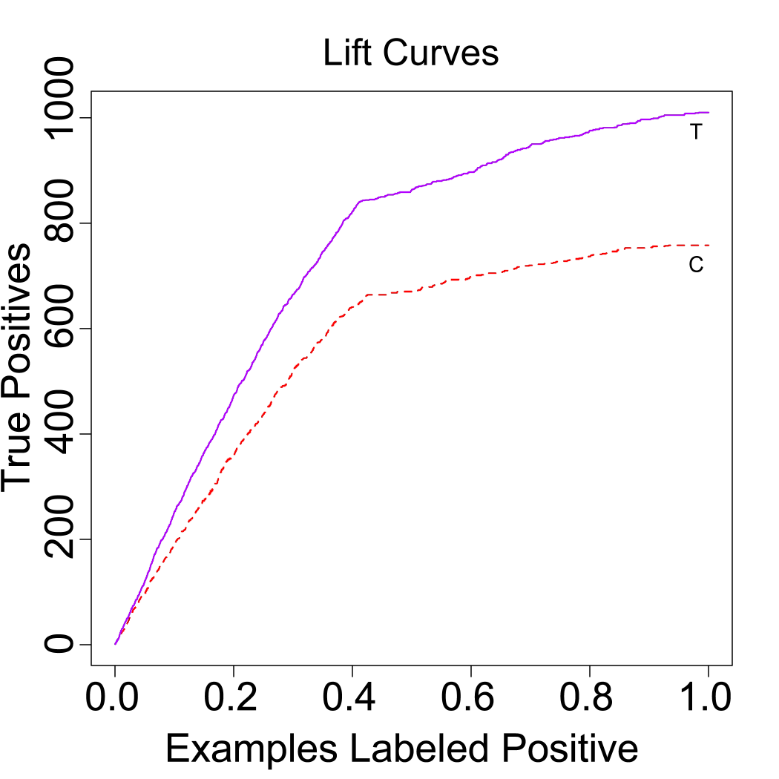
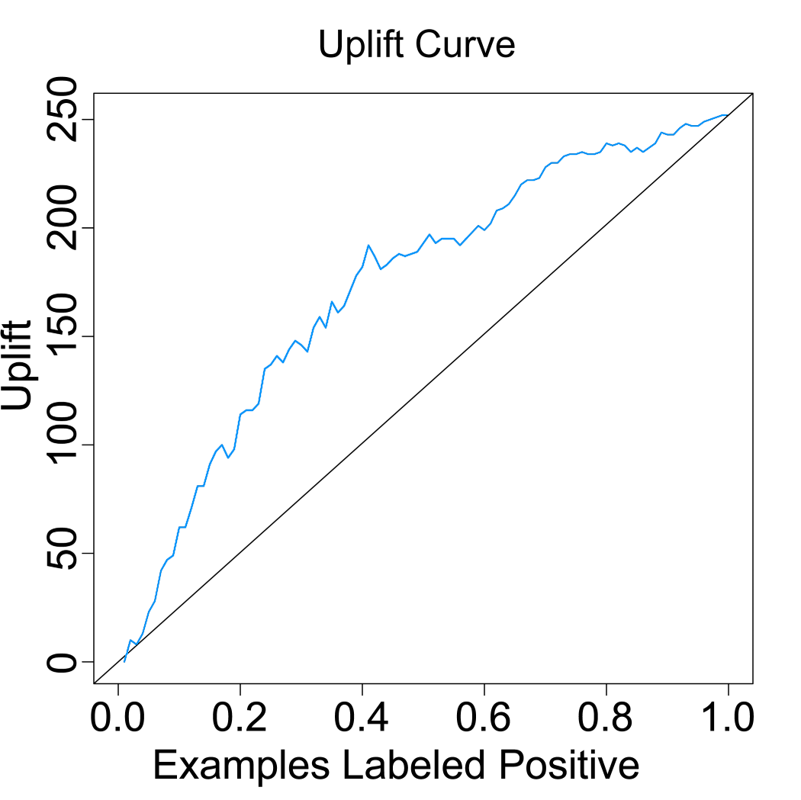

Uplift Modeling
(RADCLIFFE & SIMPSON, 2008)
Lift
The number of responders that a classifier identifies at a given proportion of the population targeted.
Uplift
The difference in lift produced by a classifier between treatment and control subgroups.

Slide 40


COX-2 Inhibitors
Non-steroidal anti-inflammatory drug (NSAID)
Significantly reduced occurrence of adverse gastrointestinal effects common to other NSAIDs (e.g. ibuprofen)
Wide use for treatment of ailments such as arthritis
Later clinical trials showed increased risk of myocardial infarction (MI), or “heart attack”

Slide 41
COX-2 Inhibitors
Main Assumption
Patients with an increased risk of MI due to treatment with COX-2 inhibitors are directly analogous to Persuadables.

Slide 42
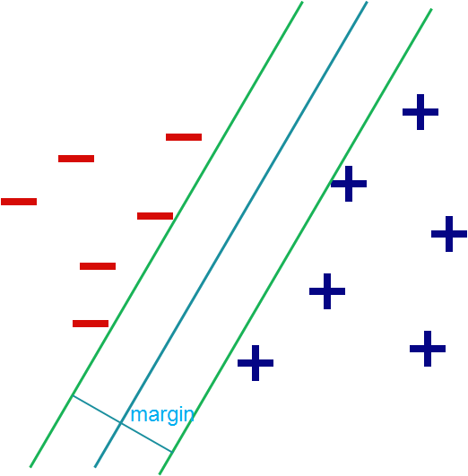
Support Vector Machines
Find maximum-margin separating plane between positive and negative examples.

Slide 43
SVM for Uplift
Extend previous SVM work maximizing AUC (Joachims, 2005) to maximize AUU instead.

Slide 44
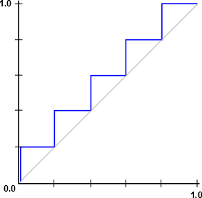
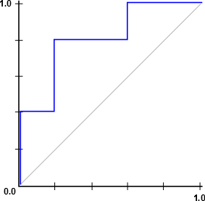
ROC and AUC
+ Model Ranking -
+ Model Ranking -
+ - + - + - + - + -
+ + - + + - - + - -
True Positive Rate
True Positive Rate
False Positive Rate
False Positive Rate

Slide 45


SVM for Uplift
Let the positive skew of data be:
Then (Tuffery, 2011):

Slide 46
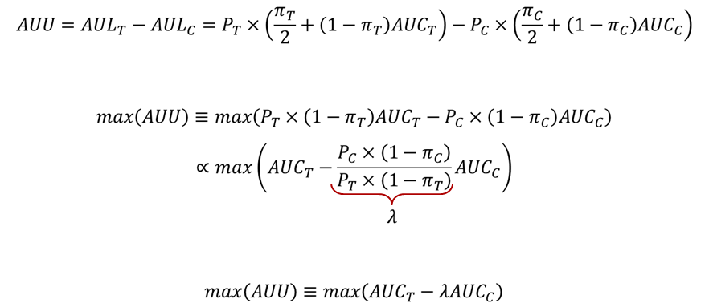
SVM for Uplift

Slide 47
Uplift Modeling Simulation: Persuadable ROC
Generated synthetic customer population
Subjected customer population randomly to simulated marketing activity
Measured ROC with Persuadables as the positive class, others as negative

Slide 48
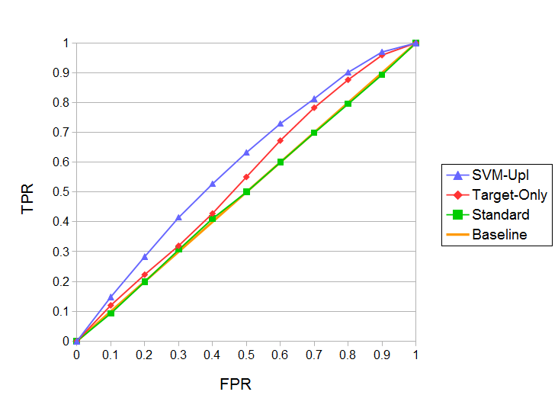
Uplift Modeling Simulation: Persuadable ROC

Slide 49
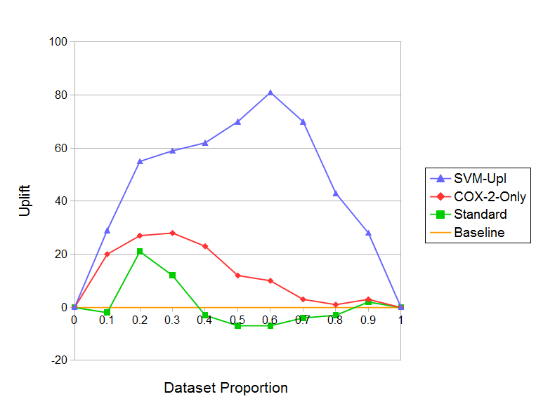
COX-2 Inhibitor Results

Slide 50
COX-2 Inhibitor Results
Model | AUU | COX-2 AUL | No COX-2 AUL | AUU p-value
SVM^{Upl} | 50.7 | 123.4 | 72.7 | -
COX-2-Only | 13.8 | 151.5 | 137.7 | 0.002*
Standard | 1.2 | 147.7 | 146.5 | 0.002*
Baseline | 0.0 | 0.0 | 0.0 | 0.002*
Notes:
P-value shows 10-fold comparison of AUU
Developed an SVM model to maximize uplift
Empirically demonstrated that uplift identified persuadables
Applied uplift modeling to important adverse drug event task

Slide 51
Outline
Introduction
Advice-Based Learning Framework
Support Vector Machines for Uplift Modeling
Conclusions

Slide 52
Contributions
In This Presentation
Developed framework for collaboration between clinicians and machine learning experts to address challenges in decision support (Kuusisto et al., 2015)
Developed support vector machine for uplift modeling to address COX-2 inhibitor treatment and understand indolent breast cancer in older patients (Kuusisto et al., 2014)

Slide 53
Contributions
In This Presentation
Developed framework for collaboration between clinicians and machine learning experts to address challenges in decision support (Kuusisto et al., 2015)
Developed support vector machine for uplift modeling to address COX-2 inhibitor treatment and understand indolent breast cancer in older patients (Kuusisto et al., 2014)
Other Contributions
Investigated use of machine learning for accurately estimating individualized treatment effects versus traditional approaches with RCT and observational data (Weiss et al., 2015)
Developed statistical relational uplift modeling algorithm to understand factors contributing to indolent breast cancer in older patients (Nassif et al., 2013)
Applied inductive logic programming with rule evaluation function tailored to meet clinical objective (Kuusisto et al., 2013)

Slide 54
Overall Conclusions
Close collaboration with clinicians is essential to develop models to meet clinical objectives
Leveraging clinical expertise in model-building can alleviate challenges of gathering sufficient data for rare diseases
Machine learning and uplift modeling have potential applications in treatment assignment and knowledge discovery

Slide 55
Acknowledgements
Advisors: | Jude Shavlik, David Page
Committee: | Elizabeth Burnside, Vitor Santos Costa, Charles Dyer
Collaborators: | Ines Dutra, Houssam Nassif, Yirong Wu
Funding: | NLM R01LM010921, NIH R01CA165229, NIH R01LM011028, NIGMS R01GM097618
Friends: | Eric Lantz, Aubrey Barnard, Alex Cobian, Kendrick Boyd, Jeremy Weiss, Jie Liu, Brandon Smith, Sarah Edlund
Family: | Maggie Kuusisto, Larry Kuusisto, Elina Kuusisto

Slide 56
Thank You!

Slide 57
Future Directions

Slide 58
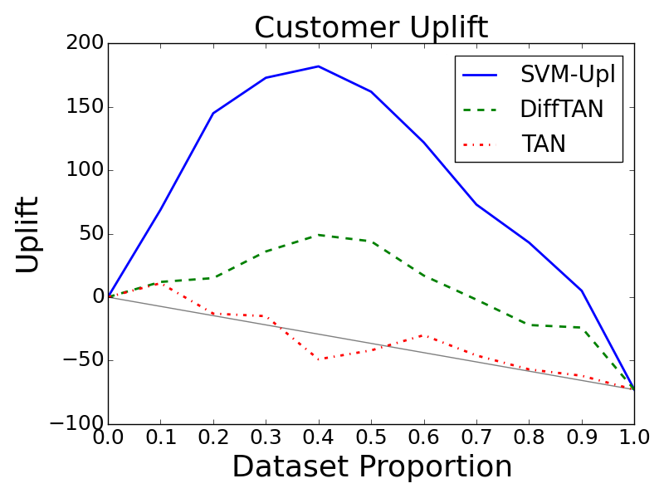
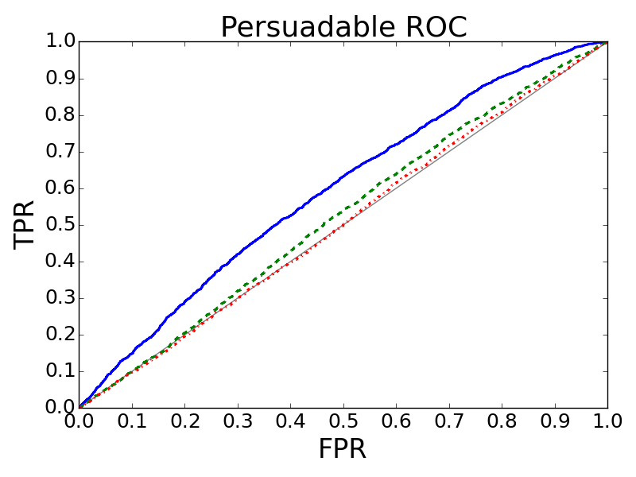

Uplift Bayesian Networks
Uplift TAN
$$I_{DIFF}\left(A;B | Class\right)=$$
$$I_{treat}\left(A;B | Class\right)−I_{control}(A;B|Class)$$

Slide 59
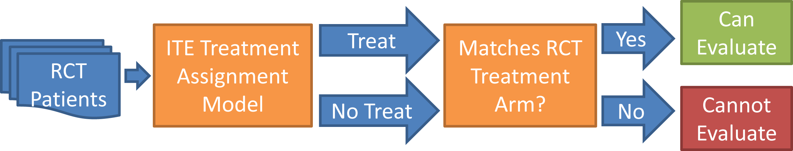
Net Benefit Maximization
Can evaluate treatment assignment model on RCT data (Vickers et al., 2007)
Could optimize for treatment assignment directly

Slide 60
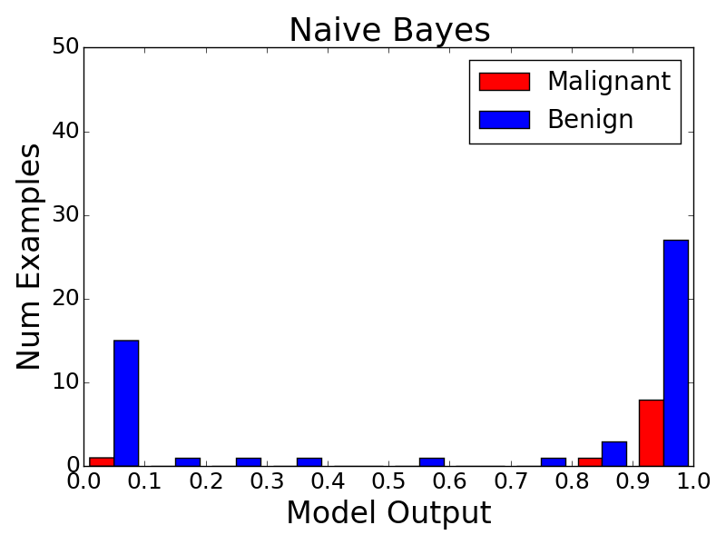
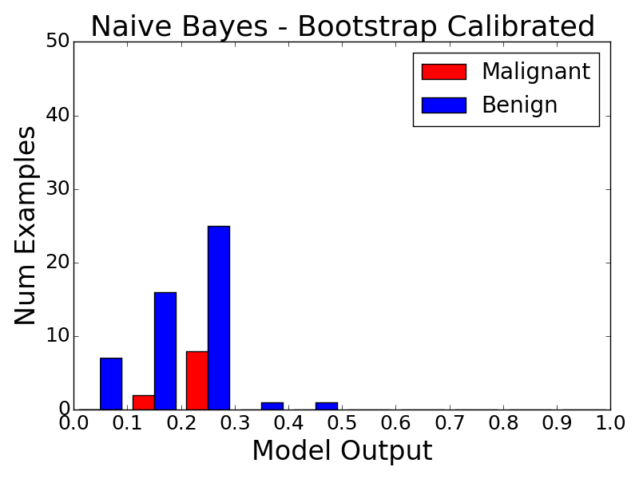
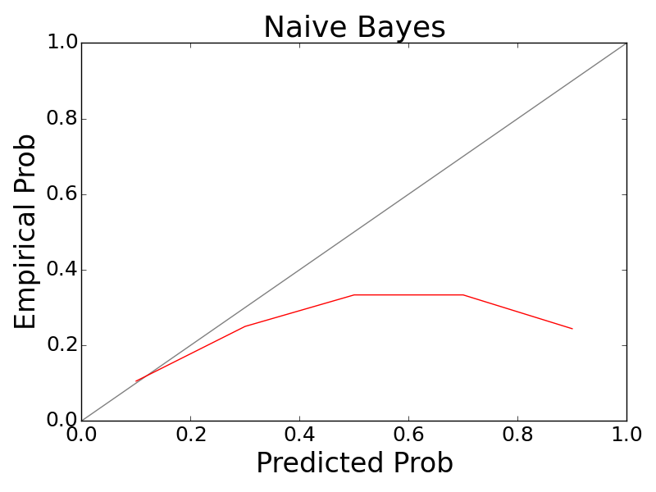
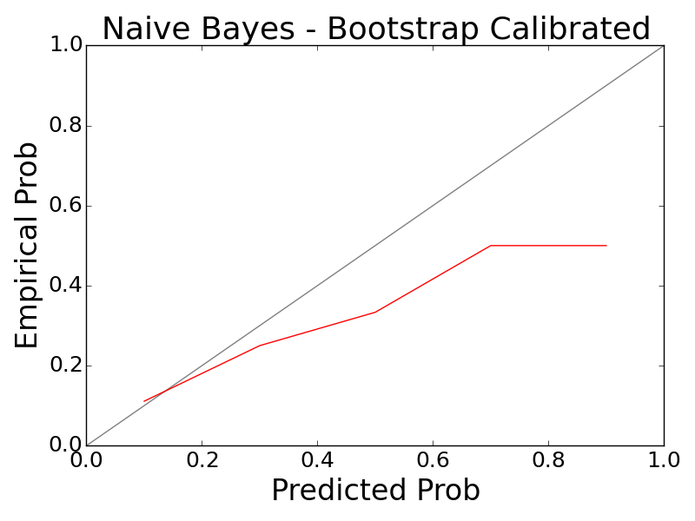
Model Calibration

Slide 61
Other Work

Slide 62
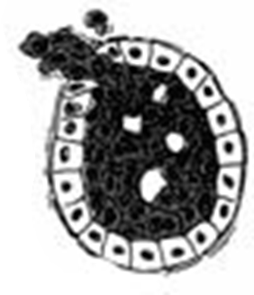
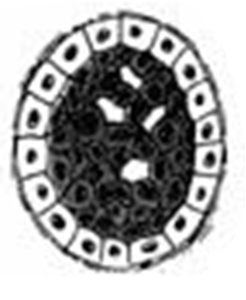
Breast Cancer States
In Situ
Earlier state
Cancer localized
Invasive
Later state
Cancer has invaded surrounding tissue

Slide 63
Breast Cancer Age Differences
Older
Cancer tends to progress less aggressively
Patient has less time for progression
Younger
Cancer tends to progress more aggressively
Patient has more time for progression

Slide 64
Uplift SVM Older In Situ Rules
10 = Clinically Interesting
1 = Clinically Counter-Intuitive
Rank | Feature | Older In Situ Correlation | Radiologist Assessment
1 | Linear Calc. Distribution Present | Positive | 10
2 | Spiculated Mass Margin Present | Negative | 10
3 | Palpable Lump Present | Positive | 3
4 | Irregular Mass Shape Present | Negative | 9-10
5 | No Family History | Negative | 8

Slide 65
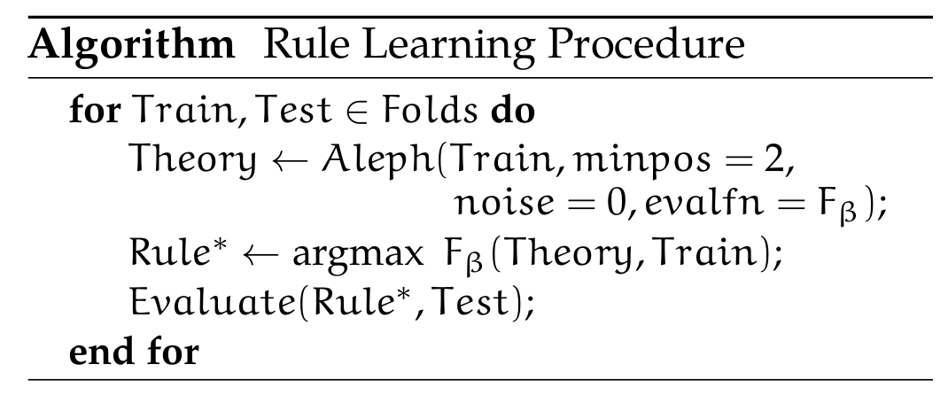
Upgrade Rules
Use F-score to learn precise rules to predict benign
non-definitive biopsies

Slide 66
Upgrade Rules
Benign Avoided | Malignant Missed
30 | 0
29 | 0
34 | 1
31 | 1
28 | 0
1 | The patient did not have a previous surgery, imaging did not present a spiculated mass margin, and the abnormality did not disappear in post-biopsy imaging
2 | Imaging did not present an indistinct mass margin, imaging did not present a spiculated mass margin, and the abnormality did not disappear in post-biopsy imaging
3 | Imaging did not present a spiculated mass margin, and the abnormality did not disappear in post-biopsy imaging
4 | Imaging did not present an indistinct mass margin, and the abnormality did not disappear in post-biopsy imaging
5 | The patient has no personal history of breast cancer, and the abnormality did not disappear in post-biopsy imaging

Slide 67
SAYL
Use ILP to induce feature set used by BN that maximizes uplift.

Slide 68
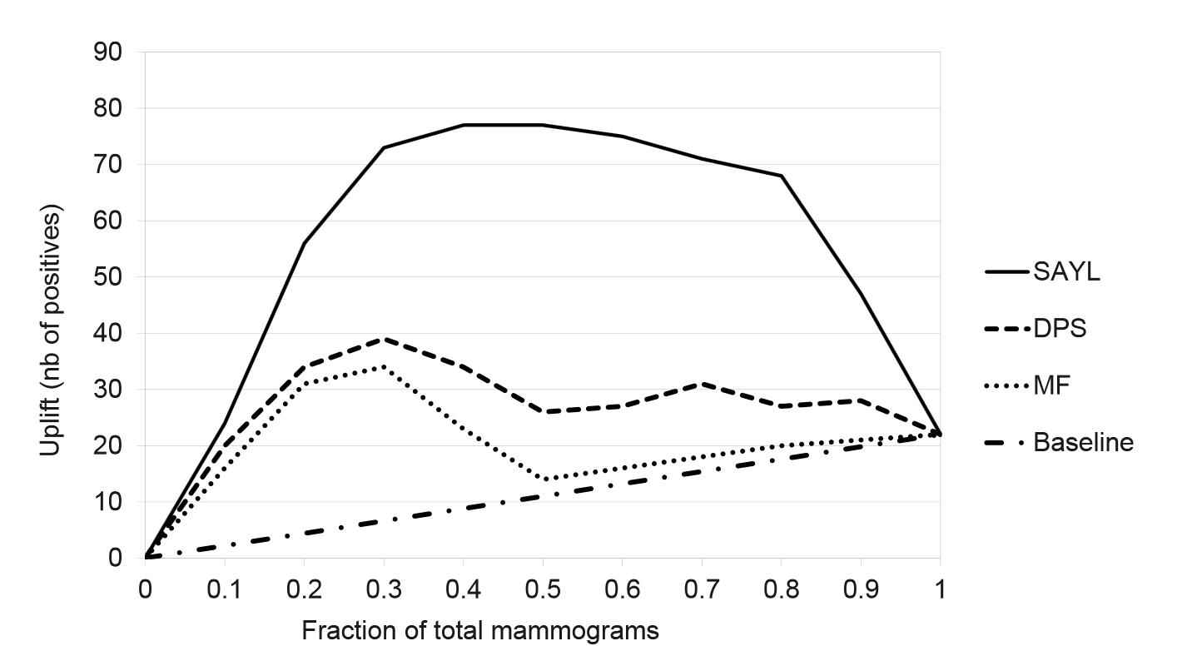
SAYL

Slide 69
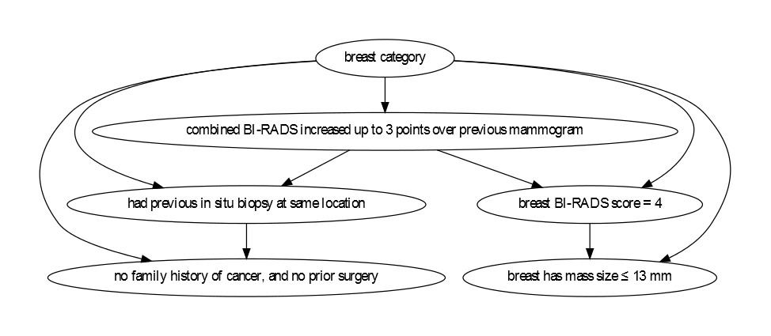
SAYL - Older Model

Slide 70
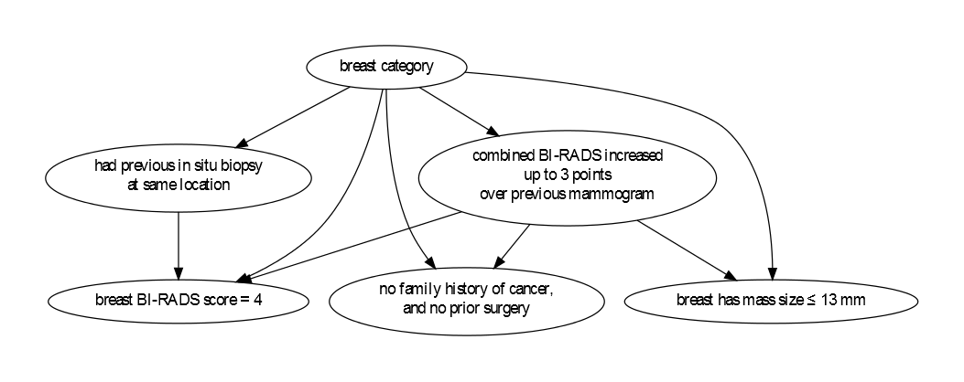
SAYL - Younger Model

Slide 71
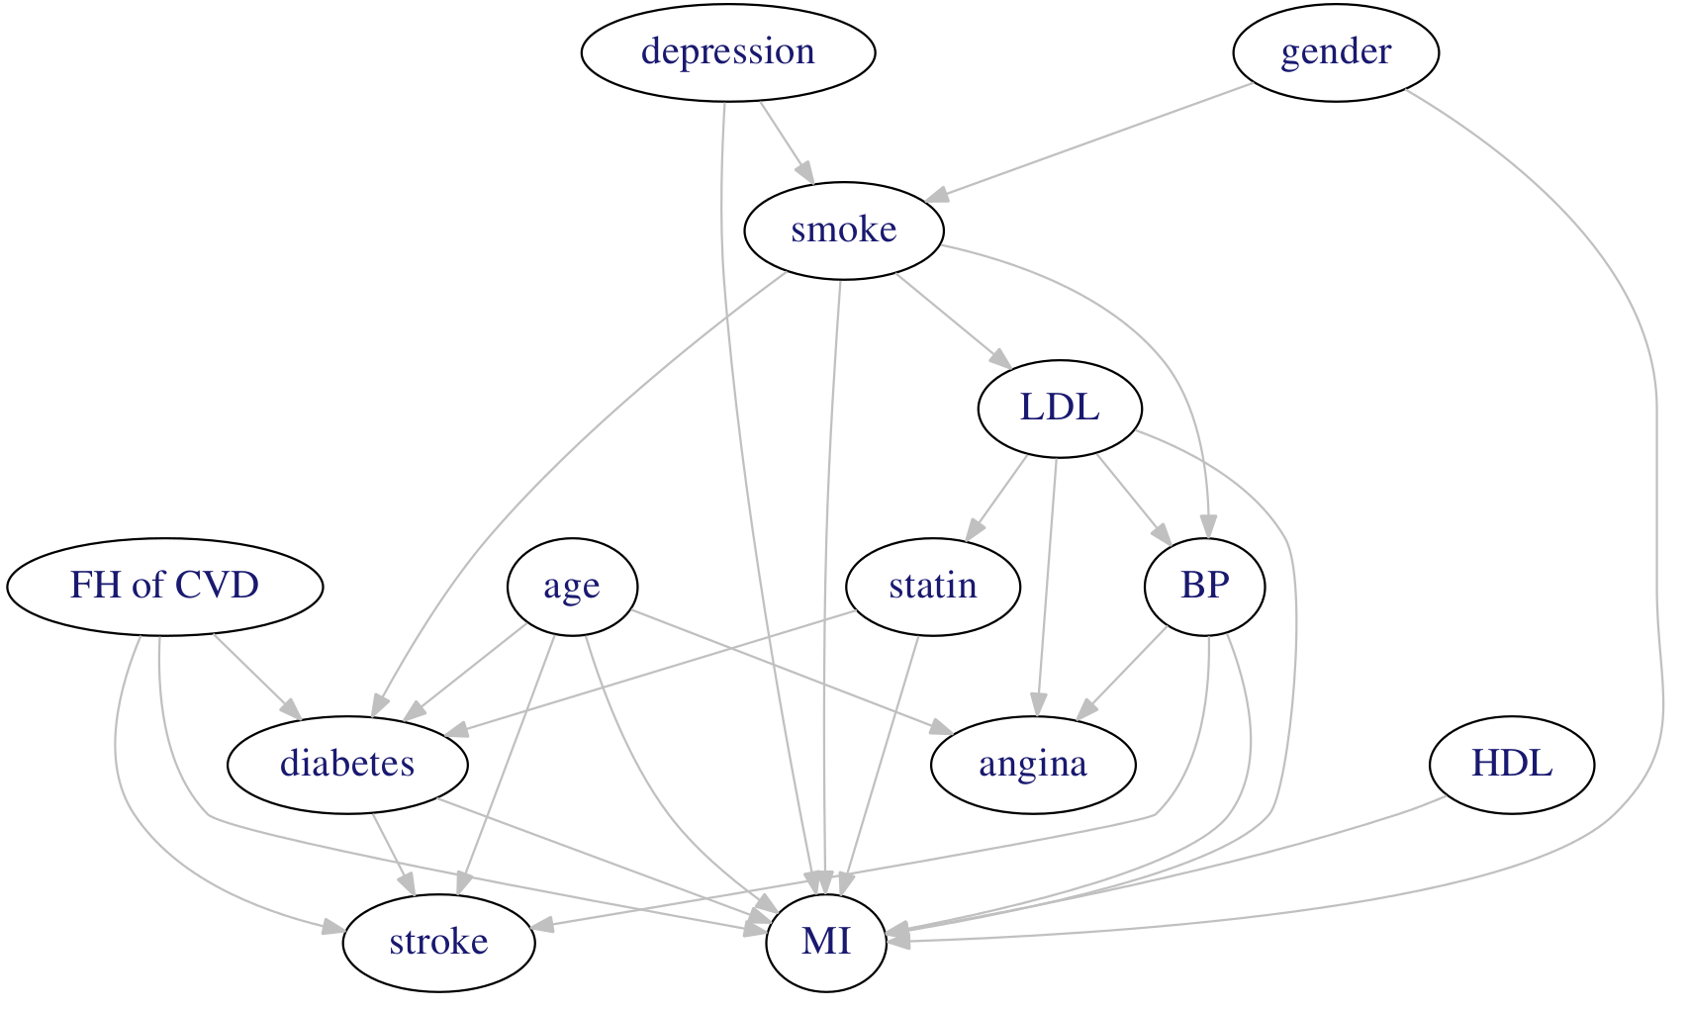
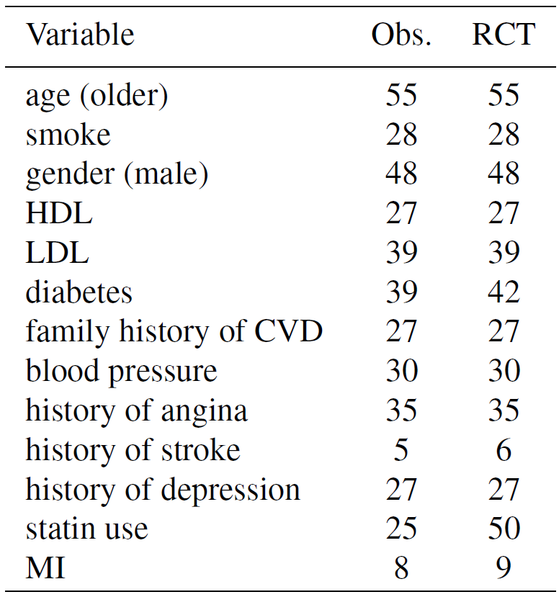
Individualized Treatment

Slide 72
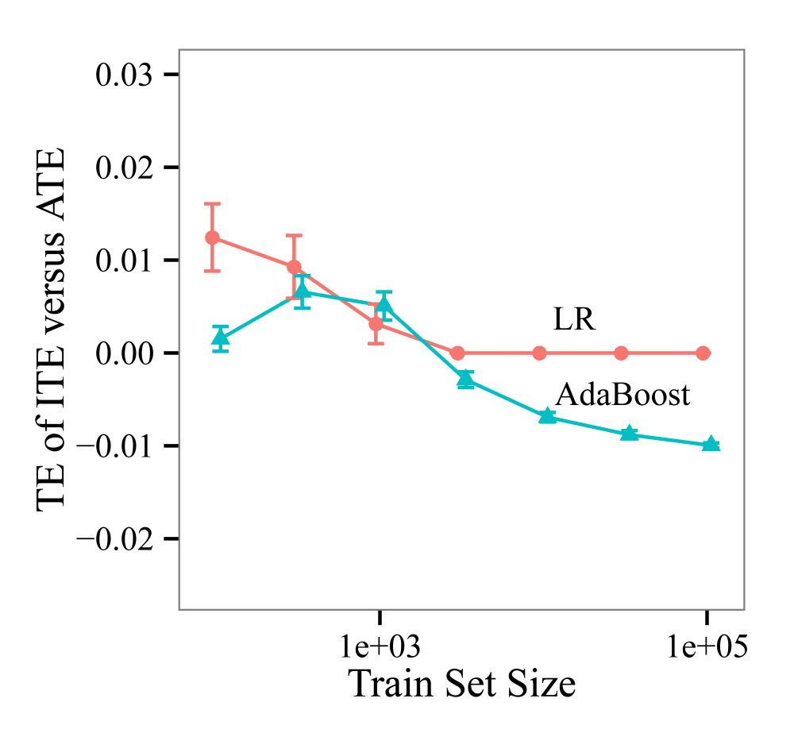
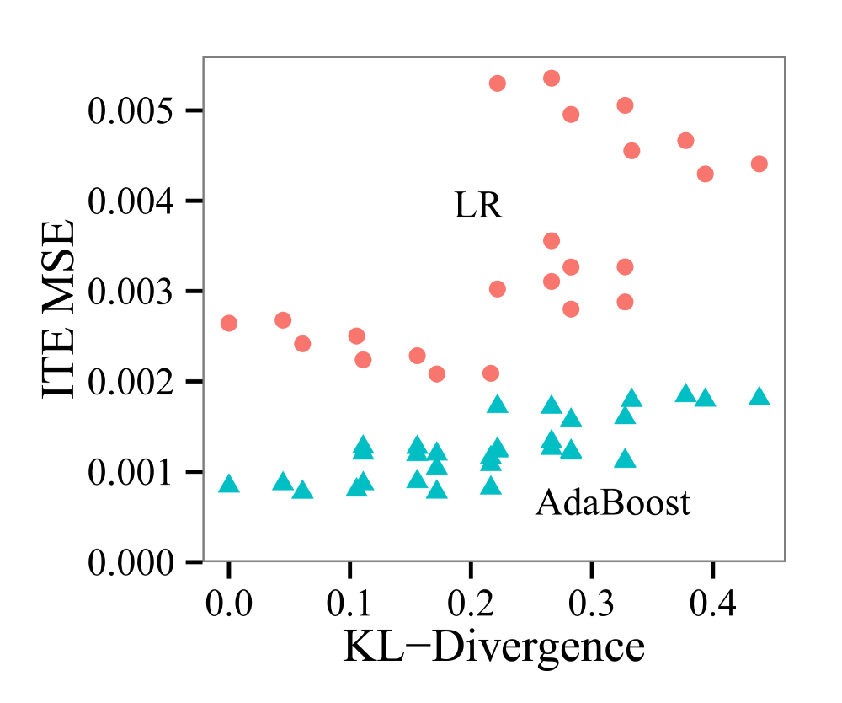
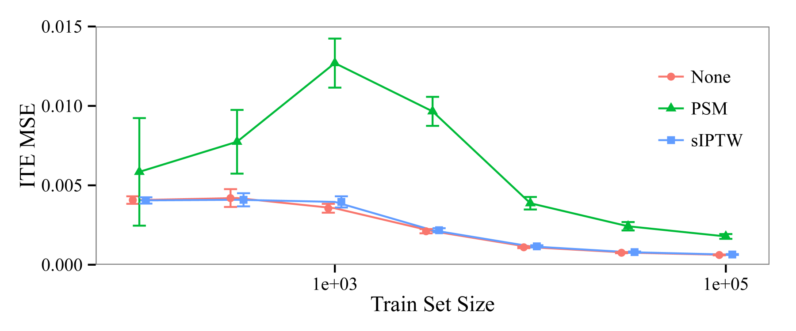
Individualized Treatment

