Slide 1



Boosting Markov Logic Networks
Tushar Khot
Joint work with Sriraam Natarajan, Kristian Kersting and Jude Shavlik

Slide 2

Sneak Peek
Present a method to learn structure and parameter for MLNs simultaneously
Use functional gradients to learn many
weakly predictive models
Use regression trees/clauses to fit
the functional gradients
Faster and more accurate results than
state-of-the-art structure learning methods
1.0 publication(A,P), publication(B, P) → advisedBy(A,B)
ψ_{m}
p(X)
n[p(X) ] > 0
q(X,Y)
W₃
n[q(X,Y) ] > 0
n[q(X,Y)] = 0
W₁
W₂
Notes:
In today’s talk I will present our approach to learn structure and parameters for Markov Logic Networks simultaneously.
I will talk about how we use FGB to learn multiple weak models.
I will also show how we use relational regression trees to fit the functional gradients.
Lastly, I will present our results that shows we are faster and more accurate than state-of-the-art

Slide 3

Outline
Background
Functional Gradient Boosting
Representations
  Regression Trees
  Regression Clauses
Experiments
Conclusions
Notes:
This is the general outline of my talk. I would present some background on FGB and MLNs before going on to explain how we apply FGB to MLNs.I will then talk about the two representations that we used, followed by the experiments and conclusions.

Slide 4
Traditional Machine Learning
Task: Predicting whether burglary occurred at the home
Burglary
Earthquake
B | E | A | M | J
1 | 0 | 1 | 1 | 0
0 | 0 | 0 | 0 | 1
. | . | .
0 | 1 | 1 | 0 | 1
Alarm
MaryCalls
JohnCalls
Features
Data
Notes:
Traditional machine learning uses a set of features and each example is assumed to be iid and can be represented as a fixed length feature vector. In this example, we have 5 features: whether a burglary occurred, if there was an earthquake in the city, whether the house alarm is ringing , whether your neighbor Mary or John called. A sample dataset corresponding to these features is shown on the right

Slide 5
Structure Learning
Parameter Learning
P(E)
0.1
P(B)
0.1
Burglary
Earthquake
 | P(A)
B E | 0.9
B ¬E | 0.5
¬B E | 0.4
¬B ¬E | 0.1
Alarm
 | P(M)
A | 0.7
¬ A | 0.2
MaryCalls
JohnCalls
 | P(J)
A | 0.9
¬A | 0.1
Notes:
Structure learning for a Bayesian Network would correspond to learning the parents of each feature. In this example, Alarm has B and E as parents and JohnC and MaryC has the same parent Alarm.
The weight learning task would correspond to learning the parameters on each node which corresponds to the CPD. For e.g. Alarm node has 4 parameters that corresponds to the probability of Alarm being true for all 4 configurations of the parents. So if Burglary has not occurred and Earthquake has occurred then the probability of Alarm ringing is 0.6

Slide 6
Real-World Datasets
Previous
Blood Tests
Patients
Previous
Rx
Previous Mammograms
Key challenge different amount of data for each patient
Notes:
But data in real world may not be so simple. Consider an EHR dataset where we have a list of patients. Each patient would have multiple test results and prescriptions. Also patients would have different number of tests performed as well as all tests wouldn’t be performed on all the patients. Hence it is non-trivial to convert this dataset into an iid dataset with fxd len f.v.

Slide 7
Inductive Logic Programming
ILP directly learns first-order rules from structured data
Searches over the space of possible rules
Key limitation
  The rules are evaluated to be true or false, i.e. deterministic
Notes:
Ind.. L.. Pro handles this problem by using first order logic to represent structured data. It learns FOL rules using a greedy search approach.
For e.g., the rule says that if a patient has a mass in two consecutive scans, then we should do a biopsy. But the issue with ILP is that the rules are deterministic ie they either evaluate to be true/false.

Slide 8
Logic + Probability =
Statistical Relational Learning Models
Logic
Add Probabilities
Statistical Relational Learning (SRL)
Probabilities
Add Relations
Notes:
One way to resolve this issue, is by adding probabilities to FOL ie we can think about each rule that is learnt is true with some probability. This would give us Stat. Rel Lear model
Or we could imagine adding first order logic or relns to probabilistic models.

Slide 9
Markov Logic Networks
Weighted logic
Structure
Weights
Weight of formula i
Number of true groundings of formula i in worldState
Friends(A,B)
Friends(A,B)
Smokes(A)
Friends(A,A)
Smokes(A)
Friends(A,A)
Smokes(B)
Smokes(B)
Friends(B,B)
Friends(B,B)
Friends(B,A)
Friends(B,A)
(Richardson & Domingos, MLJ 2005)
Notes:
Popular SRL model – Mar Lo Ne
MLN contains wted fol rules
Explain example
Rules corr to struct
Parameters corr to wt
Prob of world state in mln calculated using formula here. Z is norm term
To compute ni, we generally grnd the mln to mn. Consider only 2nd rule with two consts A & B. ground mn is shown here. A world state is shown, red – false, green-true. In this state, 3 true gndgs and 1 false gndg. So ni=3

Slide 10

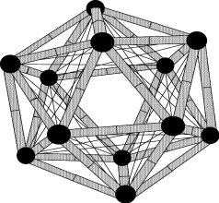
Learning MLNs – Prior Approaches
Weight learning
  Requires hand-written MLN rules
  Uses gradient descent
  Needs to ground the Markov network
  Hence can be very slow
Structure learning
  Harder problem
  Needs to search space of possible clauses
  Each new clause requires weight-learning step

Slide 11
Motivation for Boosting MLNs
True model may have a complex structure
  Hard to capture using a handful of highly accurate rules
Our approach
  Use many weakly predictive rules
  Learn structure and parameters simultaneously
Notes:
Hard to obtain complex model from expert and do wt learning or capture using long accurate rules

Slide 12
Problem Statement
Given Training Data
  First Order Logic facts
  Ground target predicates
Learn weighted rules for target predicates
student(Alice)
professor(Bob)
publication(Alice, Paper157)
advisedBy(Alice,Bob)
1.2 | publication(A,P), publication(B, P) → advisedBy(A,B)
. . .

Slide 13
Outline
Background
Functional Gradient Boosting
Representations
  Regression Trees
  Regression Clauses
Experiments
Conclusions

Slide 14
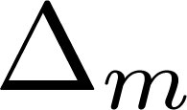


Functional Gradient Boosting
Model = weighted combination of a large number of simple functions
ψ_{m}
Data
=
Gradients
Induce
Initial Model
vs
Predictions
+
Iterate
+
+
+
+
+
Final Model =
…
Notes:
Take an init model. It could be expert advice or just prior. Use predictions to compute gradient or residues. Learn a regression function to fit the residues. Update model. Sum of all reg func gives the final model.

Slide 15
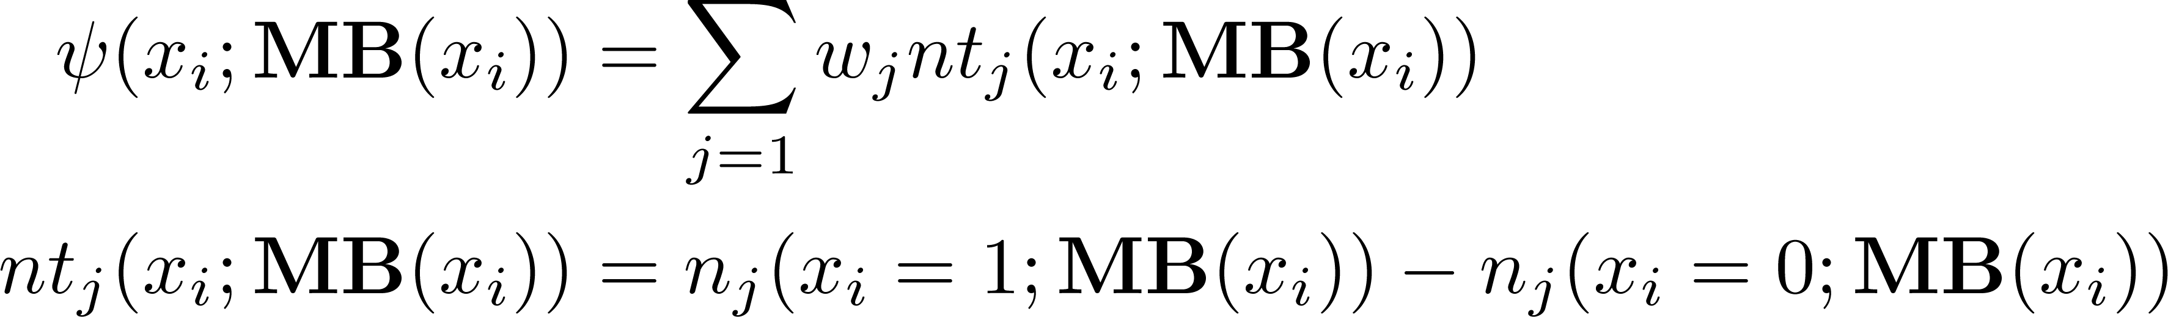
Function Definition for Boosting MLNs
Probability of an example
We define the function ψ as
nt_{j} corresponds to non-trivial groundings of clause C_{j}
Using non-trivial groundings allows us to avoid unnecessary computation
Notes:
In this work we derived the fg for mlns. Consider prob of eg given mb. Mb of an example corresponds to all the nbrs of the example in ground mn. For .e.g the green nodes is the mb of purple node.
We define function corresponding to the functional grad as shown here. We use non-trival instead of num grnds in our function. This avoids unnecessary computation and allows efficient learning of the mln struct.

Slide 16
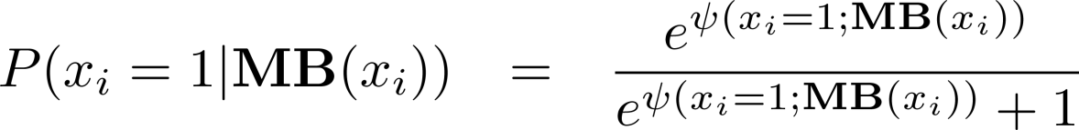
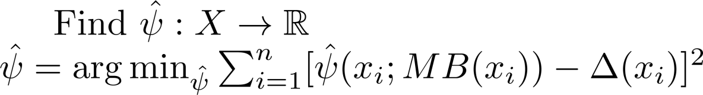
Functional Gradients in MLN
Probability of example x_{i}
Gradient at example x_{i}
Notes:
Given the def of the function, prob of example is a sigmoid over the function. Smlr to prevv fgb methods, our grad corresponds to difference between observed label and computed probability. +ve eg with curr prob as 0.1 would have gradient of 0.9 whereas neg example would have grad of -0.1
So we want to learn a reg function that min least square error .

Slide 17
Outline
Background
Functional Gradient Boosting
Representations
  Regression Trees
  Regression Clauses
Experiments
Conclusions
Notes:
We use two representations for reg func – tree and clauses

Slide 18
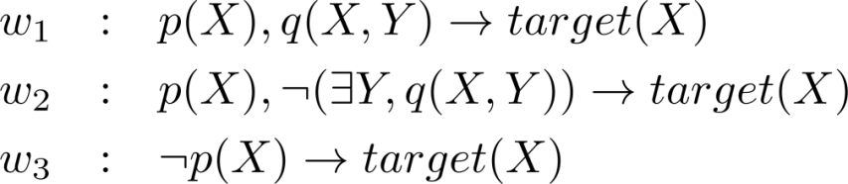
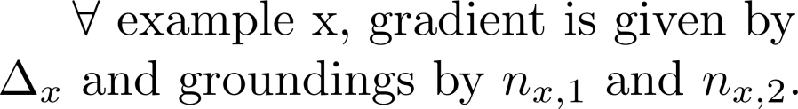


Learning Trees for Target(X)
p(X)
Learning Clauses
n[p(X) ] > 0
n[p(X)] = 0
q(X,Y)
Same as squared error for trees
Force weight on false branches (W_{3 ,}W₂)
to be 0
Hence no existential vars needed
W₃
n[q(X,Y)] > 0
n[q(X,Y)] = 0
W₁
W₂
Closed-form solution for weights given residues (see paper)
False branch sometimes introduces existential variables
I
J
Notes:
Explain tree
Root
split based on num of gndgs or condition on node
wt w3 is fixed
evaluating q(x,y), y is exist variable
split node based on existence chk
- wt have closed form soln. so easy to evaluate. Greedy search like dec tree.
Mln corr to tree
- exist var → slow inference
so learn one clauses. Force wts=0 on false .0 wt clause has no impact As shown here no exist vars

Slide 19
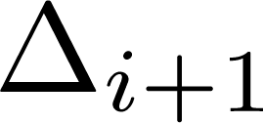


Jointly Learning Multiple Target Predicates
targetX
targetY
Data
targetX
=
Gradients
Induce
vs
Predictions
F_{i}
Approximate MLNs as a set of conditional models
  Extends our prior work on RDNs (ILP’10, MLJ’11) to MLNs
  Similar approach by Lowd & Davis (ICDM’10) for propositional Markov Networks
    Represent every MN conditional potentials with a single tree
Notes:
What if we have more than one target pred. use prev models to compute predictions. But still learn one tree at a time.
Extend our work on learning rdns in ilp and extend work by lowd & davis later that yr on mn to relational setting.

Slide 20
Boosting MLNs
For each gradient step
m=1 to M
For each query predicate, P
For each example, x
Generate trainset using
previous model, F_{m-1}
Compute gradient for x
Learn a regression function,
T_{m,p}
Add <x, gradient(x)> to trainset
Add T_{m,p} to the model, F_{m}
Learn Horn clauses with P(X) as head
Set F_{m} as current model
Notes:
Algo

Slide 21
Agenda
Background
Functional Gradient Boosting
Representations
  Regression Trees
  Regression Clauses
Experiments
Conclusions

Slide 22

Experiments
Approaches
  MLN-BT
  MLN-BC
  Alch-D
  LHL
  BUSL
  Motif
Datasets
  UW-CSE
  IMDB
  Cora
  WebKB
  Boosted Trees
  Boosted Clauses
  Discriminative Weight Learning (Singla’05)
Learning via Hypergraph Lifting (Kok’09)
  Bottom-up Structure Learning (Mihalkova’07)
  Structural Motif (Kok’10)

Slide 23
Results – UW-CSE
Predict advisedBy relation
  Given student, professor, courseTA, courseProf, etc relations
5-fold cross validation
Exact inference since only single target predicate
advisedBy | AUC-PR | CLL | Time
MLN-BT | 0.94 ± 0.06 | -0.52 ± 0.45 | 18.4 sec
MLN-BC | 0.95 ± 0.05 | -0.30 ± 0.06 | 33.3 sec
Alch-D | 0.31 ± 0.10 | -3.90 ± 0.41 | 7.1 hrs
Motif | 0.43 ± 0.03 | -3.23 ± 0.78 | 1.8 hrs
LHL | 0.42 ± 0.10 | -2.94 ± 0.31 | 37.2 sec
Notes:
Explain AUC-PR & CLL. Compare learning time.

Slide 24
Results – Cora
Task: Entity Resolution
Predict: SameBib, SameVenue, SameTitle, SameAuthor
  Given: HasWordAuthor, HasWordTitle, HasWordVenue
Joint model considered for all predicates
Notes:
Explain Y axis. Pt to our approach. SameBib much better and sameauthor not very different.

Slide 25

Future Work
Maximize the log-likelihood instead of
pseudo log-likelihood
Learn in presence of missing data
Improve the human-readability of the learned MLNs
Notes:
Increase space between pts

Slide 26
Conclusion
Presented a method to learn structure and parameter for MLNs simultaneously
  FGB makes it possible to learn many effective short rules
  Used two representation of the gradients
Efficiently learn order-of-magnitude more rules
Superior test set performance vs. state-of-the-art
MLN structure-learning techniques

Slide 27

Thanks
Supported By
DARPA
Fraunhofer ATTRACT fellowship STREAM
European Commission

Slide 28
Non-trivial Groundings
Consider p(X), q(X,Y) → target(X)
  ¬p(X) v ¬ q(X, Y) v target(X)
Trivial true groundings for target(c)
  When p(c) is false
  When q(c, Y) is false
So non-trivial groundings for x_{i} = target(c)
#true groundings[p(c) ∧ q(c,Y)]
Hence non-trivial groundings are the true groundings of body of the clause
Notes:
Use \not and capitalize titles

Slide 29

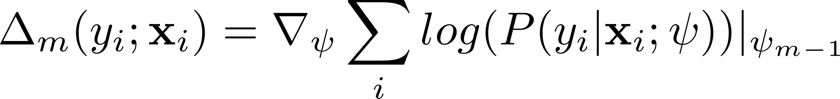
Functional Gradient Boosting
Gradient descent as a sum of gradients over the parameters, θ
Now instead use functional gradient at each example
+
+
+
+
…
J.H. Friedman. Greedy function approximation: A gradient boosting machine.

Slide 30
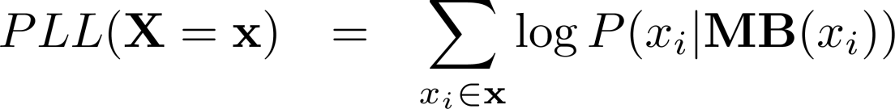
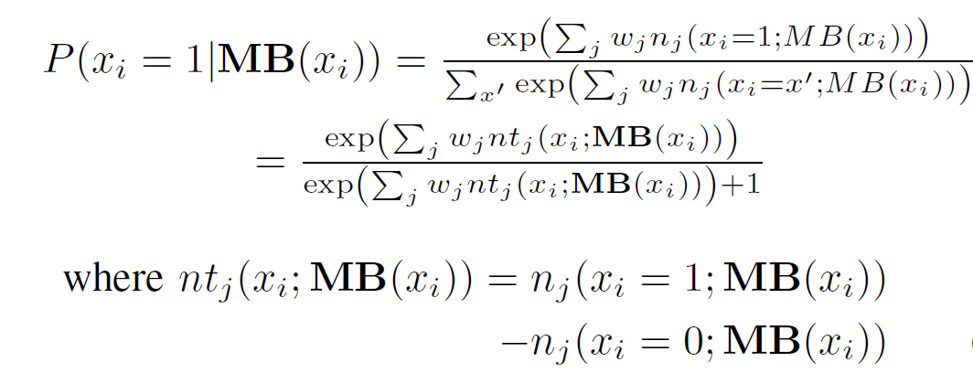
Function Definition for Boosting MLNs
We maximize the pseudo log-likelihood
Probability of every example
Non-trivial groundings

