Slide 1
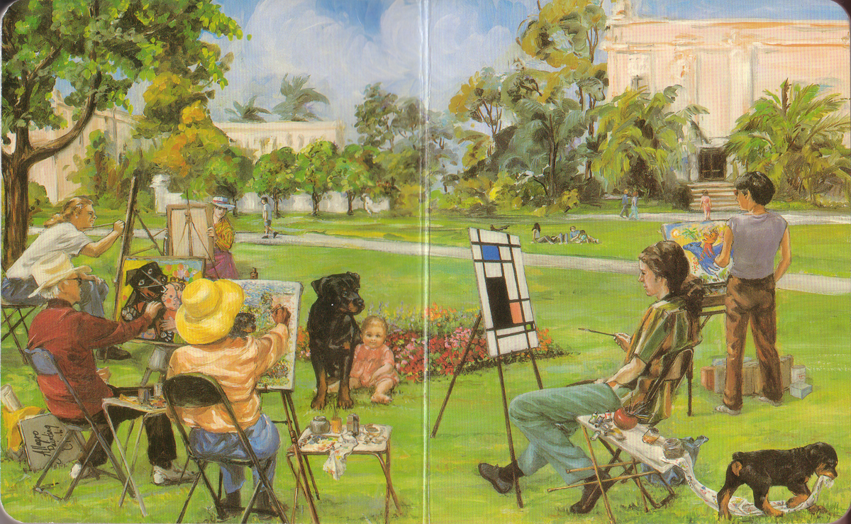
Carl’s afternoon in the Park, by Alexandra Day

Slide 2
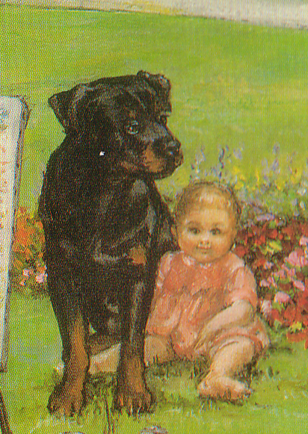
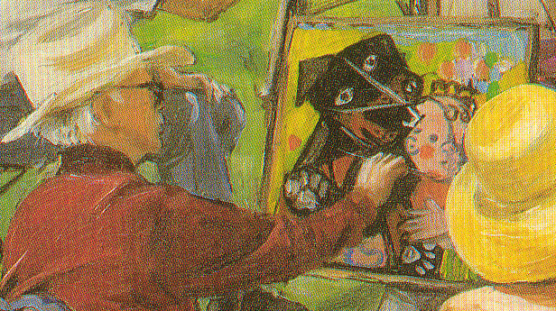
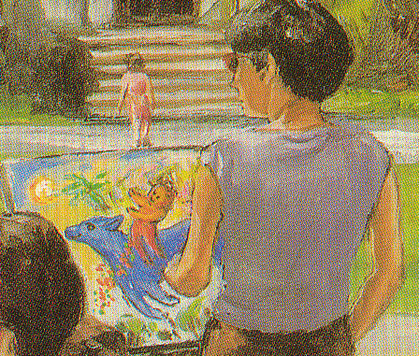
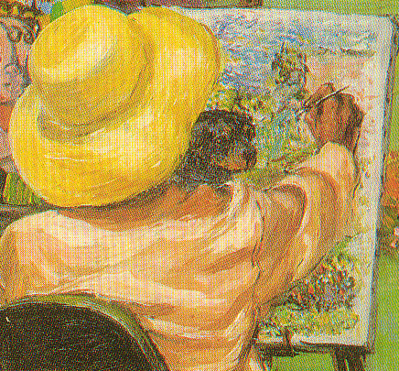
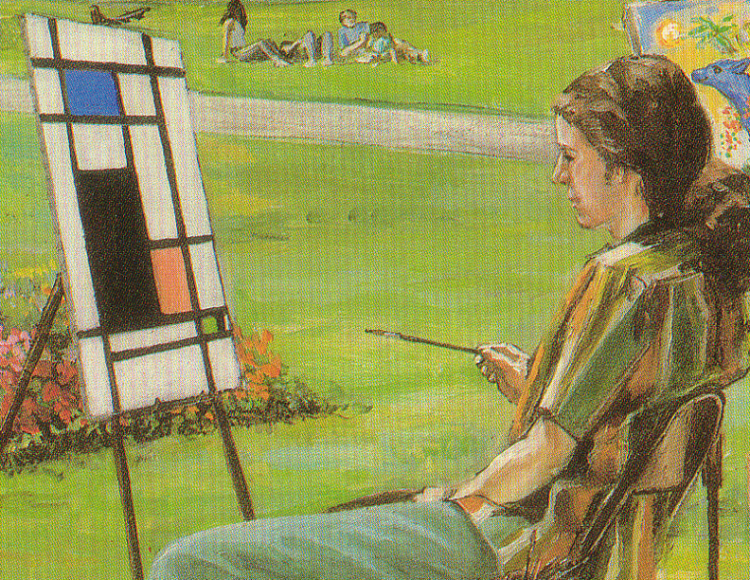

Slide 3
What does art do?
Create impossible things
Show things in a different light
Make clearer
Make subtle
Add mood, style
Tell a story
Abstract
Exagerate
Emphasize
Ellaborate
Alter
Stylize
Interpret
Portray in a medium
…..

