Slide 1
Some Art and Art History

Slide 2
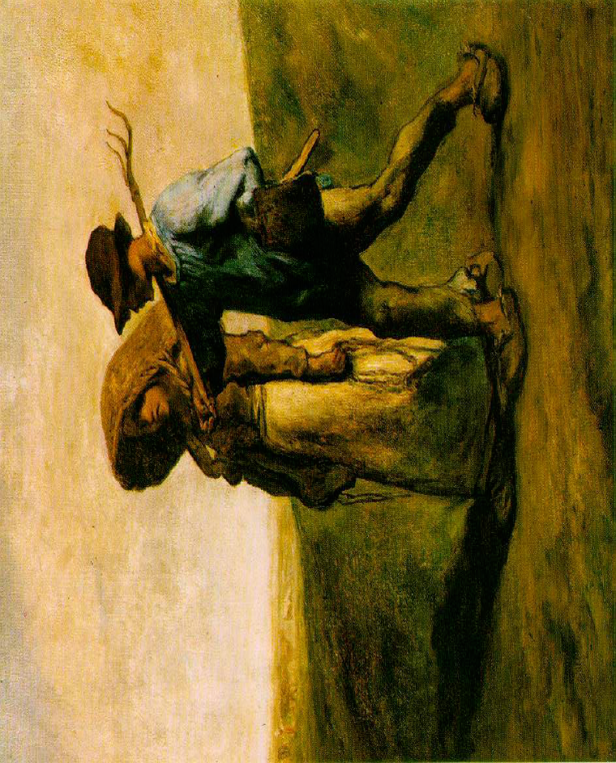
“Realism”
1830s – 1870s
With Realism, nature and life was for the first time depicted in an honest and unsentimental way. …This was a major stepping stone into the world of modern art.
Millet, Jean-François
The Walk to Work (Le Depart pour le Travail) 1851

Slide 3
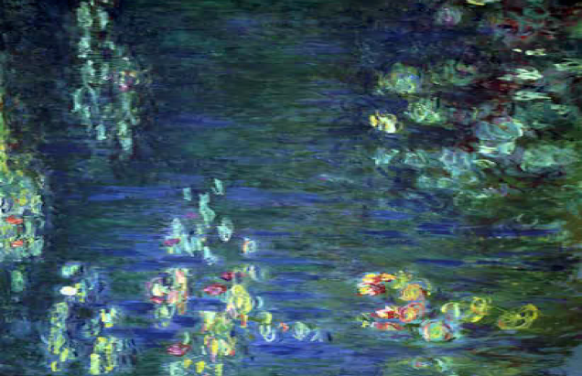
Impressionism
Claude Monet – Water Lillies

Slide 4
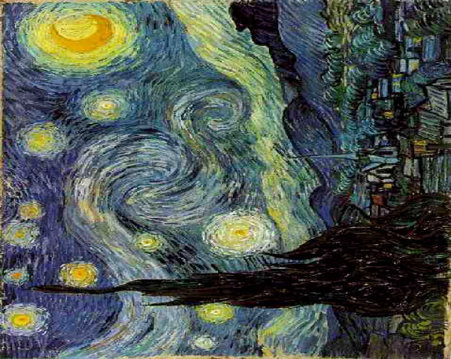
Post-Impressionism

Slide 5
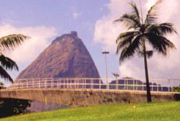
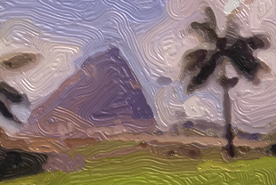
Aaron Hertzmann,
Stroke-Based Rendering

Slide 6
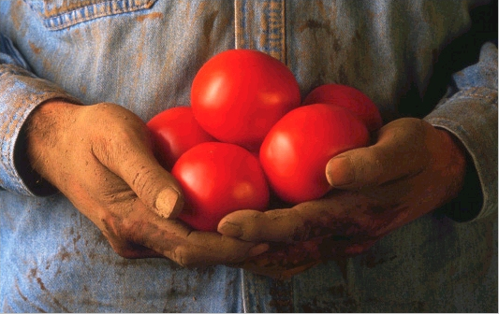
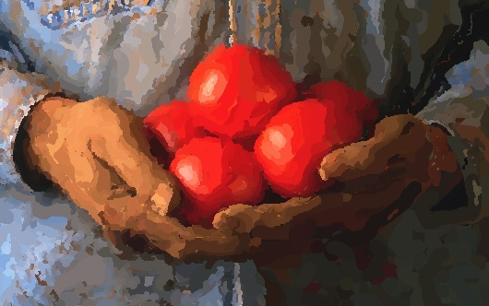

Slide 7
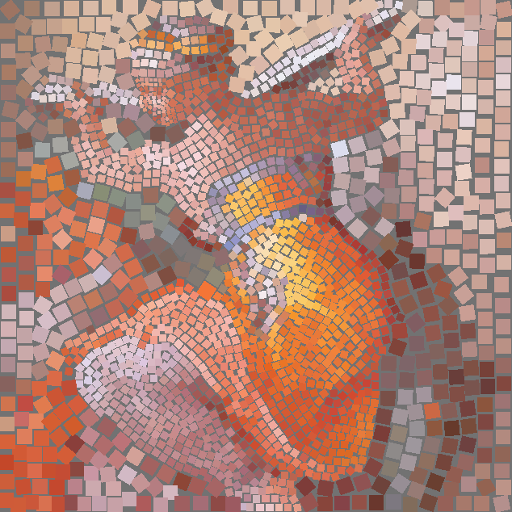

Slide 8
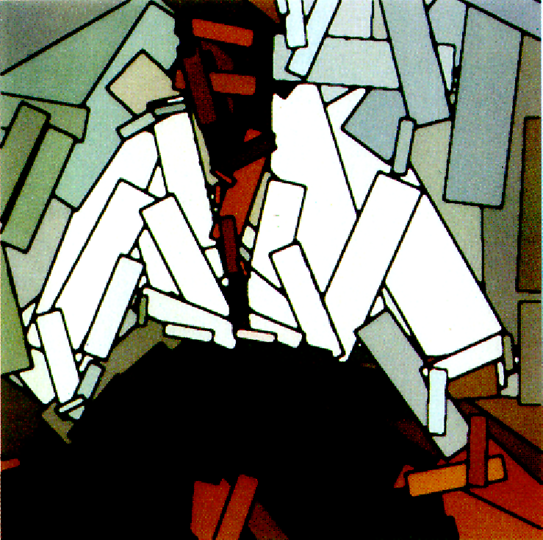

Slide 10
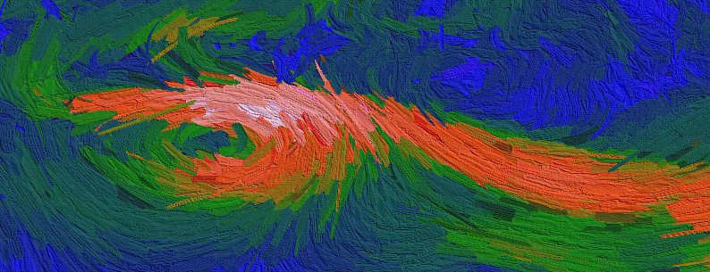
Engaging Viewers Through Nonphotorealistic Visualizations,
Tateosian, Healy, Enns

Slide 11
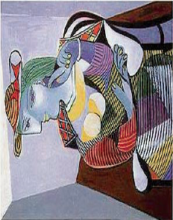
Cubism
Picasso was once accosted on a train by a stranger who recognized him. The stranger complained: Why couldn't he draw pictures of people the way they actually were? Why did he have to distort the way people looked? Picasso then asked the man to show him pictures of his family. After gazing at the snapshot, Picasso, replied, "Oh, is your wife really that small and flat?“

Slide 12
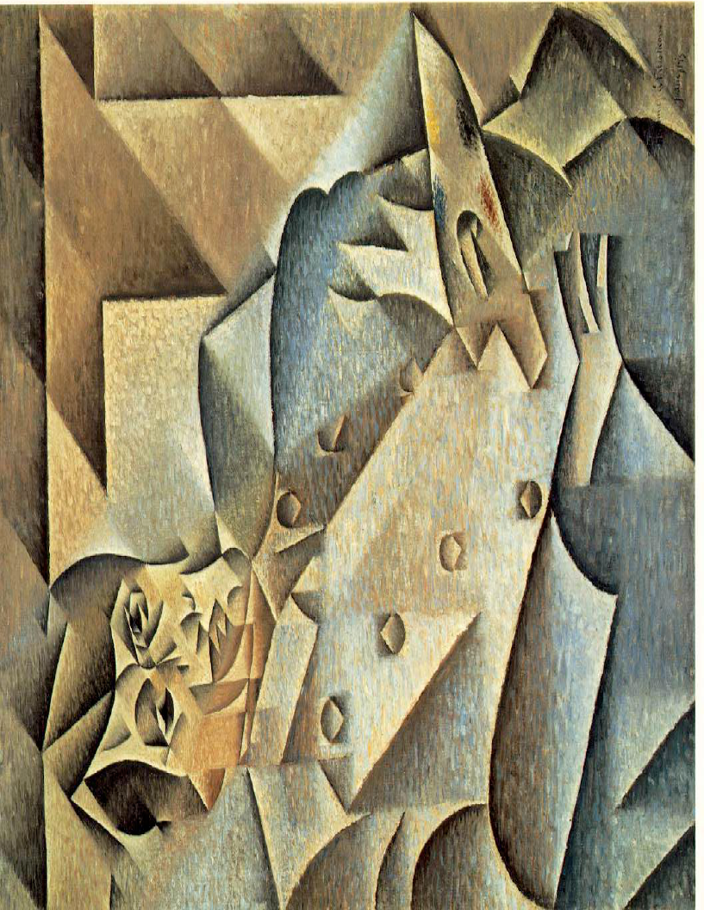
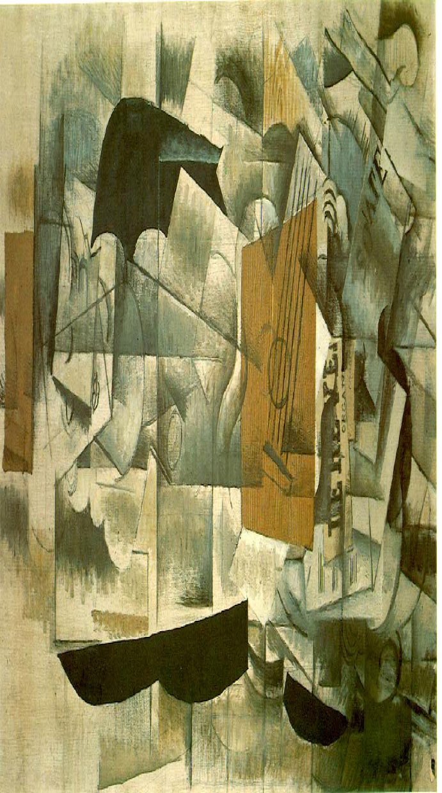

Slide 13
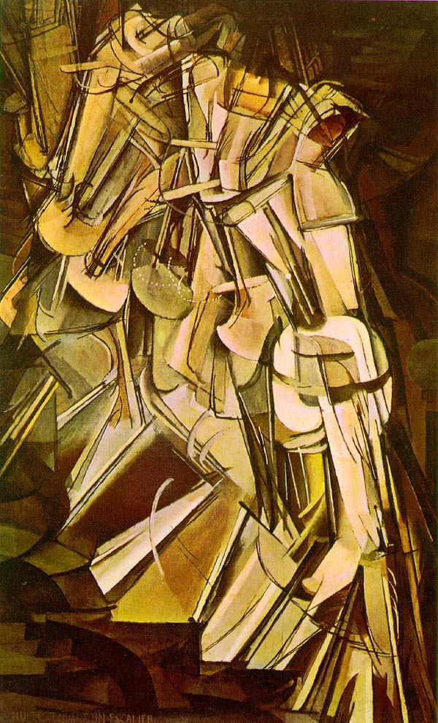

Slide 14
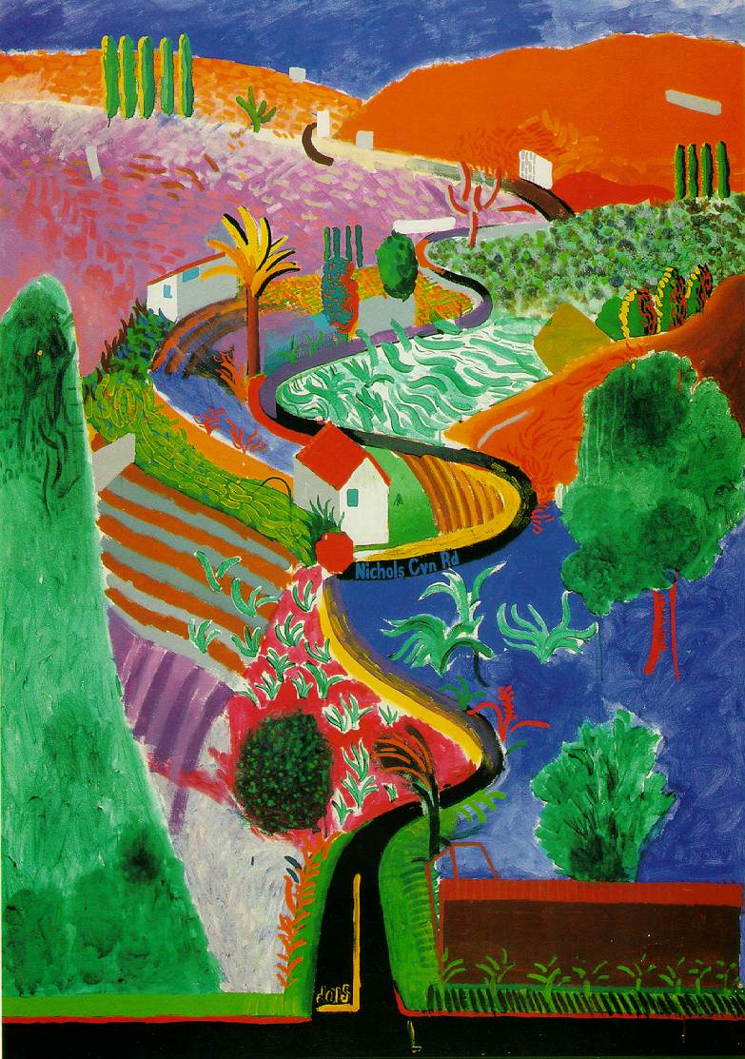

Slide 15
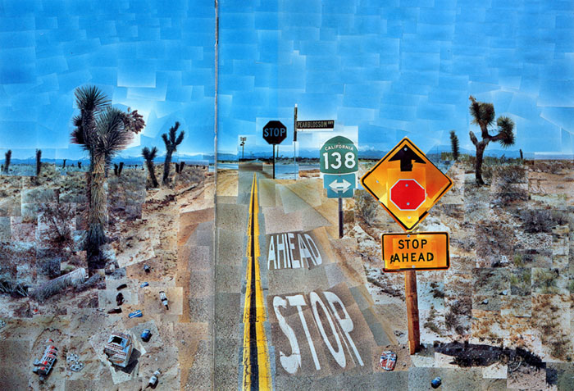

Slide 16
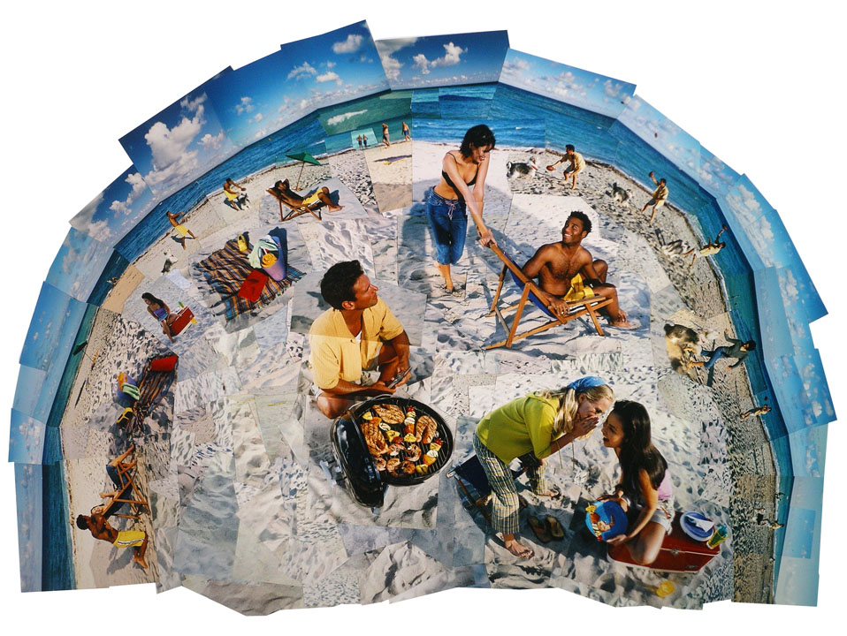

Slide 17
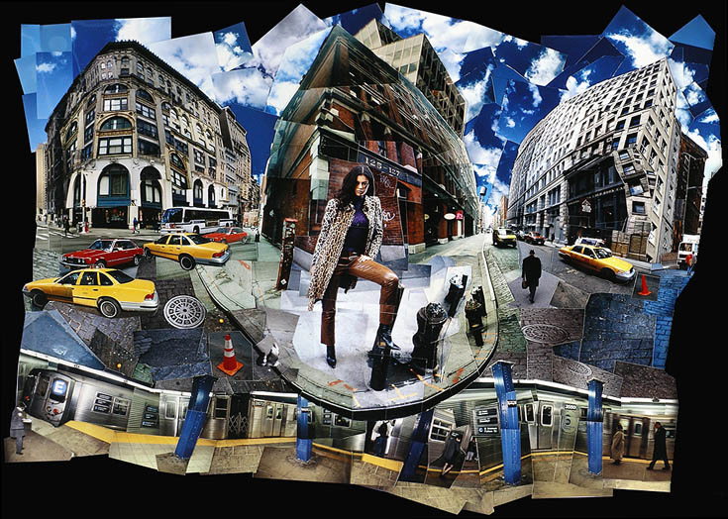

Slide 18
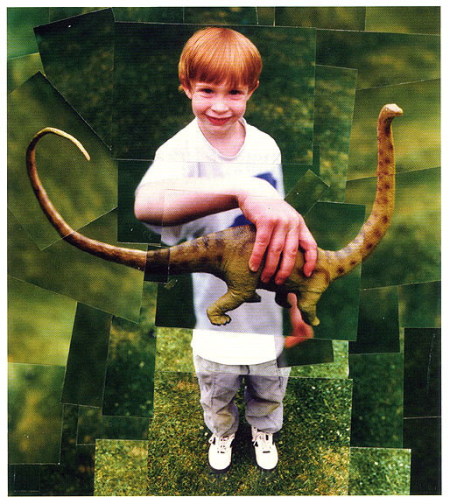

Slide 19
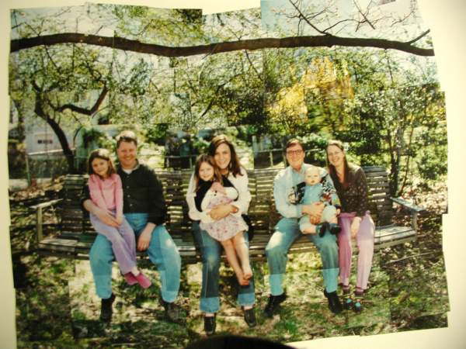

Slide 20
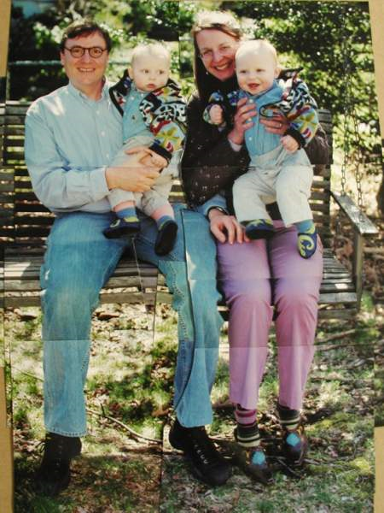

Slide 21
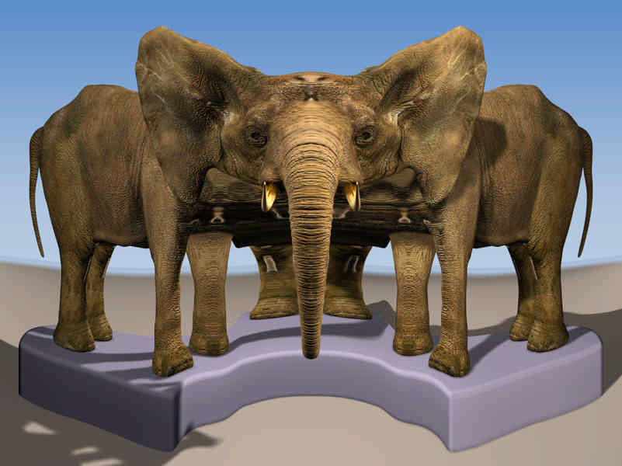
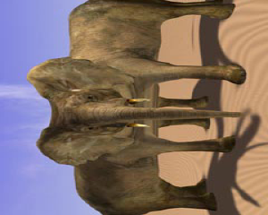
Paul Rademacher and Gary Bishop
Multiple-Center-of-Projection Images
SIGGRAPH 98

Slide 22
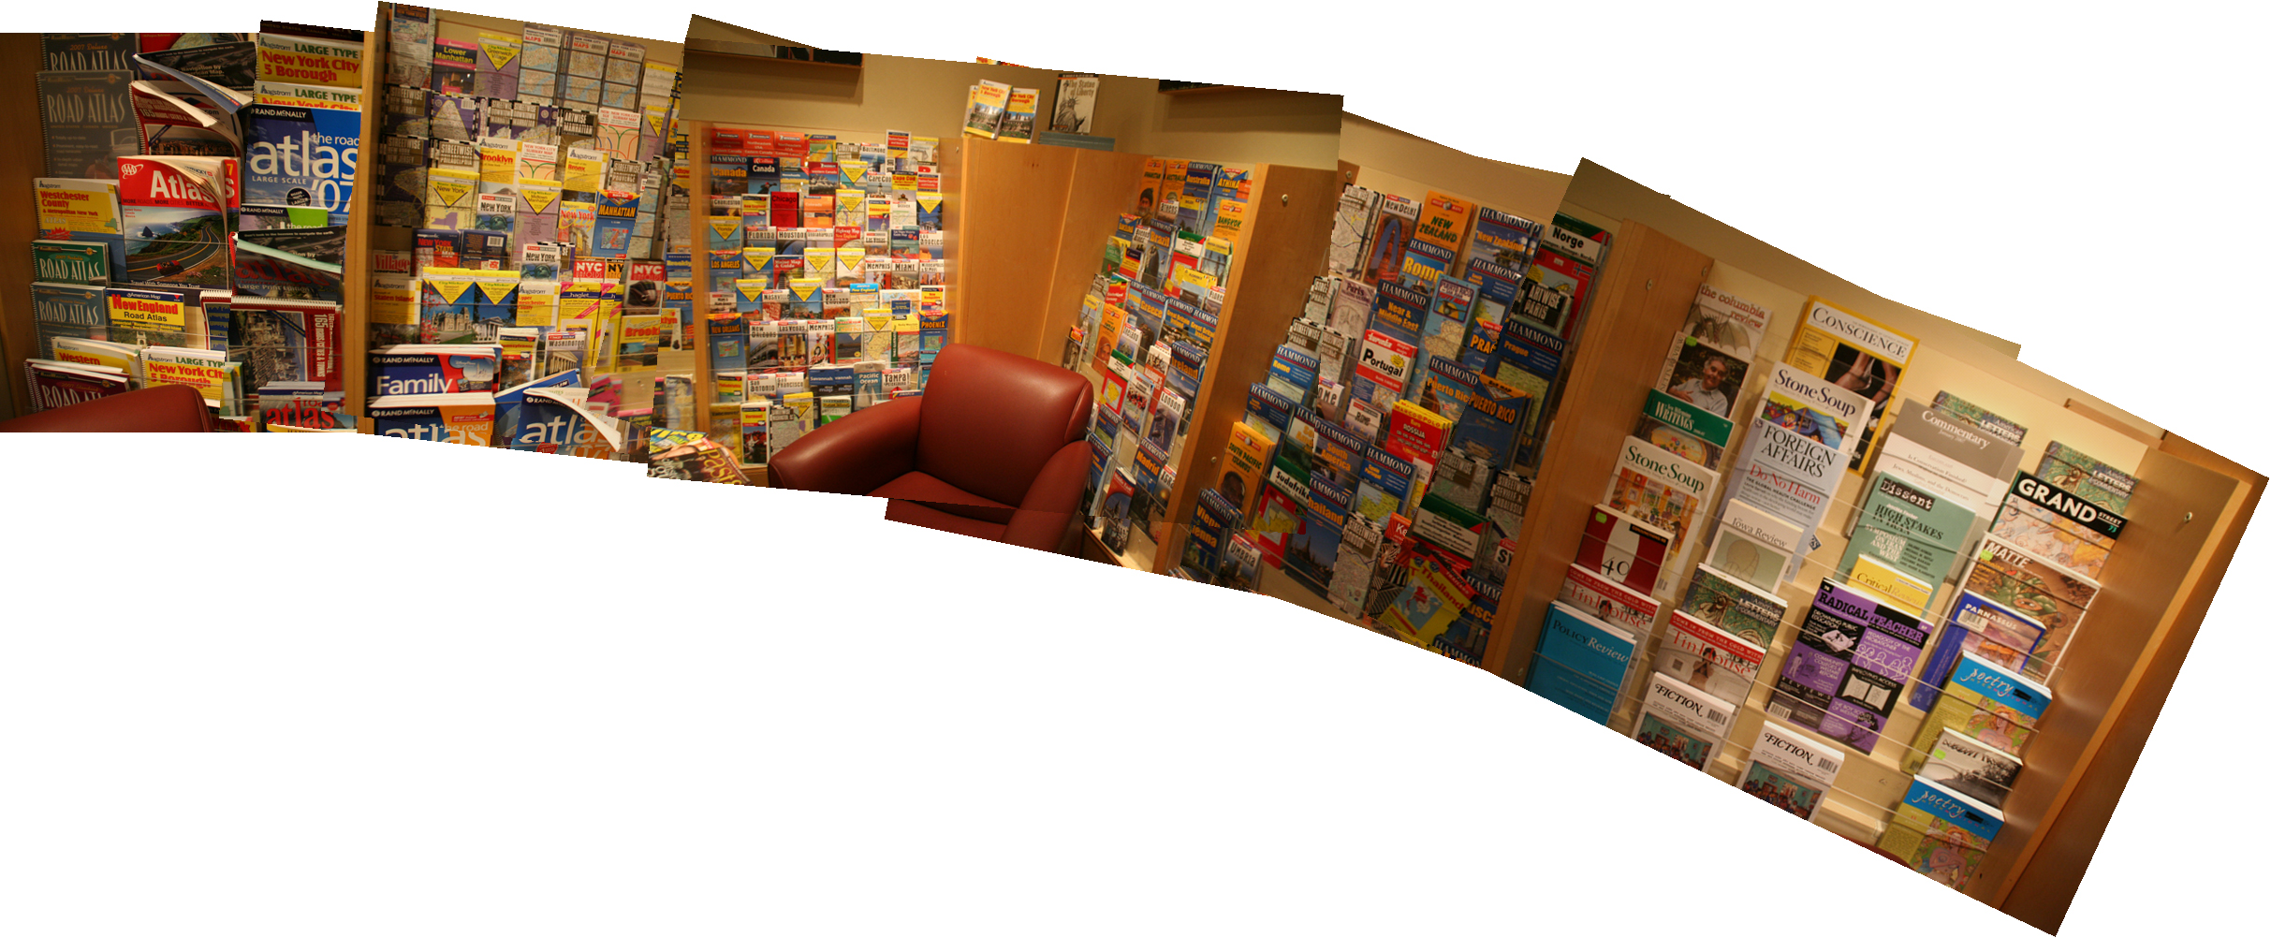
"Scene Collages and Flexible Camera Arrays," Y. Nomura, L. Zhang and S.K. Nayar

Slide 23
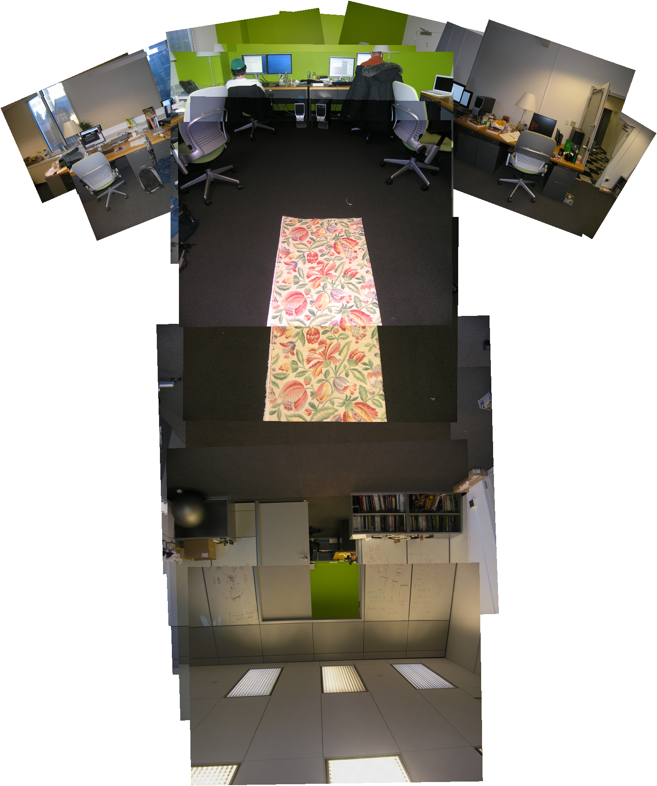

Slide 24
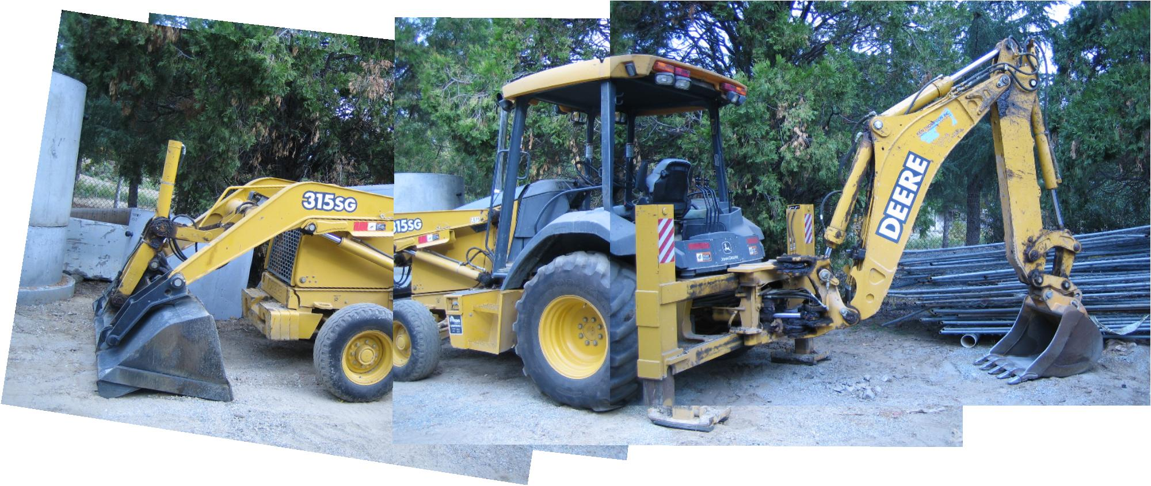
Automating Joiners - L. Zelnik-Manor and P. Perona, NPAR ‘07

Slide 25
Automatic Multiperspective Images, Roman&Lensch, EGSR 2006
Photographing Long Scenes with Multi-Viewpoint Panoramas
Agarwala et al.

Slide 26
GL-Hijacking

Slide 28
Pencil-Sketch Light Saber Fight?

Slide 29
Not too bad for real-time…

Slide 30
There’s no accounting for taste…
The Jedi-Outcast folks did this, not us!

Slide 31
Is this less painful in pencil sketch?

Slide 32
Draw it your own way…
Quake 3 Arena
Before
After
(still approx 30fps!)

Slide 33
Or write it to disk… Print Screen to Maya!
Note view culling issues

Slide 34
Useful NPR

Slide 36
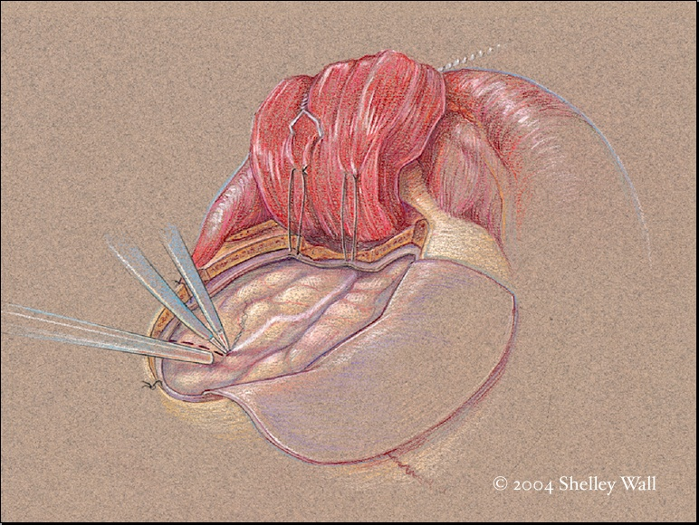
“Visually-Oriented Knowledge Media Design in Medicine”
Nick Woolridge and Jodie Jenkinson
Biomedical Communications, University of Toronto

Slide 37
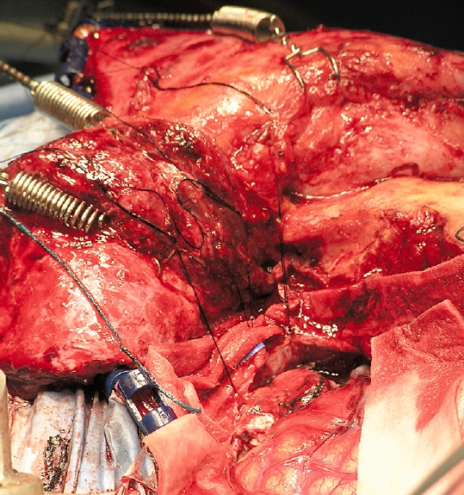
“Visually-Oriented Knowledge Media Design in Medicine”
Nick Woolridge and Jodie Jenkinson
Biomedical Communications, University of Toronto

Slide 38
Scientific Illustrations
←
SI ( )

Slide 39
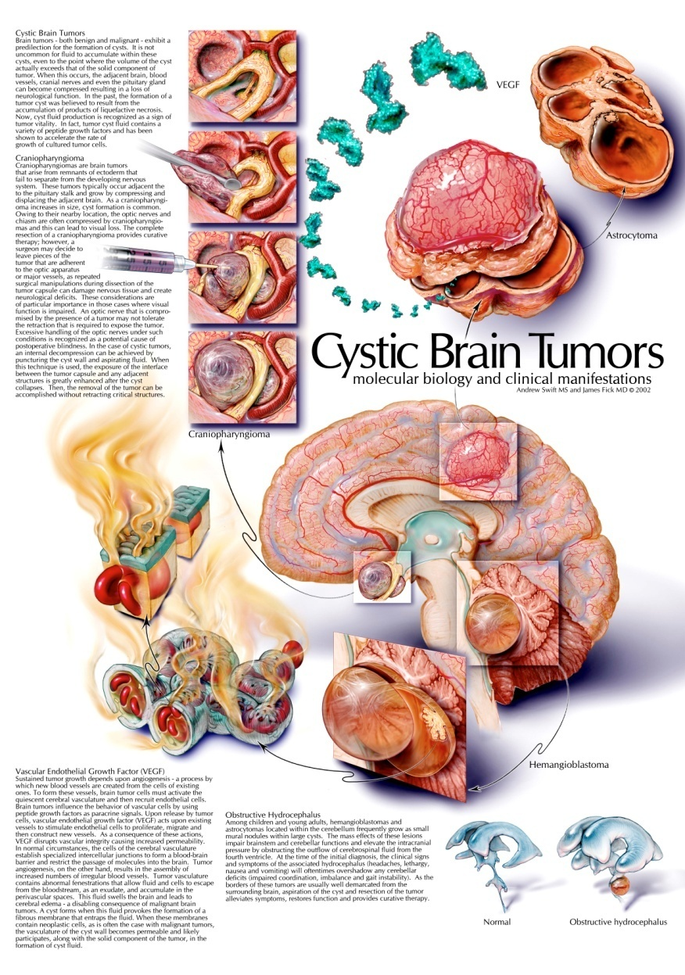
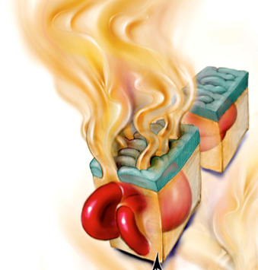
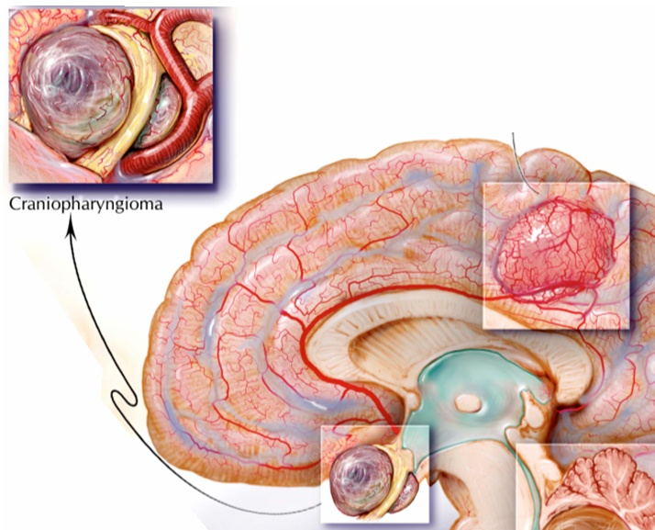
Copyright 2004 Andrew Swift MS CMI and James Fick MD.
Used by permission.
www.mcg.edu/medart
www.swiftillustration.com

Slide 40
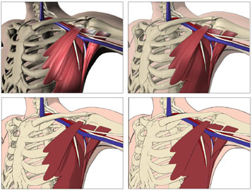
The Interpretive Visualization Group
Division of Biomedical Communication
University of Toronto
Visual complexity in anatomical relationships
© 2000-2005 IVIS Group, University of Toronto.

Slide 41
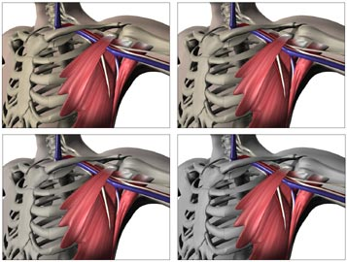
The Interpretive Visualization Group
Division of Biomedical Communication
University of Toronto
Selective color saturation in anatomical relationships
© 2000-2005 IVIS Group, University of Toronto.

Slide 42
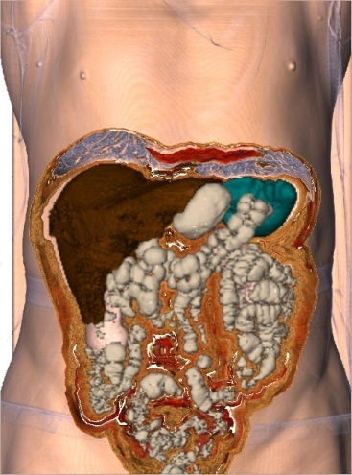
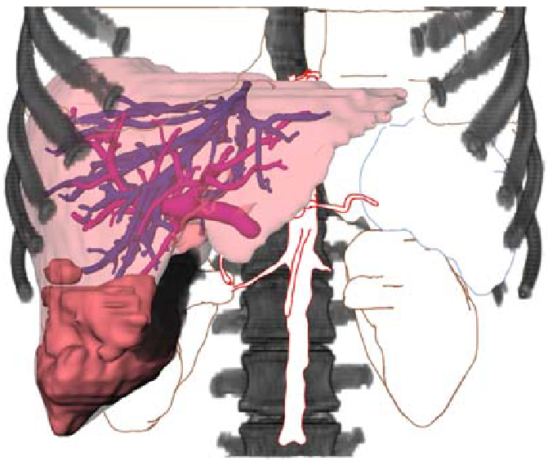
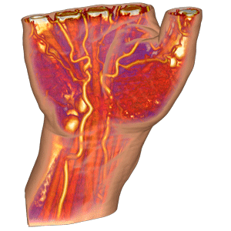
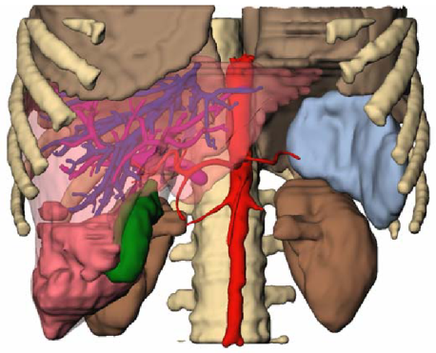
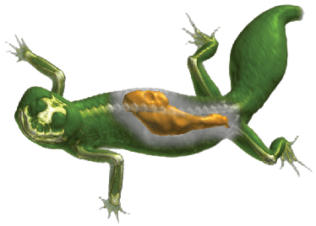
Illustrative Visualization
[Bruckner et al 2005]
[Tietjen et al 2005]
[Viola et al 2004]

Slide 43
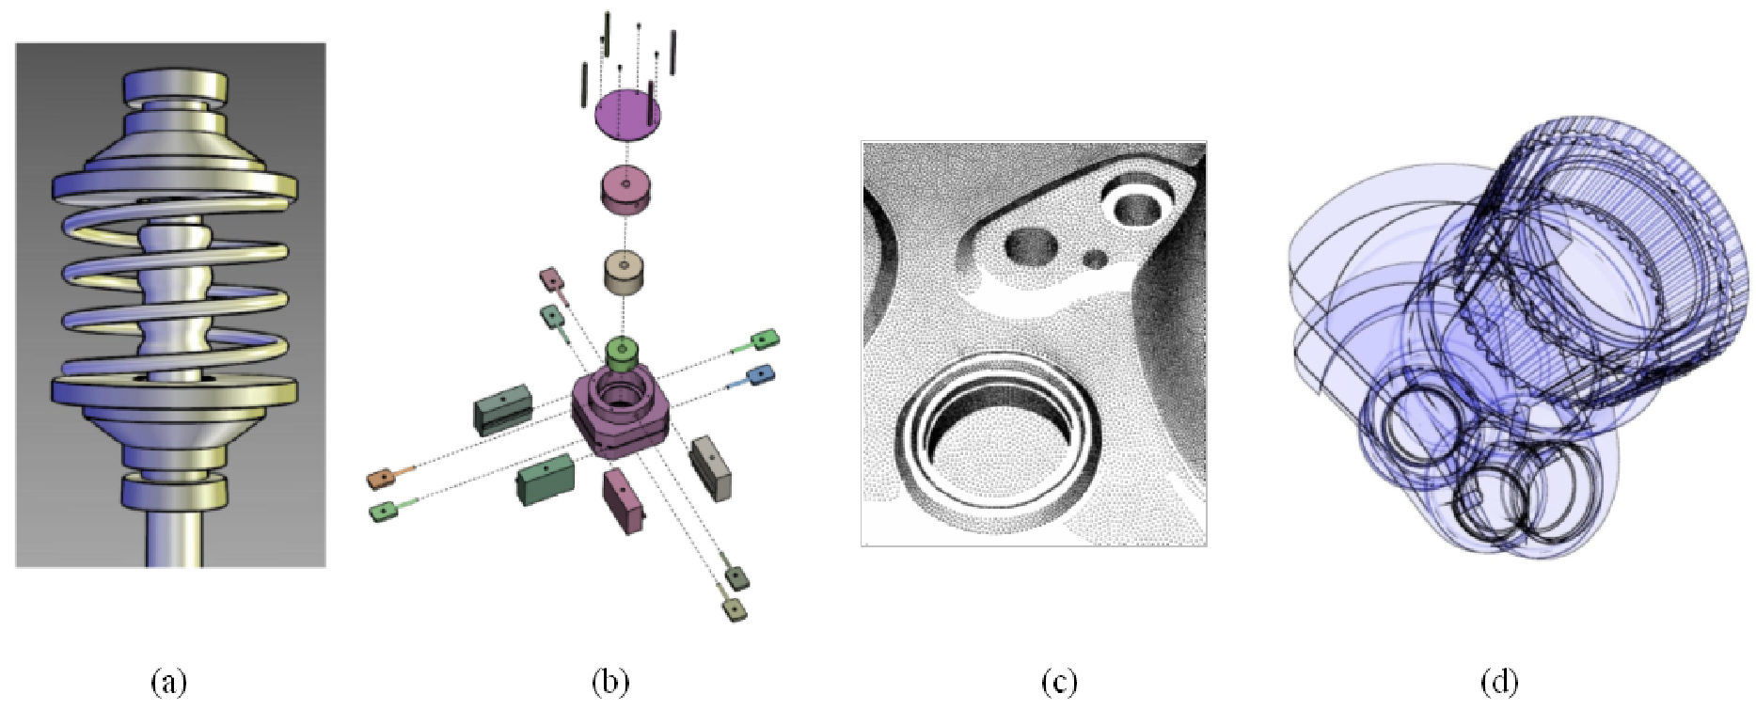
Technical Illustration
Selection of NPR results for technical illustration
Copyright
(a) 1998 Amy Gooch [Gooch et al. 1998],
(b) 2003 Maneesh Agrawala [Agrawala et al. 2003],
(c) 2000 Oliver Deussen [Deussen et al. 2000],
(d) 2004 Marc Nienhaus and Jurgen Dollner [Nienhaus and Dollner 2004].
Used by Permission.

Slide 44
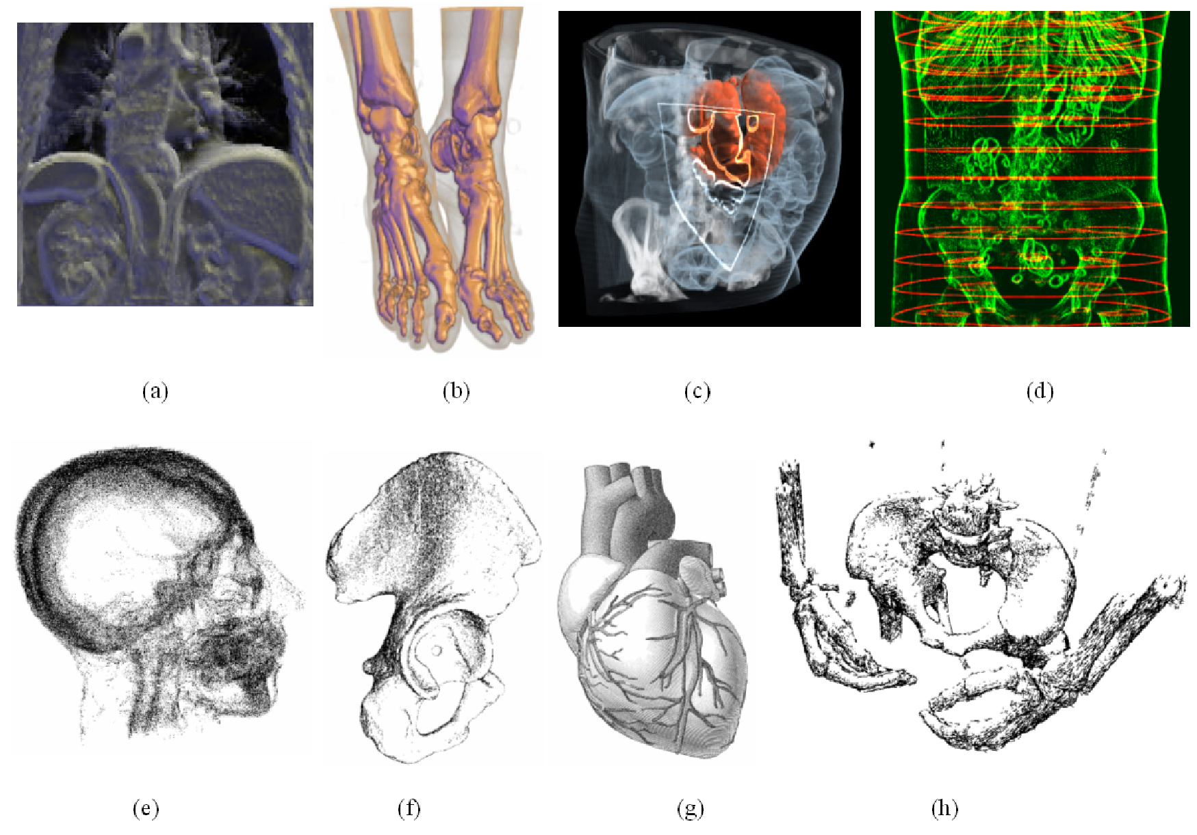
Selection of NPR results for medical illustration
Copyright
(a) 2000 David S. Ebert and Penny Rheingans [Ebert and Rheingans 2000],
(b) 2002 Eric B. Lum [Lum and Ma 2002],
(c) 2005 Nikolai Svakhine, David S. Ebert and Don Stredney [Svakhine et al 2005],
(d) 2001 Balazs Csebfalvi [Csebfalvi et al. 2001],
(e) 2002 Lu, A., Morris, C., Ebert, D., Rheingans, P., and Hansen [Lu et al. 2002],
(f) 2003 Mario Costa Sousa [Sousa et al. 2003],
(g) 2000 Jorg Hamel [Hamel 2000], (h) 2004 Mario Costa Sousa [Sousa et al. 2004].
Used by Permission.
Medical Illustration

Slide 45
Vascular Visualization

Slide 46
What if… You could see every capillary?
That’s a lot of vessels!
And this is just one slice!

Slide 47
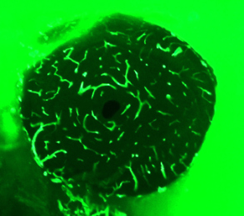
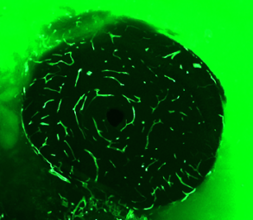
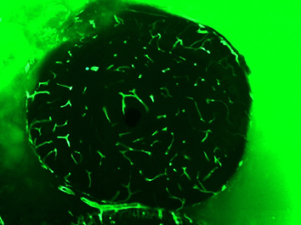
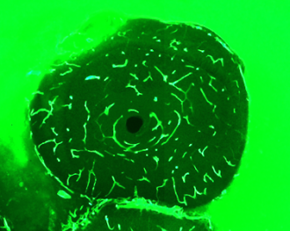
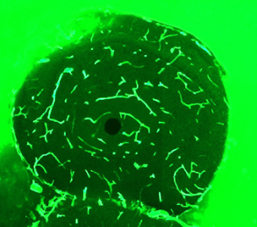
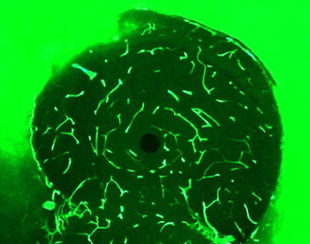
A Tiny Example
Olfactory bulb from a neo-natal mouse
Small piece of a small brain

Slide 48
Registration
Drag points to corresponding locations
Don’t need too many points
Fast – interactive dragging rates

Slide 49
Align Pairs Build Stacks

Slide 50
Initial Results: Tubes

Slide 51
Stylized Rendering and Other Visualization Ideas
Illustration methods (Gooch)
Kinetic methods

Slide 52
Different Brains
Rough manual alignments
Easy, even if brains are quite different
Caveat: we are introducing distortions
unaligned
aligned

Slide 53
Different Brains
Quick
Visual (Ad Hoc)
Comparisons
Comparison is important – how do we do it?

