Slide 1
559 Course Notes – 2007 Transforms (lectures 13-14)
Mike Gleicher
October 2007
Notes for lectures, not shown in class

Slide 2
Geometric graphics
Primitives
Points
Lines
Polygons
Shapes
0d vs. 1d vs 2d vs. space embedded into
What do positions mean?
Need coordinate systems

Slide 3
Coordinate Systems
Tells us how to interpret positions (coordinates)
In graphics we deal with many coordinate systems and move between them
Use what is convenient for what we’re doing
Examples
Chalkboard as coordinate system
One panel of chalkboard as coordinate system
Monitor as coordinate system

Slide 4
What is a coordinate system
Position of the zero point
Directions for each axis
Represent points as a linear combination of vectors
Vectors (basis) are axes
Scale of vectors matter (what is “1 unit”)
Directions matter (which way is up)
Doesn’t need to be perpindicular (just can’t be parallel)

Slide 5
Describing Coordinate systems
Need to have some “reference”
Where we will measure from
Give origin, vectors
Once we have 1 system, can define others
Can move points by changing their coordinate system
Piece of paper is a coordinate system
Move piece of paper around
If it were a rubber sheet could stretch it as well

Slide 6
Changing Coordinate Systems
Changing coordinate systems allows us to change large numbers of points all at once
Need to move points between coordinate systems
A coordinate system transforms points to a more canonical coordinate system
Can define coordinate systems by transformations between coordinate systems

Slide 7
Transformations
Something that changes points
y’,y’ = f(x,y) f 2 R² ! R²
Coordinate systems are a special case
Other examples
F(x,y) = x+2, y+3
F(x,y) = -y, x
F(x,y) = x^2, y
Easy way to effect large numbers of points

Slide 8
Interpreting Transformations
Can be viewed as a change of coordinates
What happens to a piece of graph paper?
Just sometimes to a stretchy piece of paper
View as a function applied to points
Function composition
F(g(h(x))) (note order)
X
h
g
f
X’

Slide 9
Linear Transformations
Important special case – linear functions
Can be written as a matrix x’ = M x (x is a vector)
Good points
Many useful transformations are of this form
Composition by matrix multiply
Easy analysis
Straight lines stay straight lines
Inverses by inverting the matrix
Note: linear operators preserve zero!

Slide 10
Example Linear Operators
Uniform Scale
Non-Uniform Scale
Reflect
Skew

Slide 11
More linear operators
Rotate
Note: all of this keeps zero
All linear operations are around the origin (?)

Slide 12
Understanding linear operators
This is POST-Multiply (vector on the right)
Pre-multiply convention works too
All the matrices get transposed
What does each element do?
Left column – where does X axis go (put in unit X vector)
Right column – where does Y axis go
Can’t do anything about origin!

Slide 13
Post-Multiply vs. Pre-Multiply
Post multiply – column vector on the left
F G H x
Pre-multiply – row vector on the right
Older convention, not used as often
x^{T} H^{T} G^{T} F^{T}
I will (almost always) use the post-multiply convention

Slide 14
Affine Transformations
Translation = move all points the same (vector +)
Affine = Linear operations plus translation
Cannot be encoded in a 2x2 matrix (for 2d)
Need six numbers for 2d
Could be a 3x2 matrix – but then no more multiplies
Rather than treat as a special case, improve our coordinates a bit

Slide 15
Homogeneous Coordinates
Big idea for graphics – really important
Will be used for several things – translation is just 1
Basic idea: add an extra coordinate
2D becomes 3D (3x3 matrices)
3D becomes 4D (4x4 matrices)
Convert “back” from homogeneous coordinates by division
(x,y) -> (x,y,1)
(x,y,w) -> (x/w, y/w)
Projection
Many points in higher dim space = 1 point in lower dim space
For now, just make w=1

Slide 16
Homogeneous Coordinates
“Normal” space is a subspace
W = 1
Think about 1D case (so embed into 2D x,w)
Many equivalent points (projection)
Only 1D Linear operation is scale
(about origin)
W=1

Slide 17
Translation in Homogeneous Coords
Translate in 2D = Skew in 3D
Deck of cards

Slide 18
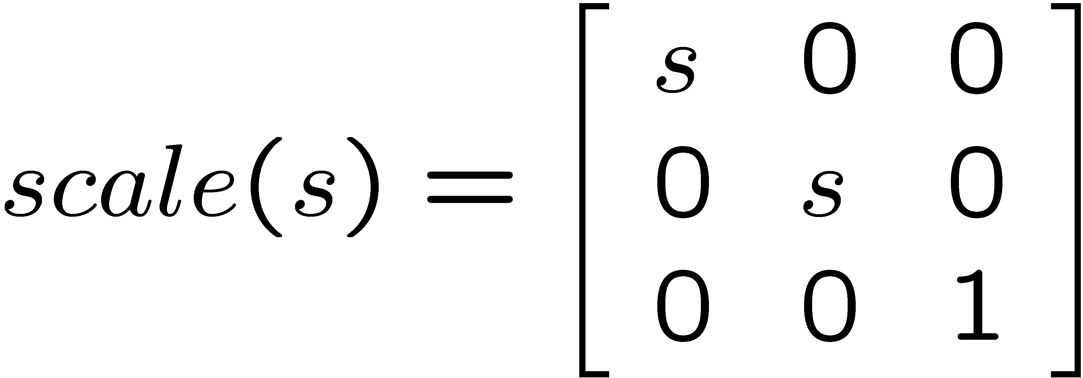
What about other linear ops
Just add an extra coordinate
Don’t change w (unless you know what you’re doing)

Slide 19
Matrices as Coordinate Systems
Where does X axis go?
Where does Y axis go?
Where does origin go?
Assumes that bottom row is [0 0 1]
Can you scale by changing w?
Yes, but often we prefer to renormalize so bottom right number is 1

Slide 20
Homogeneous Coordinates
Makes translation (affine transforms) linear
Need to work in higher dimensional space
Useful for lots of other things
Viewing (perspective)

Slide 21
Matrices as Coordinate Systems
Where does X axis go?
Where does Y axis go?
Where does origin go?
Assumes that bottom row is [0 0 1]
Can you scale by changing w?
Yes, but often we prefer to renormalize so bottom right number is 1

Slide 22
Composing Transformations
Order matters!
Scale / rotate vs. rotate/scale
Can implement by multiplying matrices
T₁ T₂ T₃ x = (T₁ T₂ T₃) x

Slide 23
Why Compose?
Rotate about a point
T_{c} R T_{-c} x
Scale along an axis
Move point to origin
Align axis w/major axis
Scale
Put things back
T_{c} R_{θ} S R_{-θ} T_{-c} x

Slide 24
Hierarchical coordinate Systems
Car
Wheel
Wheel
Person
Head / Neck
Arm / forearm / hand
Car
T
T
T
Wheel
Wheel
body
T
T
R
R
wheel
wheel

Slide 25
Matrix Stack
Multiply things onto the top
Top is “current” coordinate system
Push (copy the top) if you’ll come back
Pop to go back
Think about it as moving the coordinate system
Top of stack is “current coordinate system”
Where we will draw
Transformations change current coord system
Or change the objects that we are going to draw

Slide 26
Matrix Stack Example
Draw Car = …. Push trans wheel pop …
Push trans – draw car – pop push trans – draw car

