Slide 1
Non-photorealistic rendering (NPR)
CS559

Slide 2
Non-Photorealistic Rendering (NPR)
aka. Stylized rendering, artistic rendering, expressive graphics…
Covers any area of graphics where the point is to consciously not produce an image that is as photorealistic as possible.

Slide 3
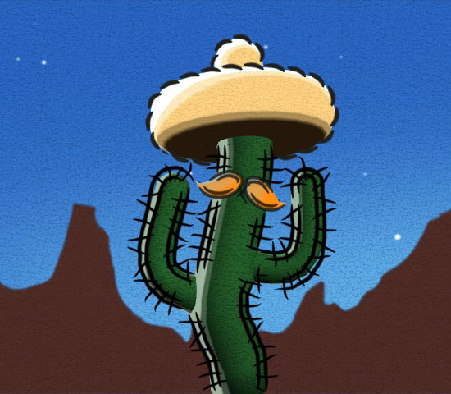
What is NPR exactly?
Covers a wide range of styles and techniques

Slide 4
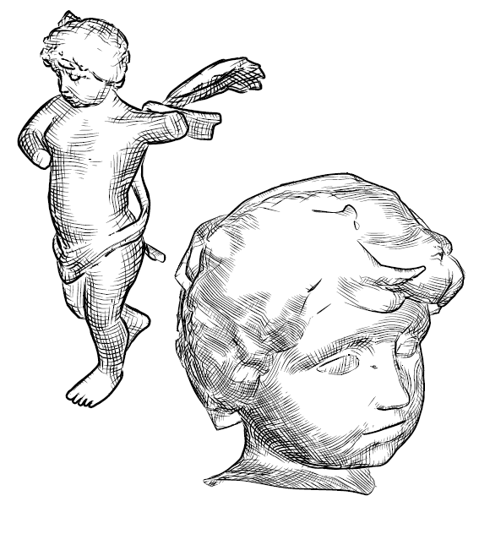
What is NPR exactly?
Covers a wide range of styles and techniques

Slide 5
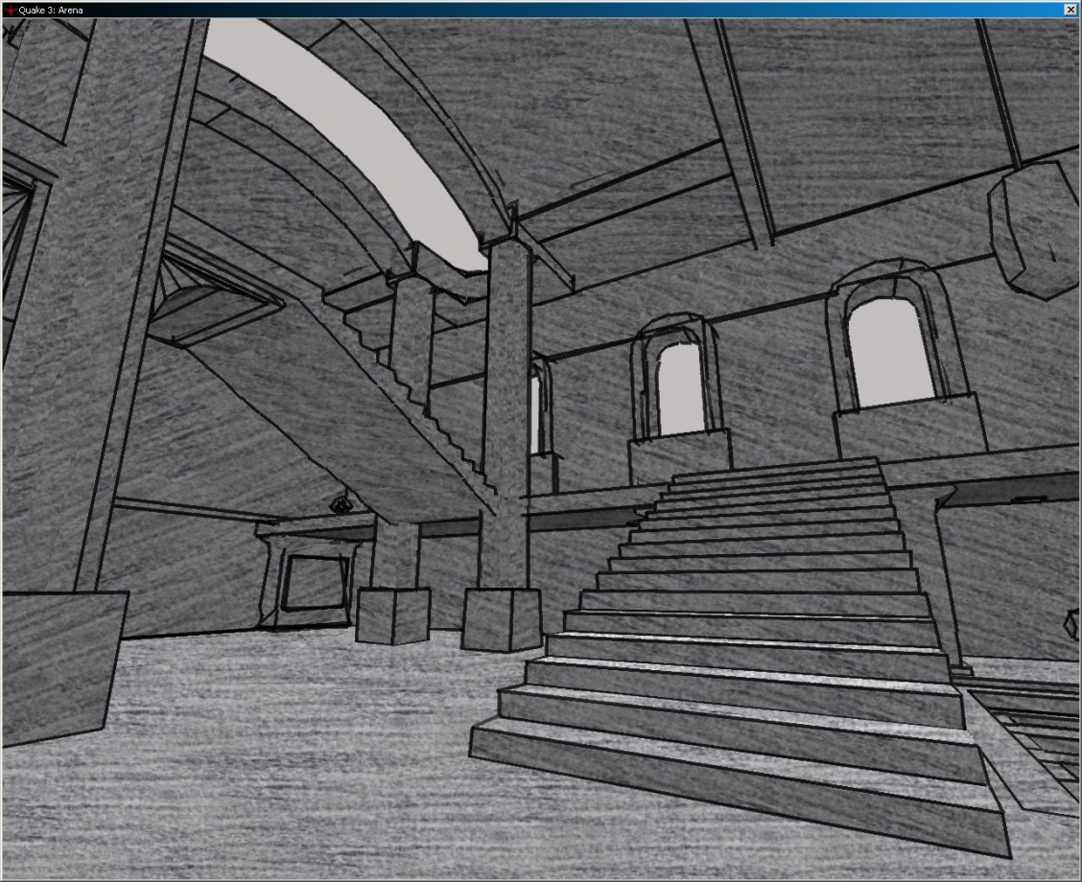
What is NPR exactly?
Covers a wide range of styles and techniques

Slide 6
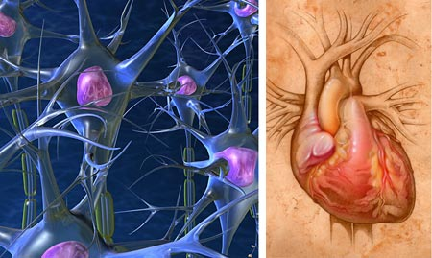
What is NPR exactly?
Covers a wide range of styles and techniques

Slide 7
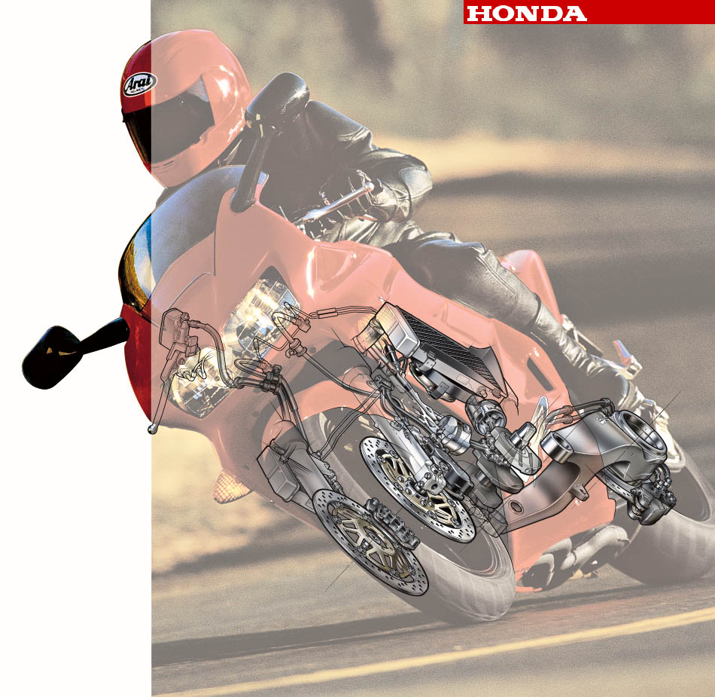
What is NPR exactly?
Covers a wide range of styles and techniques

Slide 8
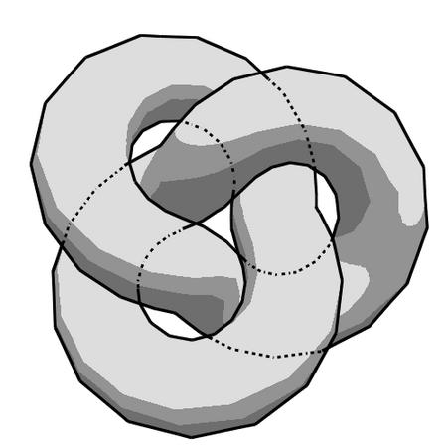
What is NPR exactly?
Covers a wide range of styles and techniques

Slide 9
What do these all have in common?
They’re not trying to look like what we see in the world

Slide 10
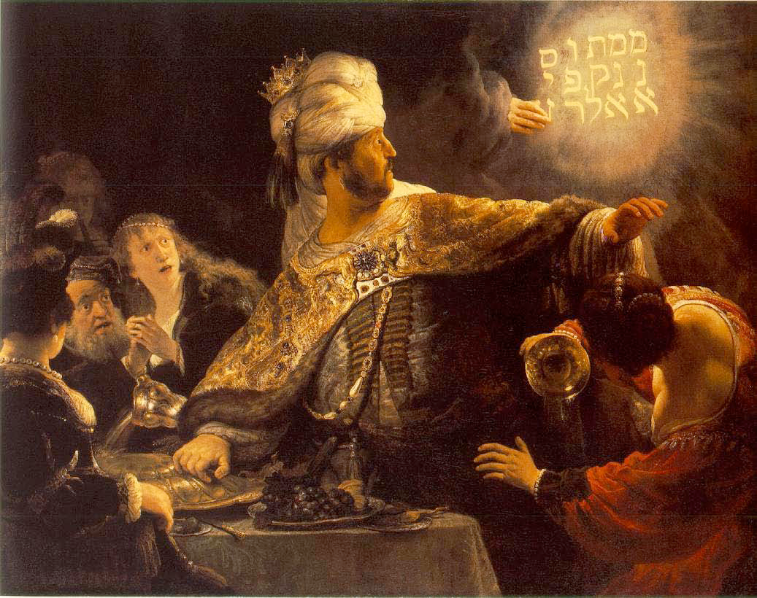
Why render Non-Photorealistically?
Emphasize important information
Convey ambiguity of uncertain information
Guide focus
Establish a ‘mood’

Slide 11
Why render Non-Photorealistically?
Convey ambiguity of uncertain information
specific ➙ universal (one person vs. everyone)
complex ➙ simple (progressive reduction of detail)
realistic ➙ iconic (requiring more translation)
Illustrations interpret physical reality; distill the essential components of the scene
We seek algorithms that can make explicit some of the intuition that artists rely upon to create an effective visual representation

Slide 12
Types of things we do with NPR:
In 2D:
Use a painterly style
In 3D:
Stylize lights, surface texture
Add outlines, halos
Common theme: start with reference image/model, tweak to achieve goals (whether artistic, or informational)
Underlying model is usually left unchanged

Slide 13
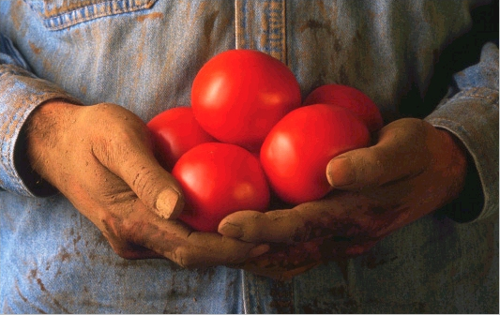
Painterly Rendering
Start with a reference image:

Slide 14
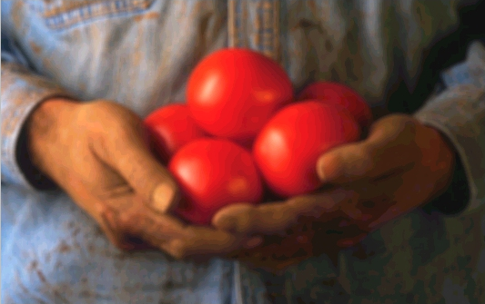
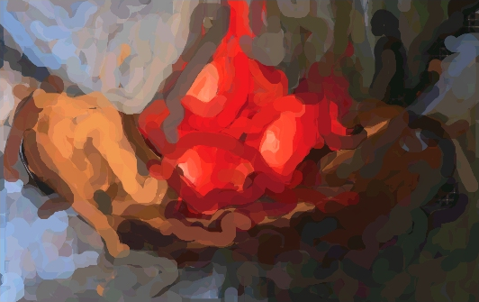
Painterly Rendering
Produce an image that looks like a painting.
Layer 1

Slide 15
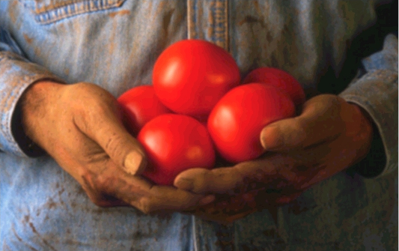
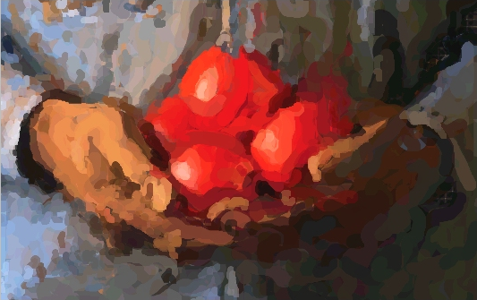
Painterly Rendering
Produce an image that looks like a painting.
Layer 2

Slide 16
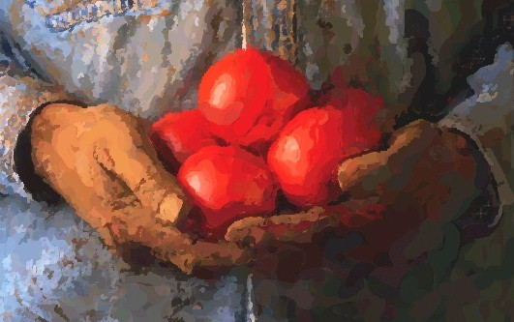
Painterly Rendering
Produce an image that looks like a painting.
Layer 3

Slide 17
Applying painterly rendering in 3D
What could go wrong when animating strokes?
Frame-to-frame coherency is a problem
Can’t just sample strokes randomly on each frame
They’d skitter around. It’d look terrible.
Can’t just attach strokes to the screen
Why not?

Slide 18
Techniques aren’t limited to still images
What Dreams May Come (1998)

Slide 19
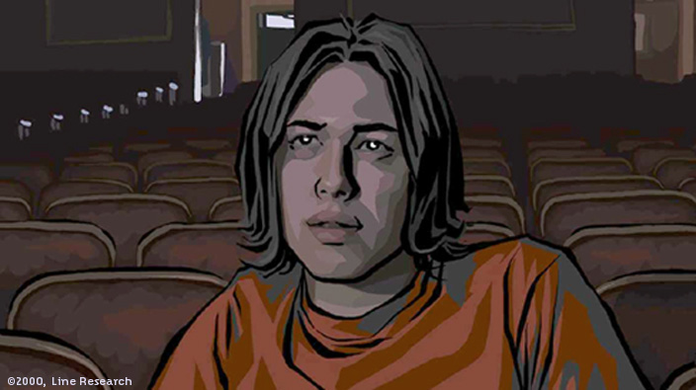
Techniques aren’t limited to still images
Waking Life (2001)

Slide 20
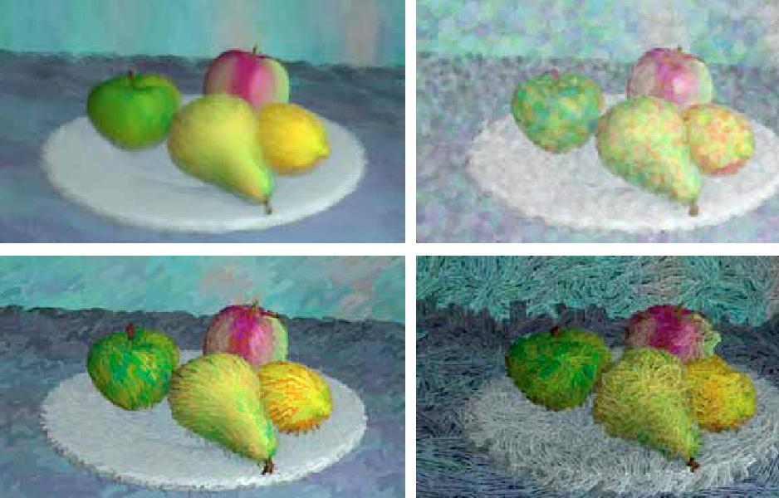
Applying painterly rendering in 3D
These are all generated from the same models
Barbara Meier, “Painterly Rendering for Animation”, 1996

Slide 21
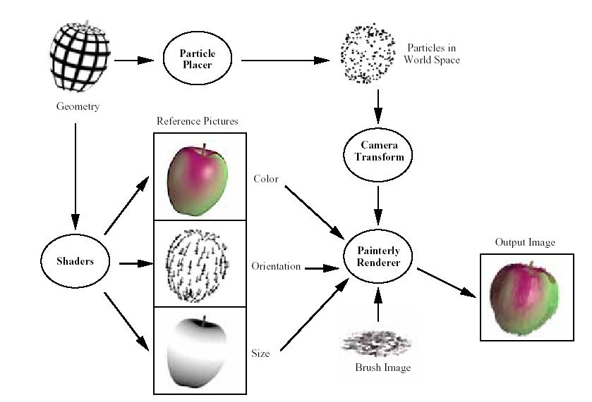
Applying painterly rendering in 3D

Slide 22
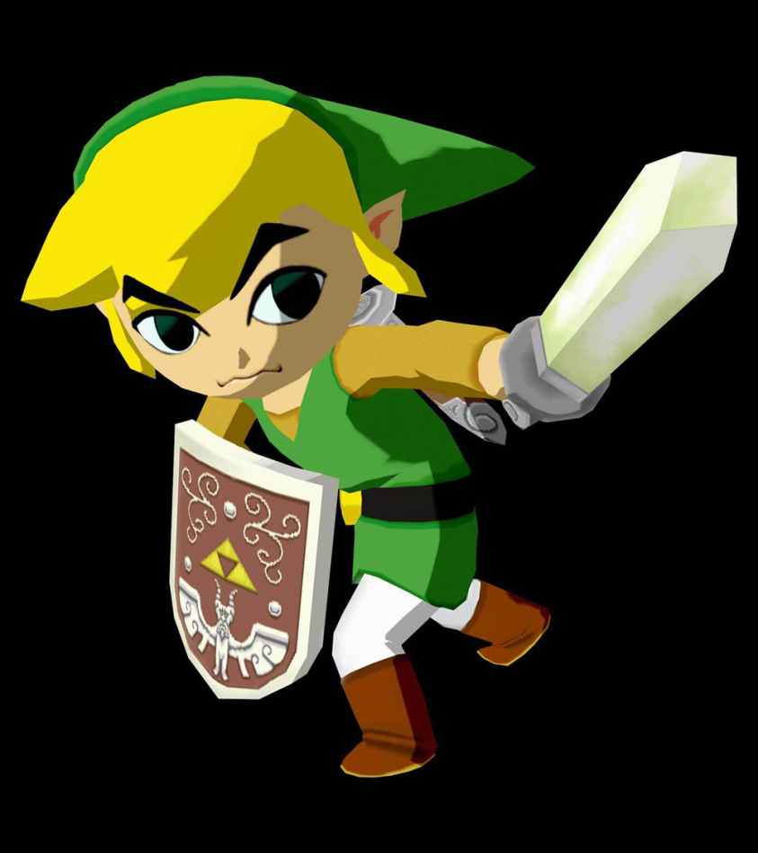
Toon (or cel) Shading
Essentially quantized Gouraud (or Phong) shading

Slide 23
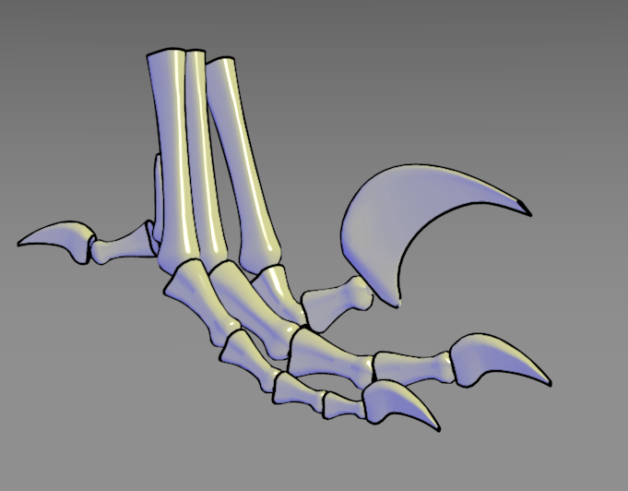
Gooch Shading
Warm color where surface faces light, fading to cool.
Gooch, et al. “A Non-Photorealistic Lighting Model For Automatic Technical Illustration”, 1998

Slide 24
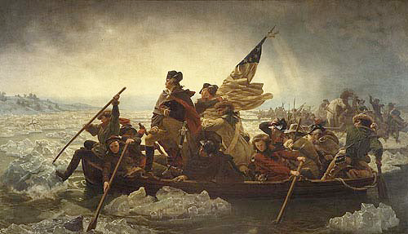
Inconsistent Lighting
George Washington Crossing the Delaware
By Emanuel Gottlieb Leutze

Slide 25
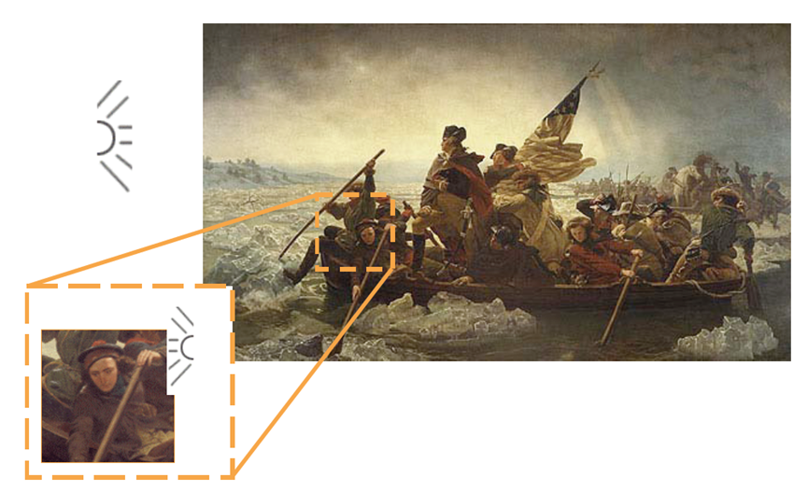
Inconsistent Lighting
George Washington Crossing the Delaware
By Emanuel Gottlieb Leutze

Slide 26
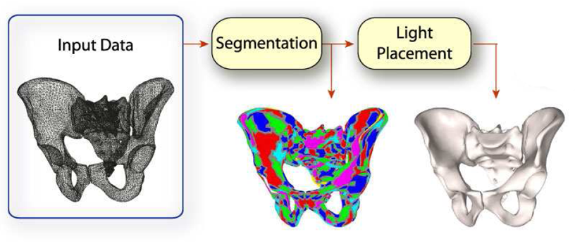
Light Collages
Apply this idea on a input mesh
Lee, et al. “Light Collages: lighting design for effective visualization”, 2004

Slide 27
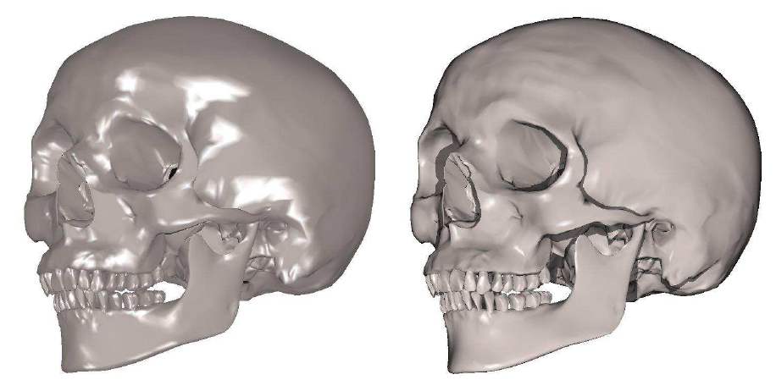
Light Collages
Lee, et al. “Light Collages: lighting design for effective visualization”, 2004

Slide 28
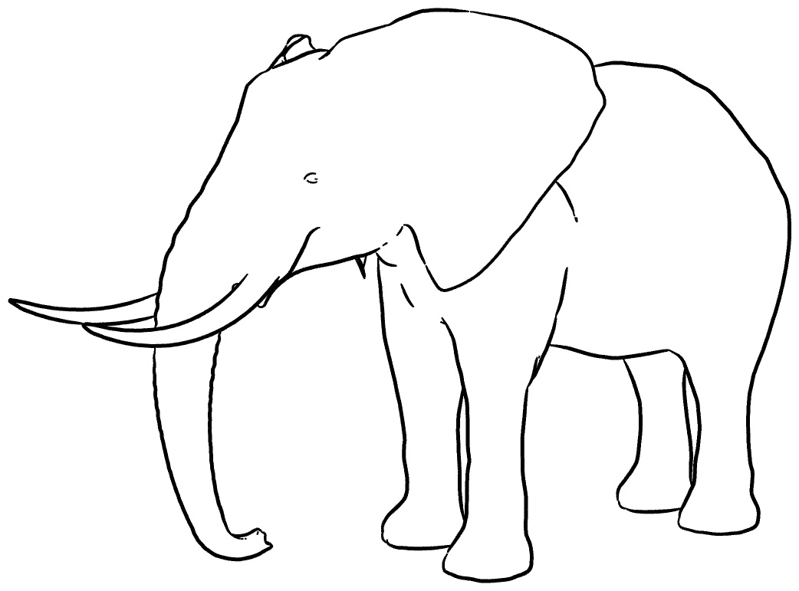
Contour Lines
Put lines where there are depth discontinuities
View dependent

Slide 29
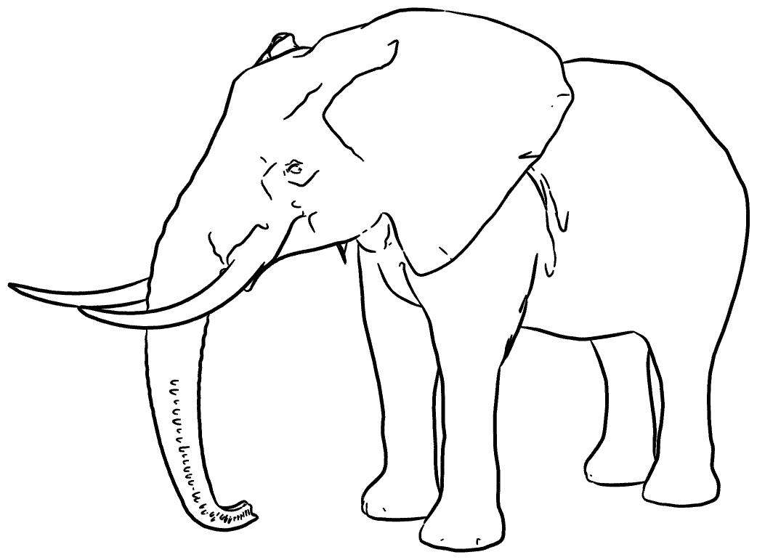
Suggestive Contours
Adds lines in regions with nearby contours
DeCarlo, et. al. “Suggestive Contours for Conveying Shape”, 2003

Slide 30
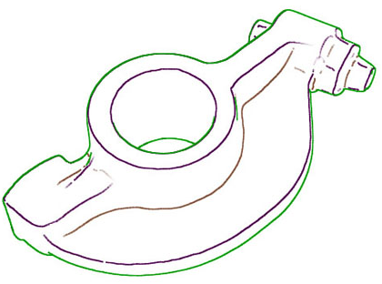
Ridges and Valleys
Put lines where there are curvature discontinuities
NOT view dependent
Often combined with contours

Slide 31
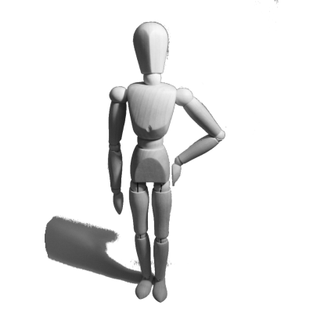
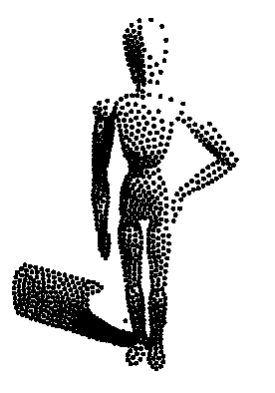
Stippling
Convey tone using dots
Of either varying size
Or varying density
Adrian Secord, “Weighted Voronoi Stippling”, 2002.

Slide 32
Pen-and-ink illustration
Renders 3D model using hatched textures according to user-specified intent.
Uses texture to convey both surface type and tone.
Georges Winkenbach and David H. Salesin. “Computer–Generated Pen–And–Ink Illustration”, 1994.

Slide 33
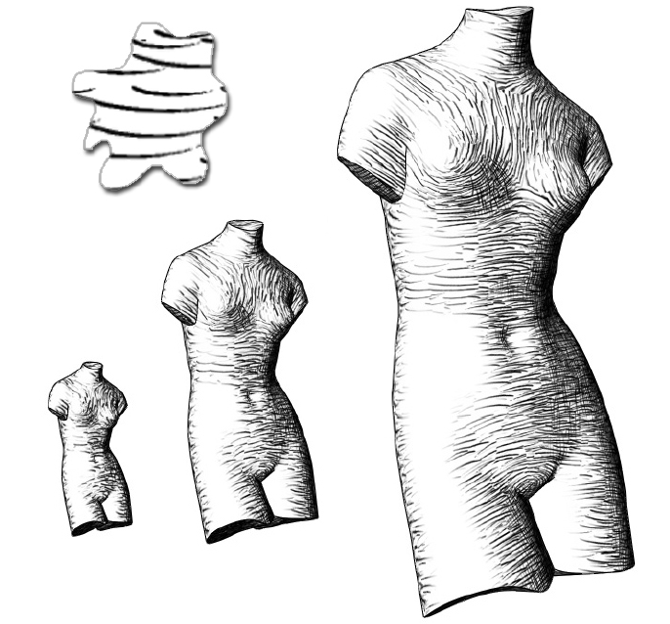
Non-photorealistic Texture
Tonal Art Maps
Orient textures along curvature
Webb, et al. “Fine Tone Control in Hardware Hatching”, 2002.

Slide 34
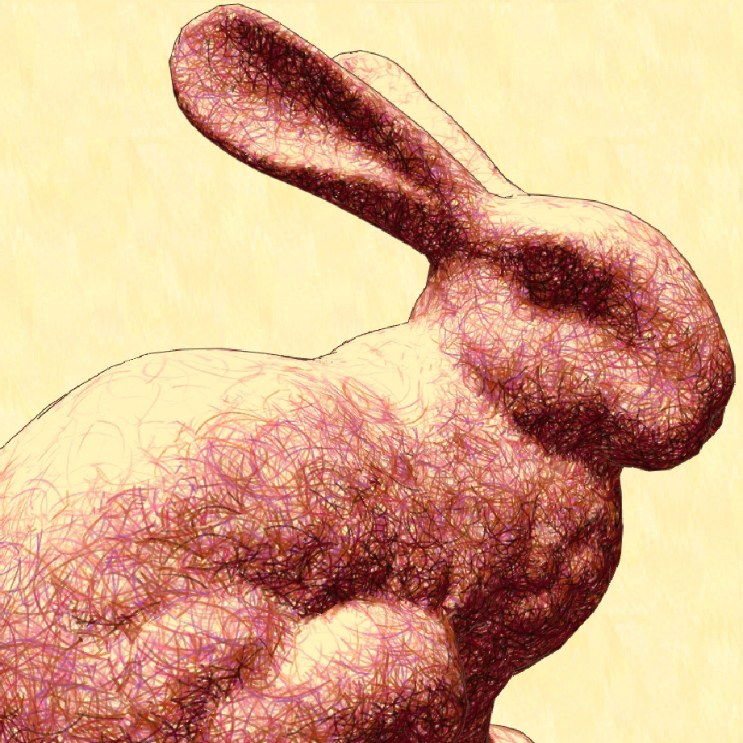
Non-photorealistic Texture
Tonal Art Maps
Orient textures along curvature
Webb, et al. “Fine Tone Control in Hardware Hatching”, 2002.

Slide 35
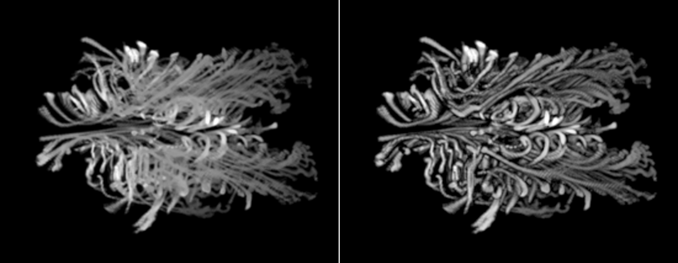
Halos
Add a glow around objects
Highlights depth-discontinuities

Slide 36
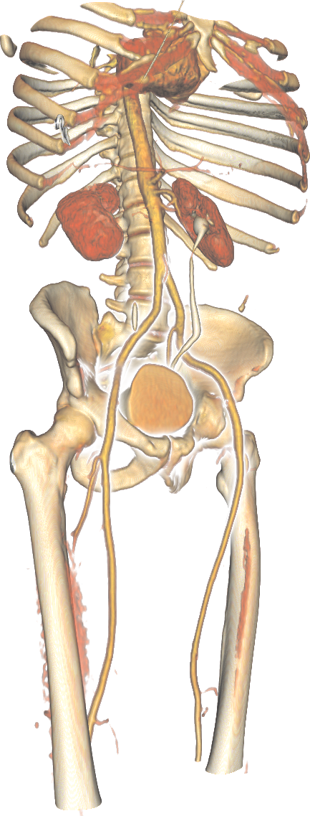
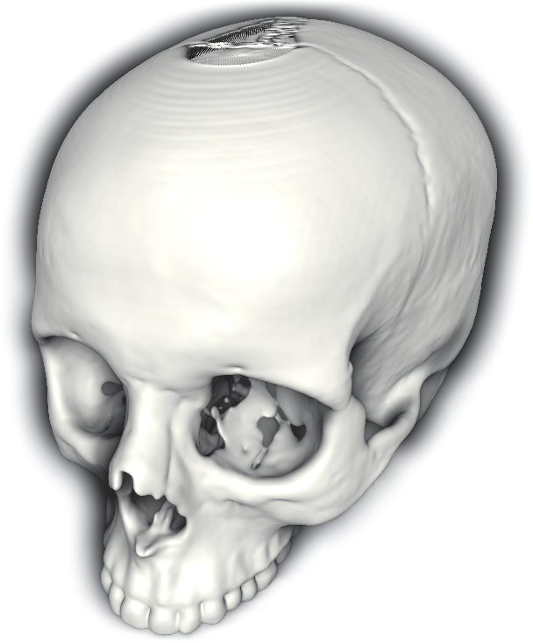
Halos
Add a glow around objects
Highlights depth-discontinuities

