Slide 1
Relational Transfer in Reinforcement Learning
Lisa Torrey
University of Wisconsin – Madison
Doctoral Defense
May 2009

Slide 2
Transfer Learning
Given
Learn
Task T
Task S

Slide 3
Reinforcement Learning
Agent
Exploration
Exploitation
Q(s₁, a) = 0
policy π(s₁) = a₁
Q(s₁, a₁) ← Q(s₁, a₁) + Δ
π(s₂) = a₂
a₁
a₂
s₂
s₃
s₁
r₂
Maximize reward
r₃
Environment
δ(s₁, a₁) = s₂
r(s₁, a₁) = r₂
δ(s₂, a₂) = s₃
r(s₂, a₂) = r₃
Reference: Sutton and Barto, Reinforcement Learning: An Introduction, MIT Press 1998

Slide 4
Learning Curves
higher asymptote
higher slope
performance
higher start
training

Slide 5
RoboCup Domain
3-on-2 KeepAway
3-on-2 BreakAway
2-on-1 BreakAway
3-on-2 MoveDownfield
Q_{a}(s) = w₁f₁ + w₂f₂ + w₃f₃ + …
Hand-coded defenders
Single learning agent

Slide 6
Transfer in Reinforcement Learning
Starting-point
methods
Imitation
methods
Hierarchical
methods
Alteration
methods
New RL algorithms

Slide 7
Relational Transfer
Opponent 1
pass(t1)
Opponent 2
pass(t2)
IF feature(Opponent)
THEN
pass(Teammate)

Slide 8
Thesis Contributions
Advice transfer
  Advice taking
  Inductive logic programming
  Skill-transfer algorithm ECML 2006
  (ECML 2005)
Macro transfer
  Macro-operators
  Demonstration
  Macro-transfer algorithm ILP 2007
Markov Logic Network transfer
  Markov Logic Networks
  MLNs in macros
  MLN Q-function transfer algorithm AAAI workshop 2008
  MLN policy-transfer algorithm ILP 2009

Slide 9
Thesis Contributions
Advice transfer
  Advice taking
  Inductive logic programming
  Skill-transfer algorithm
Macro transfer
  Macro-operators
  Demonstration
  Macro-transfer algorithm
Markov Logic Network transfer
  Markov Logic Networks
  MLNs in macros
  MLN Q-function transfer algorithm
  MLN policy-transfer algorithm

Slide 10
Advice
IF these conditions hold
THEN pass is the best action

Slide 11
Transfer via Advice
Try what worked
in a previous task!

Slide 12
Learning Without Advice
Batch Reinforcement Learning via Support Vector Regression (RL-SVR)
Agent
Agent
Compute
Q-functions
…
Environment
Environment
Batch 1
Batch 2
Find Q-functions that minimize: ModelSize + C × DataMisfit
(one per action)

Slide 13
Learning With Advice
Batch Reinforcement Learning with Advice (KBKR)
Agent
Agent
Compute
Q-functions
…
Environment
Environment
Batch 1
Advice
Batch 2
Find Q-functions that minimize: ModelSize + C × DataMisfit
+ µ × AdviceMisfit
Robust to negative transfer!

Slide 14
Inductive Logic Programming
IF [ ]
THEN pass(Teammate)
IF distance(Teammate) ≤ 5
THEN pass(Teammate)
IF distance(Teammate) ≤ 10
THEN pass(Teammate)
…
IF distance(Teammate) ≤ 5
angle(Teammate, Opponent) ≥ 15
THEN pass(Teammate)
IF distance(Teammate) ≤ 5
angle(Teammate, Opponent) ≥ 30
THEN pass(Teammate)
F(β) = (1+ β²) × Precision × Recall
(β² × Precision) + Recall
Reference: De Raedt, Logical and Relational Learning, Springer 2008

Slide 15
Skill-Transfer Algorithm
Source
ILP
IF distance(Teammate) ≤ 5
angle(Teammate, Opponent) ≥ 30
THEN pass(Teammate)
Advice Taking
Target

Slide 16
Selected Results
Skill transfer from 3-on-2 MoveDownfield to 4-on-3 MoveDownfield
IF distance(me, Teammate) ≥ 15
distance(me, Teammate) ≤ 27
distance(Teammate, rightEdge) ≤ 10
angle(Teammate, me, Opponent) ≥ 24
distance(me, Opponent) ≥ 4
THEN pass(Teammate)

Slide 17
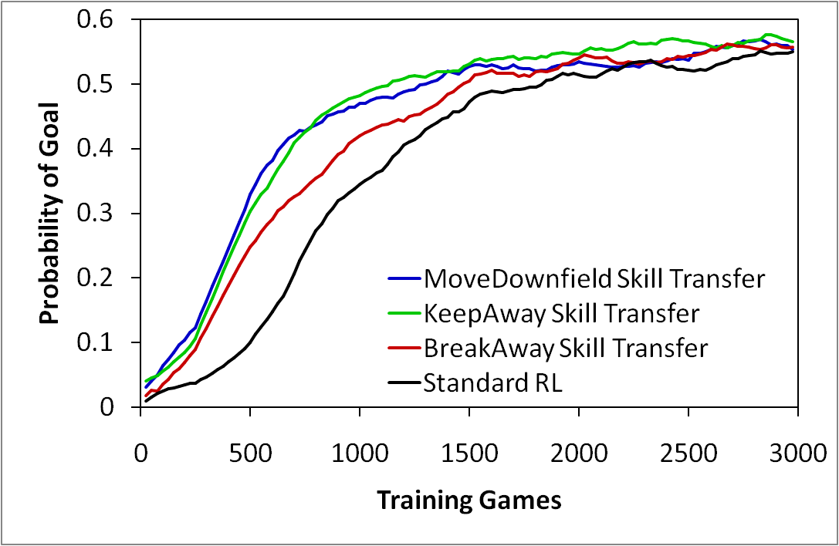
Selected Results
Skill transfer from several tasks to 3-on-2 BreakAway
Torrey et al. ECML 2006

Slide 18
Thesis Contributions
Advice transfer
  Advice taking
  Inductive logic programming
  Skill-transfer algorithm
Macro transfer
  Macro-operators
  Demonstration
  Macro-transfer algorithm
Markov Logic Network transfer
  Markov Logic Networks
  MLNs in macros
  MLN Q-function transfer algorithm
  MLN policy-transfer algorithm

Slide 19
Macro-Operators
IF [ ... ]
THEN pass(Teammate)
pass(Teammate)
IF [ ... ]
THEN pass(Teammate)
IF [ ... ]
THEN move(ahead)
move(Direction)
IF [ ... ]
THEN move(left)
IF [ ... ]
THEN shoot(goalRight)
shoot(goalRight)
IF [ ... ]
THEN shoot(goalRight)
IF [ ... ]
THEN shoot(goalLeft)
shoot(goalLeft)
IF [ ... ]
THEN shoot(goalRight)

Slide 20
Demonstration Method
source
policy used
target
target-task training
No more protection against negative transfer!
But… best-case scenario could be very good.

Slide 21
Macro-Transfer Algorithm
Source
ILP
Demonstration
Target

Slide 22
Macro-Transfer Algorithm
Learning structures
Positive: BreakAway games that score
Negative: BreakAway games that didn’t score
ILP
IF actionTaken(Game, StateA, pass(Teammate), StateB)
actionTaken(Game, StateB, move(Direction), StateC)
actionTaken(Game, StateC, shoot(goalRight), StateD)
actionTaken(Game, StateD, shoot(goalLeft), StateE)
THEN isaGoodGame(Game)

Slide 23
Macro-Transfer Algorithm
Learning rules for arcs
Positive: states in good games that took the arc
Negative: states in good games that could have taken the arc but didn’t
ILP
shoot(goalRight)
pass(Teammate)
IF [ … ]
THEN enter(State)
IF [ … ]
THEN loop(State, Teammate))

Slide 24
Macro-Transfer Algorithm
Selecting and scoring rules
Add to
ruleset
Rule 1 Precision=1.0
Rule 2 Precision=0.99
Rule3 Precision=0.96
… …
Does rule increase
F(10) of ruleset?
yes
Rule score = # games that follow the rule that are good
# games that follow the rule

Slide 25
Selected Results
Macro transfer from 2-on-1 BreakAway to 3-on-2 BreakAway
pass(Teammate)
move(right)
shoot(goalLeft)
shoot(GoalPart)
move(left)
shoot(goalLeft)
shoot(goalRight)
pass(Teammate)
move(ahead)
move(away)
shoot(goalLeft)
shoot(goalRight)
shoot(goalLeft)
shoot(goalRight)
move(right)
shoot(goalLeft)
shoot(goalRight)
move(right)
move(left)
shoot(goalLeft)
shoot(goalRight)
move(ahead)
move(right)
shoot(goalLeft)
shoot(goalRight)

Slide 26
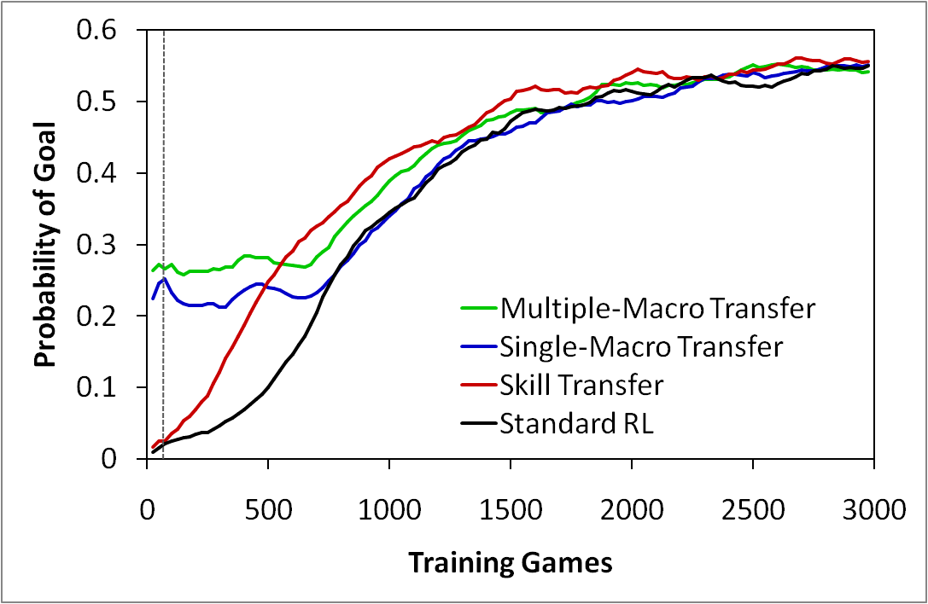
Selected Results
Macro transfer from 2-on-1 BreakAway to 3-on-2 BreakAway
Torrey et al. ILP 2007

Slide 27
Selected Results
Macro self-transfer in 2-on-1 BreakAway
Asymptote 56%
Probability of goal
Multiple macro 43%
Single macro 32%
Initial 1%
Training games

Slide 28
Thesis Contributions
Advice transfer
  Advice taking
  Inductive logic programming
  Skill-transfer algorithm
Macro transfer
  Macro-operators
  Demonstration
  Macro-transfer algorithm
Markov Logic Network transfer
  Markov Logic Networks
  MLNs in macros
  MLN Q-function transfer algorithm
  MLN policy-transfer algorithm

Slide 29
Markov Logic Networks
Formulas (F)
evidence1(X) AND query(X)
evidence2(X) AND query(X)
Weights (W)
w₀ = 1.1
w₁ = 0.9
query(x₁)
query(x₂)
e1
e2
…
e1
e2
…
  n_{i}(world) = # true groundings of i^{th} formula in world
Reference: Richardson and Domingos, Markov Logic Networks, Machine Learning 2006

Slide 30
MLN Weight Learning
From ILP:
IF [ ... ]
THEN …
Alchemy
weight learning
MLN:
w₀ = 1.1
Reference: http://alchemy.cs.washington.edu

Slide 31
Markov Logic Networks in Macros
IF angle(Teammate, defender) > 30
THEN pass(Teammate)
IF distance(Teammate, goal) < 12
THEN pass(Teammate)
pass(Teammate)
Matches t1 , score=0.92
Matches t2 , score=0.88
MLN
P(t1) = 0.35
P(t2) = 0.65

Slide 32
Markov Logic Networks in Macros
pass(Teammate) AND angle(Teammate, defender) > 30
pass(Teammate) AND distance(Teammate, goal) < 12
pass(t1)
angle(t1, defender) > 30
distance(t1, goal) < 12
pass(t2)
angle(t2 , defender) > 30
distance(t2, goal) < 12

Slide 33
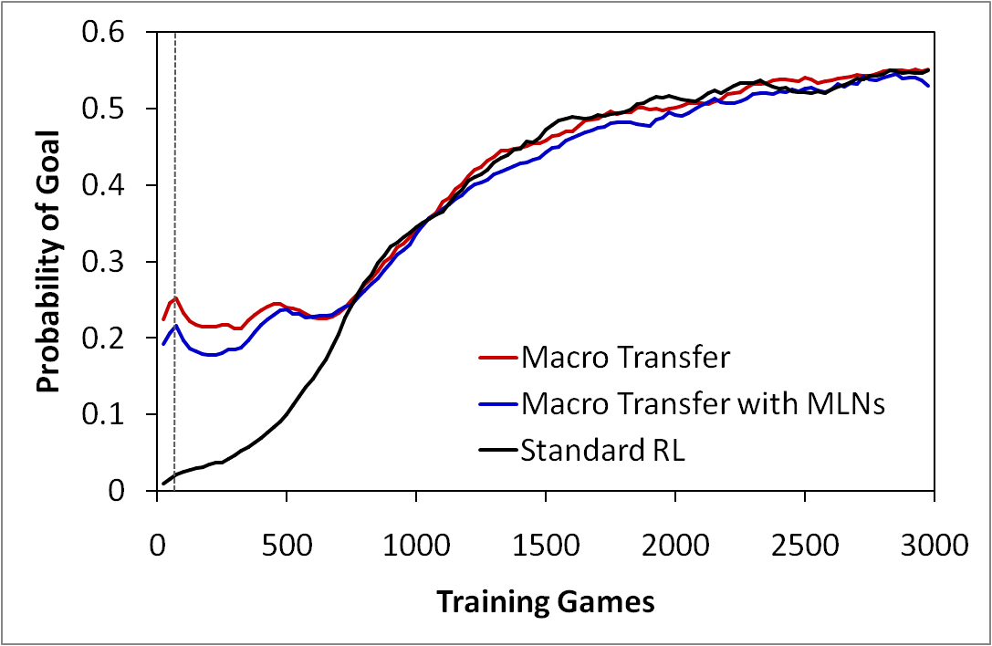
Selected Results
Macro transfer from 2-on-1 BreakAway to 3-on-2 BreakAway

Slide 34
Selected Results
Macro self-transfer in 2-on-1 BreakAway
Asymptote 56%
Probability of goal
Macro with MLN 43%
Regular macro 32%
Initial 1%
Training games

Slide 35
MLN Q-Function Transfer Algorithm
Source
ILP, Alchemy
MLN Q-functions
State
MLN for
action 1
Q-value
State
MLN for
action 2
Q-value
…
Demonstration
Target

Slide 36
MLN Q-Function
0 ≤ Q_{a} < 0.2
0.2 ≤ Q_{a} < 0.4
0.4 ≤ Q_{a} < 0.6
…
…
…
…
Probability
Probability
Probability
Bin Number
Bin Number
Bin Number

Slide 37
Selected Results
MLN Q-function transfer from 2-on-1 BreakAway to 3-on-2 BreakAway
IF distance(me, GoalPart) ≥ 42
distance(me, Teammate) ≥ 39
THEN pass(Teammate) falls into [0, 0.11]
IF angle(topRight, goalCenter, me) ≤ 42
angle(topRight, goalCenter, me) ≥ 55
angle(goalLeft, me, goalie) ≥ 20
angle(goalCenter, me, goalie) ≤ 30
THEN pass(Teammate) falls into [0.11, 0.27]
IF distance(Teammate, goalCenter) ≤ 9
angle(topRight, goalCenter, me) ≤ 85
THEN pass(Teammate) falls into [0.27, 0.43]

Slide 38
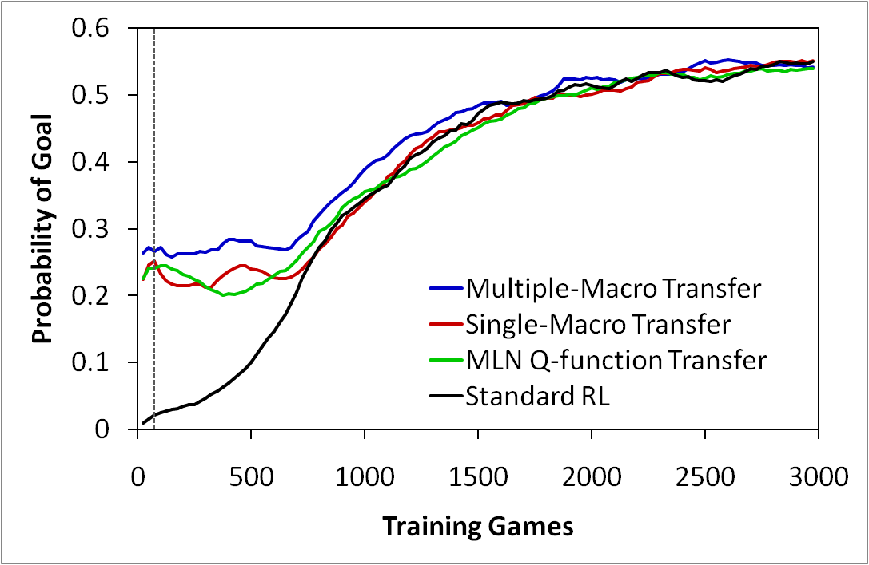
Selected Results
MLN Q-function transfer from 2-on-1 BreakAway to 3-on-2 BreakAway
Torrey et al. AAAI workshop 2008

Slide 39
MLN Policy-Transfer Algorithm
Source
ILP, Alchemy
MLN Policy
State
Action
MLN
(F,W)
Probability
Demonstration
Target

Slide 40
MLN Policy
move(ahead)
pass(Teammate)
shoot(goalLeft)
…
…
…
…
Policy = highest-probability action

Slide 41
Selected Results
MLN policy transfer from 2-on-1 BreakAway to 3-on-2 BreakAway
IF angle(topRight, goalCenter, me) ≤ 70
timeLeft ≥ 98
distance(me, Teammate) ≥ 3
THEN pass(Teammate)
IF distance(me, GoalPart) ≥ 36
distance(me, Teammate) ≥ 12
timeLeft ≥ 91
angle(topRight, goalCenter, me) ≤ 80
THEN pass(Teammate)
IF distance(me, GoalPart) ≥ 27
angle(topRight, goalCenter, me) ≤ 75
distance(me, Teammate) ≥ 9
angle(Teammate, me, goalie) ≥ 25
THEN pass(Teammate)

Slide 42
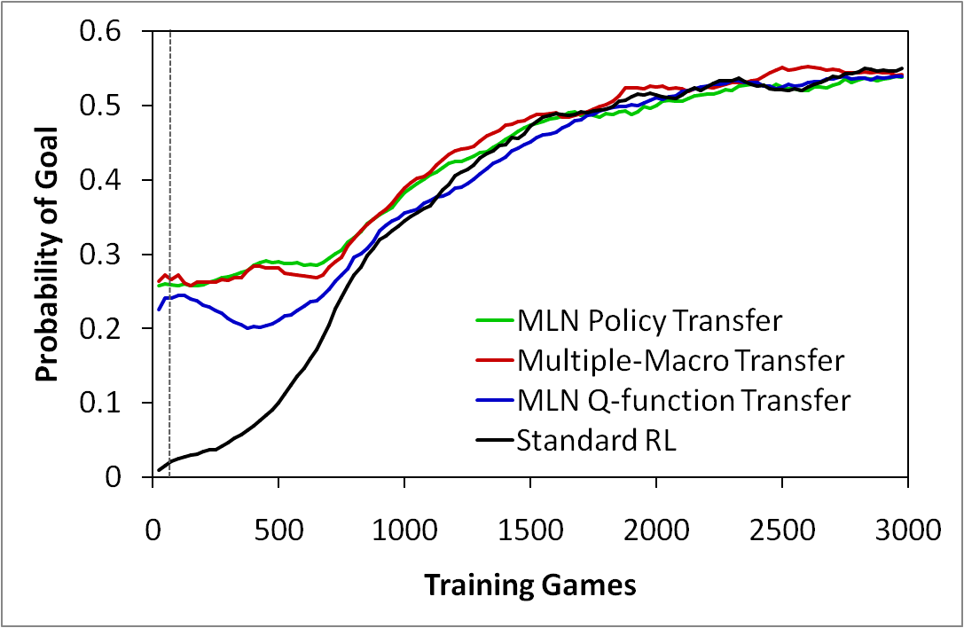
Selected Results
MLN policy transfer from 2-on-1 BreakAway to 3-on-2 BreakAway
Torrey et al. ILP 2009

Slide 43
Selected Results
MLN self-transfer in 2-on-1 BreakAway
MLN Policy 65%
MLN Q-function 59%
Asymptote 56%
Probability of goal
Initial 1%
Training games

Slide 44
Thesis Contributions
Advice transfer
  Advice taking
  Inductive logic programming
  Skill-transfer algorithm ECML 2006
  (ECML 2005)
Macro transfer
  Macro-operators
  Demonstration
  Macro-transfer algorithm ILP 2007
Markov Logic Network transfer
  Markov Logic Networks
  MLNs in macros
  MLN Q-function transfer algorithm AAAI workshop 2008
  MLN policy-transfer algorithm ILP 2009

Slide 45
Related Work
Starting-point
  Taylor et al. 2005: Value-function transfer
Imitation
  Fernandez and Veloso 2006: Policy reuse
Hierarchical
  Mehta et al. 2008: MaxQ transfer
Alteration
  Walsh et al. 2006: Aggregate states
New Algorithms
  Sharma et al. 2007: Case-based RL

Slide 46
Conclusions
Transfer can improve reinforcement learning
  Initial performance
  Learning speed
Advice transfer
  Low initial performance
  Steep learning curves
  Robust to negative transfer
Macro transfer and MLN transfer
  High initial performance
  Shallow learning curves
  Vulnerable to negative transfer

Slide 47
Conclusions
Close-transfer scenarios
Multiple Macro
Single Macro
Skill Transfer
≥
≥
=
=
MLN Policy
MLN Q-Function
Distant-transfer scenarios
Skill Transfer
Multiple Macro
Single Macro
≥
≥
=
=
MLN Policy
MLN Q-Function

Slide 48
Future Work
Multiple source tasks
Task T
Task S1

Slide 49
Future Work
Theoretical results
  How high can the initial performance be?
  How quickly can the target-task learner improve?
  How many episodes are “saved” through transfer?
Source
Relationship?
Target

Slide 50
Future Work
Joint learning and inference in macros
  Single search
  Combined rule/weight learning
pass(Teammate)
move(Direction)

Slide 51
Future Work
Refinement of transferred knowledge
  Macros
    Revising rule scores
    Relearning rules
    Relearning structure
  MLNs
    Revising weights
    Relearning rules
(Mihalkova et. al 2007)
Too-general
clause
Better
clause
Too-specific
clause
Better
clause

Slide 52
Future Work
Relational reinforcement learning
  Q-learning with MLN Q-function
  Policy search with MLN policies or macro
MLN Q-functions lose too much information:
Probability
Bin Number

Slide 53
Future Work
General challenges in RL transfer
Diverse tasks
Complex testbeds
Automated mapping
Protection against negative transfer

Slide 54
Acknowledgements
Advisor: Jude Shavlik
Collaborators: Trevor Walker and Richard Maclin
Committee
  David Page
  Mark Craven
  Jerry Zhu
  Michael Coen
UW Machine Learning Group
Grants
  DARPA HR0011-04-1-0007
  NRL N00173-06-1-G002
  DARPA FA8650-06-C-7606

Slide 55
Backup Slides

Slide 56
Transfer in Reinforcement Learning
Starting-point methods
Initial Q-table
transfer
Source task
2 | 5 | 4 | 8
9 | 1 | 7 | 2
5 | 9 | 1 | 4
no transfer
0 | 0 | 0 | 0
0 | 0 | 0 | 0
0 | 0 | 0 | 0
target-task training

Slide 57
Transfer in Reinforcement Learning
Imitation methods
source
policy used
target
training

Slide 58
Transfer in Reinforcement Learning
Hierarchical methods
Soccer
Pass
Shoot
Run
Kick

Slide 59
Transfer in Reinforcement Learning
Alteration methods
Original states
Original actions
Original rewards
Task S
New states
New actions
New rewards

Slide 60
Policy Transfer Algorithm
Source
IF Q(pass(Teammate)) > Q(other)
THEN pass(Teammate)
Advice Taking
Target

Slide 61
Skill Transfer Algorithm
no
action = pass(X) ?
yes
no
outcome = caught(X) ?
yes
no
some action good?
no
pass(X) good?
yes
yes
no
pass(X) clearly bad?
no
pass(X) clearly best?
yes
yes
Positive example for pass(X)
Reject example
Negative example for pass(X)

Slide 62
Markov Logic Networks in Macros
Exact Inference
pass(t1) AND angle(t1, defender) > 30
pass(t1) AND distance(t1, goal) < 12
x₁ = world where pass(t1) is true x₀ = world where pass(t1) is false
Note: when pass(t1) is false no formulas are true

Slide 63
Markov Logic Networks in Macros
Exact Inference

