Slide 1

Techniques for
Improved Probabilistic Inference in Protein-Structure Determination via X-Ray Crystallography
Ameet Soni
Department of Computer Sciences
Doctoral Defense
August 10, 2011

Slide 2
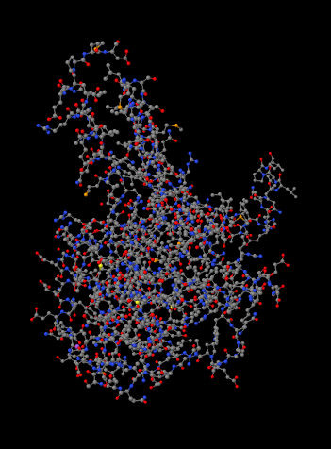
Protein-Structure Determination
Proteins essential to cellular function
  Structural support
  Catalysis/enzymatic activity
  Cell signaling
Protein structures determine function
X-ray crystallography main technique for determining structures

Slide 3
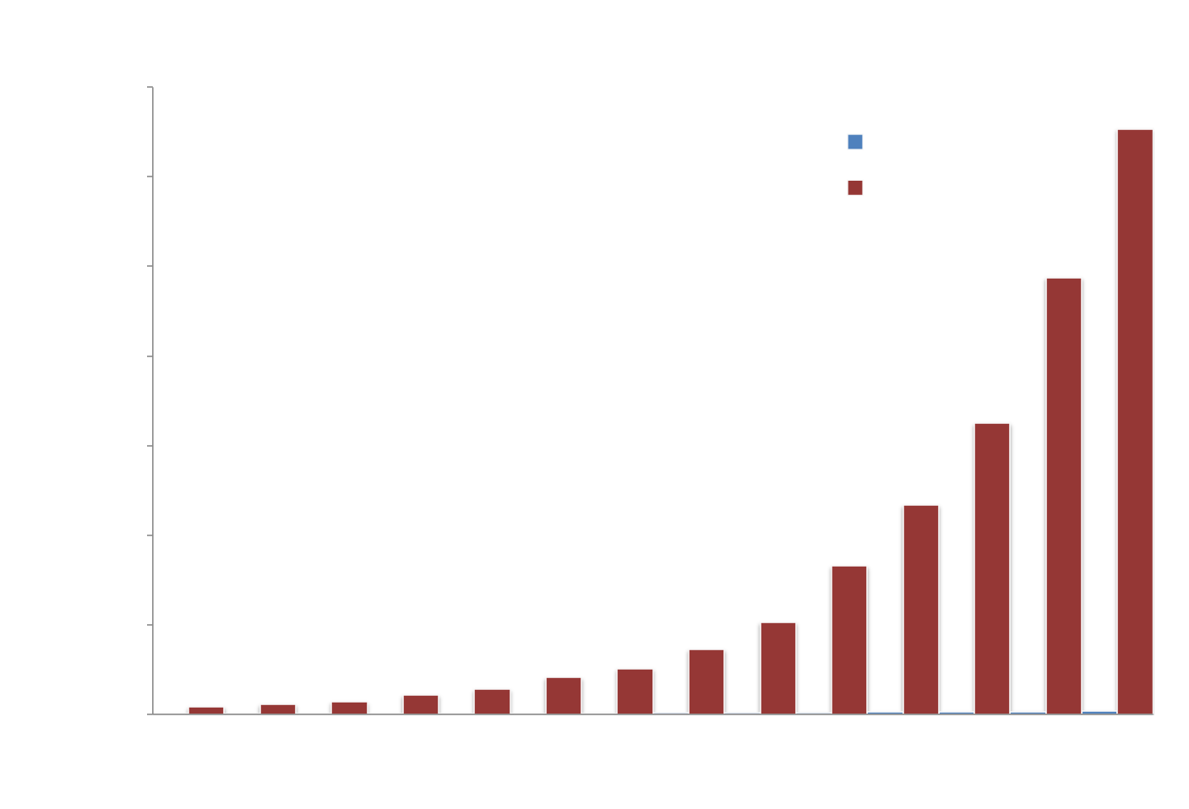
Sequences vs Structure Growth

Slide 4
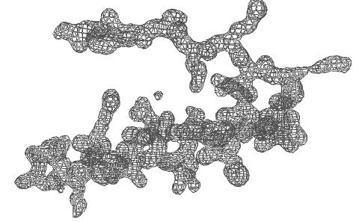
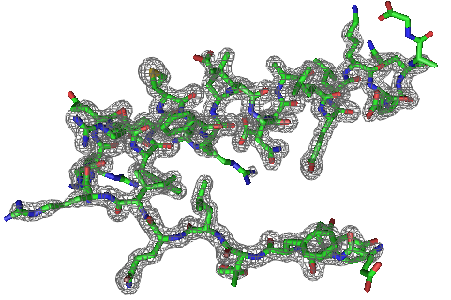
Task Overview
Given
  A protein sequence
  Electron-density map (EDM)
  of protein
Do
  Automatically produce a protein structure that
    Contains all atoms
    Is physically feasible
SAVRVGLAIM...
Notes:
Same as ab initio prediction, plus map
this is simple case
Prompt video

Slide 5
Thesis Statement
Using biochemical domain knowledge and enhanced algorithms for probabilistic inference will produce more accurate and more complete protein structures.
Notes:
SLOOOOWWWWWWW!
SLOOOOWWWWWWW!
SLOOOOWWWWWWW!
SLOOOOWWWWWWW!
SLOOOOWWWWWWW!

Slide 6
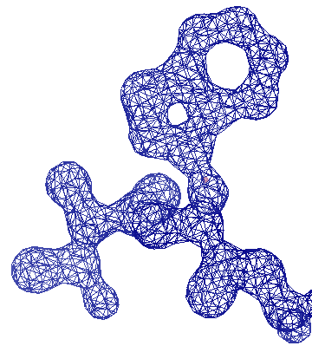
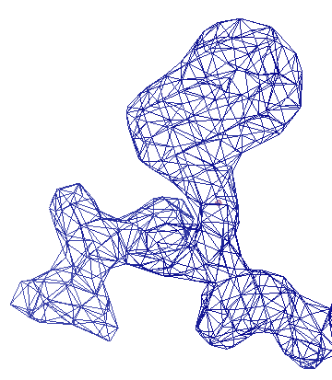
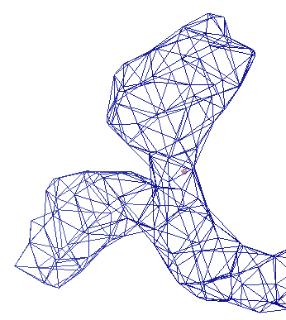
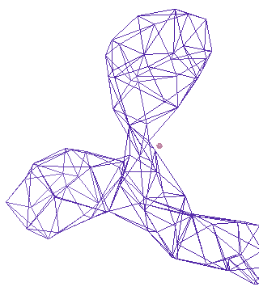
Challenges & Related Work
Resolution is a property of the protein
1 Å
2 Å
3 Å
4 Å
ARP/wARP
TEXTAL & RESOLVE
Higher Resolution : Better Image Quality
Our Method: ACMI
Notes:
Define Angstroms

Slide 7
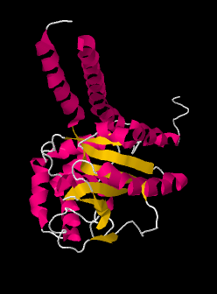
Outline
Background and Motivation
ACMI Roadmap and My Contributions
Inference in ACMI
Guided Belief Propagation
Probabilistic Ensembles in ACMI (PEA)
Conclusions and Future Directions

Slide 8
Outline
Background and Motivation
ACMI Roadmap and My Contributions
Inference in ACMI
Guided Belief Propagation
Probabilistic Ensembles in ACMI (PEA)
Conclusions and Future Directions

Slide 9
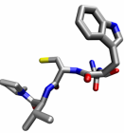
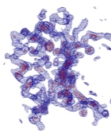
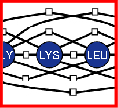
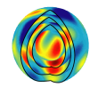
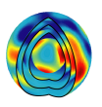
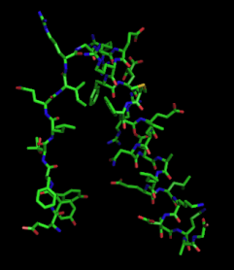
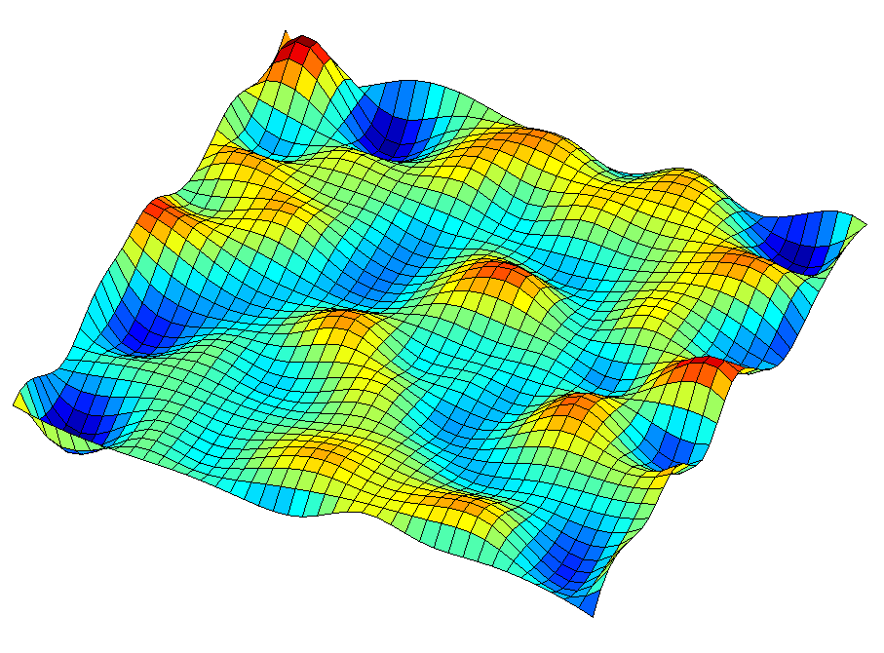
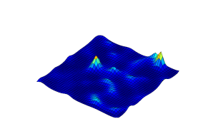
ACMI Roadmap
(Automated Crystallographic Map Interpretation)
Perform Local Match
Apply Global Constraints
Sample Structure
Phase 1
Phase 2
Phase 3
*1…M
b
b
k
k+1
b
k-1
prior probability of
each AA’s location
posterior probability
of each AA’s location
all-atom protein structures
Notes:
Automated Crystallographic Map Interpretation
Probabilistic model
3 phase
Phase 1: Independent search PARALLEL
Phase 2: Add in biochemical constraints, combine info INCONSISTENCIES
Phase 3: Sample structure BIOLOGISTS WANT

Slide 10
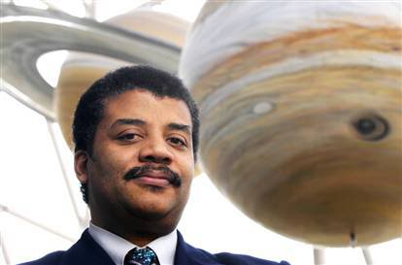
Analogy: Face Detection
Phase 1
Find Nose
Find Eyes
Find Mouth
Phase 2
Combine and
Apply Constraints
Phase 3
Infer Face

Slide 11
Phase 1: Local Match Scores
General CS area: 3D shape matching/object recognition
Given: EDM, sequence
Do: For each amino acid in the sequence, score its match to every location in the EDM
My Contributions
Spherical-harmonic decompositions for local match [DiMaio, Soni, Phillips, and Shavlik, BIBM 2007] {Ch. 7}
Filtering methods using machine learning
[DiMaio, Soni, Phillips, and Shavlik, IJDMB 2009] {Ch. 7}
Structural homology using electron density [Ibid.] {Ch. 7}

Slide 12
Phase 2: Apply Global Constraints
General CS area: Approximate probabilistic inference
Given: Sequence, Phase 1 scores, constraints
Do: Posterior probability for each amino acid’s
3D location given all evidence
My Contributions
Guided belief propagation using domain knowledge
[Soni, Bingman, and Shavlik, ACM BCB 2010] {Ch. 5}
Residual belief propagation in ACMI [Ibid.] {Ch. 5}
Probabilistic ensembles for improved inference
[Soni and Shavlik, ACM BCB 2011] {Ch. 6}

Slide 13
Phase 3: Sample Protein Structure
General CS area: Statistical sampling
Given: Sequence, EDM, Phase 2 posteriors
Do: Sample all-atom protein structure(s)
My Contributions
Sample protein structures using particle filters [DiMaio, Kondrashov, Bitto, Soni, Bingman, Phillips, Shavlik, Bioinformatics 2007] {Ch. 8}
Informed sampling using domain knowledge
[Unpublished elsewhere] {Ch. 8}
Aggregation of probabilistic ensembles in sampling
[Ibid. ACM BCB 2011] {Ch. 6}

Slide 14
Comparison to Related Work
[DiMaio, Kondrashov, Bitto, Soni, Bingman, Phillips, and Shavlik, Bioinformatics 2007]
[Ch. 8 of dissertation]
Notes:
*PURPOSE: ACMI is the leader, my results build on ACMI no further comparison
ARP/wARP
Bottom-up approach - add free atoms then constraints
TEXTAL:
Pattern-recognition based method
RESOLVE:
Top-down approach
Recognize secondary structure elements first

Slide 15
Outline
Background and Motivation
ACMI Roadmap and My Contributions
Inference in ACMI
Guided Belief Propagation
Probabilistic Ensembles in ACMI (PEA)
Conclusions and Future Directions

Slide 16
ACMI Roadmap
Perform Local Match
Apply Global Constraints
Sample Structure
Phase 1
Phase 2
Phase 3
*1…M
b
b
k
k+1
b
k-1
prior probability of
each AA’s location
posterior probability
of each AA’s location
all-atom protein structures

Slide 17
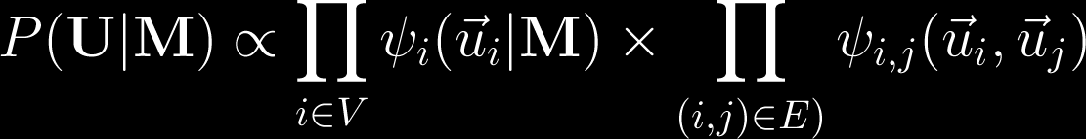
Phase 2 – Probabilistic Model
ACMI models the probability of all possible traces using a pairwise Markov Random Field (MRF)
ALA₁
GLY₂
LYS₃
LEU₄
SER₅
Notes:
MRF is undirected graphical model
Compact representation of full-joint probability
U is trace, M is map, A vertex represents an amino acid’s location, ui
An edge enforces a pairwise constraint between two amino acids

Slide 18
Size of Probabilistic Model
# nodes: ~1,000
# edges: ~1,000,000

Slide 19
Approximate Inference
Best structure intractable to calculate
  ie, we cannot infer the underlying structure analytically
Phase 2 uses Loopy Belief Propagation (BP) to approximate solution
  Local, message-passing scheme
  Distributes evidence among nodes
Convergence not guaranteed
Notes:
BP not guaranteed to converge
Marginal is posterior probability of a single variable

Slide 20
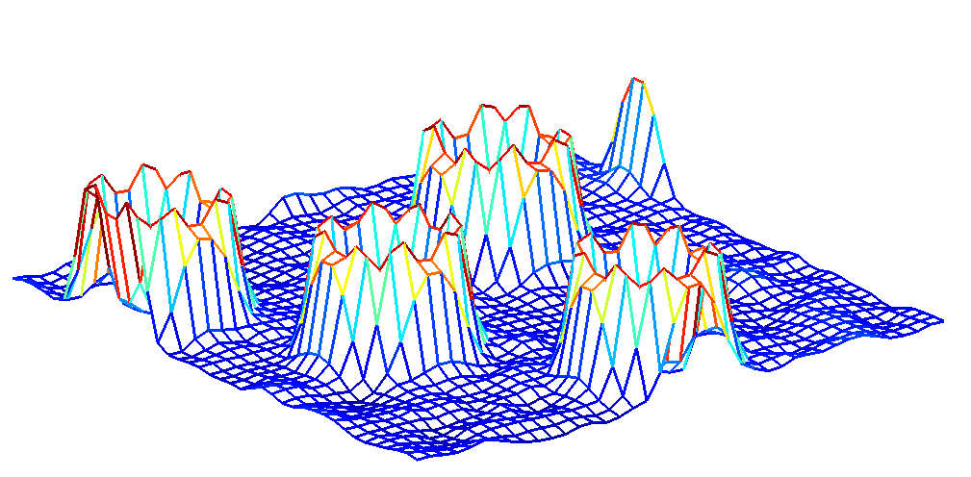
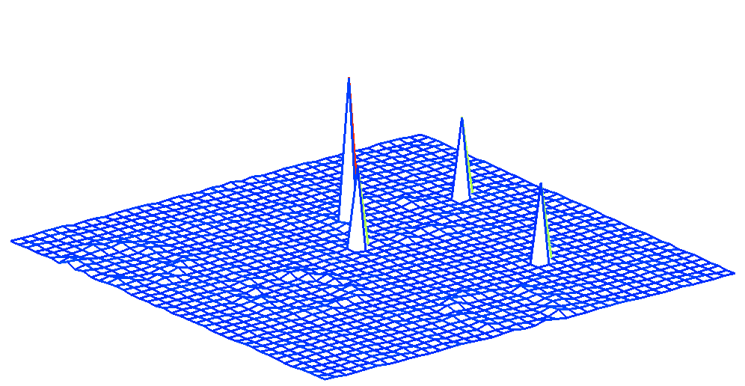
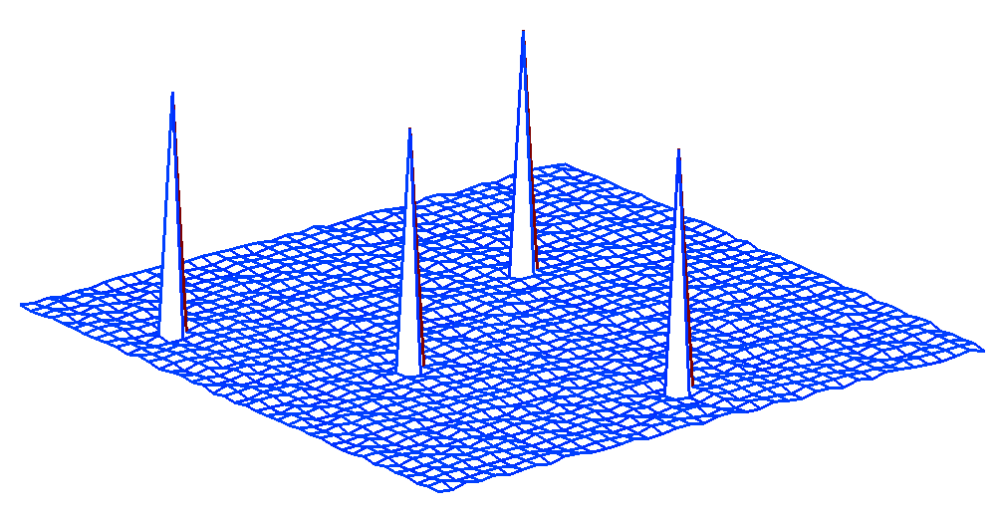
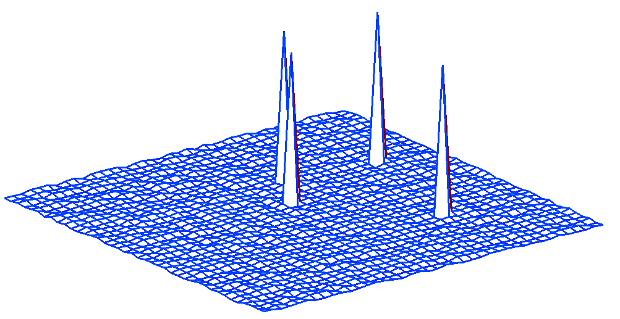
Example: Belief Propagation
LYS₃₁
LEU₃₂
m_{LYS31→LEU32}
p_{LYS31}
p_{LEU32}
Notes:
31 is sequence position
Node is passing info

Slide 21
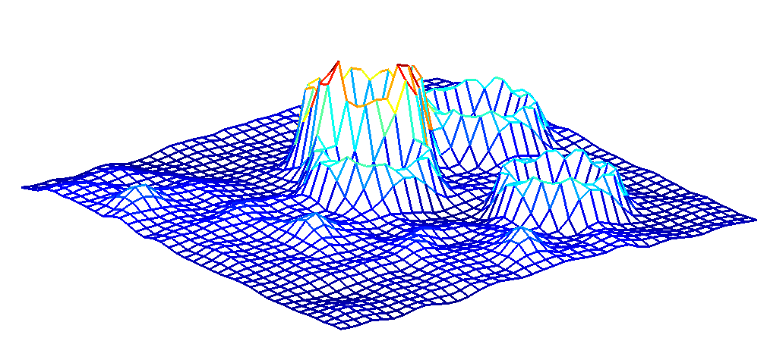
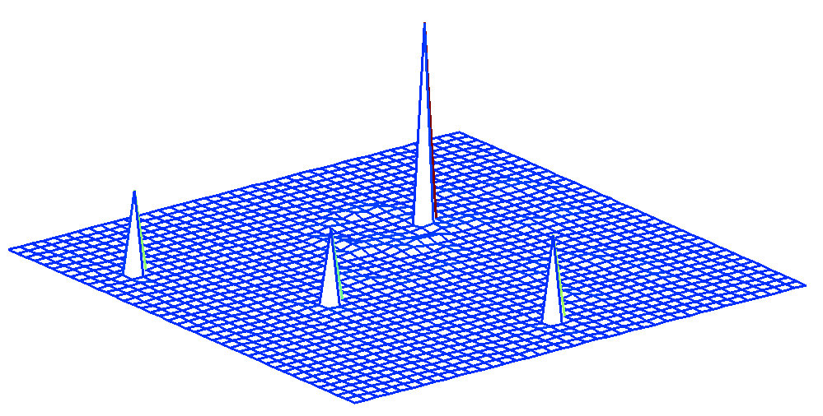
Example: Belief Propagation
LYS₃₁
LEU₃₂
m_{LEU32→LEU31}
p_{LYS31}
p_{LEU32}

Slide 22
Shortcomings of Phase 2
Inference is very difficult
  ~10⁶ possible locations for each amino acid
  ~100-1000s of amino acids in one protein
  Evidence is noisy
  O(N²) constraints
Solutions are approximate,
room for improvement

Slide 23
Outline
Background and Motivation
ACMI Roadmap and My Contributions
Inference in ACMI
Guided Belief Propagation
Probabilistic Ensembles in ACMI (PEA)
Conclusions and Future Directions

Slide 24
Message Scheduling [ACM-BCB 2010]{Ch. 5}
Key design choice: message-passing schedule
  When BP is approximate, ordering affects solution
  [Elidan et al, 2006]
Phase 2 uses a naïve, round-robin schedule
  Best case: wasted resources
  Worst case: poor information is excessive influence
ALA
LYS
SER
Notes:
Why does ordering affect results?

Slide 25
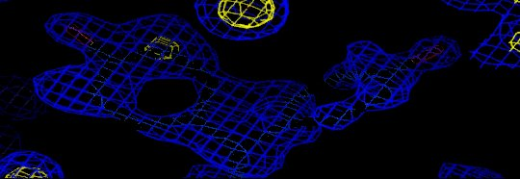
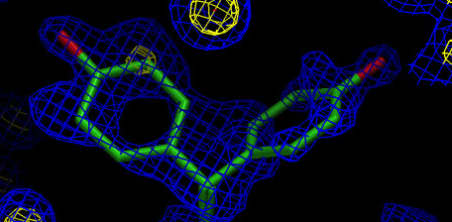
Using Domain Knowledge
Biochemist insight: well-structured regions of protein correlate with strong features in density map
  eg, helices/strands have stable conformations
Disordered regions are more difficult to detect
General idea: prioritize what order messages are sent using expert knowledge
  eg, disordered amino acids receive less priority
Notes:
***Our contribution***
Crystallographers use this knowledge for guidance
Expert can decide ordering of messages
should have more more reliable phase 1 probabilities
More ordered residues should have better info --> quicker convergence

Slide 26
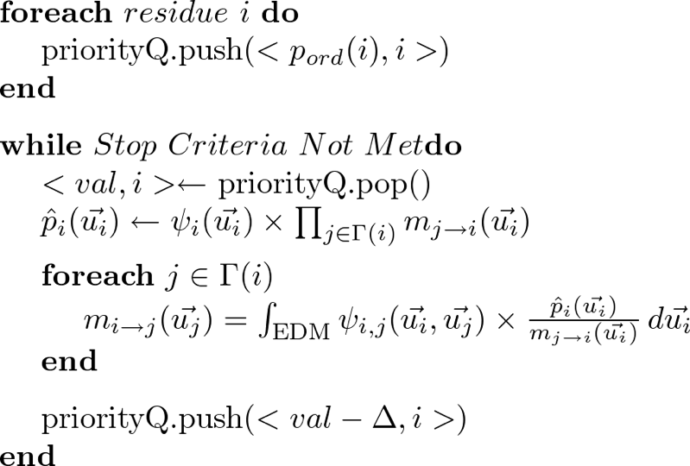
Guided Belief Propagation
Notes:
General method
p_ord should capture importance of variable
ACMI concentrates early iterations on more likely to be ordered residues
Disordered residues get more refined messages

Slide 27
Related Work
Assumption: messages with largest change in value are more useful
Residual Belief Propagation [Elidan et al, UAI 2006]
  Calculates residual factor for each node
  Each iteration, highest-residual node passes messages
  General BP technique
Notes:
General BP algo
New information is important
pushes information faster

Slide 28
Experimental Methodology
Our previous technique: naive, round robin (ORIG)
My new technique:
Guidance using disorder prediction (GUIDED)
  Disorder prediction using DisEMBL [Linding et al, 2003]
  Prioritize residues with high stability (ie, low disorder)
Residual factor (RESID) [Elidan et al, 2006]
Notes:
DisEMBL trained on “hot loops”, no secondary structure, high temperature factors, 60-70% for disorder and 80% for ordered

Slide 29
Experimental Methodology
Run whole ACMI pipeline
  Phase 1: Local amino-acid finder (prior probabilities)
  Phase 2: Either ORIG, GUIDED, RESID
  Phase 3: Sample all-atom structures from
  Phase 2 results
Test set of 10 poor-resolution electron-density maps
  From UW Center for Eukaryotic Structural Genomics
  Deemed the most difficult of a large set of proteins
Notes:
**SAME a priori probabilities
Previously solved, deemed to require significant human effort

Slide 30
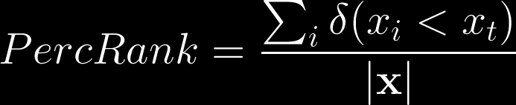
Phase 2 Accuracy: Percentile Rank
x | P(x)
A | 0.10
B | 0.30
C | 0.35
D | 0.20
E | 0.05
100%
Truth
Truth
60%

Slide 31
Phase 2 Marginal Accuracy
Notes:
Log likelihood of true solution – 2.5 orders of magnitude
GUIDE: 10%-point, RESID:18%-point

Slide 32
Protein-Structure Results
Do these better marginals produce more accurate protein structures?
RESID fails to produce structures in Phase 3
  Marginals are high in entropy (28.48 vs 5.31)
  Insufficient sampling of correct locations
Notes:
Entropy:
RESID 28.5, GUIDED 5.16, ORIG 5.31
Non-convergent oscillations – small group of nodes choked resources (median 5 vs 40)

Slide 33
Phase 3 Accuracy:
Correctness and Completeness
Correctness akin to precision – percent of predicted structure that is accurate
Completeness akin to recall – percent of true structure predicted accurately
Truth
Model A
Model B

Slide 34
Protein-Structure Results
Notes:
PRECISION vs RECALL
Most the same or better, dramatic improvement in the worst cases

Slide 35
Outline
Background and Motivation
ACMI Roadmap and My Contributions
Inference in ACMI
Guided Belief Propagation
Probabilistic Ensembles in ACMI (PEA)
Conclusions and Future Directions

Slide 36
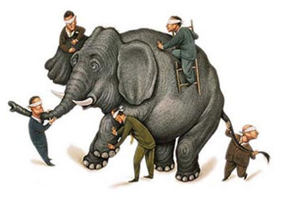
Ensemble Methods [ACM-BCB 2011]{Ch. 6}
Ensembles: the use of multiple models to improve predictive performance
Tend to outperform best single model [Dietterich ‘00]
  eg, 2010 Netflix prize

Slide 37
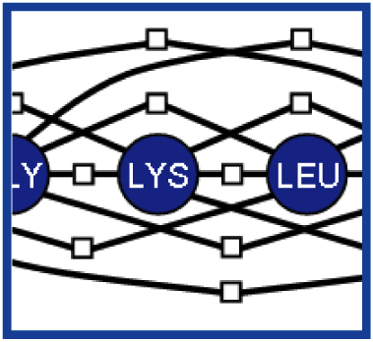
Phase 2: Standard ACMI
message-scheduler: how ACMI sends messages
MRF
Protocol
P(b_{k})

Slide 38
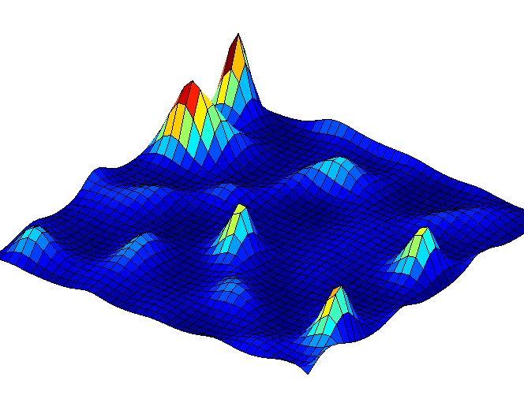
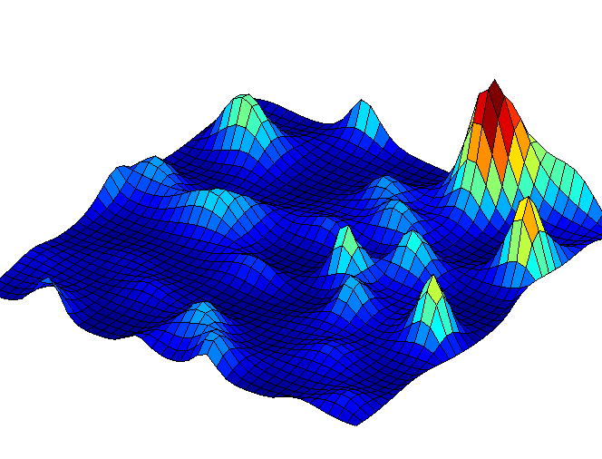
Phase 2: Ensemble ACMI
MRF
P₁(b_{k})
Protocol 1
Protocol 2
P₂(b_{k})
…
…
Protocol C
P_{C}(b_{k})

Slide 39
Probabilistic Ensembles in ACMI (PEA)
New ensemble framework (PEA)
  Run inference multiple times, under different conditions
  Output: multiple, diverse, estimates of each
  amino acid’s location
Phase 2 now has several probability distributions for each amino acid, so what?
  Need to aggregate distributions in Phase 3

Slide 40
ACMI Roadmap
Perform Local Match
Apply Global Constraints
Sample Structure
Phase 1
Phase 2
Phase 3
*1…M
b
b
k
k+1
b
k-1
prior probability of
each AA’s location
posterior probability
of each AA’s location
all-atom protein structures

Slide 41
Backbone Step (Prior Work)
Place next backbone atom
b'
b
k-1
k
?
?
?
?
b
k-2
?
(1) Sample b_{k} from empirical
Cα- Cα- Cα pseudoangle distribution

Slide 42
Backbone Step (Prior Work)
Place next backbone atom
b'
b
k-1
k
0.25
0.20
…
b
k-2
0.15
(2) Weight each sample by its
Phase 2 computed marginal

Slide 43
Backbone Step (Prior Work)
Place next backbone atom
b'
b
k-1
k
0.25
0.20
…
b
k-2
0.15
(3) Select b_{k} with probability
proportional to sample weight

Slide 44
Backbone Step for PEA
P₁(b'_{k})
P₂(b'_{k})
P_{C}(b'_{k})
b
0.23
0.15
0.04
k-1
b'
k
?
Aggregator
b
k-2
w(b'_{k})

Slide 45
Backbone Step for PEA: Average
P₁(b'_{k})
P₂(b'_{k})
P_{C}(b'_{k})
b
0.23
0.15
0.04
k-1
b'
k
?
AVG
b
k-2
0.14

Slide 46
Backbone Step for PEA: Maximum
P₁(b'_{k})
P₂(b'_{k})
P_{C}(b'_{k})
b
0.23
0.15
0.04
k-1
b'
k
?
MAX
b
k-2
0.23

Slide 47
Backbone Step for PEA: Sample
P₁(b'_{k})
P₂(b'_{k})
P_{C}(b'_{k})
b
0.23
0.15
0.04
k-1
b'
k
?
SAMP
b
k-2
0.15

Slide 48
Recap of ACMI (Prior Work)
b
0.25
k-1
0.20
Protocol
…
b
k-2
0.15
P(b_{k})
Phase 2
Phase 3

Slide 49
Recap of PEA
Protocol
b
0.14
k-1
0.26
Protocol
Aggregator
…
b
k-2
0.05
Protocol
Phase 2
Phase 3

Slide 50
Results: Impact of Ensemble Size
Notes:
7 proteins
50 prots
Average model
Larges leap to 10, no more growth after 20

Slide 51
Experimental Methodology
PEA (Probabilistic Ensembles in ACMI)
  4 ensemble components
  Aggregators: AVG, MAX, SAMP
ACMI
  ORIG – standard ACMI (prior work)
  EXT – run inference 4 times as long
  BEST – test best of 4 PEA components

Slide 52
Phase 2 Results: PEA vs ACMI
*p-value < 0.01
Notes:
SAMP doesn’t apply yet
89th percentile vs 66th
EXT → not just resources
BEST → not just luck
2 orders of magnitude probability

Slide 53
Protein-Structure Results: PEA vs ACMI
*p-value < 0.05
Notes:
10% extra correctness, 6% completeness
6 structs do better, 4 the same, 0 worse

Slide 54
Protein-Structure Results: PEA vs ACMI
Notes:
10% extra correctness, 6% completeness
6 structs do better, 4 the same, 0 worse
WHY AVERAGE?

Slide 55
Outline
Background and Motivation
ACMI Roadmap and My Contributions
Inference in ACMI
Guided Belief Propagation
Probabilistic Ensembles in ACMI (PEA)
Conclusions and Future Directions

Slide 56
My Contributions
Perform Local Match
Apply Global Constraints
Sample Structure
Local matching with spherical harmonics
First-pass filtering
Machine-learning search filter
Structural homology detection
Guided BP using domain knowledge
Residual BP in ACMI
Probabilistic Ensembles in ACMI
All-atom structure sampling using particle filters
Incorporating domain knowledge into sampling
Aggregation of ensemble estimates

Slide 57
Overall Conclusions
ACMI is the state-of-the-art method for determining protein structures in low-quality images
Broader implications
  Phase 1: Shape Matching, Signal Processing,
  Search Filtering
  Phase 2: Graphical models, Statistical Inference
  Phase 3: Sampling, Video Tracking
Structural biology is a good example of a challenging probabilistic inference problem
  Guiding BP and PEA are general solutions
Notes:
Future directions:

Slide 58
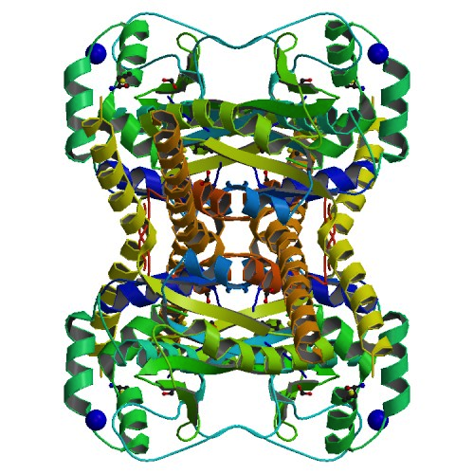
UCH37 [PDB 3IHR]
E. S. Burgie et al. Proteins: Structure, Function, and Bioinformatics. In-Press
Notes:
ACMI developed a preliminary model
Low resolution, making difficult to solve (2.95)
ARP failed, ACMI built a good initial model of key domain
de-ubiquitylating enzyme
Others obtained portions, but first time relationship between structural domains and oligomeric state was revealed

Slide 59
Further Work on ACMI
Advanced Filtering in Phase 1
Generalize Guided BP
  Requires domain knowledge priority function
Generalize PEA
  Learning; Compare to other approaches
More structures (membrane proteins)
Domain knowledge in Phase 3 scoring

Slide 60
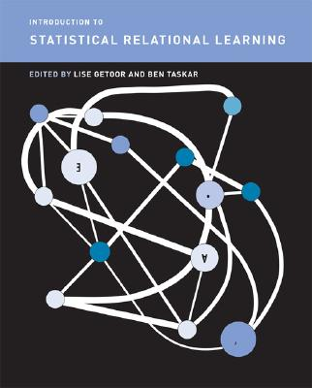
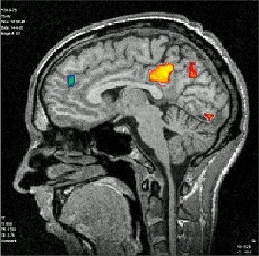
Future Work
Inference in complex domains
  Non-independent data
  Combining multiple object types
  Relations among data sets
Biomedical applications
  Medical diagnosis
  Brain imaging
  Cancer screening
  Health record analysis
Notes:
Future directions:

Slide 61
Acknowledgements
Advisor: Jude Shavlik
Committee: George Phillips, David Page, Mark Craven, Vikas Singh
Collaborators: Frank DiMaio and Sriraam Natarajan,
Craig Bingman, Sethe Burgie, Dmitry Kondrashov
Funding: NLM R01-LM008796, NLM Training Grant T15- LM007359, NIH PSI Grant GM074901
Practice Talk Attendees: Craig, Trevor, Deborah, Debbie, Aubrey
ML Group

Slide 62
Acknowledgements
Friends: Nick, Amy, Nate, Annie, Greg, Ila, 2*(Joe and Heather), Dana, Dave, Christine, Emily, Matt, Jen, Mike, Angela, Scott, Erica, and others
Family: Bharat, Sharmistha, Asha, Ankoor, and Emily
Dale, Mary, Laura, and Jeff

Slide 63

Thank you!

Slide 64
Publications
A. Soni and J. Shavlik, “Probabilistic ensembles for improved inference in protein-structure determination,” in Proceedings of the ACM International Conference on Bioinformatics and Computational Biology, 2011
A. Soni, C. Bingman, and J. Shavlik, “Guiding belief propagation using domain knowledge for protein-structure determination,” in Proceedings of ACM International Conference on Bioinformatics and Computational Biology, 2010.
E. S. Burgie, C. A. Bingman, S. L. Grundhoefer, A. Soni, and G. N. Phillips, Jr., “Structural characterization of Uch37 reveals the basis of its auto-inhibitory mechanism.” Proteins: Structure, Function, and Bioinformatics, In-Press. PDB ID: 3IHR.
F. DiMaio, A. Soni, G. N. Phillips, and J. Shavlik, “Spherical-harmonic decomposition for molecular recognition in electron-density maps,” International Journal of Data Mining and Bioinformatics, 2009.
F. DiMaio, A. Soni, and J. Shavlik, “Machine learning in structural biology: Interpreting 3D protein images,” in Introduction to Machine Learning and Bioinformatics, ed. Sushmita Mitra, Sujay Datta, Theodore Perkins, and George Michailidis, Ch. 8. 2008.
F. DiMaio, A. Soni, G. N. Phillips, and J. Shavlik, “Improved methods for template matching in electron-density maps using spherical harmonics,” in Proceedings of the IEEE International Conference on Bioinformatics and Biomedicine, 2007.
F. DiMaio, D. Kondrashov, E. Bitto, A. Soni, C. Bingman, G. Phillips, and J. Shavlik, “Creating protein models from electron-density maps using particle-filtering methods,” Bioinformatics, 2007.

