Slide 1

Probabilistic Ensembles for Improved Inference in
Protein-Structure Determination
Ameet Soni* and Jude Shavlik
Dept. of Computer Sciences
  Dept. of Biostatistics and Medical Informatics
Presented at the ACM International Conference on Bioinformatics and Computational Biology 2011
Notes:
Thank attendees
State TItle

Slide 2
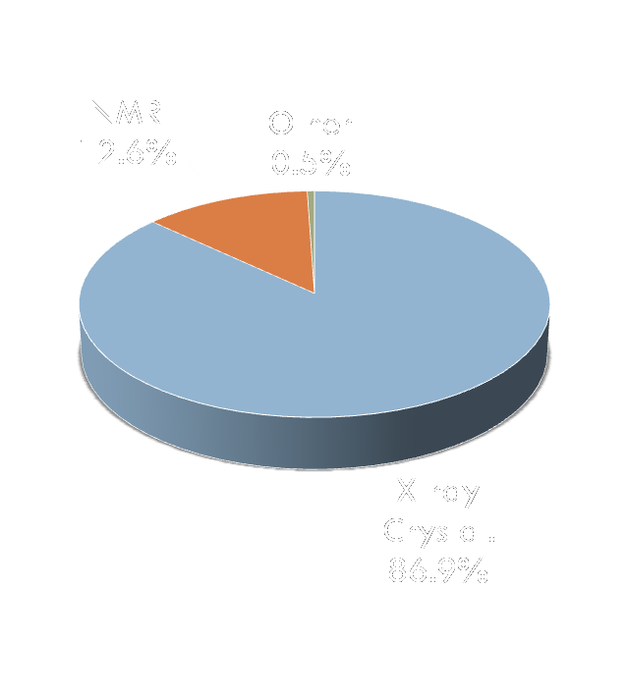
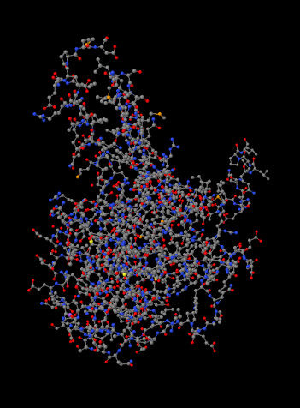
Protein Structure Determination
Proteins essential to most
cellular function
  Structural support
  Catalysis/enzymatic activity
  Cell signaling
Protein structures determine function
X-ray crystallography is main technique for determining structures

Slide 3
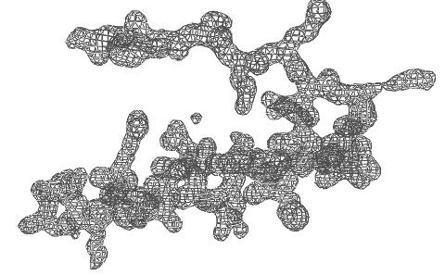
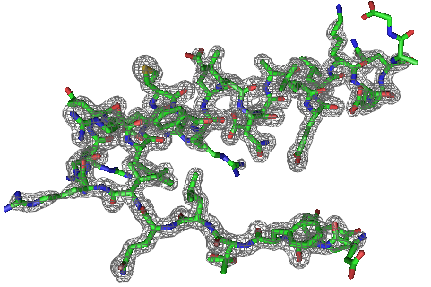
Task Overview
Given
  A protein sequence
  Electron-density map (EDM)
  of protein
Do
  Automatically produce a protein structure that
    Contains all atoms
    Is physically feasible
SAVRVGLAIM...
Notes:
Same as ab initio prediction, plus map
this is simple case
Prompt video

Slide 4
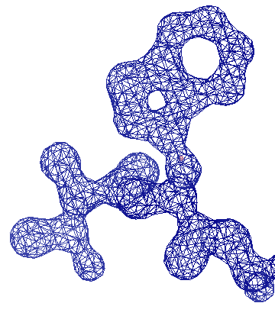
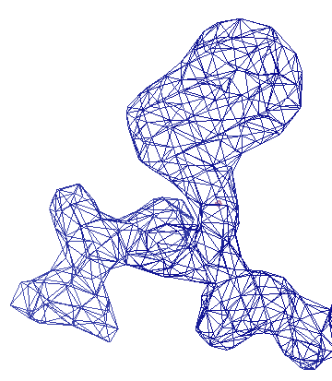
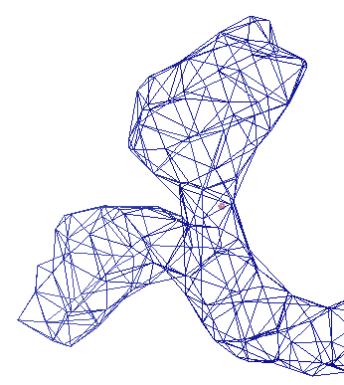
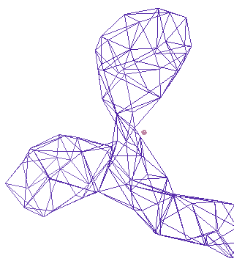
Challenges & Related Work
Resolution is a property of the protein
1 Å
2 Å
3 Å
4 Å
ARP/wARP
TEXTAL & RESOLVE
Higher Resolution : Better Quality
Our Method: ACMI
Notes:
Define Angstroms

Slide 5
Outline
Protein Structures
Prior Work on ACMI
Probabilistic Ensembles in ACMI (PEA)
Experiments and Results

Slide 6
Outline
Protein Structures
Prior Work on ACMI
Probabilistic Ensembles in ACMI (PEA)
Experiments and Results

Slide 7
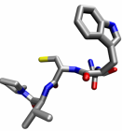
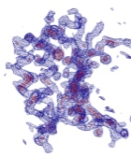
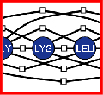
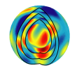
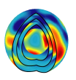
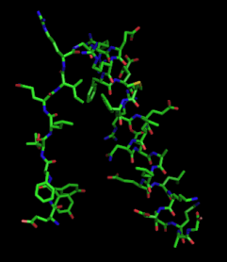
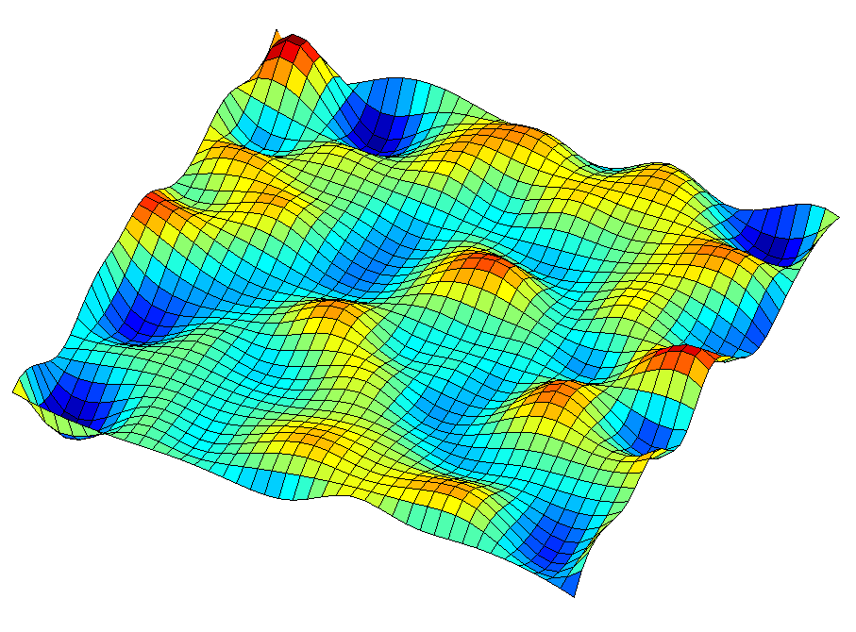
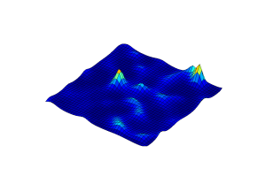
Our Technique: ACMI
Perform Local Match
Apply Global Constraints
Sample Structure
Phase 1
Phase 2
Phase 3
*1…M
b
b
k
k+1
b
k-1
prior probability of
each AA’s location
posterior probability
of each AA’s location
all-atom protein structures
Notes:
Automated Crystallographic Map Interpretation
Probabilistic model
3 phase
Phase 1: Independent search PARALLEL
Phase 2: Add in biochemical constraints, combine info INCONSISTENCIES
Phase 3: Sample structure BIOLOGISTS WANT

Slide 8
Results
[DiMaio, Kondrashov, Bitto, Soni, Bingman, Phillips, and Shavlik, Bioinformatics 2007]

Slide 9
ACMI Outline
Perform Local Match
Apply Global Constraints
Sample Structure
Phase 1
Phase 2
Phase 3
*1…M
b
b
k
k+1
b
k-1
prior probability of
each AA’s location
posterior probability
of each AA’s location
all-atom protein structures
Notes:
Automated Crystallographic Map Interpretation
Probabilistic model
3 phase
Phase 1: Independent search PARALLEL
Phase 2: Add in biochemical constraints, combine info INCONSISTENCIES
Phase 3: Sample structure BIOLOGISTS WANT

Slide 10
Phase 2 – Probabilistic Model
ACMI models the probability of all possible traces using a pairwise Markov Random Field (MRF)
ALA₁
GLY₂
LYS₃
LEU₄
SER₅
Notes:
MRF is undirected graphical model
Compact representation of full-joint probability
U is trace, M is map, A vertex represents an amino acid’s location, ui
An edge enforces a pairwise constraint between two amino acids

Slide 11
Probabilistic Model
# nodes: ~1,000
# edges: ~1,000,000
Notes:
MRF is undirected graphical model
Compact representation of full-joint probability
U is trace, M is map, A vertex represents an amino acid’s location, ui
An edge enforces a pairwise constraint between two amino acids

Slide 12
Approximate Inference
Best structure intractable to calculate
  i.e., we cannot infer the underlying structure analytically
Phase 2 uses Loopy Belief Propagation (BP) to approximate solution
  Local, message-passing scheme
  Distributes evidence between nodes
Notes:
BP not guaranteed to converge
Marginal is posterior probability of a single variable

Slide 13
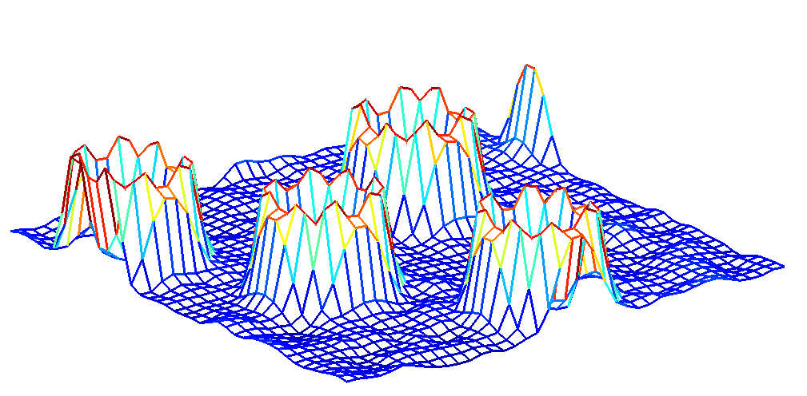
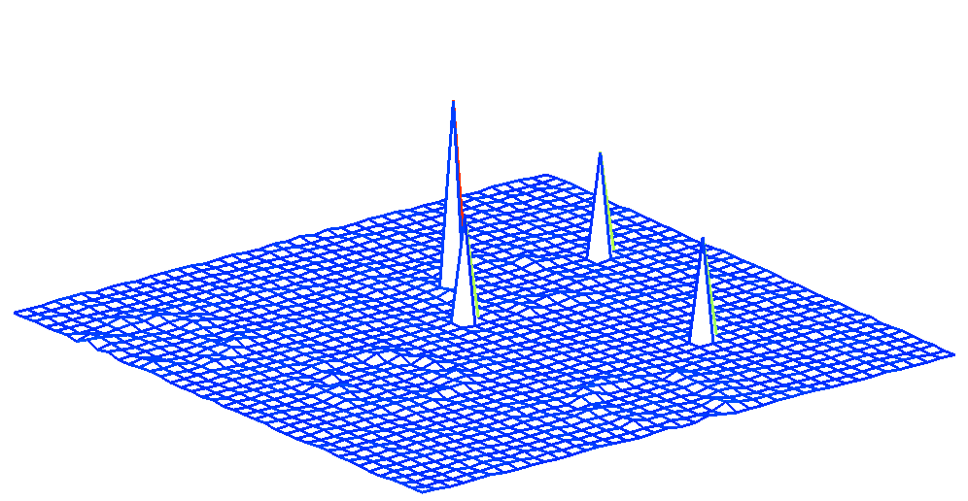
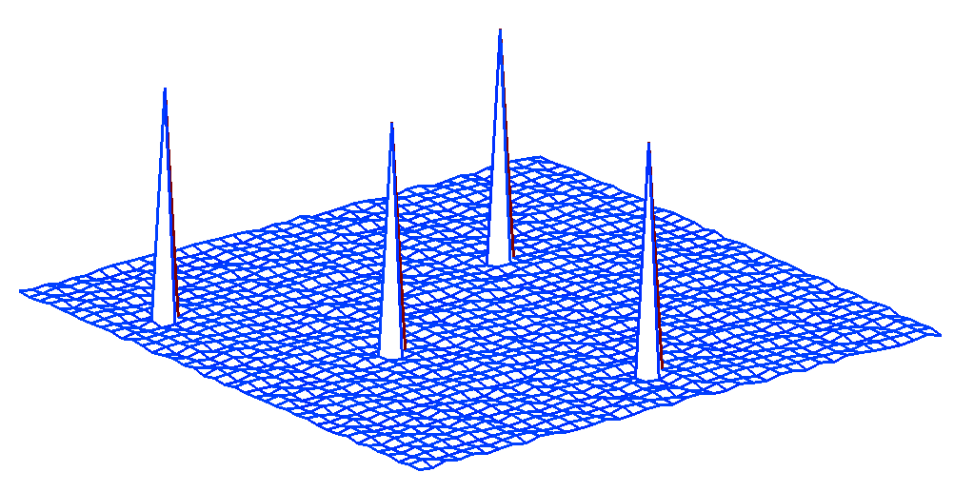
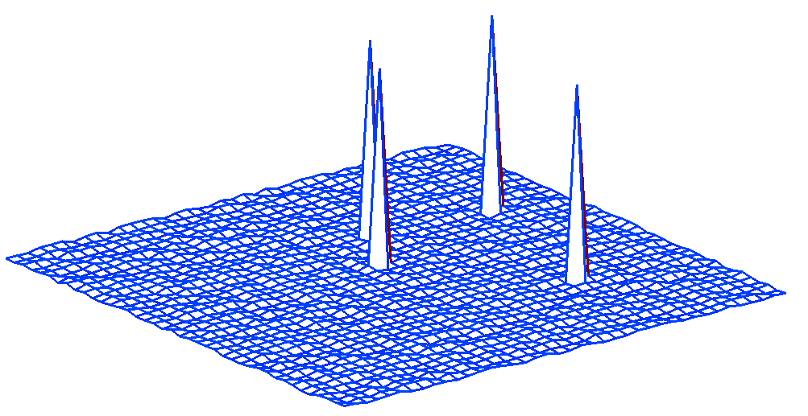
Loopy Belief Propagation
LYS₃₁
LEU₃₂
m_{LYS31→LEU32}
p_{LYS31}
p_{LEU32}
Notes:
31 is sequence position
Node is passing info

Slide 14
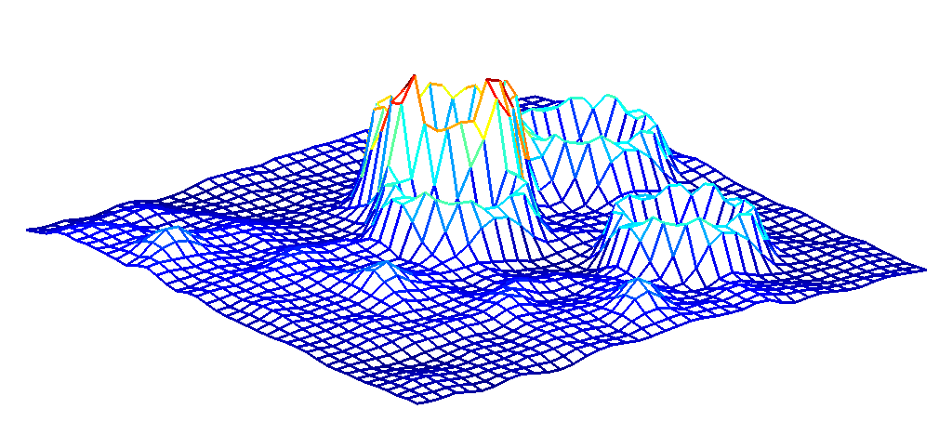
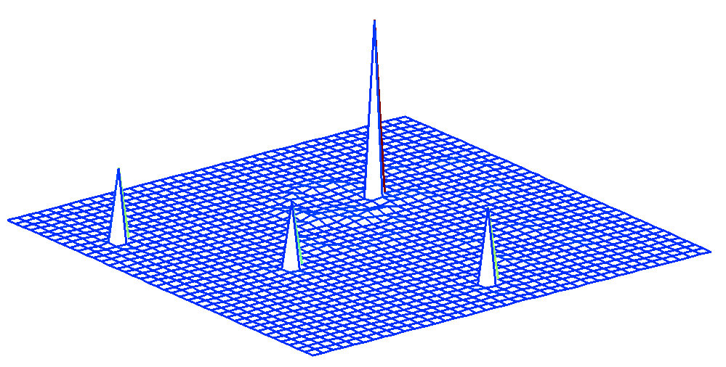
Loopy Belief Propagation
LYS₃₁
LEU₃₂
m_{LEU32→LEU31}
p_{LYS31}
p_{LEU32}

Slide 15
Shortcomings of Phase 2
Inference is very difficult
  ~1,000,000 possible outputs for one amino acid
  ~250-1250 amino acids in one protein
  Evidence is noisy
  O(N²) constraints
Approximate solutions, room for improvement

Slide 16
Outline
Protein Structures
Prior Work on ACMI
Probabilistic Ensembles in ACMI (PEA)
Experiments and Results

Slide 17

Ensemble Methods
Ensembles: the use of multiple models to improve predictive performance
Tend to outperform best single model [Dietterich ‘00]
  Eg, Netflix prize

Slide 18
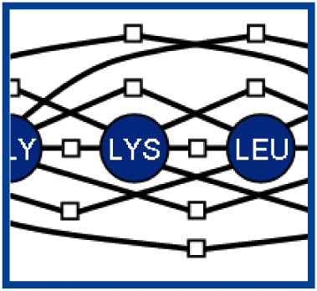
Phase 2: Standard ACMI
MRF
Protocol
P(b_{k})

Slide 19
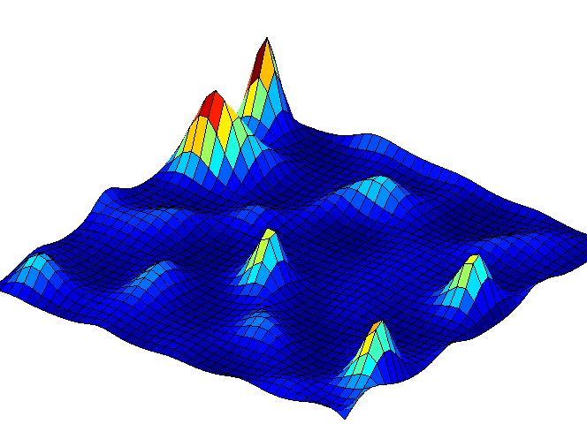
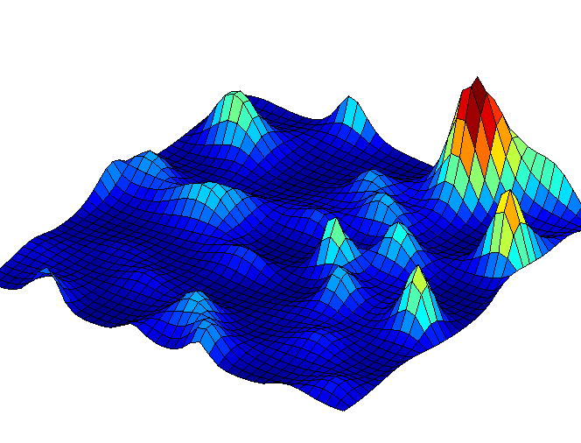
Phase 2: Ensemble ACMI
MRF
P₁(b_{k})
Protocol 1
Protocol 2
P₂(b_{k})
…
…
Protocol C
P_{C}(b_{k})

Slide 20
Probabilistic Ensembles in ACMI (PEA)
New ensemble framework (PEA)
  Run inference multiple times, under different conditions
  Output: multiple, diverse, estimates of each amino acid’s location
Phase 2 now has several probability distributions for each amino acid, so what?

Slide 21
ACMI Outline
Perform Local Match
Apply Global Constraints
Sample Structure
Phase 1
Phase 2
Phase 3
*1…M
b
b
k
k+1
b
k-1
prior probability of
each AA’s location
posterior probability
of each AA’s location
all-atom protein structures
Notes:
Automated Crystallographic Map Interpretation
Probabilistic model
3 phase
Phase 1: Independent search PARALLEL
Phase 2: Add in biochemical constraints, combine info INCONSISTENCIES
Phase 3: Sample structure BIOLOGISTS WANT

Slide 22
Backbone Step (Prior work)
Place next backbone atom
b'
b
k-1
k
?
?
?
?
b
k-2
?
(1) Sample b_{k} from empirical
Cα- Cα- Cα pseudoangle distribution
Notes:
Why not take max?

Slide 23
Backbone Step (Prior work)
Place next backbone atom
b'
b
k-1
k
0.25
0.20
…
b
k-2
0.15
(2) Weight each sample by its
Phase 2 computed marginal

Slide 24
Backbone Step (Prior work)
Place next backbone atom
b'
b
k-1
k
0.25
0.20
…
b
k-2
0.15
(3) Select b_{k} with probability
proportional to sample weight

Slide 25
Backbone Step for PEA
P₁(b'_{k})
P₂(b'_{k})
P_{C}(b'_{k})
b
0.23
0.15
0.04
k-1
b'
k
?
Aggregator
b
k-2
w(b'_{k})

Slide 26
Backbone Step for PEA: Average
P₁(b'_{k})
P₂(b'_{k})
P_{C}(b'_{k})
b
0.23
0.15
0.04
k-1
b'
k
?
AVG
b
k-2
0.14

Slide 27
Backbone Step for PEA: Maximum
P₁(b'_{k})
P₂(b'_{k})
P_{C}(b'_{k})
b
0.23
0.15
0.04
k-1
b'
k
?
MAX
b
k-2
0.23

Slide 28
Backbone Step for PEA: Sample
P₁(b'_{k})
P₂(b'_{k})
P_{C}(b'_{k})
b
0.23
0.15
0.04
k-1
b'
k
?
SAMP
b
k-2
0.15

Slide 29
Review: Previous work on ACMI
b
0.25
k-1
0.20
Protocol
…
b
k-2
0.15
P(b_{k})
Phase 2
Phase 3

Slide 30
Review: PEA
Protocol
b
0.14
k-1
0.26
Protocol
AGG
…
b
k-2
0.05
Protocol
Phase 2
Phase 3

Slide 31
Outline
Protein Structures
Prior Work on ACMI
Probabilistic Ensembles in ACMI (PEA)
Experiments and Results

Slide 32
Experimental Methodology
PEA (Probabilistic Ensembles in ACMI)
  4 ensemble components
  Aggregators: AVG, MAX, SAMP
ACMI
  ORIG – standard ACMI (prior work)
  EXT – run inference 4 times as long
  BEST – test best of 4 PEA components

Slide 33
Phase 2 Results
*p-value < 0.01
Notes:
SAMP doesn’t apply yet
89th percentile vs 66th
EXT → not just resources
BEST → not just luck
2 orders of magnitude probability

Slide 34
Protein Structure Results
Correctness
Completeness
*p-value < 0.05
Notes:
10% extra correctness, 6% completeness
6 structs do better, 4 the same, 0 worse

Slide 35
Protein Structure Results
Notes:
10% extra correctness, 6% completeness
6 structs do better, 4 the same, 0 worse

Slide 36
Impact of Ensemble Size

Slide 37
Conclusions
ACMI is the state-of-the-art method for determining protein structures in poor-resolution images
Probabilistic Ensembles in ACMI (PEA) improves approximate inference, produces better protein structures
Future Work
  General solution for inference
  Larger ensemble size
Notes:
Future directions:

Slide 38
Acknowledgements
Phillips Laboratory at UW - Madison
UW Center for Eukaryotic Structural Genomics (CESG)
NLM R01-LM008796
NLM Training Grant T15-LM007359
NIH Protein Structure Initiative Grant GM074901
Thank you!
Notes:
Future directions:

Slide 40
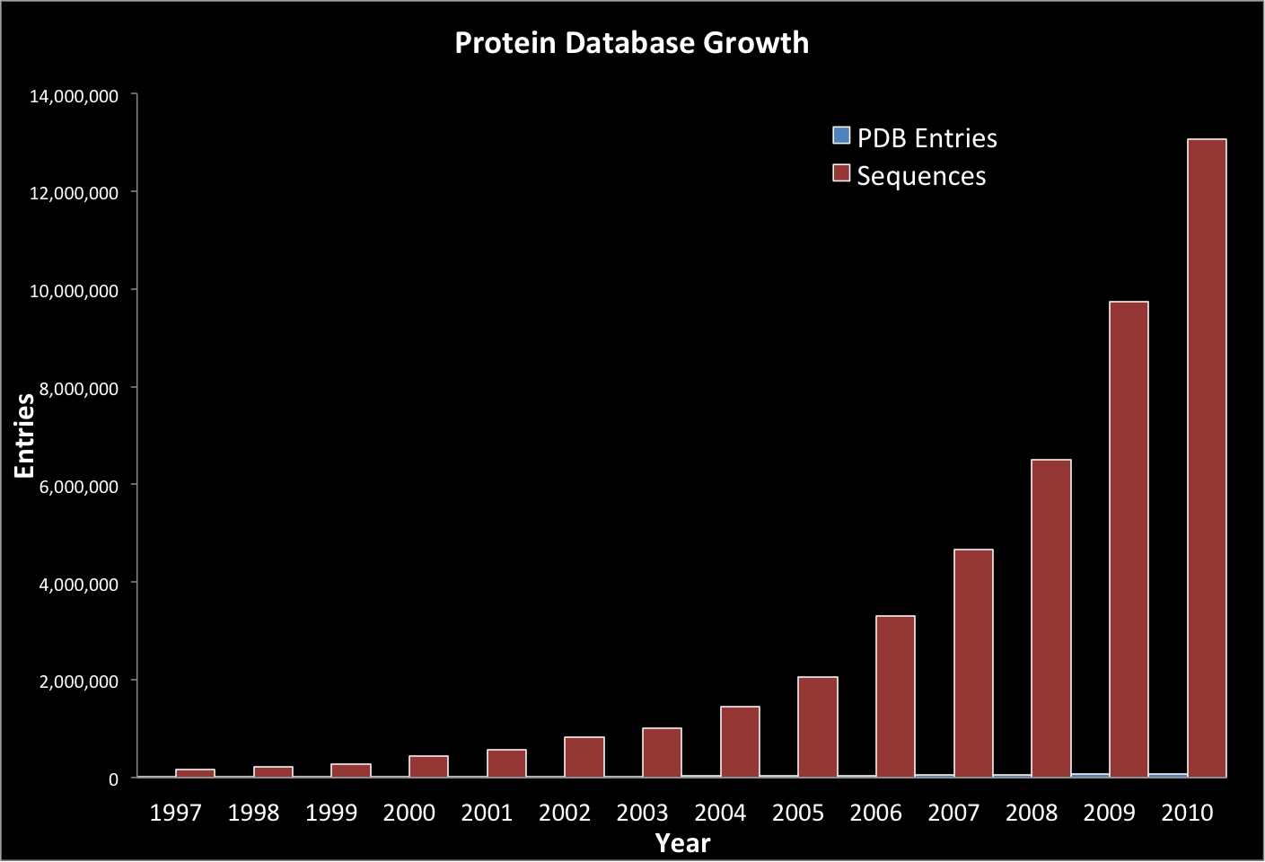
Sequences vs Structure Growth

Slide 41
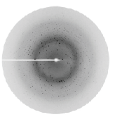
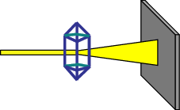
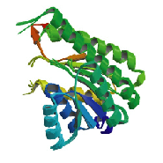
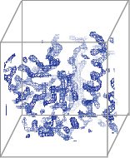
X-ray Crystallography: Background
Protein Crystal
Collect
Diffraction pattern
X-ray Beam
FFT
Protein
Structure
Interpret
Electron-Density
Map (3D Image)
Notes:
DEFINE MAP!
This is simple looking case

Slide 42
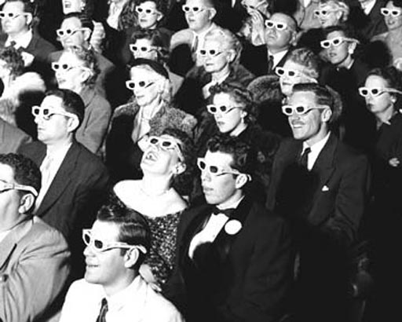
Proteins in 3D!!!

Slide 43
Testset Density Maps (raw data)
43
75
60
Density-map mean phase error (deg.)
45
30
15
1.0
2.0
3.0
4.0
Density-map resolution (Å)

Slide 44
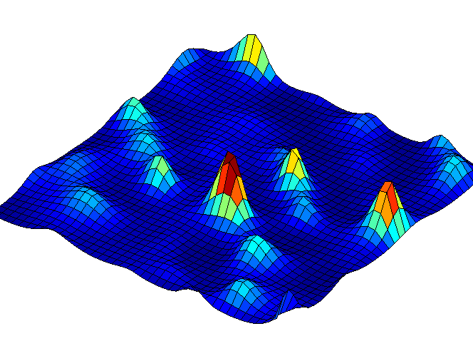
Probabilistic Model
ALA
GLY
LYS
LEU
SER
Model ties adjacency constraints, occupancy constraints, and Phase 1 priors
Notes:
combine visual evidence with chemical constraints
Adjacency constraint - 3.8A
Occupancy potential

Slide 45
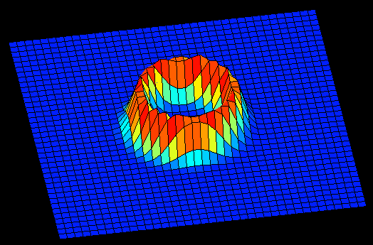
Backbone Model Potential
Constraints between adjacent amino acids:
=
x
Notes:
combine visual evidence with chemical constraints
Adjacency constraint - 3.8A
Occupancy potential

Slide 46



Slide 47
Phase 3: Ensemble ACMI
Protocol 1
Combiner
?
?
?
Protocol 2
?
?
Protocol N
MRF

Slide 48

Phase 3
[DiMaio, Kondrashov, Bitto, Soni, Bingman, Phillips, and Shavlik, Bioinformatics 2007]
Represents the space of possible structures using
  Particles: specific “guesses” of protein structure
  Weights: evaluation score for each particle
Notes:
Give Frank credit
This is important for my last portion

Slide 49
Phase 2 results

