Slide 1

Guiding Belief Propagation using Domain Knowledge for
Protein-Structure Determination
Ameet Soni* and Jude Shavlik
  Dept. of Computer Sciences
  Dept. of Biostatistics and Medical Informatics
Craig Bingman
  Dept. of Biochemistry
  Center for Eukaryotic Structural Genomics
Presented at the ACM International Conference on Bioinformatics and Computational Biology 2010
Notes:
Thank attendees, session chair
Title
Co-authors
UW-Madison

Slide 2
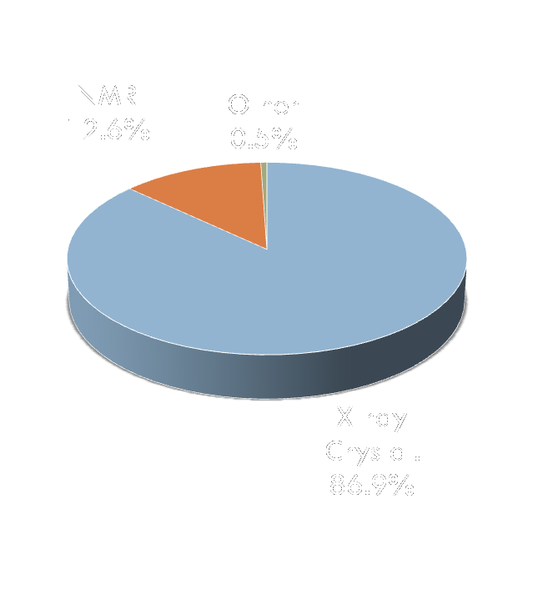
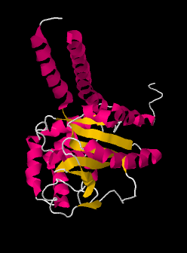
Protein Structure Determination
2
Proteins essential to most cellular function
  Structural support
  Catalysis/enzymatic activity
  Cell signaling
Protein structures determine function
X-ray crystallography is main technique for determining structures
Notes:
Why proteins?
Why structures?
Why X-ray?
-ab initio still not there

Slide 3
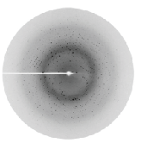
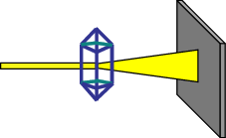
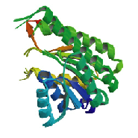
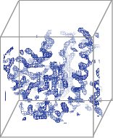
X-ray Crystallography: Background
3
Protein Crystal
Collect
Diffraction pattern
X-ray Beam
FFT
Protein
Structure
Interpret
Electron-Density
Map (3D Image)
Notes:
Thread sequence
Major bottleneck is the last step
Automated methods needed for high throughput pipeline
This is simple looking case

Slide 4
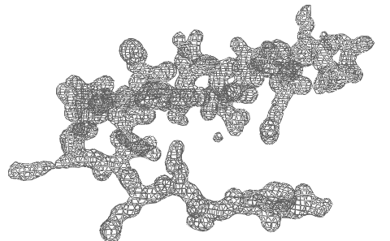
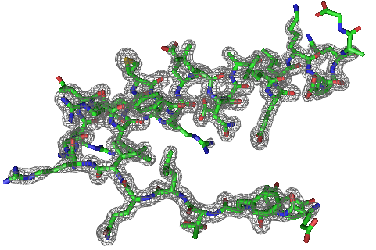
Task Overview
4
Given:
  A protein sequence
  Electron-density map (EDM) of protein
Do:
  Automatically produce a protein structure (or trace) that is
    All atom
    Physically feasible
SAVRVGLAIM...
Notes:
Same as ab initio prediction, plus map
this is simple case

Slide 5
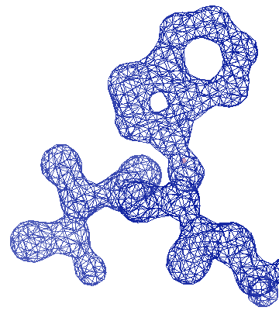
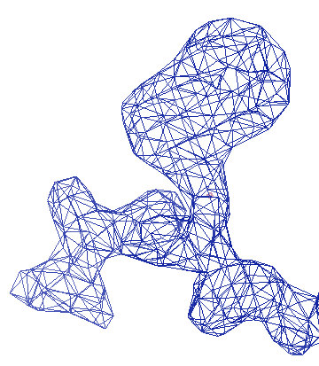
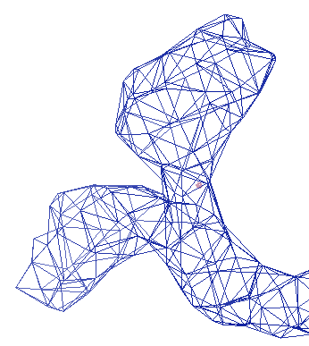
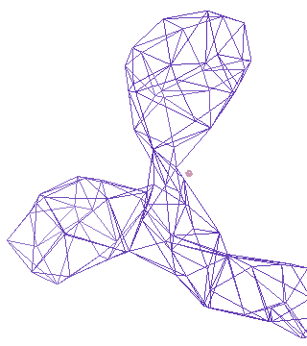
Challenges & Related Work
5
1 Å
2 Å
3 Å
4 Å
ARP/wARP
TEXTAL & RESOLVE
Our Method: ACMI
Notes:
ARP/wARP most popular technique
poor resolution is property of protein
Arrows are primary focus

Slide 6
ACMI Overview
- Background
6
- Inference in ACMI-BP
- Guiding Belief Propagation
- Experiments & Results

Slide 7
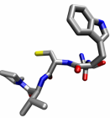
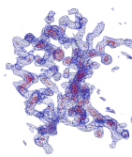
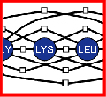
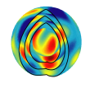
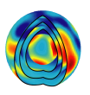
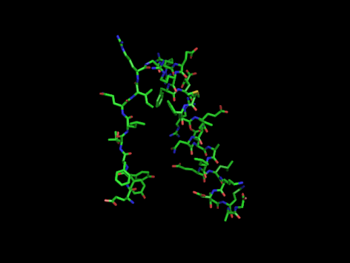
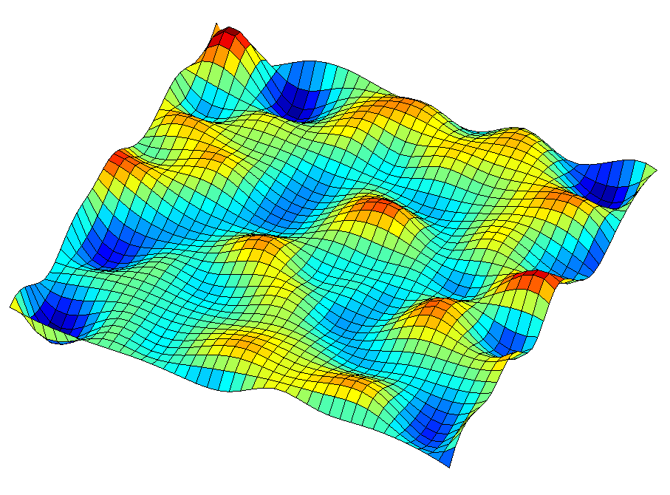
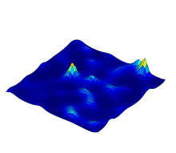
Our Technique: ACMI
7
Perform Local Match
Apply Global Constraints
Sample Structure
ACMI-SH
ACMI-BP
ACMI-PF
*1…M
b
b
k+1
*1
k
p_{k+1}(b )
k+1
*2
p_{k+1}(b )
…
k+1
b
*M
k-1
p_{k+1}(b )
k+1
a priori probability of
each AA’s location
marginal probability
of each AA’s location
all-atom protein structures
Notes:
Automated Crystallographic Map Interpretation
Probabilistic model
3 phase

Slide 8
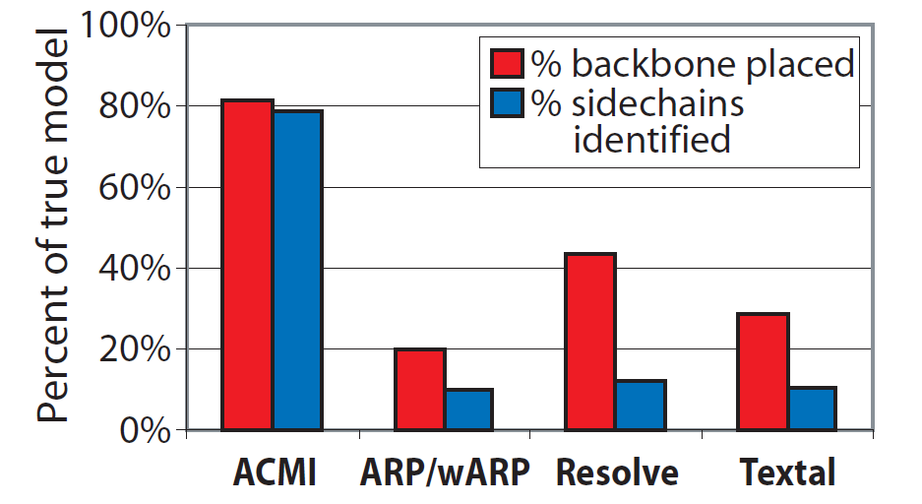
Previous Work [DiMaio et al, 2007]
8

Slide 9
ACMI Framework
9
Perform Local Match
Apply Global Constraints
Sample Structure
ACMI-SH
ACMI-BP
ACMI-PF
*1…M
b
b
k+1
*1
k
p_{k+1}(b )
k+1
*2
p_{k+1}(b )
…
k+1
b
*M
k-1
p_{k+1}(b )
k+1
a priori probability of
each AA’s location
marginal probability
of each AA’s location
all-atom protein structures
Notes:
We focus on on #2

Slide 10
Inference in ACMI-BP
- Background
- ACMI Overview
10
- Guiding Belief Propagation
- Experiments & Results

Slide 11
ACMI-BP
11
ACMI models the probability of all possible traces using a pairwise Markov Random Field (MRF)
ALA
GLY
LYS
LEU
SER
Notes:
MRF is undirected graphical model
Compact representation of full-joint probability
U is trace, M is map, A vertex represents an amino acid’s location, ui
An edge enforces a pairwise constraint between two amino acids

Slide 12
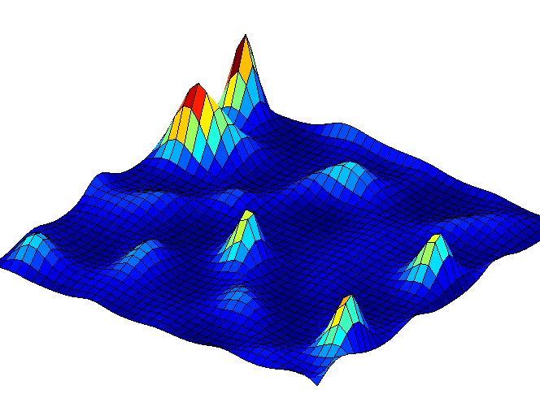
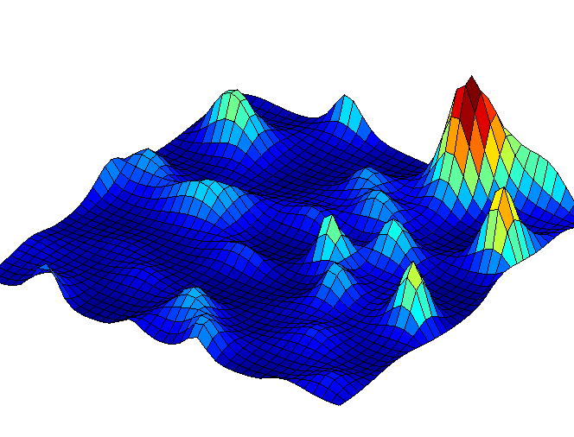
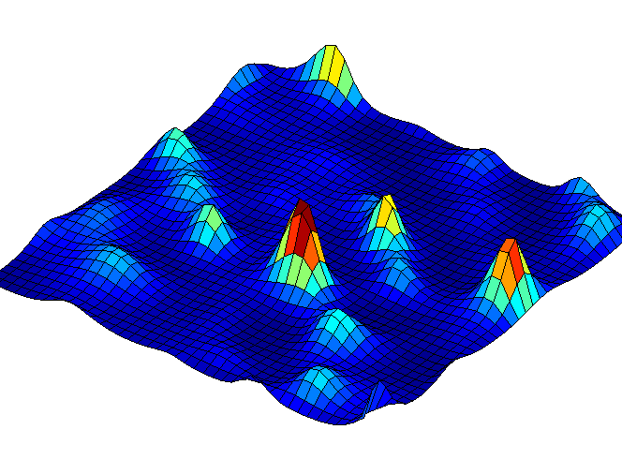
ACMI-BP: Pairwise Markov Field
12
ALA
GLY
LYS
LEU
SER
Model ties adjacency constraints, occupancy constraints, and Phase 1 priors
Notes:
combine visual evidence with chemical constraints
Adjacency constraint - 3.8A
Occupancy potential

Slide 13
Approximate Inference
13
P(U|M) intractable to calculate, maximize exactly
ACMI-BP uses Loopy Belief Propagation (BP)
  Local, message-passing scheme
  Distributes evidence between nodes
  Approximates marginal probabilities if graph has cycles
Notes:
BP not guaranteed to converge
Marginal is posterior probability of a single variable

Slide 14
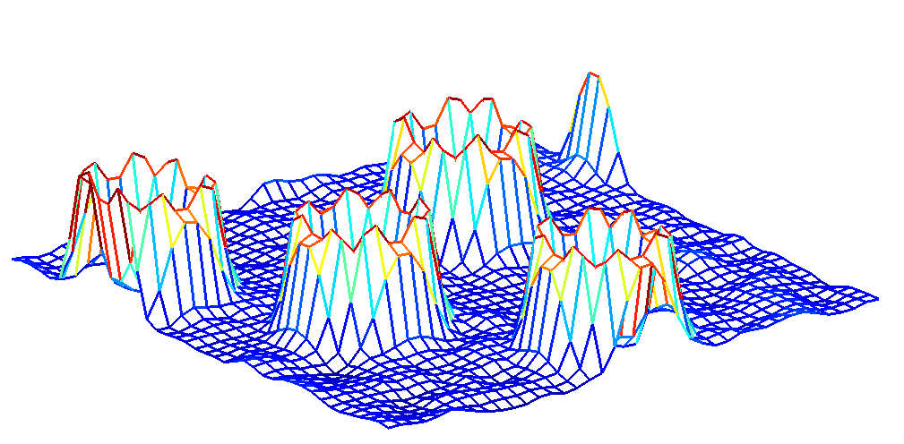
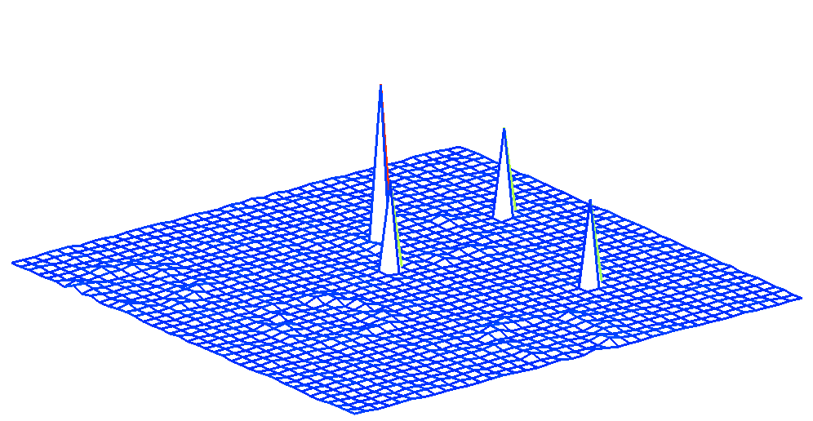
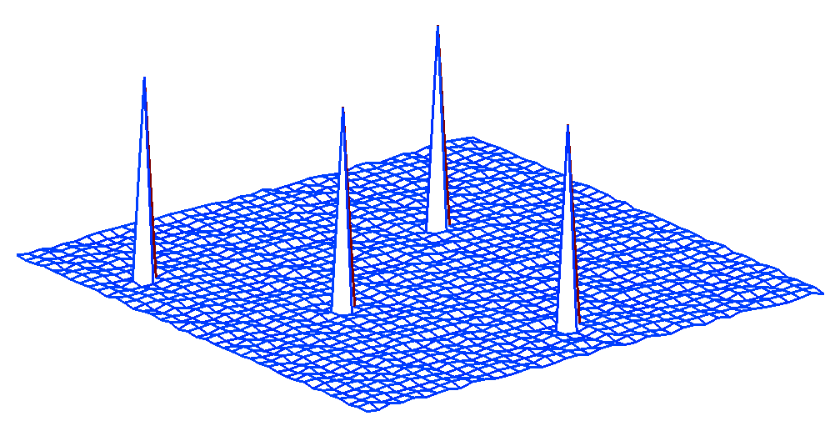
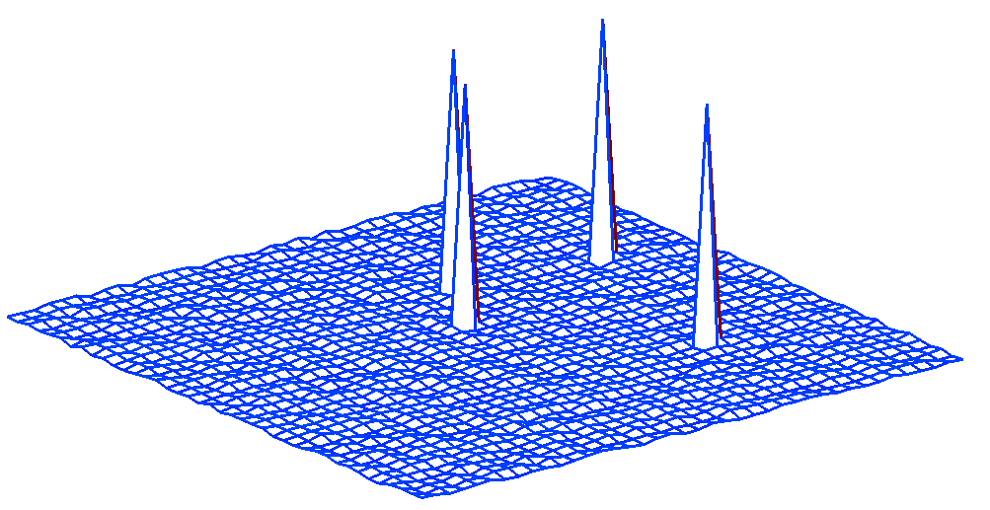
ACMI-BP: Loopy Belief Propagation
14
LYS₃₁
LEU₃₂
m_{LYS31→LEU32}
p_{LYS31}
p_{LEU32}
Notes:
FAST!!!!!!!!!!!!!!
one message being passed

Slide 15
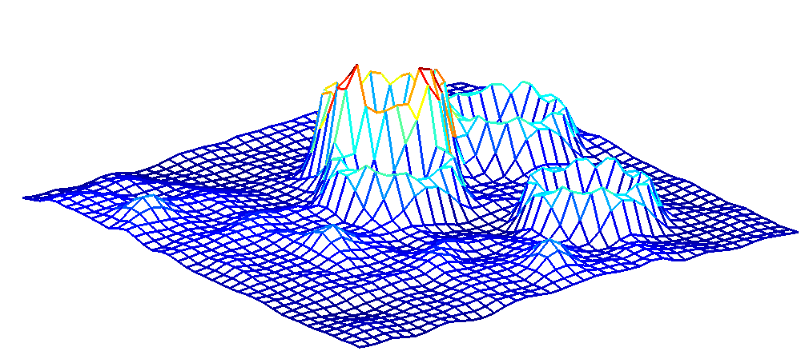
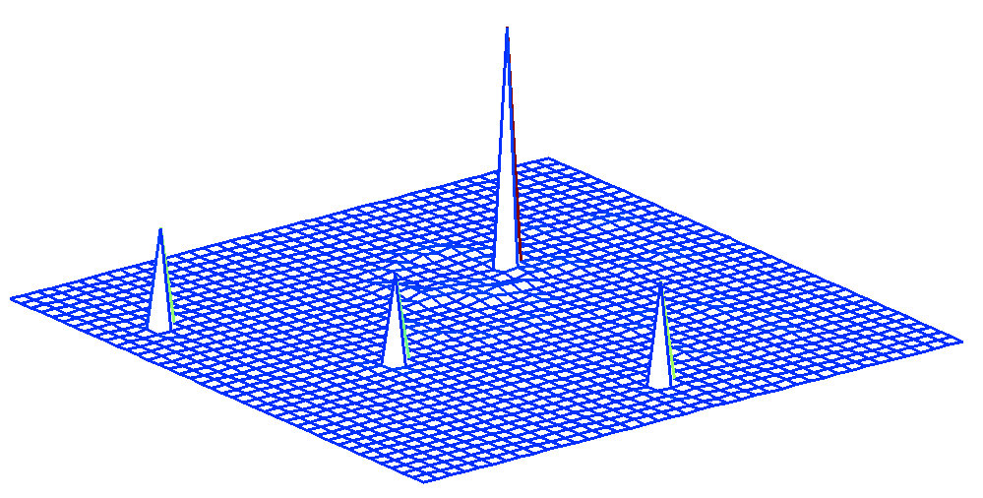
ACMI-BP: Loopy Belief Propagation
15
LYS₃₁
LEU₃₂
m_{LEU32→LEU31}
p_{LYS31}
p_{LEU32}

Slide 16
Guiding Belief Propagation
- Background
- ACMI Overview
- Inference in ACMI-BP
16
- Experiments & Results

Slide 17
Message Scheduling
17
Key design choice: message-passing schedule
  When BP is approximate, ordering affects solution
  [Elidan et al, 2006]
ACMI-BP uses a naïve, round-robin schedule
  Best case: wasted resources
  Worst case: poor information given more influence
ALA
LYS
SER
Notes:
each iteration
-node accepts all messages, updates belief
-calculates outgoing messages
BP: left to right, then reverse

Slide 18
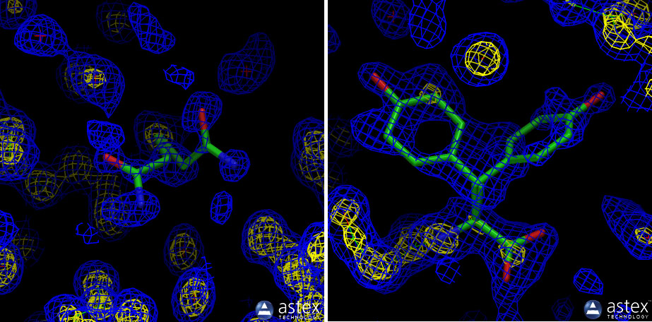
Using Domain Knowledge
18
Idea: use expert to assign importance of messages
Biochemist insight: well-structured regions of protein correlate with strong features in density map
  eg, helices/strands have stable conformations
Protein disorder - regions of a structure that are unstable/hard to define
  ACMI-BP can use disorder to decide importance
  Accurate predictors exist based on sequence alone
Notes:
***Our contribution***
Crystallographers use this knowledge for guidance
Expert can decide ordering of messages
should have more more reliable phase 1 probabilities
More ordered residues should have better info --> quicker convergence

Slide 19
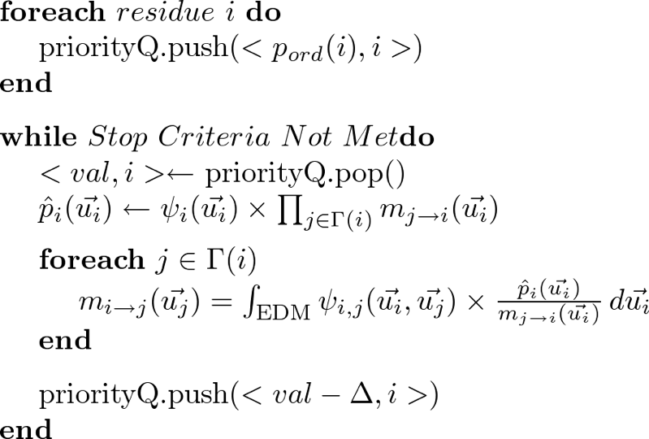
Guided ACMI-BP
19
Notes:
General method
p_ord should capture importance of variable
ACMI concentrates early iterations on more likely to be ordered residues
Disordered residues get more refined messages

Slide 20
Related Work
20
Assumption: messages with largest change in value are more useful
Residual Belief Propagation [Elidan et al, UAI 2006]
  Calculates residual factor for each node
  Each iteration, highest residual node passes messages
  General BP technique
Notes:
General BP algo
New information is important
pushes information faster

Slide 21
Experiments & Results
- Background
- ACMI Overview
- Inference in ACMI-BP
- Guiding Belief Propagation
21

Slide 22
Message Schedulers Tested
22
Our previous technique: naive, round robin (BP)
Our proposed technique:
Guidance using disorder prediction (DOBP)
  Disorder prediction using DisEMBL [Linding et al, 2003]
  Prioritize residues with high stability (ie, low disorder)
Residual factor (RBP) [Elidan et al, 2006]
Notes:
DisEMBL trained on “hot loops”, no secondary structure, high temperature factors, 60-70% for disorder and 80% for ordered

Slide 23
Experimental Methodology
23
Run whole ACMI pipeline
  Phase 1: Local amino-acid finder (prior probabilities)
  Phase 2: Either BP, DOBP, or RBP
  Phase 3: Sample all-atom structures from Phase 2 results
Test set of 10 poor-resolution electron-density maps
  From UW Center for Eukaryotic Structural Genomics
  Deemed the most difficult of a large set of proteins
Notes:
**SAME a priori probabilities
Previously solved, deemed to require significant human effort

Slide 24
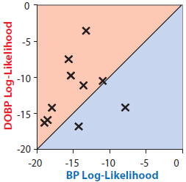
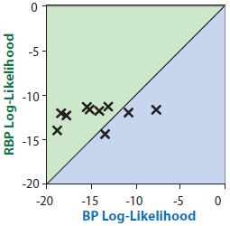
ACMI-BP Marginal Accuracy
24
Notes:
Log likelihood of true solution.
Explain true!
BP: -14.5
BP-DO: -12.0
RBP -12.2

Slide 25
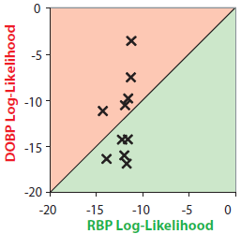
ACMI-BP Marginal Accuracy
25
Notes:
RBP uniform

Slide 26
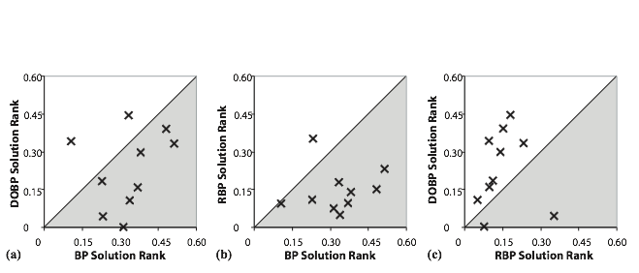
ACMI-BP Marginal Accuracy
26
Notes:
Rank is normalized, so size of edm doesn’t matter
below line is better
RBP: 15%
DOBP: 23%
BP: 33%

Slide 27
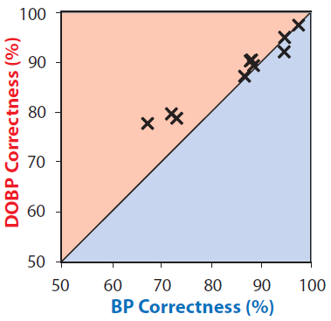
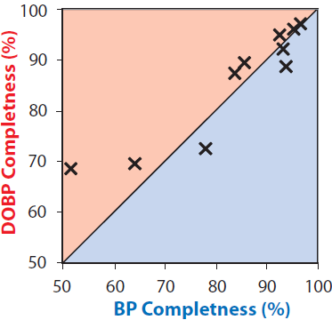
Protein Structure Results
27
Do these better marginals produce more accurate protein structures?
RBP fails to produce structures in ACMI-PF
  Marginals are high in entropy (28.48 vs 5.31)
  Insufficient sampling of correct locations
Notes:
a) is akin to precision b) recall, b)

Slide 28
Conclusions
28
Our contribution: framework for utilizing domain knowledge in BP message scheduling
  General technique for belief propagation
  Alternative to information-based techniques
Our technique improves inference in ACMI
  Disorder prediction used in our framework
  Residual-based technique fails
Future directions
Notes:
Future directions:
combine
sampling
apply to other problems

Slide 29
Acknowledgements
29
Phillips Laboratory at UW - Madison
UW Center for Eukaryotic Structural Genomics (CESG)
NLM R01-LM008796
NLM Training Grant T15-LM007359
NIH Protein Structure Initiative Grant GM074901
Thank you!

Slide 30
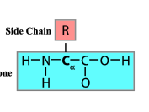
Protein Structures: Background
30
Building blocks are amino acids (AKA residues)
Chain of amino acids form the primary sequence
Sidechain
Alpha Carbon
Backbone

Slide 31
Related Work
31
ARP/wARP [Morris, Perrakis, and Lamzin, 1999]
TEXTAL [Ioerger and Sacchettini, 2003]
RESOLVE [Terwilliger, 2003]
BUCCANEER [Cowtan, 2006]
Notes:
ARP/wARP
Bottom-up approach - add free atoms then constraints
TEXTAL:
Pattern-recognition based method
RESOLVE:
Top-down approach
Recognize secondary structure elements first

Slide 32
Previous Work
32
0.65
0.65
0.65
0.55
0.55
0.55
ACMI-PF R_{free}
0.45
0.45
0.45
0.35
0.35
0.35
0.25
0.25
0.25
0.25
0.35
0.45
0.55
0.65
0.25
0.35
0.45
0.55
0.65
0.25
0.35
0.45
0.55
0.65
ARP/wARP R_{free}
Resolve R_{free}
Textal R_{free}

Slide 33
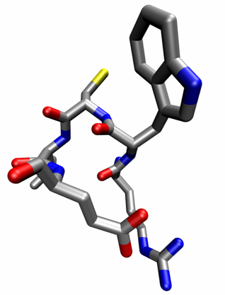

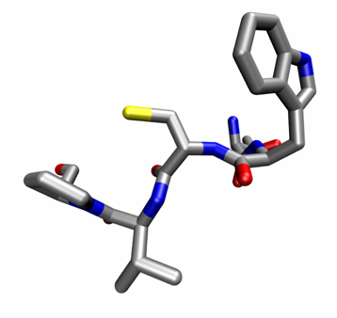
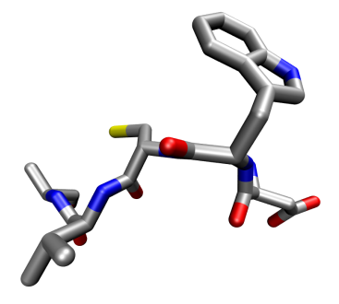
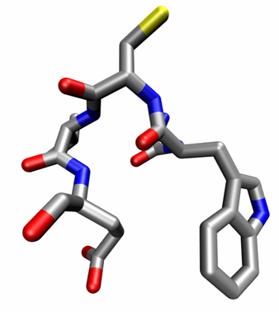
ACMI-SH: Templates
33
…SAW C VKFEKPADKNGKTE…
Protein
DB
Notes:
In practice, 50

Slide 34
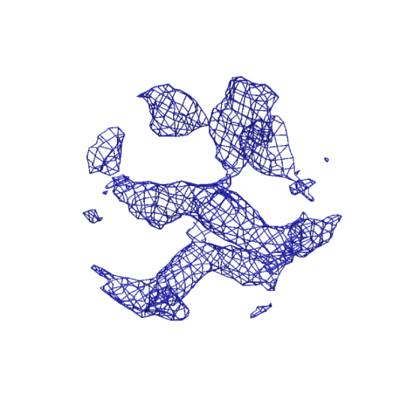


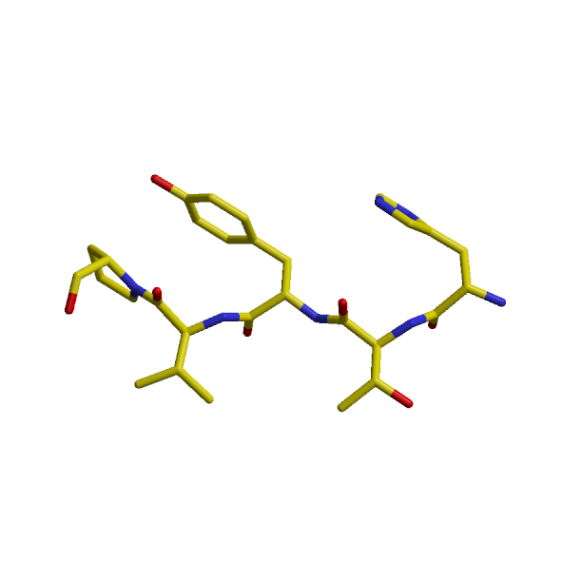
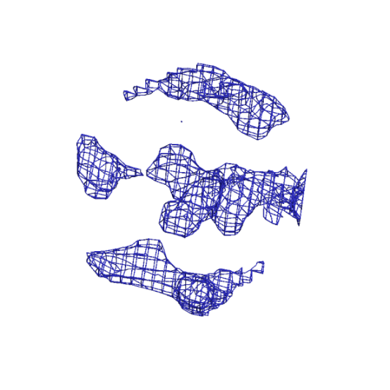

ACMI-SH: Fast Rotation Search
34
sampled region of
density in 5A sphere
map-region
sampled in
spherical shells
electron density map
template-density
sampled in
spherical shells
pentapeptide fragment
from PDB (the “template”)
calculated (expected)
density in 5A sphere

Slide 35
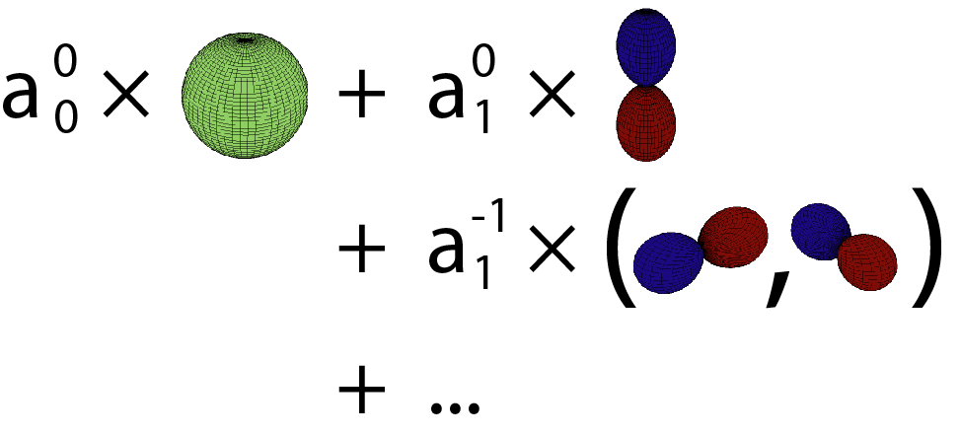
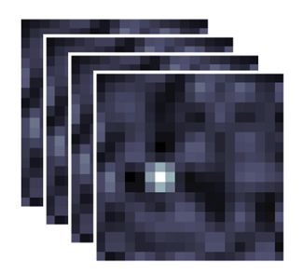

ACMI-SH: Fast Rotation Search
35
map-region spherical-
harmonic coefficients
map-region
sampled in
spherical shells
fast-rotation
function
(Navaza 2006,
Risbo 1996)
correlation
coefficient
as function
of rotation
template-density
sampled in
spherical shells
template spherical-
harmonic coefficients

Slide 36
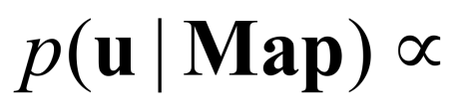
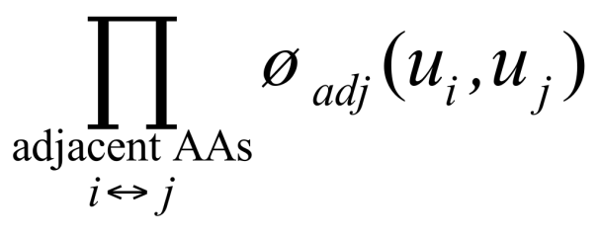








Backbone Model Potential
36
Constraints between adjacent amino acids:
=
x

Slide 37


Backbone Model Potential
37
Constraints between nonadjacent amino acids:

Slide 38


Backbone Model Potential
38
Observational (“amino-acid-finder”) probabilities

Slide 39
Publications
39
F. DiMaio, A. Soni, and J. Shavlik, “Machine learning in structural biology: Interpreting 3D protein images,” in Introduction to Machine Learning and Bioinformatics, 2008.
F. DiMaio, A. Soni, G. N. Phillips, and J. Shavlik, “Improved methods for template matchingin electron-density maps using spherical harmonics,” in Proceedings of the 2007 IEEE International Conference on Bioinformatics and Biomedicine
F. DiMaio, A. Soni, G. N. Phillips, and J. Shavlik, “Spherical-harmonic decomposition for molecular recognition in electron-density maps,” International Journal of Data Mining and Bioinformatics, 2009.
F. DiMaio, D. Kondrashov, E. Bitto, A. Soni, C. Bingman, G. Phillips, and J. Shavlik, “Creating protein models from electron-density maps using particle-filtering methods,” Bioinformatics, 2007.
E. S. Burgie, C. A. Bingman, S. L. Grundhoefer, A. Soni, and G. N. Phillips, Jr., “Structural characterization of Uch37 reveals the basis of its auto-inhibitory mechanism.” In preparation, PDB ID: 3IHR.

Slide 40
Testset Density Maps (raw data)
40
75
60
Density-map mean phase error (deg.)
45
30
15
1.0
2.0
3.0
4.0
Density-map resolution (Å)

Slide 41

ACMI-PF Overview
41
s_{k}
b_{k}
b_{k-1}
b_{k+1}
Particle refers to one layout of protein subsequence
An iteration alternately places, for each of N particles
  C_{α} position b_{k+1} given b_{k}
  All sidechain atoms s_{k} given b_{k-1:k+1}

Slide 42
ACMI-PF: Backbone Step
42
place b_{k}^{i}₊₁ given b_{k}^{i} , b_{k}^{i}₋₁(for particle i )
b
*1…M
b
k
k+1
b
k-1
(1) Sample M b_{k+1}’s from empirical Cα- Cα- Cα pseudoangle distribution

