Slide 1

Efficient Learning of Statistical Relational Models
Tushar Khot
PhD Defense
Department of Computer Sciences
University of Wisconsin-Madison

Slide 2






Machine Learning
Height: 75
Weight: 200
LDL:
Gender:
BP:
….
Height: 72
Weight: 175
LDL:
Gender:
BP:
….
Height (in)
Height: 65
Weight: 250
Height: 62
Weight: 160
Height: 62
Weight: 190
LDL:
Gender:
BP:
….
LDL:
Gender:
BP:
….
LDL:
Gender:
BP:
….
Height: 55
Weight: 185
Weight (lb)

Slide 3
Data Representation
Id | Age | Gender | Weight | BP | Sugar | LDL | Diabetes?
1 | 27 | M | 170 | 110/70 | 6.8 | 40 | N
2 | 35 | M | 200 | 180/90 | 9.8 | 70 | Y
3 | 21 | F | 150 | 120/80 | 4.8 | 50 | N
 |  |  |  | …
But what if data is multi-relational ?
Notes:
Traditionally, statistical machine learning has dealt with examples with a fixed number of features.
In the table here, each row corresponds to an example with each examples having same number of features
predict disease or not
what if data is not in single table with same #features for each

Slide 4
Electronic Health Record
patient(id, gender, date).
visit(id, date, phys, symp, diagnosis).
PatientID Gender Birthdate
P1 M 3/22/63
PatientID Date Physician Symptoms Diagnosis
P1 1/1/01 Smith palpitations hypoglycemic
P1 2/1/03 Jones fever, aches influenza
Patient Table
Visit Table
lab(id, date, test, result).
SNP(id, snp1, …, snp500K).
PatientID Date Lab Test Result
PatientID SNP1 SNP2 … SNP500K
P1 AA AB BB
P2 AB BB AA
Lab Tests
P1 1/1/01 blood glucose 42
P1 1/9/01 blood glucose 65
SNP Table
prescriptions(id, date_p, date_f, phys, med, dose, duration).
PatientID Date Prescribed Date Filled Physician Medication Dose Duration
P1 5/17/98 5/18/98 Jones prilosec 10mg 3 months
Prescriptions
Notes:
We are working on this data set currently. The goal is to predict the adverse reactions of drugs.

Slide 5
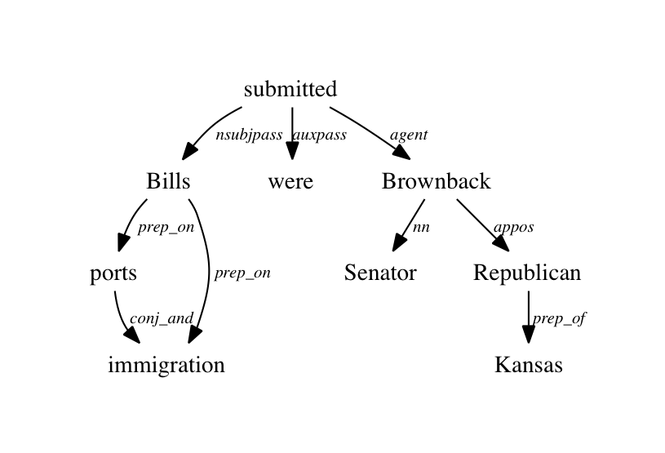
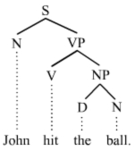
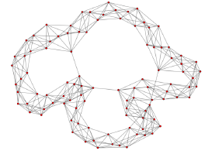


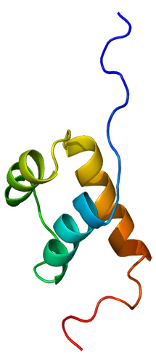
Structured data is everywhere
Parse Tree
Dependency graph
Social Network

Slide 6
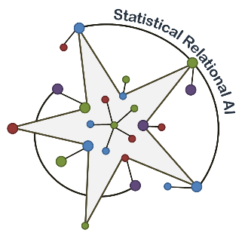
Statistical Relational Learning
Data is multi-relational
Data has uncertainty
Logic
Probabilities
Probabilities
Logic
Statistical Relational Learning (SRL)

Slide 7

Thesis Outline
S | A
TK | JS
TK | SN
PO | SN
S | I
SG | H
CG | L
Advised(S, A)
TK | ??
Paper(S, P)
IQ(S, I)
S | P
JS | FG
TK | FG
SN | FG
S | C
JS | 760
DP | 731
AD | 784
Course(A, C)

Slide 8
Outline
SRL Models
Efficient Learning
Dealing with Partial Labels
Applications

Slide 9
Relational Probability Tree
P(satisfaction(Student) | grade, course, difficulty, advisedby, paper)
grade(Student, C, G), G=‘A’
yes
no
course(Student, C, Q), difficulty(C, high)
0.2
…
yes
no
SRL Models
0.8
advisedBy(Student, Prof)
yes
no
paper(Student, Prof)
0.4
yes
no
0.9
0.7
Blockeel & De Raedt ’98

Slide 10
Relational Dependency Network
Cyclic directed graphs
Approximated as product of conditional distributions
grade(S,C,G)
course(S,C,Q)
SRL Models
advisedBy(S, P)
paper(S, P)
satisfaction(S)
J. Neville and D. Jensen ’07,
D. Heckerman et al. ‘00
Notes:
Each CPD modeled using RPT giving the structure. Leaf values give the parameters

Slide 11
Markov Logic Networks
Weighted logic
Weight of formula i
Number of true groundings of formula i in current instance
SRL Models
Friends(A,B)
advisor(A,B)
Smokes(A)
Friends(A,A)
paper(A, P)
advisor(A,A)
paper(B, P)
Smokes(B)
Friends(B,B)
advisor(B,B)
Friends(B,A)
advisor(B,A)
Richardson & Domingos ‘05
Notes:
Popular SRL model
MLN contains wted fol rules
Explain example
Rules corr to struct, Parameters corr to wt
higher wt -> more likely to be true
Prob of world state in mln calculated using formula here. Z is norm term
world state is one instantiation of the database
Ground network
To compute ni, we generally grnd the mln to mn. Consider only 2nd rule with two consts A & B. ground mn is shown here. A world state is shown, red – false, green-true. In this state, 3 true gndgs and 1 false gndg. So ni=3

Slide 12
Learning

Slide 13
Learning Characteristics
No Learning
Expert’s Time
Efficient Learning
Parameter Learning
Structure Learning
Learning Time

Slide 14
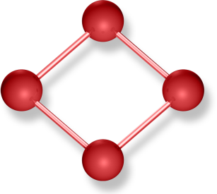
Structure Learning
Large space of possible structures
P(pop(X) | frnds(X, Y)), P(pop(X) | frnds(Y, X)), P(pop(X) | frnds(X, ‘Obama’))
Typical approaches
  Learn the rules followed by parameter learning
  [Kersting and De Raedt’02, Richardson & Domingos‘04]
  Learn parameters for every candidate structure iteratively
    [Kok and Domingos ’05 ’09 ’10]
Key Insight: Learn multiple weak models
Efficient Learning
Inference
Weight Learning
Structure Learning
Notes:
second tougher problem is struct learning
two typical app
learn structure first followed by weights blps
simultaneously predict par and struct. FGB helps

Slide 15
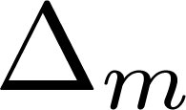


Functional Gradient Boosting
ψ_{m}
Initial Model
Induce
Data
-
=
Efficient Learning
Gradients
+
+
Predictions
+
+
+
+
Final Model =
…
SN, TK, KK, BG and JS ILP’10, ML’12 journal
Notes:
Take an init model. It could be expert advice or just prior. Use predictions to compute gradient or residues. Learn a regression function to fit the residues. Update model. Sum of all reg func gives the final model.

Slide 16
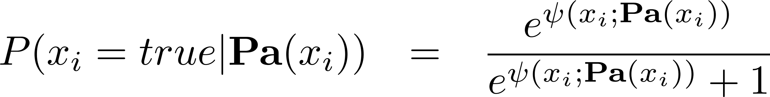
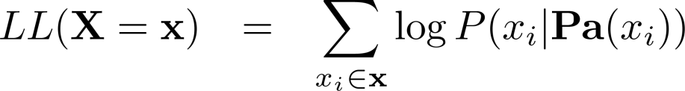
Functional Gradients for RDNs
Probability of an example
Functional gradient
  Maximize
  Gradient of log-likelihood w.r.t ψ
  Sum all gradients to get final ψ
x | Δ
target(x1) | 0.7
target(x2) | -0.2
target(x3) | -0.9
Efficient Learning
J. Friedman ’01, Dietterich ‘04, Gutmann & Kersting ‘06

Slide 17

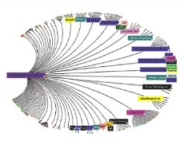
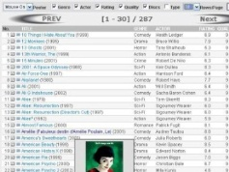

Experimental Results
Predicting the advisor for a student
Algo | Likelihood | AUC-ROC | AUC-PR | Time
Boosting | 0.810 | 0.961 | 0.930 | 9s
RPT | 0.805 | 0.894 | 0.863 | 1s
MLN | 0.730 | 0.535 | 0.621 | 93 hrs
Efficient Learning
Movie Recommendation
Citation Analysis
Discovering Relations
Learning from
Demonstrations
Scale of Learning Structure
150 k facts describing the citations
115k drug-disease interactions
11 M facts on a NLP task
Notes:
11 M facts with TempEval

Slide 18
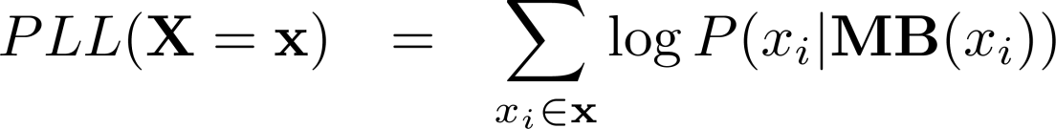
Learning MLNs
Weight of formula i
Number of true groundings of formula i in current Instance
Normalization term sums over all world states
Learning approaches maximize the pseudo-loglikelihood
Efficient Learning
Key Insight: View MLNs as sets of RDNs

Slide 19
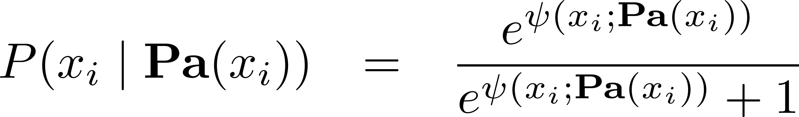
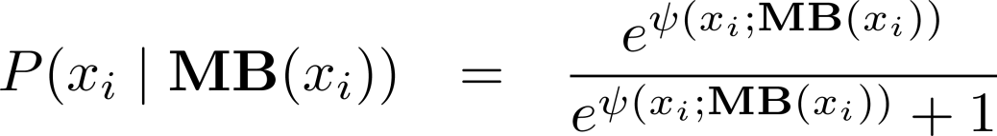
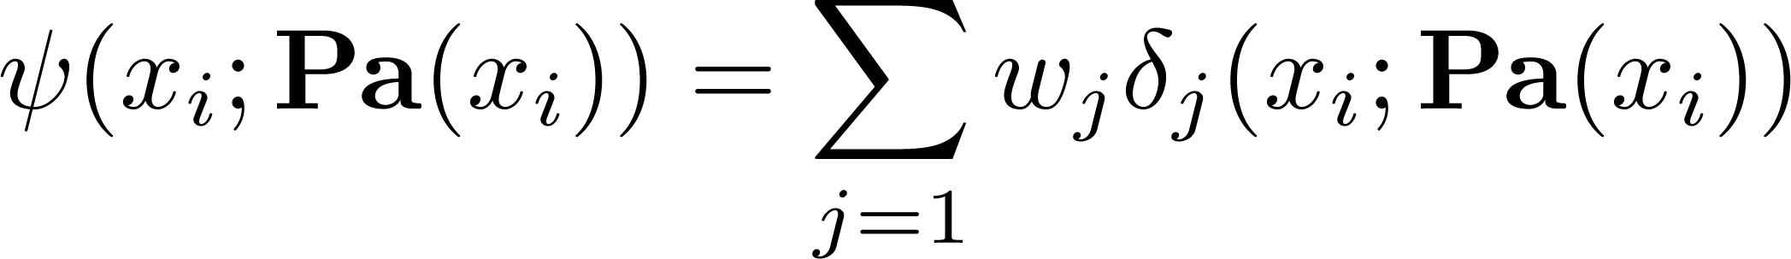
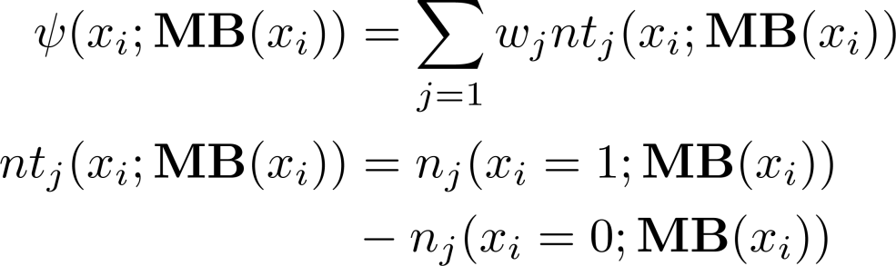
Functional gradient for SRL
RDN
MLN
Maximize
Probability of x_{i}
ᴪ(x)
Maximize
Probability of x_{i}
ᴪ(x)
Model defined as a product of conditional distributions
Learning optimizes a product of conditional distributions
Each conditional distribution can be learned independently
Each conditional distribution not learned independently
Efficient Learning
Regression tree uses aggregators (e.g. Exists)
Regression tree scales output by the number of groundings
[TK, SN, KK and JS ICDM’11]

Slide 20
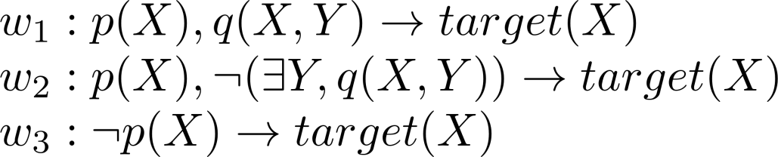
MLN from trees
p(X)
n[p(X)] = 0
Learning Clauses
n[p(X)] > 0
Same as squared error for trees
Force weight on false branches (W_{3 ,}W₂)
to be 0
Hence no existential vars needed
q(X,Y)
W₃
n[q(X,Y)] > 0
n[q(X,Y)] = 0
Efficient Learning
W₁
W₂
Notes:
Explain tree
Root
split based on num of gndgs or condition on node
wt w3 is fixed
evaluating q(x,y), y is exist variable
split node based on existence chk
- wt have closed form soln. so easy to evaluate. Greedy search like dec tree.
Mln corr to tree
- exist var → slow inference
so learn one clauses. Force wts=0 on false .0 wt clause has no impact As shown here no exist vars

Slide 21
Entity Resolution : Cora
Detect similar titles, venues and authors in citations
Jointly detect similar citations based on predictions
on individual fields
Efficient Learning
Notes:
Explain Y axis. Pt to our approach. SameBib much better and sameauthor not very different.

Slide 22
Probability Calibration
Output from boosted models may not match empirical distribution
Use a calibration function that maps the model probability to the empirical probabilities
Goal: Probabilities close to the diagonal

Slide 23
Partial Labels

Slide 24
Missing Data in SRL
Most methods assume that missing data is false
i.e. closed world assumption
EM approaches for parameter learning explored in SRL
[Koller & Pfeffer 1997, Xiang & Neville 2008, Natarajan et al. 2009]
Naive structure learning
  Compute expectations over the missing values in the E-step
  Learn a new structure to fit these values during the M-step
Partial Labels

Slide 25
Our Approach
We developed an efficient structural-EM approach using boosting
We only update the structure during the
M-step without discarding the previous model
We derive the EM update equations using functional gradients
Partial Labels
  [TK, SN, KK and JS ILP‘13]

Slide 26
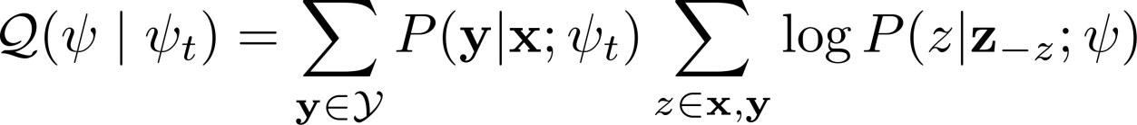
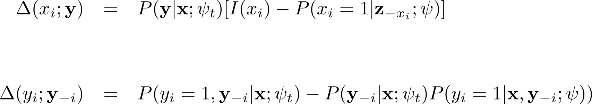
EM Gradients
X
Y
Modified Likelihood Equation
where
Gradient for observed groundings x_{i} and y:
Gradient for hidden groundings y_{i} and y :
Partial Labels
  Under review at ML journal

Slide 27
RFGB-EM
Sample
Hidden States
Observed
E-Step
Hidden
ψ_{t}
Partial Labels
|W|
Input Data
+
M-Step
…
Induce Trees
T trees
Δ_{x}
Δ_{y}
Regression Examples

Slide 28

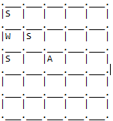


Experimental Results
Predict cancer in a social network using stress and smoke attributes
Likely to have cancer if friends smoke
Likely to smoke if friends smoke
Hidden: smoke attribute
Hidden | 20% | 40%
SEM-10 | -1.445 | -1.315
SEM-1 | -1.648 | -1.586
CWA | -1.629 | -1.693
CLL Values
Partial Labels

Slide 29

One-class classification
...
Peter Griffin and his wife, Lois Griffin, visit their neighbors
Joe Swanson and his wife Bonnie
…
Married
Unmarked negative
Partial Labels
Unmarked positive

Slide 30
Propositional Examples
Partial Labels
Notes:
Consider the propositional examples shown here with two features. Relational examples can be viewed as having no predefined features or dimensions (shown as the single point)

Slide 31
Relational Examples
Partial Labels
{S1, S2, …, SN}
Notes:
Consider the propositional examples shown here with two features. Relational examples can be viewed as having no predefined features or dimensions (shown as the single point)

Slide 32
Basic Idea
verb(sen, verb)
Efficient Learning
contains(sen, “married”), contains(sen, “wife”)
Notes:
The basic idea of our approach is to introduce new dimensions that separate the relational examples. As shown here, we introduce the first dimension that spreads the examples into four groups. We then introduce one more dimension to further separate the examples.

Slide 33
Relational Distance
Defined a tree-based relational distance measure
More similar are the paths in trees, more similar are the examples
Satisfies Non-negativity, Symmetry and Triangle Inequality
univ(per, uni),
country(uni, USA)
bornIn(per, USA)
C
Partial Labels
A
B

Slide 34
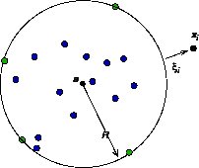
Relational OCC
Distance Measure
One-class
Classifier
+
+
Multiple trees learned to directly optimize the performance on one-class classification
Can be learned efficiently
  Greedy feature selection at every node
  Only examples reaching a node scored
Used combination functions to merge multiple distances
Special case of Kernel Density Estimation and
Propositional OCC
Partial Labels
[TK, SN and JS AAAI’14]

Slide 35
Results – Link Prediction
UW-CSE dataset to predict advisors of students
Features: course professors, TAs, publications, etc.
To simulate OCC task, assume 20, 40 and 60% of examples are marked
Partial Labels

Slide 36
Applications

Slide 37
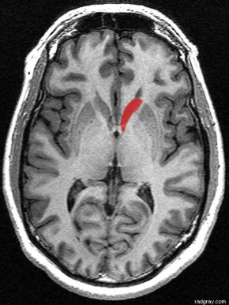
Alzheimer's Prediction
Alzheimer’s (AD) - Progressive neurodegenerative condition resulting in loss of cognitive abilities and memory
Humans are not very good at identifying people with AD, especially before cognitive decline
MRI data – major source for distinguishing AD vs CN (Cognitively normal) or MCI (Mild Cognitive Impairment) vs CN
Applications
[Natarajan et al. IJMLC ’13]

Slide 38
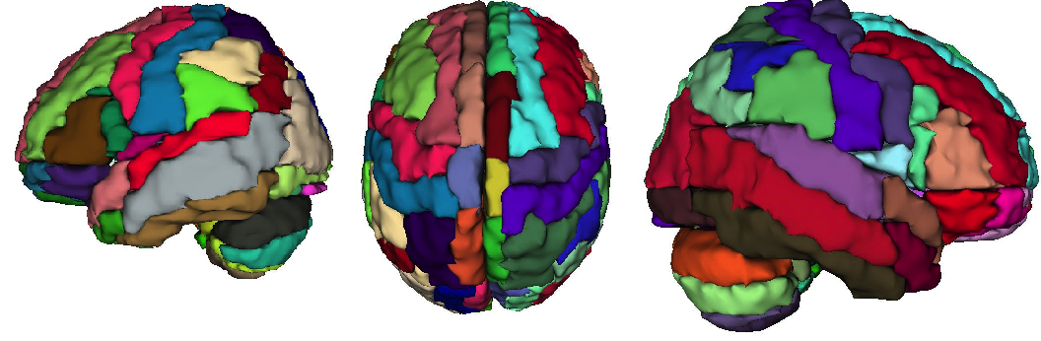
MRI to Relational Data
Predicate | Description
centroidx(P, R, X) | Centroid of region R is X
avgSpread(P, R, S) | Avg spread of R is S
size(P, R, S) | Size of R is S
avgWMI(P, R, W) | Avg intensity of white matter in R is W
avgGMI(P, R, G) | Avg intensity of gray matter in R is G
avgCSFI(P, R, C) | Avg intensity of CSF in R is C
variance(P, R, V) | Variance of intensity in R is V
entropy(P, R, E) | Entropy of R is E
adj(R1, R2) | R1 is adjacent to R2
Applications
Notes:
Different #segments => SRL
Describe predicates

Slide 39
Results
Applications

Slide 40
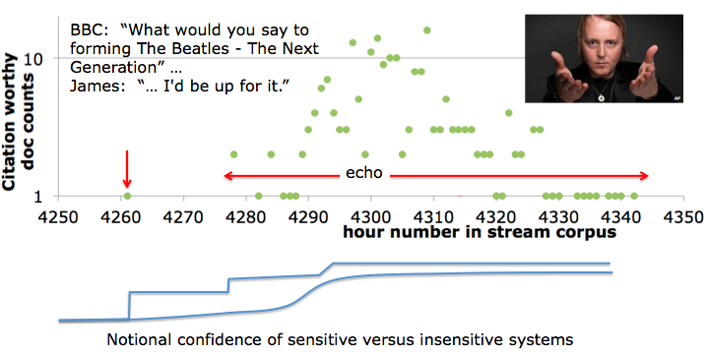
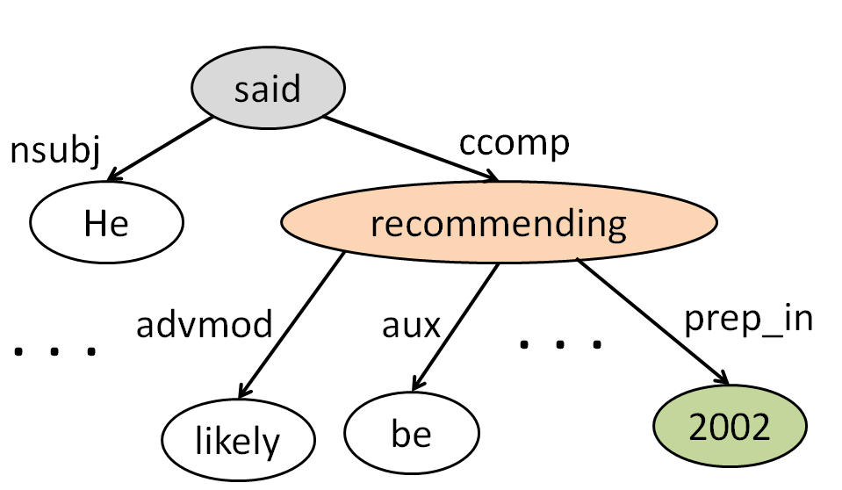
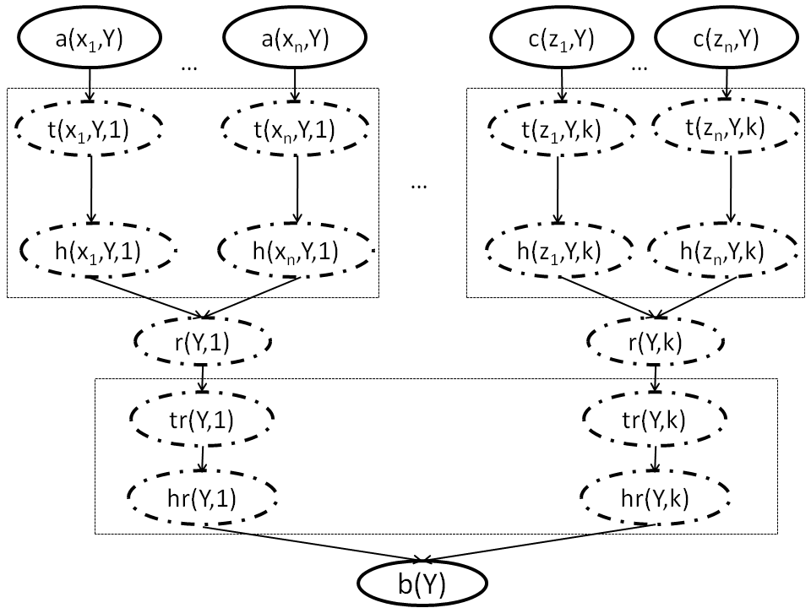
Other work
WW I
1918
WW 2
Image from TAC KBA
Other work
Aaron Rodgers‘ 48-yard TD pass to Randall Cobb with 38 seconds left gave the Packers a 33-28 victory against the Bears in Chicago on Sunday evening.

Slide 41
Future Directions
Reduce inference time
  Learning for inference
  Exploit decomposability
Adapt models
  Based on feedback from an expert
  To change in definition over time
Broadly apply relational models
  Learn constraints between events and/or relations
  Extend to directed models

Slide 42
Conclusion
Developed an efficient structure learning algorithm for two models
Derived the first EM algorithm for structure learning of RDNs and MLNs
Designed a one-class classification approach for relational data
Applied my approach on biomedical and NLP tasks
-
=
Induce
Sample
Hidden States
ψ_{t}
|W|
…
Δ_{x}
Δ_{y}
Distance Measure
One-class
Classifier
+
+
WW I
1918
WW 2

Slide 43


Acknowledgements
Advisors

Slide 44





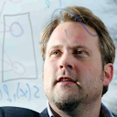

Acknowledgements
Advisors
Committee Members
Collaborators
Grants
  DARPA Machine Reading (FA8750-09-C-0181)
  DARPA Deep Exploration and Filtering of Text (FA8750-13-2-0039)

Slide 45

Thanks

