Slide 1
Broadening the Applicability of Relational Learning
Trevor Walker
Ph.D. Defense

Slide 2
Introduction – Relational Learning
cargo(car1, penguin)
car(train1, car1)
count(car1, 2)
train1
cargo(car2, giraffe)
car(train1, car2)
count(car2, 3)
Relations between “things”
“things” – constants, values, etc.
Notes:
SRL Mention

Slide 3
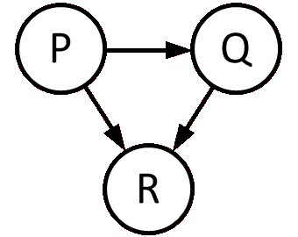
Relational Supervised Learning
Positive Examples
Negative Examples
Learner
Model
Background Knowledge
Specifically Inductive Logic Programming (ILP)

Slide 4
Advantages and Disadvantages
Better representation of world
More expressive models using logical expressions
Hard for user without ILP expertise

Slide 5
Thesis Statement
Providing automatic advice-taking algorithms, human-computer interfaces, and automatic parameter tuning greatly increases the applicability of ILP,
enabling use of ILP by users whose expertise lies outside of ILP.

Slide 6
ILP Task Definition
Given
Positive examples
Negative examples
Background knowledge
Do
Learn a model that covers (i.e., implies)
As many positive examples as possible
As few negative examples as possible

Slide 7
Here Comes the Circus
Learn rule(s) distinguishing circus trains from non-circus trains
circus(Train) ←
car(Train, C1), cargo(C1, penguin), count(C1, 2),
car(Train, C2), cargo(C2, giraffe), count(C2, 3).
Notes:
Lowercase – Literal names and constants
Uppercase – Variables
Target Literal -> Circus
Logical implication -> Rule
Head -> Consequence of a Rule
Body -> Antecedence of a Rule

Slide 8
ILP Task Definition
Positives and negatives
Background knowledge
Facts
Rules
Search space specification
Parameters

Slide 9
ILP : Positive and Negatives
Positive example: circus(train1)
Negative example: circus(train2)
Notes:
Lowercase – Literal names and constants
Uppercase – Variables
Target Literal -> Circus
Logical implication -> Rule
Head -> Consequence of a Rule
Body -> Antecedence of a Rule

Slide 10
ILP : Defining the Search Space
Determinations: What literals are allowed
Modes: Constraints on arguments of literals
circus(-train)
car(+train, -car)
cargo(+car, #animal)
Example Rule:
circus(Train) ←
car(Train, Car), cargo(Car, penguin)
Introduces Train Variable
penguin constant
Uses Train Variable

Slide 11
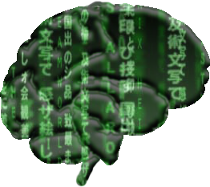
ILP : Background Knowledge
Logical statements expressing what is known
Facts – Ground positive literals
Rules – Universally qualified implications
Facts are easy
Rules are hard

Slide 12
ILP : Specifying Parameters
MaximumClausesInTheory
MinimumRecallPerClause
MinimumPrecisionPerClause
MinimumTheoryPrecision
MaximumClauseLength
MaximumSearchNodes
F1EarlyStoppingScore
LearnNegatedConcept

Slide 13
Contributions
Background Knowledge Acquisition via Advice-Taking [ Walker et al., 2010 ]
Advice-Taking via Human-Computer Interface (HCI) [ Walker et al., 2011 ]
Parameter Tuning via the Onion [ Walker et al., 2010 ]
ILP Applied to Reinforcement Learning Tasks [ Torrey et al., 2007; Walker et al., 2007 ]

Slide 14
Outline
Introduction
Advice-Taking
Human-Computer Interfaces
Parameter Tuning (Time Permitting)
Conclusions

Slide 15
What is Advice?
Teacher-provided statements
Hints about the concept being learned
Advice pertains to specific positive or negative examples
[ Walker et al., 2010 ]

Slide 16
Advice about Specific Examples
Specific Advice
train1 is a circus train if
car1 is carrying penguins
car1 is carrying 2 objects
General Advice
A Train is a circus train if
the Train has a Car carrying penguins
and the same Car is carrying 2 objects

Slide 17
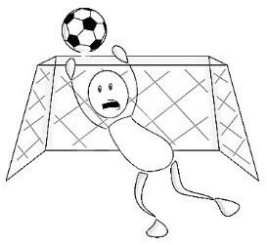
Automated Advice-Taking Goals
Inclusion of most teacher- mentioned advice
Robustness to teacher errors
Create both background knowledge and setup ILP search space

Slide 18
Overview of Algorithm
Teacher provides advice
Convert to grounded implications
Generalize implications
Create background knowledge by combining all advice
Setup ILP search space based on generated knowledge

Slide 19
Sample Teacher Advice
Teacher says
Example ex(a) is positive instance because p(a)
Example ex(b) is negative instance because q(b, b)
Example ex(c) is positive instance because r(c)
Possible meanings of advice
( p(X) ∧ ¬q(X, Z) ) ∨ r(X)
p(X) ∨ ¬q(X, Y) ∨ r(X)

Slide 20
Assumptions
Atomic features of domain are known
Teacher talks about specific examples
Teacher specifies ground advice
Teacher understands basic logic

Slide 21
Utilizing Teacher-Provided Advice
Example ex(a) is positive instance because p(a)
Example ex(b) is negative instance because q(b, b)
Example ex(c) is positive instance because r(c)
q(b,b) may seem like an odd statement

Slide 22
Utilizing Teacher-Provided Advice
Example ex(a) is positive instance because p(a)
Example ex(b) is negative instance because q(b, f(x))
Example ex(c) is positive instance because r(c)
q(b,b) may seem like an odd statement
For instance: length(train, 3), equals(3, 3)
becomes: length(train, X), equals(X, 3)

Slide 23
Utilizing Teacher-Provided Advice
Example ex(a) is positive instance because p(a)
Example ex(b) is negative instance because q(b, b)
Example ex(c) is positive instance because r(c)
Clauses may contain multiple literals

Slide 24
Utilizing Teacher-Provided Advice
Example ex(a) is positive instance because p(a)
Example ex(b) is negative instance because q(b, b)
Example ex(c) is positive instance because r(c), s(d)
Clauses may contain multiple literals

Slide 25
Utilizing Teacher-Provided Advice
Example ex(a) is positive instance because p(a)
Example ex(b) is negative instance because q(b, b)
Example ex(c) is positive instance because r(c)
Separate pieces of advice for a single example allowed

Slide 26
Utilizing Teacher-Provided Advice
Example ex(a) is positive instance because p(a)
Example ex(b) is negative instance because q(b, b)
Example ex(a) is positive instance because r(c)
Separate pieces of advice for a single example allowed

Slide 27
Utilizing Teacher-Provided Advice
Example ex(a) is positive instance because p(a)
Example ex(b) is negative instance because q(b, b)
Example ex(c) is positive instance because r(c)

Slide 28
Step 1: Form Implications
ex(a) ⟵ p(a)
ex(b) ⟵ ¬q(b, b)
ex(c) ⟵ r(c)
Negative advice is negated
Form the implication of the advice ground body to the ground example
Negate advice attached to negative examples

Slide 29
Step 2: Generalize Advice
ex(X) ⟵ p(X)
ex(Y) ⟵ ¬q(Y, Y) ex(Y) ⟵ ¬q(Y, Z)
ex(Z) ⟵ r(Z)
Perform anti-substitution of constants to variables
Direct – Identical constant = same variable
Indirect – Identical constants split into separate variables

Slide 30
Step 3: Standardize Advice Formula
ex(X) ⟵ p(X)
ex(X) ⟵ ¬q(X, X) ex(X) ⟵ ¬q(X, Z)
ex(X) ⟵ r(X)
Unify heads and apply substitution to antecedents
After unification, remove head leaving only body

Slide 31
Step 3: Standardize Advice Formula
p(X)
¬q(X, X) ¬q(X, Z)
r(X)
Unify head and apply substitution to antecedents
After unification, remove head leaving only body

Slide 32
Step 4: Create Logical Combinations
p(X) p(X) ∧ ¬q(X, X) ∧ r(X)
¬q(X, X), ¬q(X, Z) ¬q(X, Z) ∨ r(X)
r(X) ¬q(X, X) ∧ ¬q(X, Z)
Combine body via ∧ or ∨ connectives
Combinations may connect only subset of formula
Combinations at most one formula derived from any single piece of teacher advice

Slide 33
Step 5: Generate Background Clauses, Determinations, & Modes
pred1(X) ← p(X) ∧ ¬q(X, X) ∧ r(X)
pred2(X, Z) ← ¬q(X, Z) ∨ r(X)
Modes: pred1(+), pred1(#), pred2(+,-), pred2(#,#),...
Create anonymous background clauses
Create modes
Variables derived from example constants assigned + or # modes
New variables in head predicate become outputs with - or # modes

Slide 34
Final Results
Example ex(a) is positive instance because p(a)
Example ex(b) is negative instance because q(b, b)
Example ex(c) is positive instance because r(c)
pred1(X) ← p(X) ∧ ¬q(X, X) ∧ r(X)
pred2(X, Z) ← p(X) ∧ q(X, Z) ∨ r(X)
pred3(X, Z) ← q(X, Z) ∨ r(X)

Slide 35
Clause Priorities
pred1(X) ← p(X) ∧ ¬q(X, X) ∧ r(X) HIGH
pred2(X, Z) ← p(X) ∧ q(X, Z) ∨ r(X) MEDIUM
pred3(X, Z) ← q(X, Z) ∨ r(X) LOW
Clauses searched according to priority
High All advice
Medium Some advice or variables split, not both
Low Some advice and variables split

Slide 36
Difficulties - Multiple generalizations
Example ex(a) is positive instance because “p(a) ∧ q(a)”
pred1(X) ← p(X) ∧ q(X)
pred1(X) ← p(X) ∧ q(Y)
pred1(X) ← p(Y) ∧ q(X)
pred1(X) ← p(Y) ∧ q(Y)
Add multiple background rules
with different priorities

Slide 37
Difficulties - Constants
Example ex(a) is positive instance because “equals(a, 1)”
pred1(X) ← equals(X, Y)
pred1(X) ← equals(X, 1)
pred1(X) ← equals(a, Y)
pred1(X) ← equals(a, 1)
Evaluate on the training examples to determine most likely

Slide 38
Difficulties – Exposing Variables
Example ex(a) is positive instance because
“width(a, 7), height(a, 5), multiply(5, 7, 35)”
pred1(X) ← width(X, W), height(X, H), multiply(W, H, A)
pred1(X, A) ← width(X, W), height(X, H), multiply(W, H, A)
Expose last variable created during generalization

Slide 39
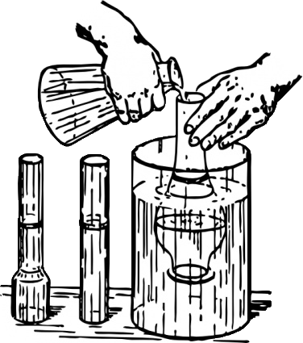
Experiments : Methodology
Bootstrap Learning domain
14 separate tasks designed by 3rd party with examples and advice
Up to 100 training examples (depending on the experiment)
100 testing examples

Slide 40
Experiment – Advice Efficacy

Slide 41
Experiment – Errors of Omission

Slide 42
Jumping into the Search Space

Slide 43
Experiment – Example Noise

Slide 44
Advice Taking: Conclusions
Automates both background knowledge creation and ILP setup
Effective during testing on independent domains
Enables use of ILP by users without expertise in ILP

Slide 45
Outline
Introduction
Advice Taking
Human-Computer Interfaces
Parameter Tuning (Time Permitting)
Conclusions

Slide 46
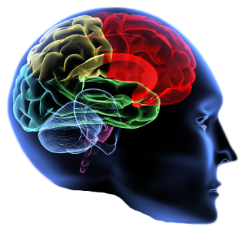
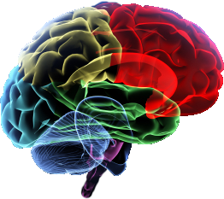
Learning with Domain Knowledge
+
=
Domain-expert knowledge
Learner
Model
Approach: Advice-taking
Some learning algorithms can take advice
Notes:
Looking at acquisition of knowledge for learning purposes
Learning with Domain knowledge is good

Slide 47
Domain Knowledge Difficulties
+
=
Domain-expert knowledge
Learner
Model
Notes:
Articulating expertise requires in-depth understanding of underlying learning mechanism
Grounded descriptions of “why” easy to provide and understandable
Generalizing advice left to learning algorithms
Still requires understanding of underlying syntax
HCI provides method to alleviate these problems
Learning is an iterative approach – Obtain knowledge, learn, fix mistakes through more knowledge

Slide 48
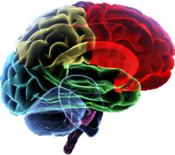
Advice Taking: Difficulties
?
Teacher advice
Learner
Articulating knowledge requires understanding of underlying algorithm – requires AI expert
Identifying important knowledge is difficult
Notes:
Articulating expertise requires in-depth understanding of underlying learning mechanism
Grounded descriptions of “why” easy to provide and understandable
Generalizing advice left to learning algorithms
Still requires understanding of underlying syntax
HCI provides method to alleviate these problems
Learning is an iterative approach – Obtain knowledge, learn, fix mistakes through more knowledge

Slide 49
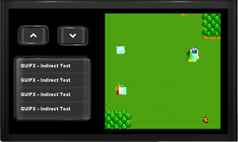
Domain Knowledge Solutions
Teacher advice
Learner
Use advice-taking Human-Computer Interface (HCI)
Iteratively acquire knowledge
Notes:
Articulating expertise requires in-depth understanding of underlying learning mechanism
Grounded descriptions of “why” easy to provide and understandable
Generalizing advice left to learning algorithms
Still requires understanding of underlying syntax
HCI provides method to alleviate these problems
Learning is an iterative approach – Obtain knowledge, learn, fix mistakes through more knowledge

Slide 50
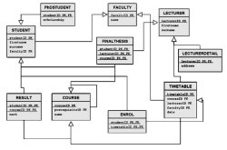
Learning Scenario Specifics
Supervised Learning
Training examples & labels are given
Relational domains
Knowledge in the form of advice
Hints to learner, possibly incorrect
Written in first-order logic
Grounded in a specific example

Slide 51
Advice Processing [Walker et al., 2010]
giraffe
Positive Example:
circus(train1)
car1
train1
Advice:
train(train1), has_car(train1, car1),
cargo(car1, giraffe)
Generated knowledge:
bk1(Train) ← train(Train), has_car(Train, Car),
cargo(Car, giraffe)
Advice:
train(train1), has_car(train1, car1),
cargo(car1, giraffe)
Generated knowledge:
bk1(Train) ← train(Train), has_car(Train, Car),
cargo(Car, giraffe)
Bad: First-Order Logic
Good: Grounded Advice

Slide 52
Grounded Advice
Easier for teacher to specify
Easier to design HCI for grounded advice
Can use previous techniques

Slide 53
Domain Knowledge Solutions
Knowledge
Learner
Iteratively acquire knowledge
Use advice-taking Human-Computer Interface (HCI)
Notes:
Articulating expertise requires in-depth understanding of underlying learning mechanism
Grounded descriptions of “why” easy to provide and understandable
Generalizing advice left to learning algorithms
Still requires understanding of underlying syntax
HCI provides method to alleviate these problems
Learning is an iterative approach – Obtain knowledge, learn, fix mistakes through more knowledge

Slide 54
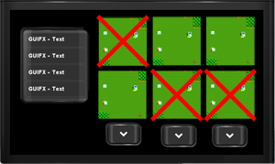
Our Knowledge-Acquisition Loop
Teacher Advice
Review HCI
Advice HCI
Model
Learner

Slide 55
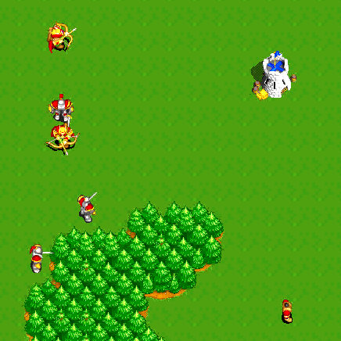
Case Study: WillTowerFall?
Our HCI advice-taking case study
WillTowerFall?
Subset of Wargus

Slide 56
WillTowerFall? Sample Scenario

Slide 57
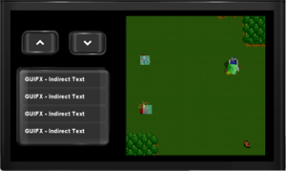
Giving Advice via the HCI
User selects example to provide advice for
HCI presents example information
User specifies advice by
1. Selecting objects 2. Specifying relations

Slide 58
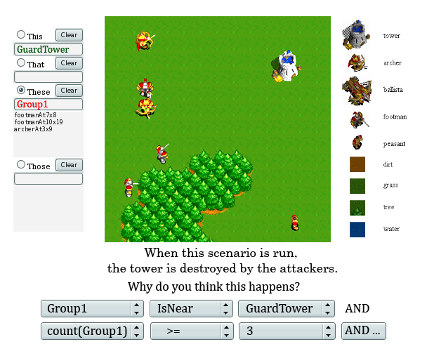
Giving Advice via the HCI
Wargus GUI

Slide 59
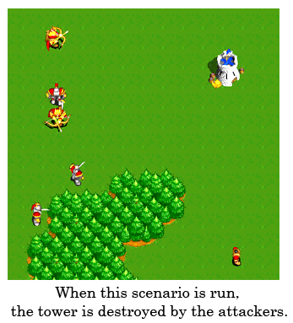
Giving Advice via the HCI
Wargus GUI

Slide 60
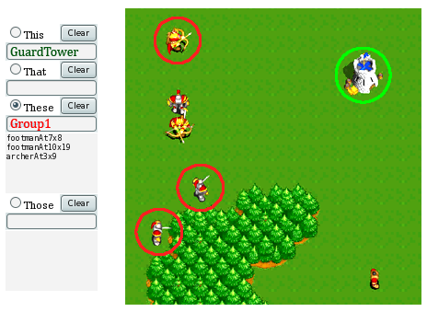
Giving Advice via the HCI
Wargus GUI

Slide 61
Giving Advice via the HCI
Wargus GUI

Slide 62
What Would Users Like to Say?
First pass – collect advice in natural language
Second pass – provide GUI that supports most of natural language sentences

Slide 63
Iterative Knowledge Acquisition
Domain-expert knowledge
Review HCI
Advice HCI
Model
Learner

Slide 64
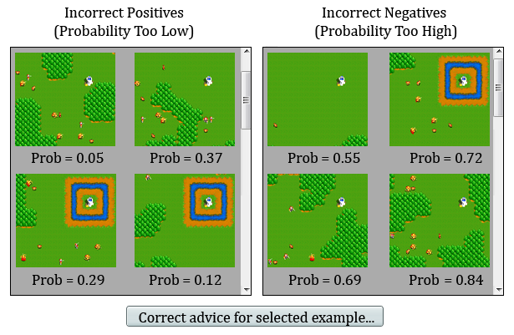
Reviewing / Correcting Results

Slide 65
Wargus Natural Language Advice
Tower will fall
Three or more footmen can take down a tower if there is no moat
Five or more archers can take down a tower
Tower will not fall
If there are only peasants, the tower stands
Four archers or less cannot take down a tower
90% representable by GUI

Slide 66
Experiments
Wargus WillTowerFall?
Use boosted relational dependency network (bRDN) [Natarajan et al., 2010]
Advice-generalization algorithm [Walker et al., 2010]

Slide 67
Experiments
Compare
No Advice
User-provide advice via HCI
Hand-written ILP expert advice
100 training examples
900 testing examples

Slide 68
Testset Results

Slide 69
HCI Conclusions
Algorithms exist that take advice but high barrier to entry for non-expert users
HCI - Allow input of advice about specific examples
Enables use of ILP by users without expertise in ILP

Slide 70
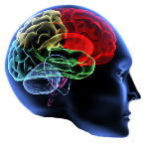
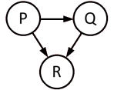
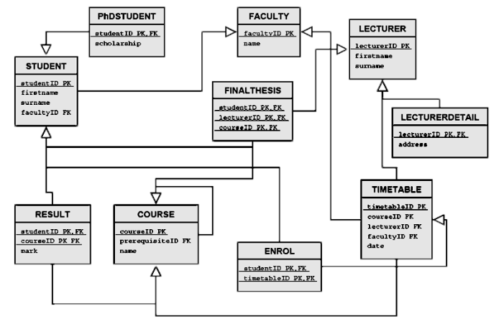
Future Work on Advice HCI
Evaluate iterative learning approach in more complex domains
Develop domain-independent GUI for relational advice taking

Slide 71
Outline
Introduction
Advice-Taking
Human-Computer Interfaces
Parameter Tuning (Time Permitting)
Conclusions

Slide 72
Onion [Walker et al., 2010]
Automated parameter turning framework
Iterative-deepening style search of parameter space
No input from user necessary

Slide 73
Experiment – Why is it Needed
Used 14 Bootstrap learning tasks
Used 24 training examples with no noise along with advice
Evaluated cross-product of parameters MaximumLiteralsInClause and MaximumClausesInTheory

Slide 74
Experiment – Why is it Needed?

Slide 75
Experiment – Comparison to Grid-Search
Used 3 standard ILP domains
Advised-By
Carcinogenesis
Mutagenesis
Compared Onion with grid-search over all possible parameter combinations
Evaluated on multiple folds

Slide 76
Experiments – Advised By

Slide 77
Experiments – Carcinogenesis

Slide 78
Experiments – Mutagenesis

Slide 79
Onion Conclusions
Automated parameter tuning via the Onion is effective
Grid-search can be equally effective but may result in overfitting
Enables use of ILP by users without expertise in ILP

Slide 80
Outline
Introduction
Advice-Taking
Human-Computer Interfaces
Parameter Tuning (Time Permitting)
Conclusions

Slide 81
Overall Conclusions
Created background knowledge and search-space specification from advice
Extended advice-taking approach by examining use of HCI
Designed an automated method for tuning the ILP parameters
Enables use of ILP by users without expertise in ILP

Slide 82
Contributions
Background Knowledge Acquisition via Advice-Taking [ Walker et al., 2010 ]
Advice-Taking via Human-Computer Interface (HCI) [ Walker et al., 2011 ]
Parameter Tuning via the Onion [ Walker et al., 2010 ]
ILP Applied to Reinforcement Learning Tasks [ Torrey et al., 2007; Walker et al., 2007 ]

Slide 83
Acknowledgements
Advisor: Jude Shavlik
Committee: Mike Coen, Mark Craven, Rich Maclin, David Page
Collaborators: Lisa Torrey, Sriraam Natarajan, Gautam Kunapuli, Noah Larsen
Supported by DARPA grants HR0011-04-1-0007, HR0011-07-C-0060, and FA8650-06-C-7606.

Slide 84
Questions
Thank You

