Slide 1
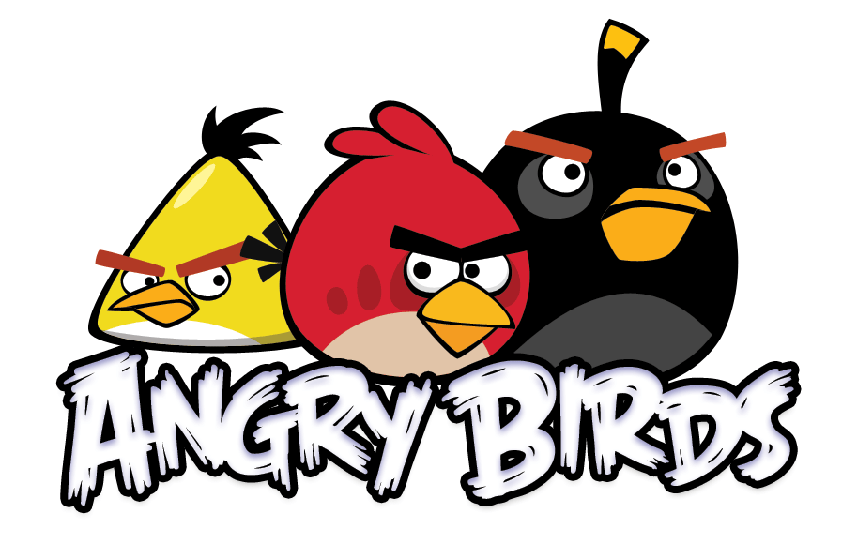
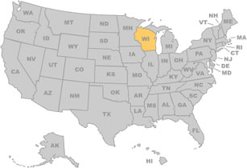
An Empirical Evaluation of Machine Learning Approaches for Angry Birds
Anjali Narayan-Chen, Liqi Xu, & Jude Shavlik
University of Wisconsin-Madison
Presented in Beijing at the 23rd International Joint Conference on Artificial Intelligence, 2013.

Slide 2
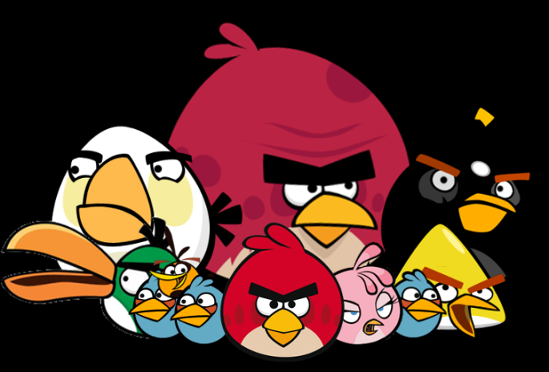
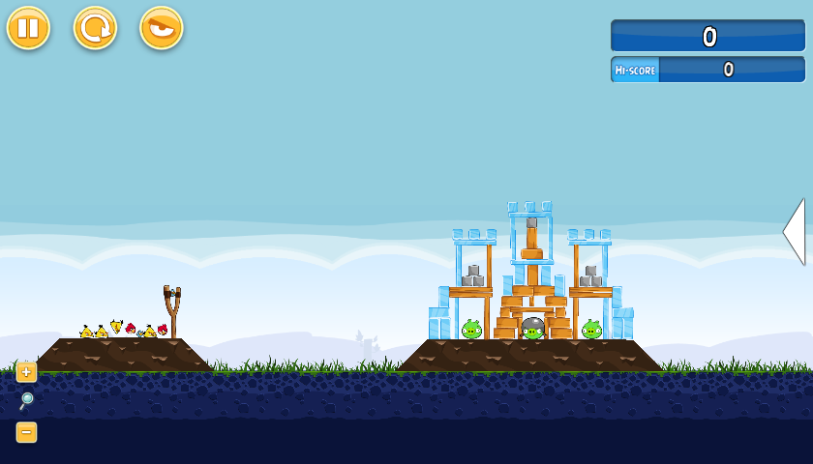
Angry Birds Testbed
Goal of each level
Destroy all pigs by shooting one or more birds
‘Tapping’ the screen changes behavior of most birds
Bird features
Red birds: nothing special
Blue birds: divide into a set of three birds
Yellow birds: accelerate
White birds: drop bombs
Black birds: explode

Slide 3

Angry Birds AI Competition
Task:
  Play game autonomously without human intervention
  Build AI agents that can play new levels better than humans
Given basic game playing software, with three components:
Computer vision
Trajectory
Game playing

Slide 4
Machine Learning Challenges
Data consists of images, shot angles, & tap times
Physics of gravity and collisions simulated
Task requires ‘sequential decision making’
(ie, multiple shots per level)
Not obvious how to judge ‘good’ vs. ‘bad’ shot

Slide 5

Supervised
Machine Learning
Reinforcement learning natural approach for Angry Birds (eg, as done for RoboCup)
However, we chose to use supervised learning (because we are undergrads)
Our work provides a baseline of achievable performance via machine learning

Slide 6
How We Create
LABELED Examples
GOOD SHOTS
  Those from games where all the pigs killed
BAD SHOTS
  Shots in ‘failed’ games, except shots that killed a pig are discarded as ambiguous

Slide 7
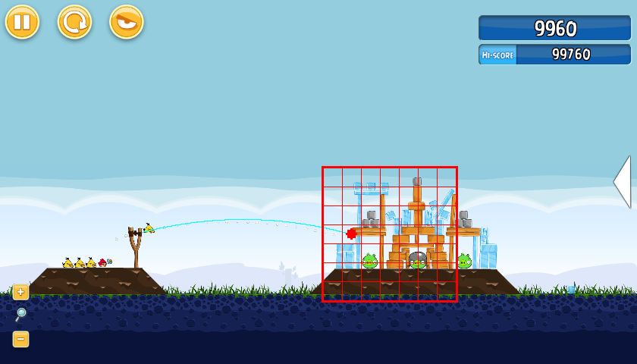
The Features We Use
Goal: have a representation that is independent of level
CellContainsPig(?x, ?y), CellContainsIce(?x, ?y), …,
CountOfCellsWithIceToRightofImpactPoint, etc

Slide 8
More about Our Features
Shot Features
Objects
in NxN Grid
Aggregation
over Grid
Relations
within Grid
release angle
pigInGrid(x, y)
count(objects
RightOfImpact)
stoneAboveIce
(x, y)
object targeted
iceInGrid(x, y)
count(objects
BelowImpact)
pigRightOfWood(x, y)
…
count(objects
AboveImpact)
…

Slide 9
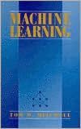
Weighted Majority Algorithm
(Littlestone, MLj, 1988)
Learns weights for a set of Boolean features
Method
  Count wgt’ed votes FOR candidate shot
  Count wgt’ed votes AGAINST candidate
  Choose shot with largest “FOR minus AGAINST”
  If answer wrong, reduce weight on features that voted incorrectly
Advantages
  Provides a rank-ordering of examples
  (the difference between the two weighted votes)
  Handles inconsistent/noisy training data
  Learning is fast and can do online/incremental learning

Slide 10
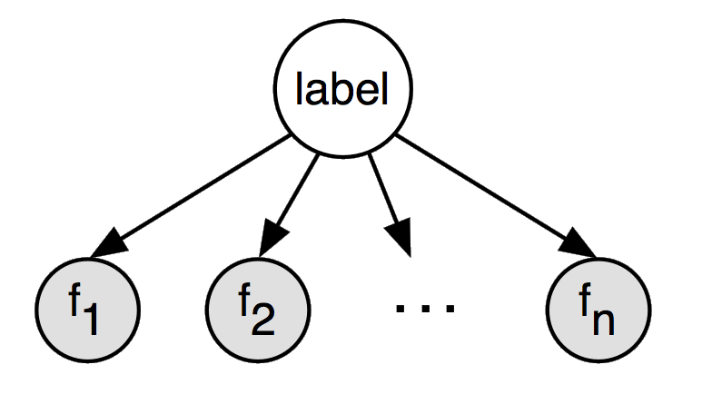
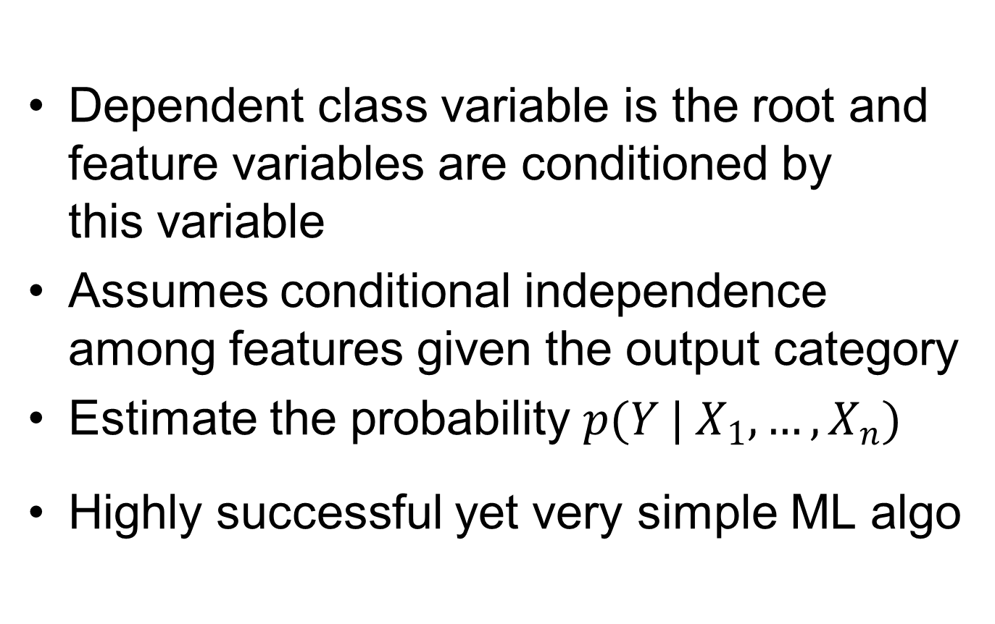
Naïve Bayesian Networks
Dependent class variable is the root and feature variables are conditioned by
this variable
Assumes conditional independence among features given the output category
Estimate the probability $p(Y |{ X}_{1}, …, X_{n})$
Highly successful yet very simple ML algo

Slide 11
The Angry Birds Task
Need to make four decisions
  Shot angle
  Distance to pull back slingshot
  Tap time
  Delay before next shot
We focus on choosing shot angle
Always pull sling back as far as possible
Always wait 10 seconds after shot
Tap time handled by finding ranges in training
data (per bird type) that performed well

Slide 12
Experimental Control:
NaiveAgent
Provided by conference organizers
Detects birds, pigs, ice, slingshot, etc, then shoots
Randomly choose pig to target
Randomly choose one of two trajectories:
- high-arching shot
- direct shot
Simple algorithm for choosing ‘tap time’

Slide 13
Data-Collection Phase
Challenge: getting enough GOOD shots
Use NaiveAgent & Our RandomAngleAgent
- Run on a number of machines
- Collected several million shots
TweakMacrosAgent
- Use shot sequences that resulted in the highest scores
- Replay these shots with some random variation
- Helps find more positive training examples

Slide 14
Data-Filtering
Summary
Training data of shots
(collected via NaiveAgent, RandomAngleAgent, and TweakMacrosAgent)
Positive examples (shots in winning games)
Negative examples (shots in losing games)
From 724,993 games
involving 3,986,260 shots
Ended up with
224,916 positive &
168,549 negative
examples
Discard ambiguous examples (in losing game, but killed pig)
Discard examples with bad tap times
(thresholds provided by TapTimeIntervalEstimator)
Discard duplicate examples
(first shots whose angles differ by < 10⁻⁵ radians)
Keep approximately 50-50 mixture of positive and negative examples per level

Slide 15
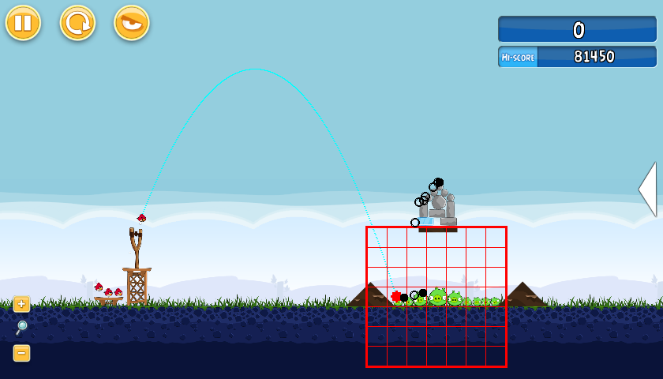
Using the Learned Models
Consider several dozen candidate shots
Choose highest scoring one, occasionally choose one of the other top-scoring shots

Slide 16
Experimental
Methodology
Play Levels 1-21 and make 300 shots
All levels unlocked at start of each run
First visit each level once (in order)
Next visit each unsolved level once in order,
repeating until all levels solved
While time remaining, visit level with best ratio
  NumberTimesNewHighScoreSet / NumberTimesVisited
Repeat 10 times per approach evaluated

Slide 17
Measuring Performance on
Levels Not Seen During Training
When playing Level X, we use models trained
on all levels in 1-21 except X
Hence 21 models learned per ML algorithm
We are measuring how well our algorithms learn to play AngryBirds, rather than how well they ‘memorize’ specific levels

Slide 18
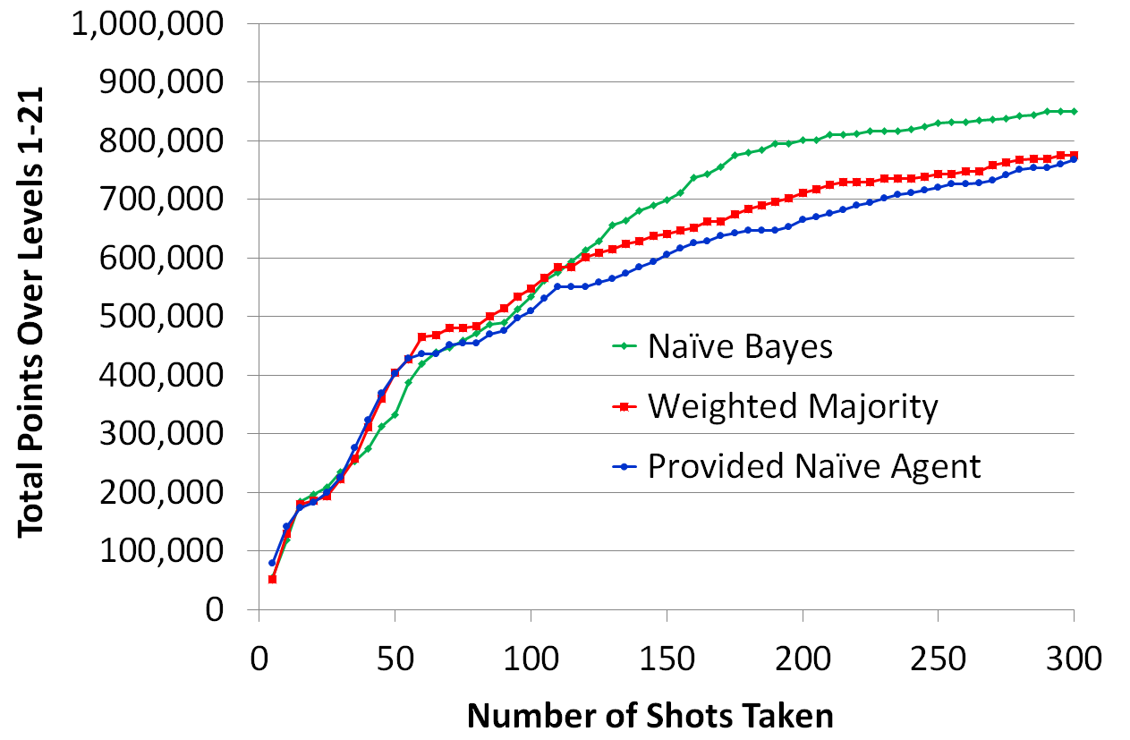
Results & Discussion:
Level 1 – 21, No Training on Level Tested
Naïve Bayes vs Provided Agent results are statistically significant

Slide 19
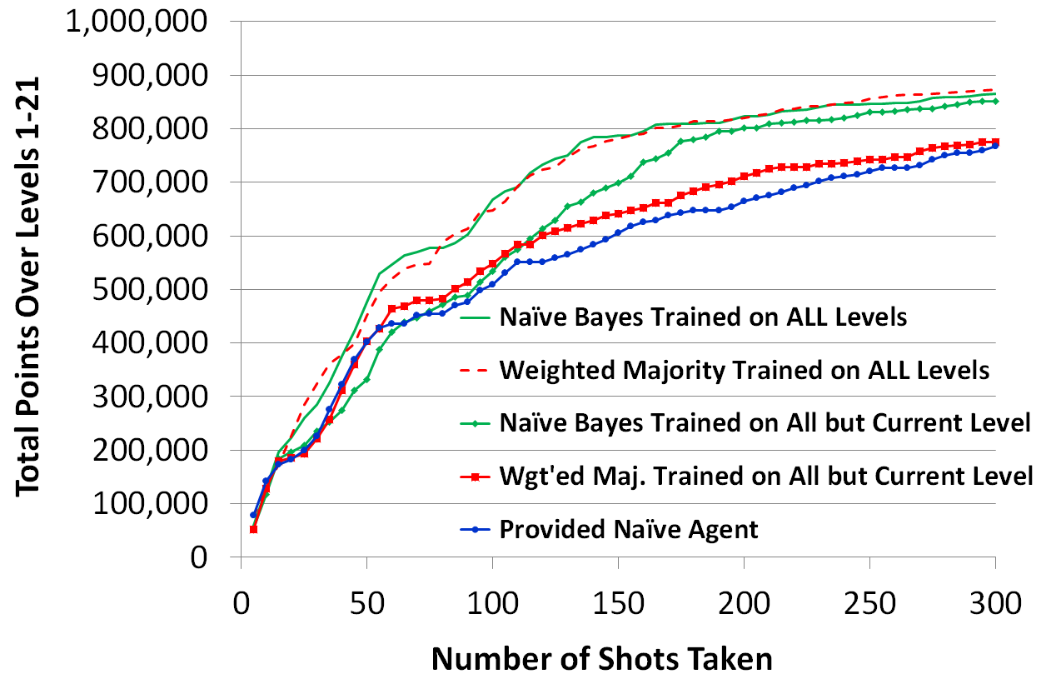
Results & Discussion:
Training on Levels Tested
All results vs Provided Agent
(except WMA trained on all but current level) are statistically significant

Slide 20
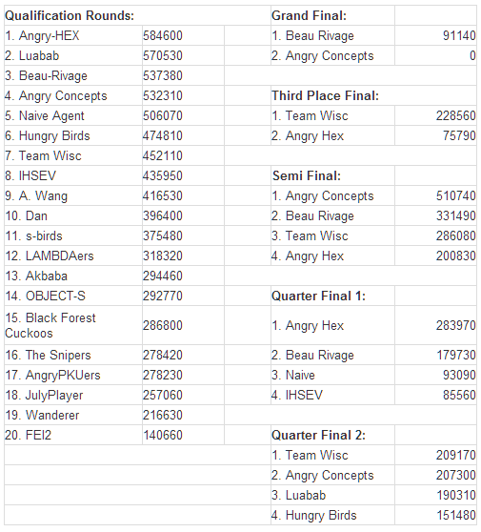

Results of Angry Birds AI Competition

Slide 21
Future Work
Consider more machine learning approaches,
including reinforcement learning
Improve definition of good and bad shots
Exploit human-provided demonstrations of good solutions

Slide 22
Conclusion
Standard supervised machine learning algorithms can learn to play Angry Birds
Good feature design important in order to
learn general shot-chooser
Need to decide how to label examples
Need to get enough positive examples

Slide 23
Thanks for Listening!
Support for this work was provided by the Univ. of Wisconsin

Slide 24
1 | (1) | 35,900 | 8 | (1) | 59,830 | 15 | (1) | 57,310
2 | (1) | 62,890 | 9 | (1) | 52,600 | 16 | (2) | 71,850
3 | (1) | 43,990 | 10 | (1) | 76,280 | 17 | (1) | 57,630
4 | (1) | 38,970 | 11 | (1) | 63,330 | 18 | (2) | 66,260
5 | (1) | 71,680 | 12 | (1) | 63,310 | 19 | (2) | 42,870
6 | (1) | 44,730 | 13 | (1) | 56,290 | 20 | (2) | 65,760
7 | (1) | 50,760 | 14 | (1) | 85,500 | 21 | (3) | 99,790
Table 1: Highest scores found for Levels 1-21,
formatted as: level (shots taken) score.

Slide 25
22 | (2) | 69,340 | 29 | (2) | 60,750 | 36 | (2) | 84,480
23 | (2) | 67,070 | 30 | (1) | 51,130 | 37 | (2) | 76,350
24 | (2) | 116,630 | 31 | (1) | 54,070 | 38 | (2) | 39,860
25 | (2) | 60,360 | 32 | (3) | 108,860 | 39 | (1) | 76,490
26 | (2) | 102,880 | 33 | (4) | 64,340 | 40 | (2) | 63,030
27 | (2) | 72,220 | 34 | (2) | 91,630 | 41 | (1) | 64,370
28 | (1) | 64,750 | 35 | (2) | 56,110 | 42 | (5) | 87,990
Table 2: Highest scores found for Levels 22-42,
formatted as: level (shots taken) score.

Slide 26
Weighted Majority Algorithm
(Littlestone, MLj, 1988)
Given a pool A of algorithms, where a_{i} is the i^{th} prediction algorithm; w_{i}, where w_{i} ≥ 0, is the associated weight for a_{i}; and β is a scalar < 1: Initialize all weights to 1 For each example in the training set {x, f(x)} Initialize y₁ and y₂ to 0 For each prediction algorithm a_{i}, If a_{i}(x) = 0 then y₁ = y₁ + w_{i} Else if a_{i}(x) = 1 then y₂ = y₂ + w_{i} If y1 > y2 then g(x) = 1 Else if y1 < y then g(x) = 0 Else g(x) is assigned to 0 or 1 randomly. If g(x) ≠ f(x) then for each prediction algorithm a_{i} If a_{i}(x) ≠ f(x) then update w_{i} with βw_{i}.

Slide 27
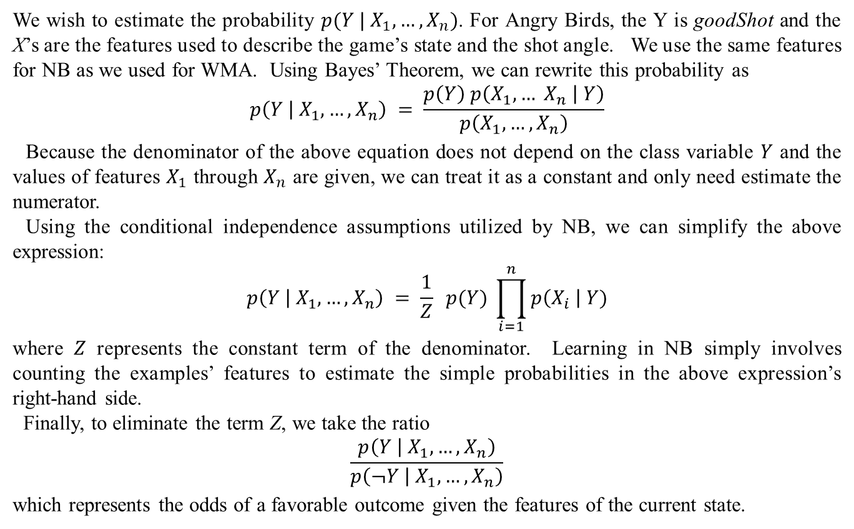
Naïve Bayesian Networks
We wish to estimate the probability $p(Y |{ X}_{1}, …, X_{n})$. For Angry Birds, the Y is goodShot and the X’s are the features used to describe the game’s state and the shot angle. We use the same features for NB as we used for WMA. Using Bayes’ Theorem, we can rewrite this probability as
$$p\left(Y | X_{1}, …, X_{n}\right) = \frac{p\left(Y\right) p\left(X_{1}, … X_{n} | Y\right)}{p\left(X_{1}, …, X_{n}\right)}$$
Because the denominator of the above equation does not depend on the class variable $Y$ and the values of features $X_{1}$ through $X_{n}$ are given, we can treat it as a constant and only need estimate the numerator.
Using the conditional independence assumptions utilized by NB, we can simplify the above expression:
$$p\left(Y | { X}_{1}, …, X_{n}\right) = \frac{1}{Z} p(Y) \prod_{i=1}^{n}{p\left(X_{i} \right| Y)}$$
where $Z$ represents the constant term of the denominator. Learning in NB simply involves counting the examples’ features to estimate the simple probabilities in the above expression’s right-hand side.
Finally, to eliminate the term Z, we take the ratio
$$\frac{p\left(Y | { X}_{1}, …, X_{n}\right)}{p\left(¬Y | X_{1}, …, X_{n}\right)}$$
which represents the odds of a favorable outcome given the features of the current state.

