Slide 1



Integrating Machine Learning and Physician Knowledge to Improve the Accuracy of Breast Biopsy
Inês Dutra
University of Porto, CRACS & INESC-Porto LA
Houssam Nassif, David Page, Jude Shavlik, Roberta Strigel, Yirong Wu, Mai Elezabi and Elizabeth Burnside
UW-Madison
Notes:
Amazing interdisciplinary team, history of collaboration with publications

Slide 2
Intro and Motivation
USA:
  1 woman dies of breast cancer every 13 minutes
  In 2011:
    estimated 230,480 new cases of invasive cancer
    39,520 women are expected to die
    Source: U.S. Breast Cancer Statistics, 2011

Slide 3
Intro and Motivation
Portugal:
  Per year:
    4,500 new cases
    1,500 deaths (33%)
  Source: Liga Portuguesa Contra o Cancro - September 2011

Slide 4
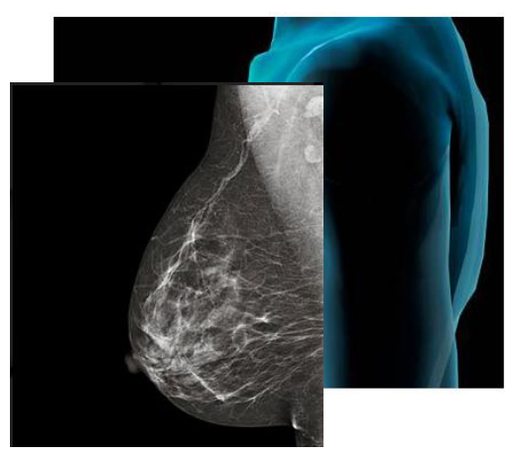
Intro and Motivation
  Mammography
  MRI
  Ultrasound
  Biopsies

Slide 5

Intro and Motivation
Image-guided percutaneous core needle biopsy
  standard for the diagnosis of suspicious findings
Over 700,000 women undergo breast core biopsy in the US
Imperfect: biopsies can
be inconclusive in
5-15% of cases
  ≈ 35,000-105,000 of the above will require additional biopsies

Slide 6
Intro and Motivation
Breast biopsies:
  Fine needle breast biopsy
  Stereotactic breast biopsy
  Ultrasound-guided core biopsy
  Excisional biopsy
  MRI-guided

Slide 7
Objectives
Hypotheses
  Can we learn characteristics of inconclusive biopsies?
  Can we improve the classifer by adding expert knowledge?

Slide 8
Terminology
Inconclusive biopsies: “non-definitive”:
  Discordant biopsies
  High risk lesions
    Atypical ductal hyperplasia
    Lobular carcinoma in situ
    Radial scar
    etc.
  Insufficient sampling

Slide 9
Materials and Methods
Data collected
  Oct 1st, 2005 to Dec 31st, 2008
Tools
  WEKA
  Aleph
Validation: leave-one-out cross validation
Results tested for statistical significance

Slide 10
Data source
1384 image guided core biopsies
  349 M 1035 B
  925 (C) 110 (NC)
  43 (D) 51 (ARS) 16 (I)
After eliminating redundancies
94

Slide 11
Data distribution
94 non-concordant cases went through additional procedures (e.g., excision)
15 were “upgraded” from benign to malignant
Our population: 15+/79-
Task: find a distinction between upgrades and non-upgrades

Slide 12
Data Features
biopsy procedure | abn. disappeared
pathology priority | mass present
pathology description | asymmettry
concordance | architectural distortion
mammography birads | calcs
ultrasound birads | mass shape
MRI birads | mass margins
combined birads | mass density
biopsy needle type | calcifications
biopsy needle gauge | calcification distribution
clip in site of biopsy | mass size

Slide 13
WEKA and Aleph
Data cleaning, single table
15-fold stratified cross-validation (leave-one-out)
WEKA (Bayes TAN) and Aleph
    Without expert knowledge
    With expert knowledge

Slide 14
WEKA and Aleph
Waikato Environment for Knowledge Analysis
  Collection of machine learning algorithms and data mining tasks
    use “propositionalized” data (flat table)
A Learning Engine for Proposing Hypotheses
  Inductive Logic Programming (ILP) system
  Knowledge representation: first order rules

Slide 15
Method
Learn rules about how and why non-definitive cases are “upgraded”
Other rules (simple) provided by a specialist
Combine
New rules

Slide 16
Modelling upgrades without expert knowledge
Aleph learning on the 94 cases (15+/79-)
Example of rule learned
upgrade(A) IF
bxneedlegauge(A,9) AND
abndisappeared10(A,0) AND
mass01(A,1) AND
anotherlesionbxatsametime01(A,0).
[4+/0-]
Notes:
Less gauge: thicker and larger outer diameter

Slide 17
Examples of Expert rules
(1) Upgrade increases on stereo if calcifications and ADH are present
upgrade(A) IF
pathdx(A,atypical_ductal_hyperplasia) AND
calcifications(A,’a,f’) AND
biopsyprocedure(A, stereo).
(2) Upgrade increases on US(Ultra-Sound) if high BIRADS category
upgrade(A) IF
concordance(A,d) AND mammobirads(A,4B/4C/5).

Slide 18
Modelling upgrades with expert knowledge
Example of rule learned
upgrade(A) IF
numOfSpecimens(A,gt6) AND
rule1_2(A) AND
rule1_3(A).
[3+/1-]
rule1_2(A) IF pathdxabbr(A,adh) AND calcifications(A,f). [3+/4-]
rule1_3(A) IF pathdxabbr(A,adh) AND calcification_distribution(A,g). [3+/6-]

Slide 19
Results
Classif. | TP | FP | FN | TN | R | P | F
Human Rules alone | 9 | 45 | 6 | 34 | .60 | .16 | .26
ILP | 5 | 11 | 10 | 68 | .33 | .31 | .32
Rules+ILP | 8 | 13 | 7 | 66 | .53 | .38 | .44
Weka | 3 | 9 | 12 | 70 | .20 | .25 | .22
Rules+ Weka | 3 | 6 | 12 | 73 | .20 | .33 | .25
Notes:
Boldface numbers
Compare “with rules” with “without rules” Aleph and Weka

Slide 20
Results
Classif. | TP | FP | FN | TN | R | P | F
Human Rules alone | 9 | 45 | 6 | 34 | .60 | .16 | .26
ILP | 5 | 11 | 10 | 68 | .33 | .31 | .32
Rules+ILP | 8 | 13 | 7 | 66 | .53 | .38 | .44
Weka | 3 | 9 | 12 | 70 | .20 | .25 | .22
Rules+ Weka | 3 | 6 | 12 | 73 | .20 | .33 | .25
Notes:
Boldface numbers
Compare “with rules” with “without rules” Aleph and Weka

Slide 21
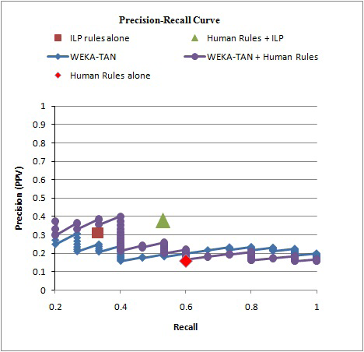
Results:
WEKA versus Aleph and human rules

Slide 22
Conclusions
Both WEKA and Aleph can improve results when combining original data with expert knowledge (without tuning)
WEKA improves on false positives and can be adjusted to achieve Recall of 100% with the need to re-examine around 60 women (out of 79)
Aleph improves on false negatives and produces a better classifier with the advantage of using a language that is easily understandable by the specialist

Slide 23
Future Work
NLM project started this month

Slide 24
Future Work
NLM project started this month
Short term tasks:
  Augment the current dataset
  Review consistently misclassified examples
  Possibily use association rules to produce a first subset of rules

Slide 25
Future Work
NLM project started this month
Short term tasks:
  Augment the current dataset
  Review consistently misclassified examples
  Possibily use association rules to produce a first subset of rules
Medium term tasks:
  learn from the cases that were not upgraded
  Develop the iterative cycle of learning and expert rule revision

Slide 26
Future Work
NLM project started this month
Short term tasks:
  Augment the current dataset
  Review consistently misclassified examples
  Possibily use association rules to produce a first subset of rules
Medium term tasks:
  learn from the cases that were not upgraded
  Develop the iterative cycle of learning and expert rule revision
Long term tasks:
  Use more sophisticated learning methods to produce better rules
  To integrate biopsy attributes and the classifiers obtained to MammoClass (http://cracs.fc.up.pt/pt/mammoclass/)

Slide 27
Acknowledgments
UW-Madison Medical School
FCT-Portugal and Horus and DigiScope projects
AMIA reviewers and organizers
Special ack to the UW-Madison Medical School people that were never “scared” of computer technology and have been always very enthusiastic about using computational methodologies to help their work

Slide 28
THANK YOU!
CONTACT: ines@dcc.fc.up.pt

Slide 29
Experiment 1
Significance tests - p-values
 | Rules+ILP | Weka | Rules+Weka
ILP | P: 0.3437 R: 0.0824 F: 0.2007 | P: 0.74 R: 0.43 F: 0.63 | P: 0.74 R: 0.43 F: 0.63
Rules+ILP |  | P: 0.32 R: 0.06 F: 0.18 | P: 0.32 R: 0.06 F: 0.18
Weka |  |  | P: 1 R : 1 F: 0.80

Slide 30
Experiment 2 tuning
5x4 stratified cross validation
Parameters tuned:
  Minacc: 0.05 and 0.1
  Minpos: 1, 2, 3
  Noise: 0, 1, 2

Slide 31
Experiment 2 tuning, best parameters per fold

Slide 32
Experiment 2 - Results
p=
0.3
0.03
0.1

Slide 33
Summary

Slide 34
UW upgrades data
94 benign cases after biopsies were discussed
15 considered to be, in fact, malignant
→ upgrades
Tasks:
  learn characteristics of upgrades that do not appear in non-upgrades → interpretable rules
  Can we improve the classifer by adding expert knowledge?

